Slide 1
List of REDD+/ REDD+ Related
Projects/Programs
For Updating/Stocktaking
Atty. Edna Maguigad (ednamaguigad@gmail.com)
Audrey Palomar (audreypalomar@gmail.com)
Yesmeen Frani (esifrani@gmail.com)

Slide 2
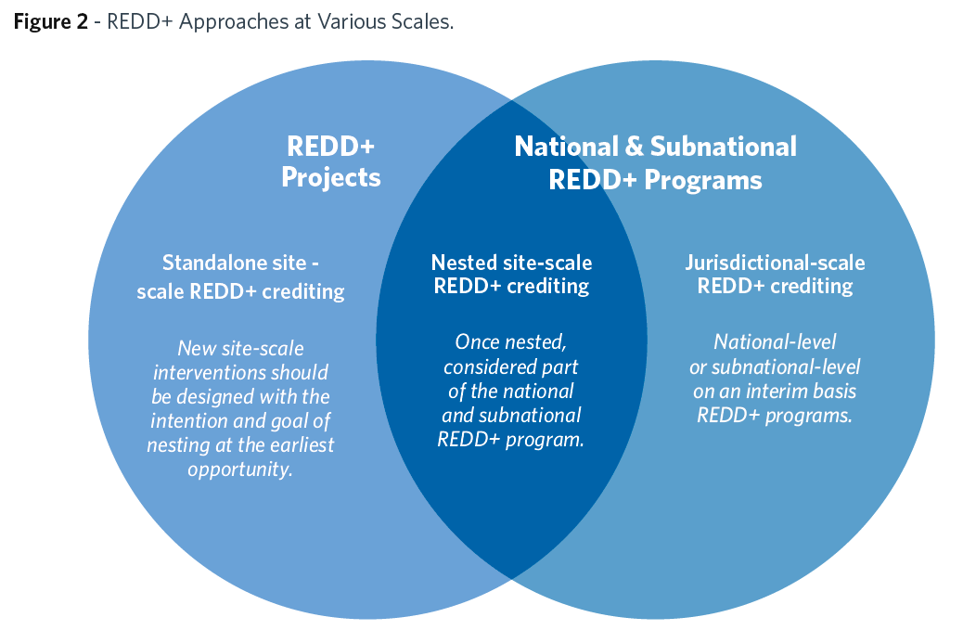
Project Standards
-VCS
Jurisdictional Standards
-VCS JNR
-FCPF Carbon Fund
-ART TREES

Slide 3
Status | Name | Implementer | Sponsor | Location | Period
Completed – Demonstration Site (No PDD) | Climate-Relevant Modernization of Forest Policy and Piloting of REDD in the Philippines | Forest Management Bureau (FMB) | German Agency for International Cooperation | Southern Leyte | 2009–2013
Completed – Demonstration Site (No PDD) | Preparation of a National REDD+ Mechanism for Greenhouse Gas Reduction and Conservation of Biodiversity in the Philippines | Forest Management Bureau (FMB) | German Agency for International Cooperation | Albay | 2012–2017
 |  |  |  | Davao Oriental
 |  |  |  | Eastern Samar
<Type status and change font color based on legend below> | Advancing Development of Victoria-Anepahan Communities and Ecosystem through REDD (ADVANCE REDD) | -Non-Timber Forest Products – Exchange Programme (NTFP-EP) -Flora and Fauna International | European Union (EU) | Narra and Quezon, Palawan | 2010–2013
<Type status and change font color based on legend below> | Community Carbon Pools Programme (C2P2) | -Flora and Fauna International -Non-Timber Forest Products - Exchange Programme | European Union (EU) Team Energy Foundation Inc. (TEFI) | Southern Sierra Madre Mountain Range | 2010–2014
<Type status and change font color based on legend below> | Mindoro Forest and Biodiversity Conservation Programme | Center for Conservation Innovations | Ayala Corporation | Puerto Galera & San Teodoro, Oriental Mindoro | 2018-Present
<Type status and change font color based on legend below> | Preparing the Communities of Victoria Anepahan Mountain Range for REDD+ Engagement | Center for Conservation Innovations | Forest Foundation Philippines | Victoria Anepahan Mountain Range, Palawan | 2020-Present
Instructions: Please type the status of the project/program and follow the color code to specify the scale of the project. Please correct other details if necessary.
Jurisdictional (Subnational)
Project-Level
Jurisdictional (National)
Others

Slide 4
Status | Name | Implementer | Sponsor | Location | Period
<Type status and change font color based on legend below> | Piloting REDD+ project | Non-Timber Forest Products - Exchange Programme | Forest Foundation Philippines | Kimangkil-Kalanawan-Sumagaya-Pamalihi (KKSP) Mountain Range | 2018-2021
<Type status and change font color based on legend below> | Quirino Forest Carbon Project | Conservation International Philippines | MoreTrees, Inc. | Quirino Province | 2009-2029
<Type status and change font color based on legend below> | Philippine Peñablanca Sustainable Reforestation Project | Conservation International Philippines | Toyota Motor Corporation (TMC) | Peñablanca Province | 2009-2014
<Type status and change font color based on legend below> | Forest and Biodiversity Conservation Programme (Natural Climate Solutions Initiative) | Conservation International Philippines | Conservation International Philippines | Mt. Mantalingahan, Southern Palawan | 2021-Present
<Type status and change font color based on legend below> | Agroforestry with smallholder cocoa farmers | Kennemer Eco Solutions Pte Ltd | Kennemer Foods International Inc. USAID-Green Invest | Maramag, Bukidnon | 2020-Present
<Type status and change font color based on legend below> | Agreement for Carbon Dioxide Offset / Rainforestation Project | PAMB | Trees for Travel Foundation (TFT), Netherlands | Mt. Malindang Natural Park | 2008-
Instructions: Please type the status of the project/program and follow the color code to specify the scale of the project. Please correct other details if necessary.
Jurisdictional (Subnational)
Project-Level
Jurisdictional (National)
Other

