Slide 1
Focused Group Discussions
FOR THE NATIONAL REDDPLUS ACTION PLAN 2021-2031
July 2021

Slide 2
Discussion flow
Introductions
Vision and National Context of REDD-Plus
Warsaw Framework for REDD+
UNFCCC Guidance for Developing National Actions Plans for REDD+
Philippine National REDD-Plus Strategy (PNRPS, 2010): Where we are now
Discussion

Slide 3
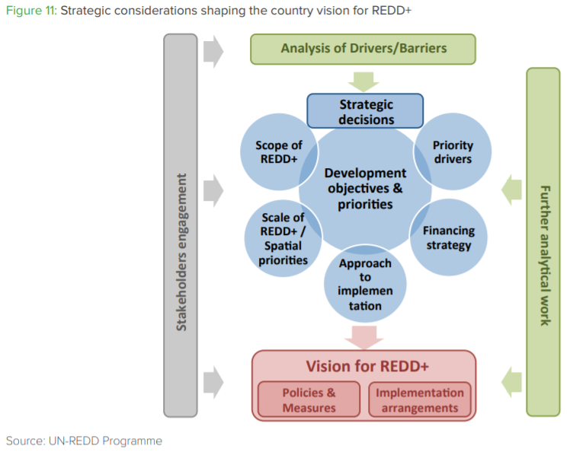
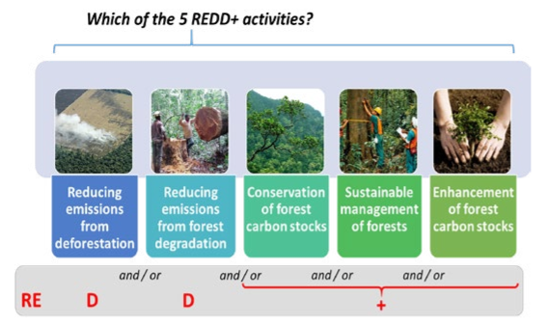
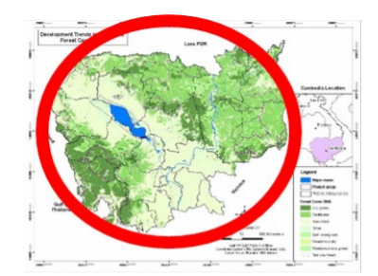
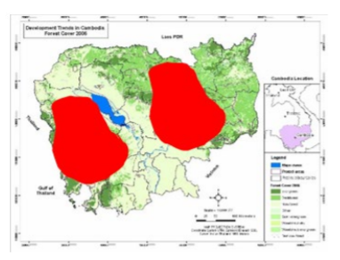

National
2013 Study Sites:
General Nakar, Quezon; Southern Leyte; Narra and Quezon, Palawan; and Mount Malindang Range Natural Park
SCOPE
Deforestation
Kaingin
Mining
Land use conversion
Settlement
Forest fire
Degradation
Logging
Climate change, calamities
Timber poaching
Charcoal making
Fuelwood gathering
2016 Study Sites:
Eastern Samar and Davao Oriental
SCALE
Subnational
Deforestation and Degradation
Upland agricultural expansion
Tree cutting for fuelwood
Timber poaching
Charcoal making
Mining
Tree cutting for rattan extraction
Notes:
Consolidated

Slide 4
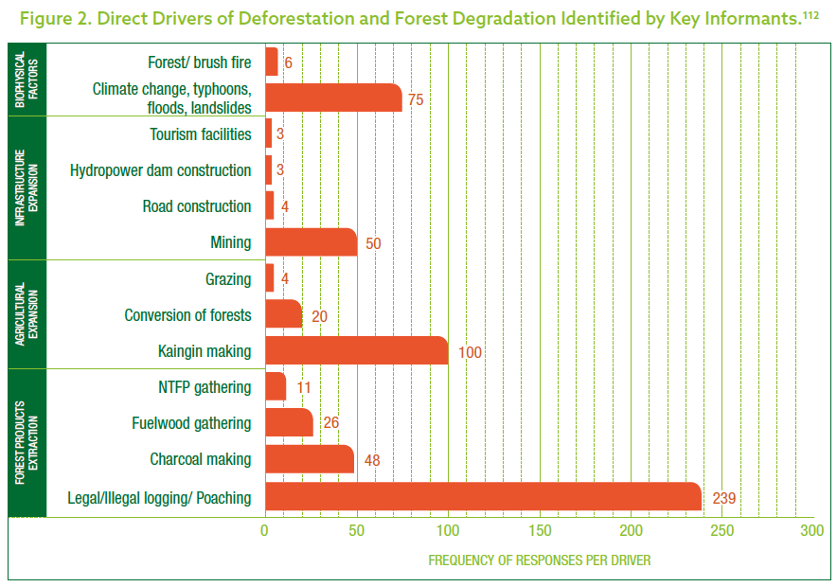
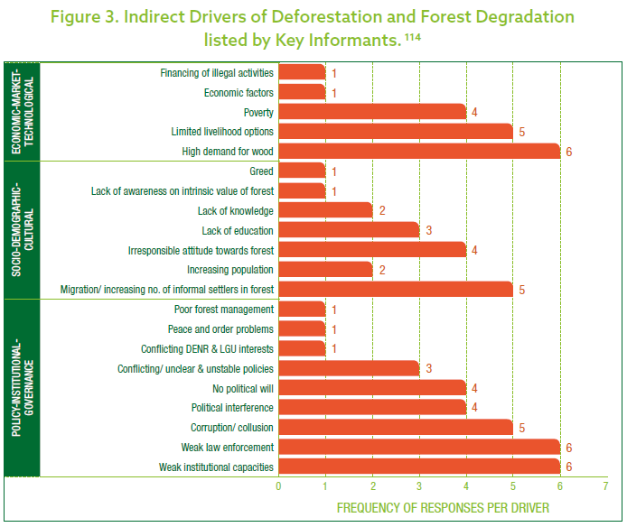
Direct Drivers of Deforestation and Degradation
Study Sites:
General Nakar, Quezon;
Southern Leyte
Narra and Quezon, Palawan; and
Mount Malindang Range Natural Park
Priority Drivers
Deforestation
Kaingin
Mining
Land use conversion
Settlement
Forest fire
2013
Degradation
Logging
Climate change, calamities
Timber poaching
Charcoal making
Fuelwood gathering
Carandang, A.P. et al. (2013). Analysis of Key Drivers of Deforestation and Forest Degradation in the Philippines. Manila, Philippines: Deutsche Gesellschaft für Internationale Zusammenarbeit (GIZ) GmbH.
Reference:
Department of Environment and Natural Resources–Forest Management Bureau (DENR–FMB). (2017). Update of the Philippine National REDD-plus Strategy. June 2017. Manila, Philippines: Deutsche Gesellschaft für Internationale Zusammenarbeit (GIZ) GmbH.
Notes:
No new studies for these sites.
2013 Study Sites
General Nakar, Quezon;
Southern Leyte towns of Maasin, Bontoc, Silago, Sogod, and Tomas Oppus;
Narra and Quezon, Palawan; and
Mount Malindang Range Natural Park in Misamis Occidental.
Recommendations:
Harmonize forestry policies
Review impact of EO23 on forest protection and conservation
National policy on co-management
Enact sustainable management of forests law
Decentralize forest management Regular updating of forest cover and land use
Implement national database
Support development and livelihood programs of LGUs
IEC
Criteria and indicators
Anti-corruption efforts
Mainstream efforts

Slide 5
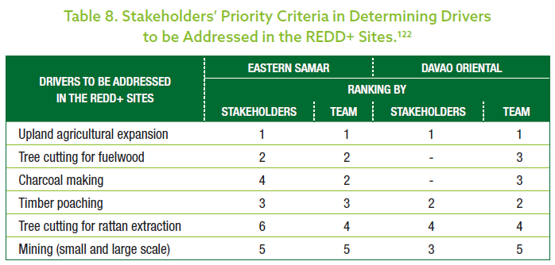
Direct Drivers of Deforestation and Degradation
Study Sites:
Eastern Samar
Davao Oriental
Recommendations:
Local ordinances on non-expansion
of existing kaingin areas
strict forest law enforcement through
Multi-stakeholder forest protection
technical assistance
on improved upland farming systems
Link with financing institutions or investors
2016
Bugayong, L.A., Dolom, P.C., and Carandang A.P. (2016). Assessment of Drivers of Deforestation and Forest Degradation in Eastern Samar and Davao Oriental REDD-plus Project Sites. Manila, Philippines: Deutsche Gesellschaft für Internationale Zusammenarbeit (GIZ) GmbH.
Reference:
Department of Environment and Natural Resources–Forest Management Bureau (DENR–FMB). (2017). Update of the Philippine National REDD-plus Strategy. June 2017. Manila, Philippines: Deutsche Gesellschaft für Internationale Zusammenarbeit (GIZ) GmbH.
Notes:
No new studies found.

Slide 6
SCOPE

Slide 7
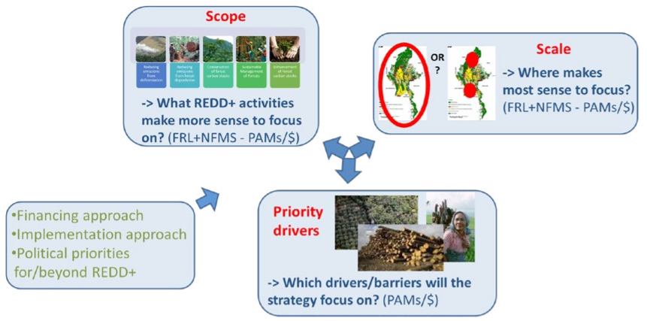
National
SCALE
Subnational
Notes:
SCALE - primarily to the geographical area in which the country will implement REDD+ with the goal of securing RBPs.
The UNFCCC allows flexibility for countries to start developing their FREL/FRL and to monitor (NFMS) and report at a subnational scale as an interim measure (Decision 1 CP/16, para 71b and c)

Slide 8
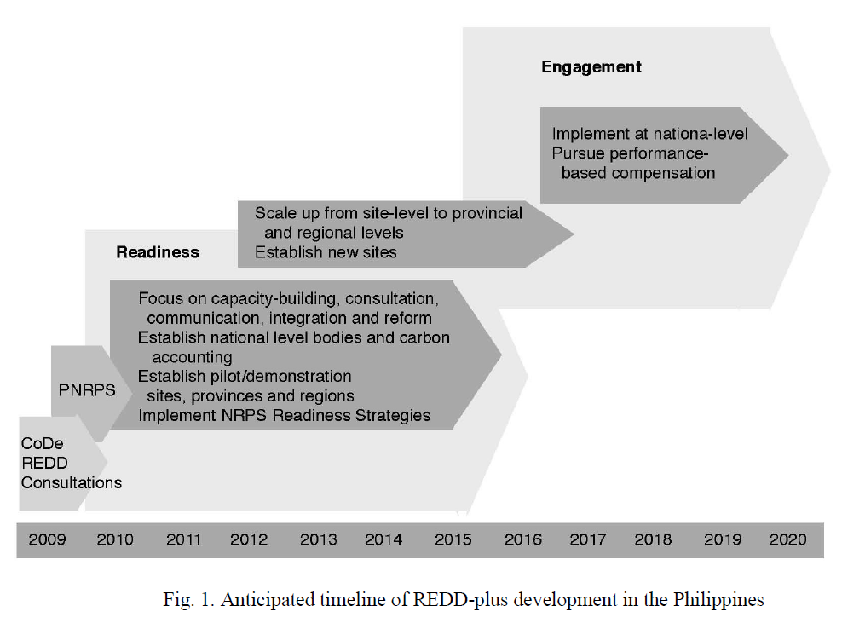
PNRPS Timeline,2010

Slide 9
PNRPS 2010 Progress Tracker
Phases | PNRPS Targets (2010) | 2010 | 2011 | 2012 | 2013 | 2014 | 2015 | 2016 | 2017 | 2018 | 2019 | 2020 | 2021
1 | National-level communications, consultations, and capacity building
 | Action planning and budgeting for PNRPS implementation
 | Short and long-term funding for REDD+
 | Pilot/demonstrate REDD+ in sites
 | Test MRV approaches that can be harmonized at the national level
 | Develop new project sites in the same jurisdiction where pilot sites are located
 | Provincial/regional capacity building, institutional support, and project demonstration
 | Establish national-level bodies responsible for REDD+ policy, implementation, and accounting
 | Establish national FRL/FREL and targets, clear safeguards, institutional development, and research
2 | Scaling-up demonstration sites to Provincial-level and then to Regional-level pilots
3 | Engage with REDD-plus at a national scale and access performance-based compensation.
Jurisdictional (National and Subnational)
Legend
1 Readiness
2 Scaling-up
3 Engagement
On-going
In progress but incomplete
Completed

Slide 10
Warsaw Framework for REDD+
(UNFCCC Guidance on REDD+ in 9 decisions up to 2015)
Measurement, reporting and verification,
Forest reference emission levels and forest reference levels,
National forest monitoring systems,
Safeguards,
Drivers of deforestation,
Finance and results based payments,
Institutional arrangements,
Non Carbon benefits
Alternative Policy Approaches

Slide 11
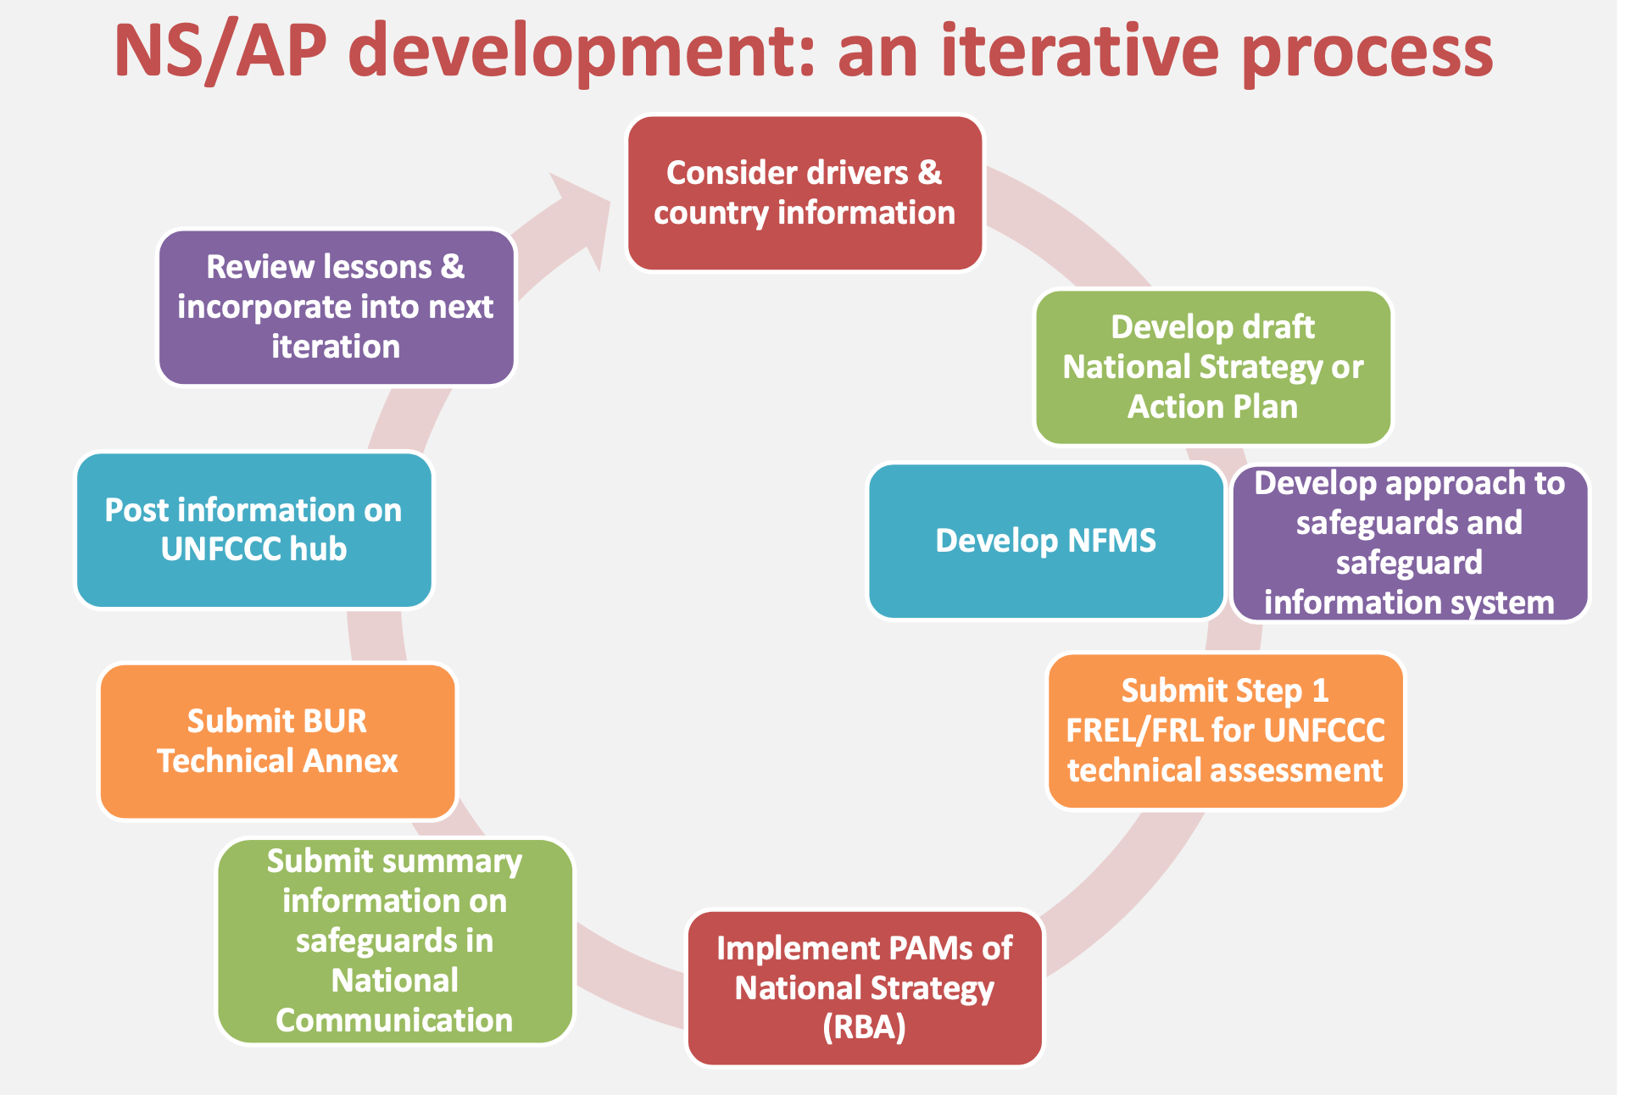
A step towards phase 3: Results Based Payments (UN REDD)

Slide 12
Consideration for the development of the National Strategy/ Action Plan (NS/AP)
UNFCCC Decision COP 16
No specific guidance on content
But when developing (phase 1) and implementing (phase 2) their NS/AP, developing countries are requested to address, inter alia (D1/CP.16, para 72):
Drivers of deforestation and forest degradation
Land tenure issues
Forest governance issues
Gender considerations
Safeguards
Full and effective participation of relevant stakeholders ( amongst others indigenous peoples and local communities)

Slide 13
Development of strategy and action plans (insights from UN REDD)
No prescription from UNFCCC: full flexibility left to countries regarding the content and structure of the document, depending on preferences & national context
Quality of design Process as important as Product!
Opportunity to:
Build high level political support and wide support base (national and international stakeholders)
Make REDD+ more tangible
Demonstrate a transformative while pragmatic vision for REDD+ towards a green economy
Catalyze REDD+ Results-Based Finance (and investment)

Slide 14
Philippine National REDD-Plus Strategy (PNRPS, 2010): Where we are now

Slide 15
Warsaw Framework for REDD+ : Status for Philippines ( 2021)
Requirements | Status
national strategy or action plan, | PNRPS: Action planning and budgeting to facilitate implementation of the PNRPS; Governance aspect was challenging(e.g. NMRC).
A national FRELs/FRL or if appropriate, as an interim measure, subnational FREL/ | In progress
Robust and transparent national forest monitoring system for the monitoring and reporting of REDD+ activities | In progress Draft DAO: Guidelines on the Operationalization of NFMS
Measurement, Reporting and Verification (MRV) | In progress, with the NFMS
a system for providing information on how safeguards are being addressed and respected. | In progress; A Proposed National REDD+ Safeguards Framework and Guidelines was developed, tested in selected sites and presented in a national conference

Slide 16
REDD+ in NATIONAL POLICY DOCUMENTS
National Framework Strategy on Climate Change includes the Philippine National REDD-plus Strategy (PNRPS) as a key result area for mitigation.
PNRPS is embedded in the NCCAP as one of the Strategic Actions on Ecosystem and Environmental Stability for 2011-2028.
The President of the Philippines, by Executive Order 881, dated 26 April 2010
Philippine Greenhouse Gas Inventory Management and Reporting System (PGHGIMRS). The Plan has identified the implementation of a national system for the archiving, reporting, monitoring, and evaluating greenhouse gas (GHG) emissions as an activity that can support better planning for climate change adaptation and mitigation actions; DENR is lead agency for the waste, industrial processes and the land-use and forestry sectors; and
In January 2018, the DENR requested Malacanang to officially designate DENR as the National Entity for REDD+ to be the focal point and liason to the UNFCCC, no response yet
Philippine Master Plan for Climate Resilient Forestry Development, PMPCRFD
Forestry Investment Road Map (FIRM) 2017–2028
Executive Orders 23 (2011) and 26 ( 2011) and the enhanced NGP, E.O 193 ( 2015)
Notes:
One of the program objectives of the Forestry Masterplan is to implement REDD+ in at least 19 provinces, it will be piloted in three provinces by 2016 and expanded to additional 10 provinces up to 2022, and another 7 provinces between 2023- 2028

Slide 17
Carbon Rights Policy
The only clear, and categorical declaration by a government agency on carbon rights was made by NCIP and this remains uncontested up to this writing, further solidifying the IPs carbon ownership in ancestral domains.
NCIP Resolution Administrative Order 20, Series of 2010:
“Accordance with IPRA and the rights-based approach, that in any forest carbon engagement, the IPs have carbon ownership in recognition of their concept of ancestral territories as referring not only to physical but the total environment including the spiritual and cultural bonds to the areas which they possess, occupy and use to which they have claims of ownership” (July 7, 2010)

Slide 18
Emerging policies to support REDD+
The CAVS provides the general approach to jumpstart forest carbon projects in the Philippines, it should function both as a registry to track applications of forest carbon projects and as a database for carbon; CAVCS will pave the way for the a carbon credit mechanism in the forestry sector.
Gaps in CAVCS: nature of carbon certificates (ownership, transferability, tradability; absent/lacks guidelines for carbon projects in protected areas and ancestral domains; No technical guidance on mangroves/ blue carbon.
Draft DENR DAO on NFMS
Low Carbon Economy Act House Bill No. 2184-It will establish a cap-and-trade system for the industrial and commercial sectors, administered by DENR and DTI.

Slide 19
Discussions

Slide 20
Private Sector
Experience in any carbon related project? Or any climate change in forest actions?
What project activities have you developed or implemented that are directly linked to REDD+ and for what purpose? (e.g. corporate social responsibility, carbon neutrality, carbon offsetting, carbon credit generation, etc).
What is the role of the government, if any, in that project? Any taxes and fees involved in the project (levied by the government)
Are you aware of REDD-plus and the PNRPS? Have you/has your office been involved in any REDD-plus or PNRPS related activities? (Please elaborate in what capacity)
Given this understanding of REDDs and PNRPs, what role/s do you think your company plays/should play in the program?
Are you interested/ engaged in forest carbon trading? In what capacity? Any insights on how this can be mover for sustainable development
What do you think are the successes and failures of the PNRPS in the last 10 years since its development? Was the PNRPS an effective strategy? What should be done to advance REDD+ in the Philippines?
What is/are the common issue(s) and concern(s) when it comes to private sector participation in REDD+?
What do you think is the main barrier to private sector financing of REDD+ in the Philippines? What actions should be taken to overcome this barrier?
What would incentivize the private sector to explore or develop REDD+?

Slide 21
Guide Questions: CSOs
Are you aware of REDD-Plus and the PNRPS? Have you/ your office been involved in any REDD-Plus or PNRPS related activities? ( pls elaborate in what capacity)
What do you think are the successes and failures of the PNRPS in the last 10 years since its development?
Given this understanding of REDDs and PNRPs, What role/s do you think your organizations plays/should play in the program? What about other stakeholders?
Experience in any carbon related project?
Was the PNRPS an effective strategy? What should be done to advance REDD+ in the Philippines?

Slide 22
Guide Questions
What do you think are the contemporary direct and indirect drivers of deforestation in the locations you are working in? Who were/are the main agents?
Which driver would be the most difficult to address? And do you think these will persist into the future if left unaddressed?
Which of the nine key features have you experienced implementing or developing? What were the challenges and how did you overcome them? What were/are your direct activities that support or advance REDD+ readiness, scaling-up, and/or engagement?
Based on your project-level experience of implementing or developing REDD+, which of the nine key features of the PNRPS should be prioritized in order to enable REDD+ at the national level?
As a former or current REDD+ developer or implementer, what do you think are the important strategic, technical, and operational decisions during REDD+ development that are necessary to be able to access results-based financing?
For Community based NGOs will be questions on the capacity of communities on REDD+ and climate change projects; lessons learn

Slide 23
Guide Questions
Are you aware of REDD-plus and the PNRPS? Have you/ your office been involved in any REDD-plus or PNRPS related activities? ( pls elaborate in what capacity)
Given this understanding of REDDs and PNRPs, What role/s do you think your office plays/should play in the program? Did your office issue any policy that enables REDD+ implementation?
What do you think are the successes and failures of the PNRPS in the last 10 years since its development? Was the PNRPS an effective strategy? What should be done to advance REDD+ in the Philippines?
What do you think were/are the challenges in fully implementing REDD+ activities at the national level? (e.g., permanence, displacement, finance, conflicting interests, institutional arrangements, benefit-sharing, technical complexity).
What do you think should be the strategic pathway to achieve REDD+ in terms of the priority drivers, scope, scale, approach to implementation, and financing strategy?

Slide 24
Guide Questions
What tool/technologies do you use for forest monitoring which specifically contributes to REDD+?
Do you have research outputs that directly contribute to any of the 9 key features of REDD+? Have these been used in REDD+ project development and did it contribute to the successful implementation of the project?
What are the challenges with the measurement of activity data and emission factors? Do you have suggestions on how to overcome them in your specific context?
What do you think should be the research priorities for REDD+ development and advancing in the Philippines?
What indicators and metrics should be developed to track the success of REDD+ in the Philippines?

Slide 25
Guide Questions
How do you think the Philippines should interpret the ‘flexibility of implementation’ in the context of defining our own national interpretation of REDD+ activities?
What are the policies and institutional arrangements that need to be in place to fully implement and operationalize REDD+?
Perspectives on Carbon Rights and over-all “carbon governance”
Perspectives on Carbon Taxes, Fees and Benefit Sharing
existing governance structures that can enable REDD+ development? At national and local levels

Slide 26
Guide Questions
Perspectives on Sub-National REDD+ projects ( jurisdictional nested approach)
For LGU initiatives on forest carbon or carbon offsets projects? What is your envisioned role on a project like this? Approvals needed from FMB/ BMB and other DENR offices? From CCC?
What do you think are the areas of support you can readily provide with LGUs and REDD+ project developers?
Presence of Capacity Building Measures and CEPA in place on Climate Change and Forest etc.

