Slide 1

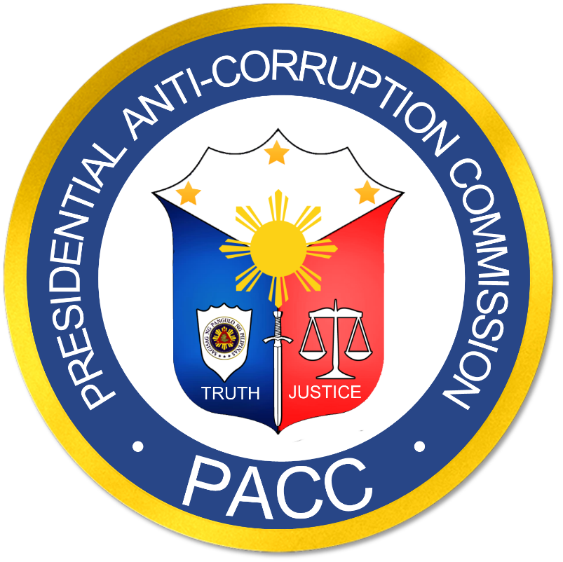

PRESIDENTIAL ANTI-CORRUPTION COMMISSION
Presentation for DILG
City of Manila, Metro Manila
August 13, 2021
Notes:
Good afternoon. I am here to give a brief introduction on PACC and one of its most important endeavor – Project Kasangga.

Slide 2

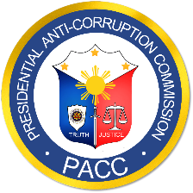
PRESIDENTIAL
ANTI-CORRUPTION
COMMISSION
TRUTH • JUSTICE • TRUTH • JUSTICE • TRUTH • JUSTICE • TRUTH • JUSTICE • TRUTH
PACC Presentation
Creation of The Commission
Officers
Powers and Functions
Project Kasangga
TRUTH • JUSTICE • TRUTH • JUSTICE • TRUTH • JUSTICE • TRUTH • JUSTICE • TRUTH
Notes:
The presentation is divided as follows: creation of the commission, key officers of PACC, followed by the powers and functions of PACC, and finally we would be explaining what is project ka-sangga.

Slide 3
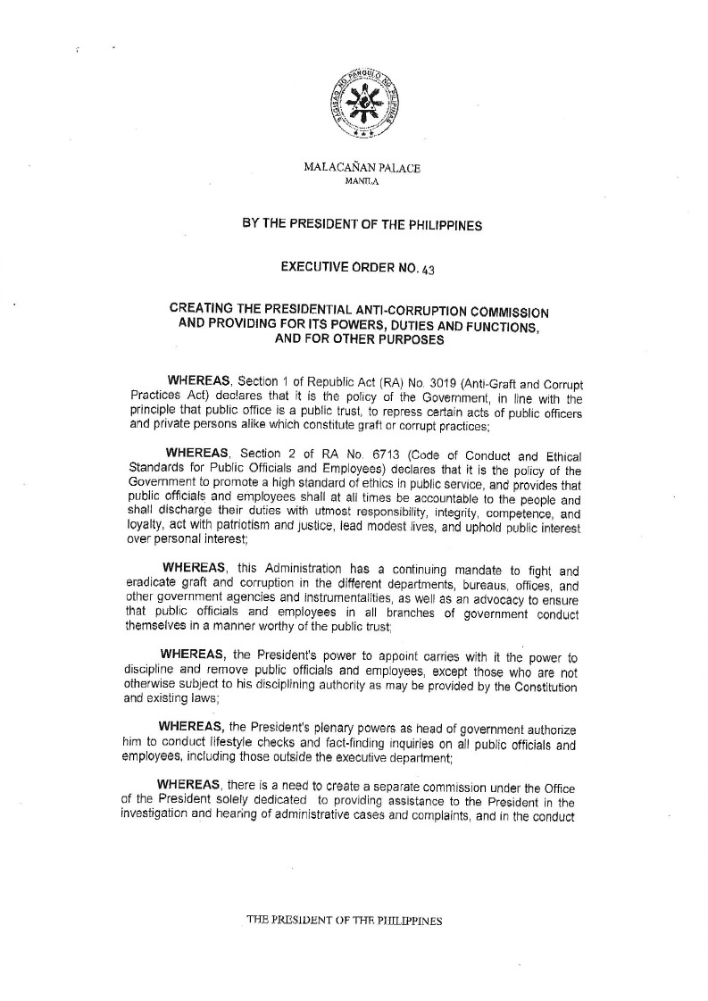
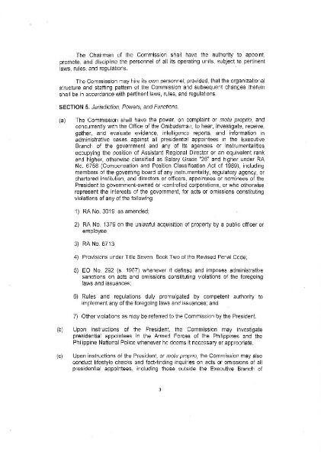
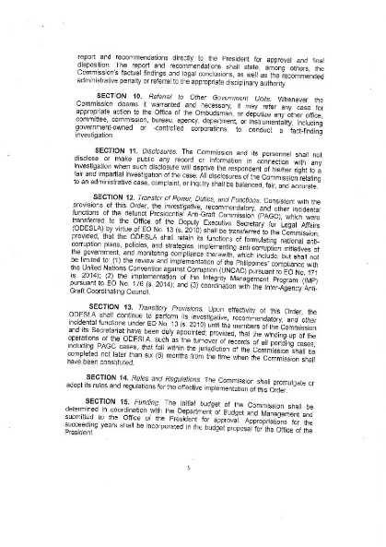
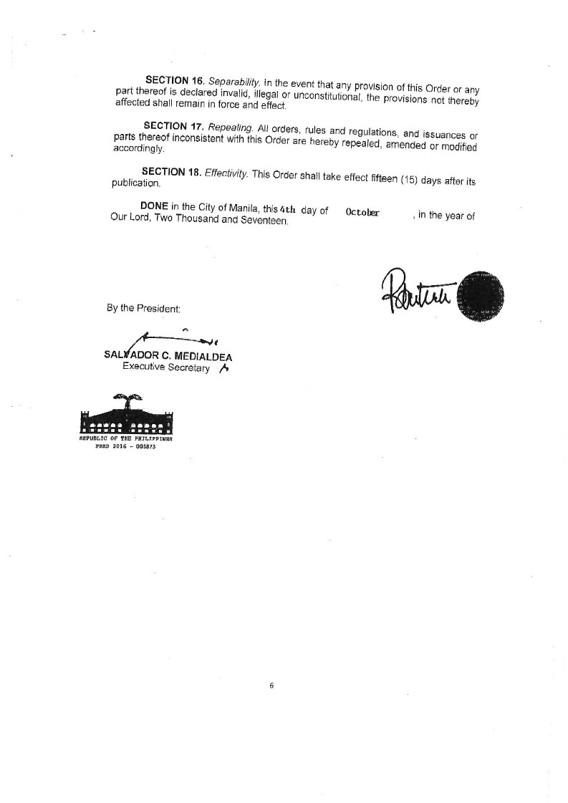
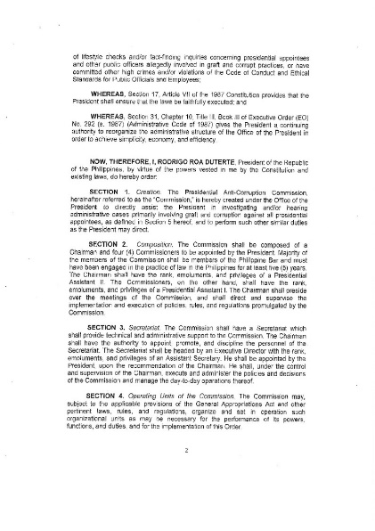
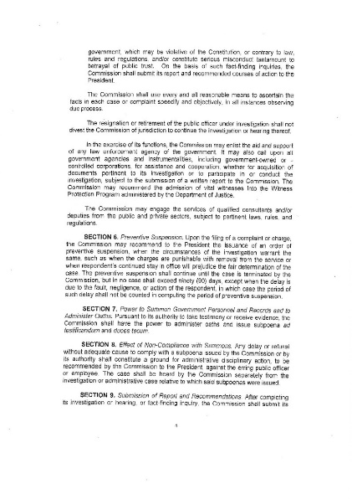
PRESIDENTIAL
ANTI-CORRUPTION
COMMISSION
October 4, 2017
EXECUTIVE ORDER 43
TRUTH • JUSTICE • TRUTH • JUSTICE • TRUTH • JUSTICE • TRUTH • JUSTICE • TRUTH
TRUTH • JUSTICE • TRUTH • JUSTICE • TRUTH • JUSTICE • TRUTH • JUSTICE • TRUTH
Notes:
PACC was created by virtue of Executive Order No. 43 in 2017. The President created the commission in order to fulfill one of his campaign promises, which is anti-corruption. PACC is mandated to investigate all corruption related cases of presidential appointees.

Slide 4
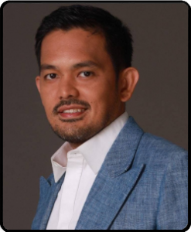
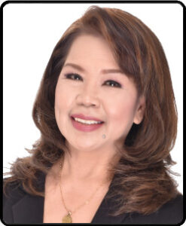
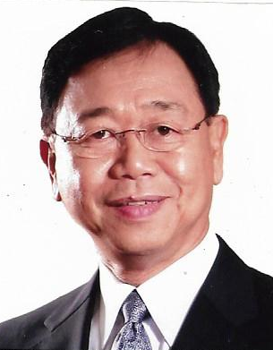
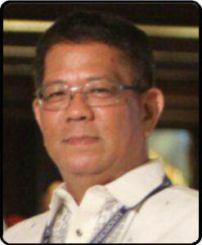
PRESIDENTIAL
ANTI-CORRUPTION
COMMISSION
PACC OFFICERS
TRUTH • JUSTICE • TRUTH • JUSTICE • TRUTH • JUSTICE • TRUTH • JUSTICE • TRUTH
CHAIRMAN
COMMISSIONER
COMMISSIONER
Sec. Greco Belgica
Usec. Yvette Contacto
Usec. Rickson Chiong
Former Councilor 6th District of Manila
CPA-Lawyer
Lawyer from Jolo, Sulu
Lead petitioner against the PDAF/DAP in the SC
Managing partner of CNLEXFIRM
Former NBI Deputy Director
Christian Pastor
FBI and Australian Federal Police College graduate
EXECUTIVE
DIRECTOR
Asec. Fortunato Guerrero
Lawyer
Retired PNP Police Brigadier General
TRUTH • JUSTICE • TRUTH • JUSTICE • TRUTH • JUSTICE • TRUTH • JUSTICE • TRUTH
Notes:
Currently, the Commission is being led by a team of dynamic, active and passionate officers, headed by Chairman Greco Belgica. With him are three experienced commissioners who are experts in their own fields: Atty Yvette Contacto, CPA-lawyer, Atty. Rickson Chiong, former NBI Deputy Director and Atty. Fortunato Guerrero, former PNP General.

Slide 5
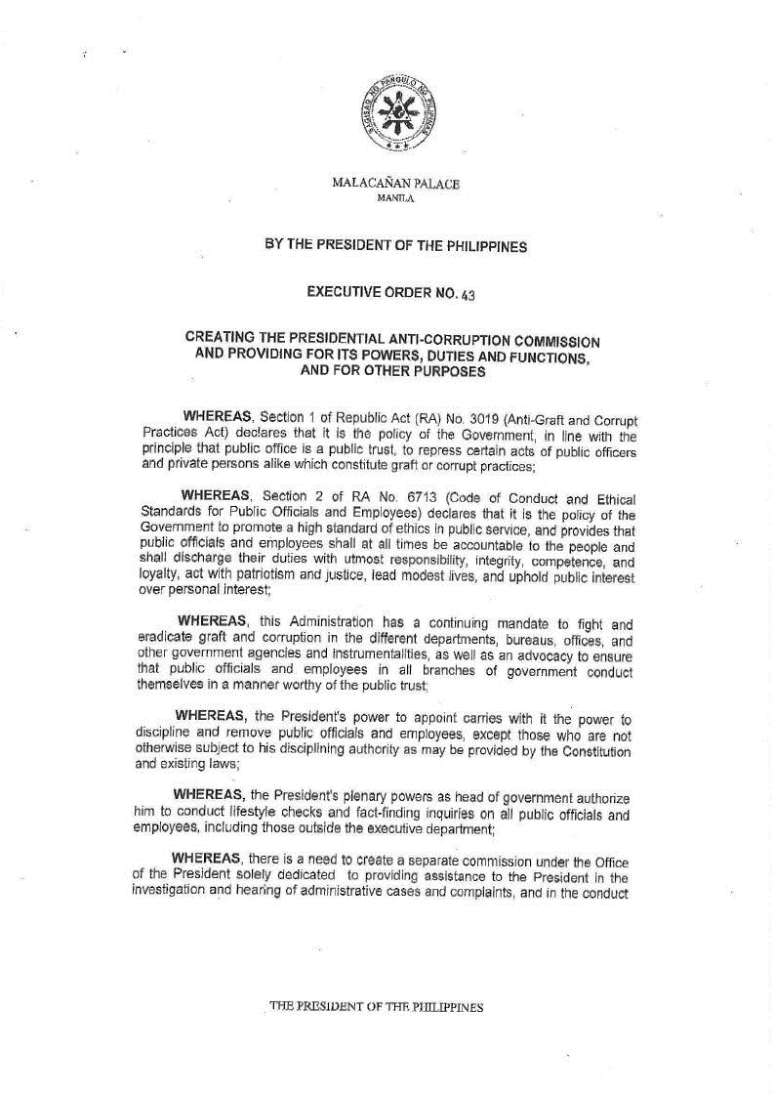
PRESIDENTIAL
ANTI-CORRUPTION
COMMISSION
PACC CREATION
TRUTH • JUSTICE • TRUTH • JUSTICE • TRUTH • JUSTICE • TRUTH • JUSTICE • TRUTH
WHY WAS THE COMMISSION CREATED?
Campaign promise
Mandate of the President
TRUTH • JUSTICE • TRUTH • JUSTICE • TRUTH • JUSTICE • TRUTH • JUSTICE • TRUTH
Notes:
The Commission was created to fight and eradicate graft and corruption in the different departments, bureaus, offices and other government agencies and instrumentalities.

Slide 6
PRESIDENTIAL
ANTI-CORRUPTION
COMMISSION
PACC CREATION
TRUTH • JUSTICE • TRUTH • JUSTICE • TRUTH • JUSTICE • TRUTH • JUSTICE • TRUTH
WHY WAS THE COMMISSION CREATED?
Campaign promise
Mandate of the President
Exercise Presidential power:
Dismiss/discipline
Conduct lifestyle check and fact-finding inquiries
TRUTH • JUSTICE • TRUTH • JUSTICE • TRUTH • JUSTICE • TRUTH • JUSTICE • TRUTH
Notes:
PACC conducts fact-finding investigations, motu proprio investigations, and lifestyle checks.

Slide 7
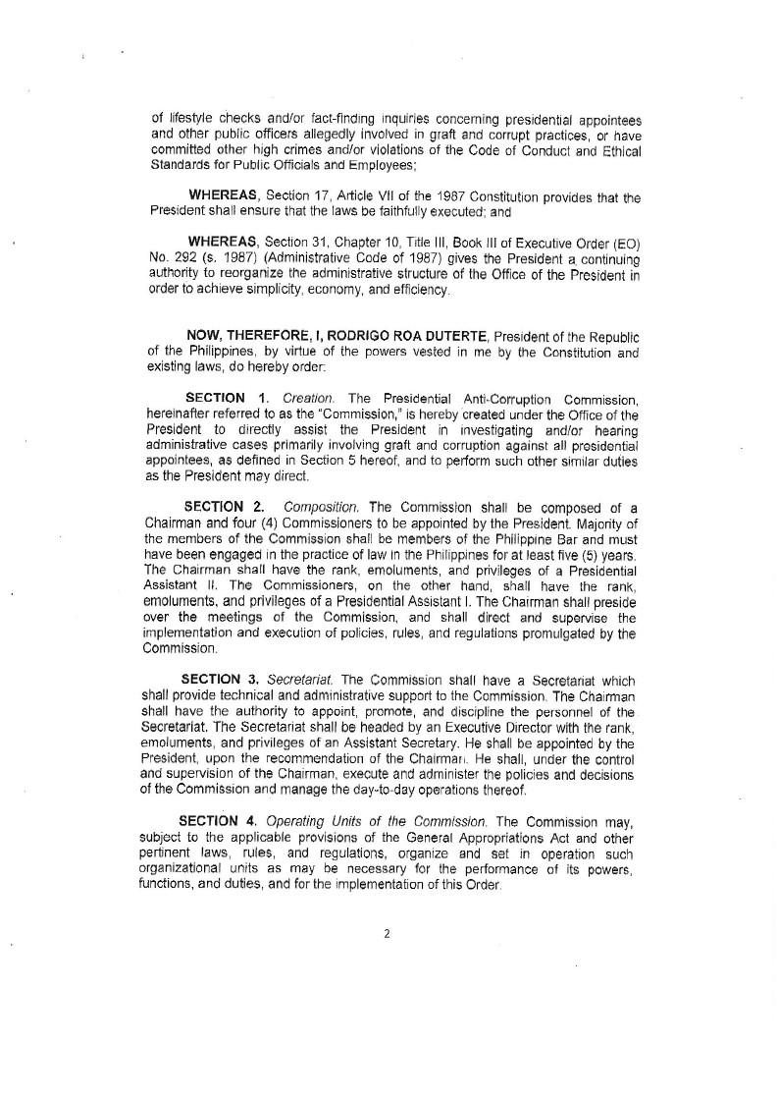
PRESIDENTIAL
ANTI-CORRUPTION
COMMISSION
PACC CREATION
TRUTH • JUSTICE • TRUTH • JUSTICE • TRUTH • JUSTICE • TRUTH • JUSTICE • TRUTH
WHAT IS THE PRESIDENTIAL
ANTI-CORRUPTION COMMISSION (PACC)?
Under the Office of the President
Hear and investigate administrative and criminal cases
TRUTH • JUSTICE • TRUTH • JUSTICE • TRUTH • JUSTICE • TRUTH • JUSTICE • TRUTH
Notes:
Under the Office of the President, PACC investigates administrative and criminal cases against presidential appointees in the executive branch.

Slide 8
PRESIDENTIAL
ANTI-CORRUPTION
COMMISSION
PACC CREATION
TRUTH • JUSTICE • TRUTH • JUSTICE • TRUTH • JUSTICE • TRUTH • JUSTICE • TRUTH
WHAT IS THE PRESIDENTIAL
ANTI-CORRUPTION COMMISSION (PACC)?
Under the Office of the President
Hear and investigate administrative and criminal cases
Headed by a Chairman and 4 Commissioners (majority lawyers)
TRUTH • JUSTICE • TRUTH • JUSTICE • TRUTH • JUSTICE • TRUTH • JUSTICE • TRUTH
Notes:
After due investigation, PACC reports are approved by the Commission en banc as a collegial body before they are submitted to the President for approval. Cases where the PACC has no jurisdiction are endorsed to the Office of the Ombudsman or the Department of Justice Task Force Corruption, as the case may be.

Slide 9

PRESIDENTIAL
ANTI-CORRUPTION
COMMISSION
PACC DUTIES
TRUTH • JUSTICE • TRUTH • JUSTICE • TRUTH • JUSTICE • TRUTH • JUSTICE • TRUTH
WHAT ARE PACC’S POWERS AND FUNCTIONS?
Hear admin cases vs appointees SG 26 & up and co-conspirators
TRUTH • JUSTICE • TRUTH • JUSTICE • TRUTH • JUSTICE • TRUTH • JUSTICE • TRUTH

Slide 10
PRESIDENTIAL
ANTI-CORRUPTION
COMMISSION
PACC DUTIES
TRUTH • JUSTICE • TRUTH • JUSTICE • TRUTH • JUSTICE • TRUTH • JUSTICE • TRUTH
WHAT ARE PACC’S POWERS AND FUNCTIONS?
Hear admin cases vs appointees SG 26 & up and co-conspirators
Upon instruction from President, investigate personnel of AFP and PNP
TRUTH • JUSTICE • TRUTH • JUSTICE • TRUTH • JUSTICE • TRUTH • JUSTICE • TRUTH

Slide 11
PRESIDENTIAL
ANTI-CORRUPTION
COMMISSION
PACC DUTIES
TRUTH • JUSTICE • TRUTH • JUSTICE • TRUTH • JUSTICE • TRUTH • JUSTICE • TRUTH
WHAT ARE PACC’S POWERS AND FUNCTIONS?
Hear admin cases vs appointees SG 26 & up and co-conspirators
Upon instruction from President, investigate personnel of AFP and PNP
Conduct lifestyle checks and fact-finding inquiries
TRUTH • JUSTICE • TRUTH • JUSTICE • TRUTH • JUSTICE • TRUTH • JUSTICE • TRUTH

Slide 12
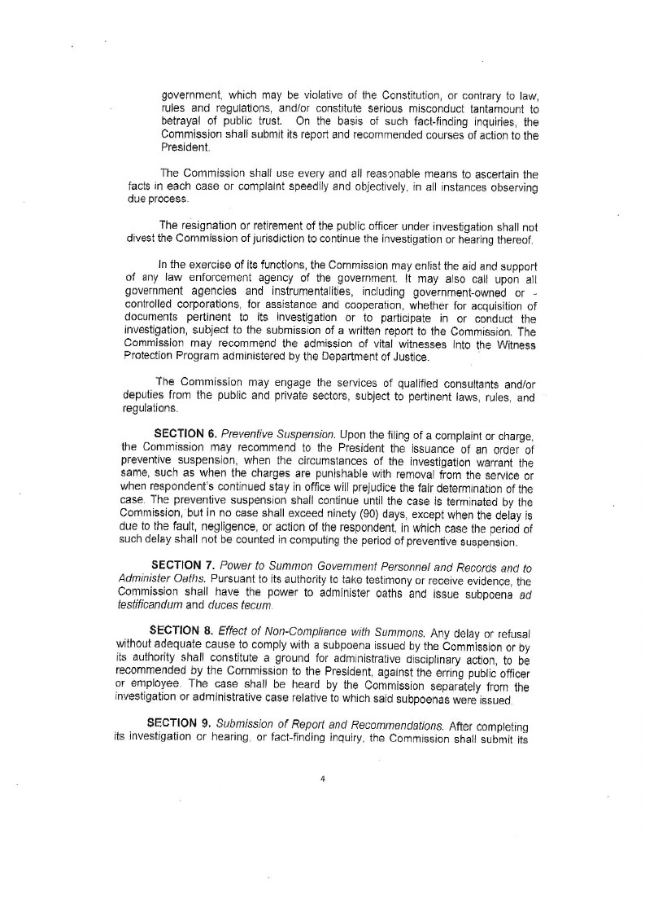
PRESIDENTIAL
ANTI-CORRUPTION
COMMISSION
PACC DUTIES
TRUTH • JUSTICE • TRUTH • JUSTICE • TRUTH • JUSTICE • TRUTH • JUSTICE • TRUTH
WHAT ARE PACC’S POWERS AND FUNCTIONS?
Hear admin cases vs appointees SG 26 & up and co-conspirators
Upon instruction from President, investigate personnel of AFP and PNP
Conduct lifestyle checks and fact-finding inquiries
Enlist support from any law enforcement agency
TRUTH • JUSTICE • TRUTH • JUSTICE • TRUTH • JUSTICE • TRUTH • JUSTICE • TRUTH

Slide 13
PRESIDENTIAL
ANTI-CORRUPTION
COMMISSION
PACC DUTIES
TRUTH • JUSTICE • TRUTH • JUSTICE • TRUTH • JUSTICE • TRUTH • JUSTICE • TRUTH
WHAT ARE PACC’S POWERS AND FUNCTIONS?
Hear admin cases vs appointees SG 26 & up and co-conspirators
Upon instruction from President, investigate personnel of AFP and PNP
Conduct lifestyle checks and fact-finding inquiries
Enlist support from any law enforcement agency
Recommend Preventive Suspension
TRUTH • JUSTICE • TRUTH • JUSTICE • TRUTH • JUSTICE • TRUTH • JUSTICE • TRUTH

Slide 14
PRESIDENTIAL
ANTI-CORRUPTION
COMMISSION
PACC DUTIES
TRUTH • JUSTICE • TRUTH • JUSTICE • TRUTH • JUSTICE • TRUTH • JUSTICE • TRUTH
WHAT ARE PACC’S POWERS AND FUNCTIONS?
Hear admin cases vs appointees SG 26 & up and co-conspirators
Upon instruction from President, investigate personnel of AFP and PNP
Conduct lifestyle checks and fact-finding inquiries
Enlist support from any law enforcement agency
Recommend Preventive Suspension
Administer oaths and issue subpoenas
TRUTH • JUSTICE • TRUTH • JUSTICE • TRUTH • JUSTICE • TRUTH • JUSTICE • TRUTH

Slide 15
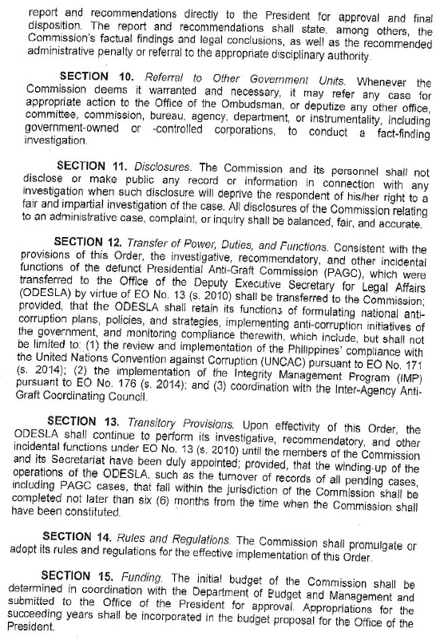
PRESIDENTIAL
ANTI-CORRUPTION
COMMISSION
PACC DUTIES
TRUTH • JUSTICE • TRUTH • JUSTICE • TRUTH • JUSTICE • TRUTH • JUSTICE • TRUTH
WHAT ARE PACC’S POWERS AND FUNCTIONS?
Hear admin cases vs appointees SG 26 & up and co-conspirators
Upon instruction from President, investigate personnel of AFP and PNP
Conduct lifestyle checks and fact-finding inquiries
Enlist support from any law enforcement agency
Recommend Preventive Suspension
Administer oaths and issue subpoenas
Submit report and recommendation to the President
TRUTH • JUSTICE • TRUTH • JUSTICE • TRUTH • JUSTICE • TRUTH • JUSTICE • TRUTH

Slide 16
PRESIDENTIAL
ANTI-CORRUPTION
COMMISSION
PACC DUTIES
TRUTH • JUSTICE • TRUTH • JUSTICE • TRUTH • JUSTICE • TRUTH • JUSTICE • TRUTH
WHAT ARE PACC’S POWERS AND FUNCTIONS?
Hear admin cases vs appointees SG 26 & up and co-conspirators
Upon instruction from President, investigate personnel of AFP and PNP
Conduct lifestyle checks and fact-finding inquiries
Enlist support from any law enforcement agency
Recommend Preventive Suspension
Administer oaths and issue subpoenas
Submit report and recommendation to the President
Refer to or deputize other agencies
TRUTH • JUSTICE • TRUTH • JUSTICE • TRUTH • JUSTICE • TRUTH • JUSTICE • TRUTH

Slide 17
PRESIDENTIAL
ANTI-CORRUPTION
COMMISSION
PACC DUTIES
TRUTH • JUSTICE • TRUTH • JUSTICE • TRUTH • JUSTICE • TRUTH • JUSTICE • TRUTH
WHAT ARE PACC’S POWERS AND FUNCTIONS?
Hear admin cases vs appointees SG 26 & up and co-conspirators
Upon instruction from President, investigate personnel of AFP and PNP
Conduct lifestyle checks and fact-finding inquiries
Enlist support from any law enforcement agency
Recommend Preventive Suspension
Administer oaths and issue subpoenas
Submit report and recommendation to the President
Refer to or deputize other agencies
Recommend witnesses for WPP to DOJ
TRUTH • JUSTICE • TRUTH • JUSTICE • TRUTH • JUSTICE • TRUTH • JUSTICE • TRUTH

Slide 18

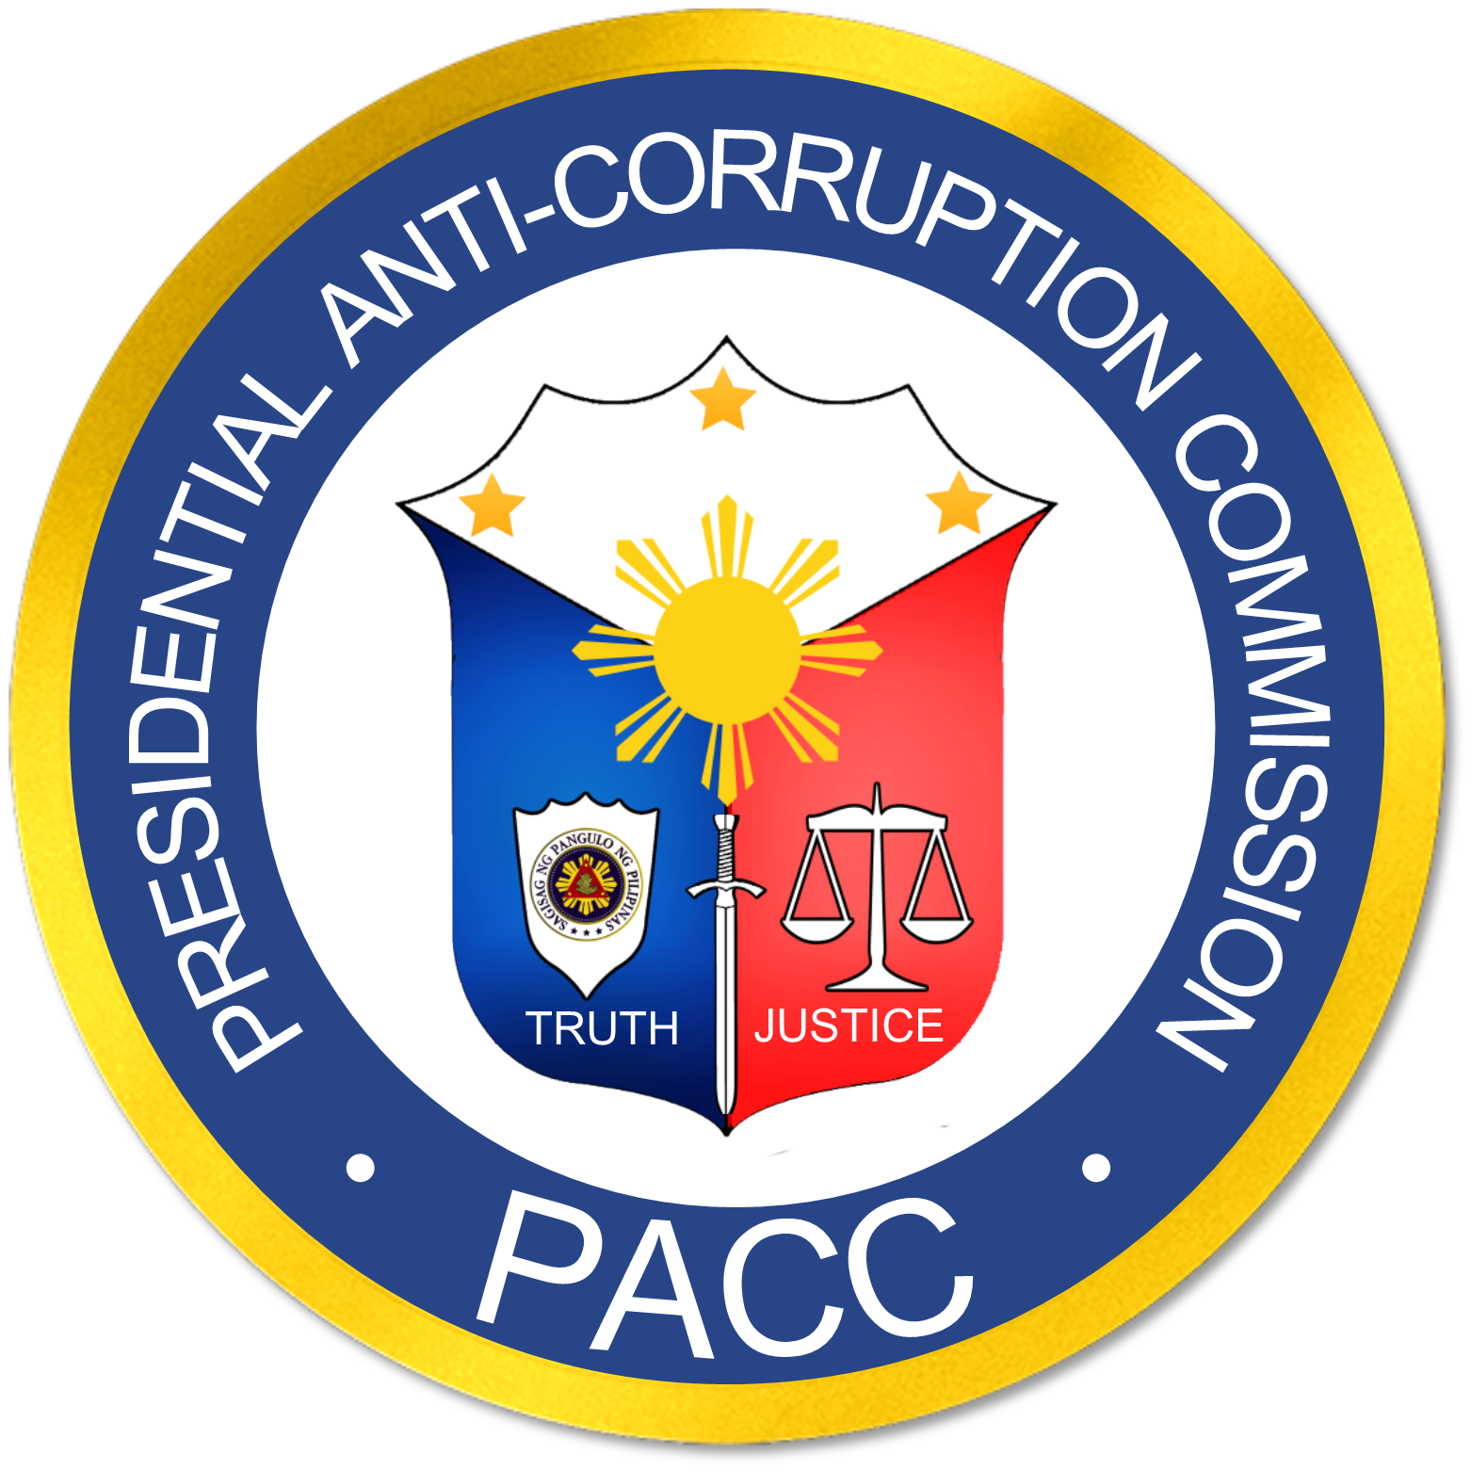
PROJECT KASANGGA
#KasanggaNgPangulo #KasanggaNgPACC #KasanggaNgMamamayan
Notes:
Finally, now we go to the main topic of my presentation – Project Kasangga.

Slide 19
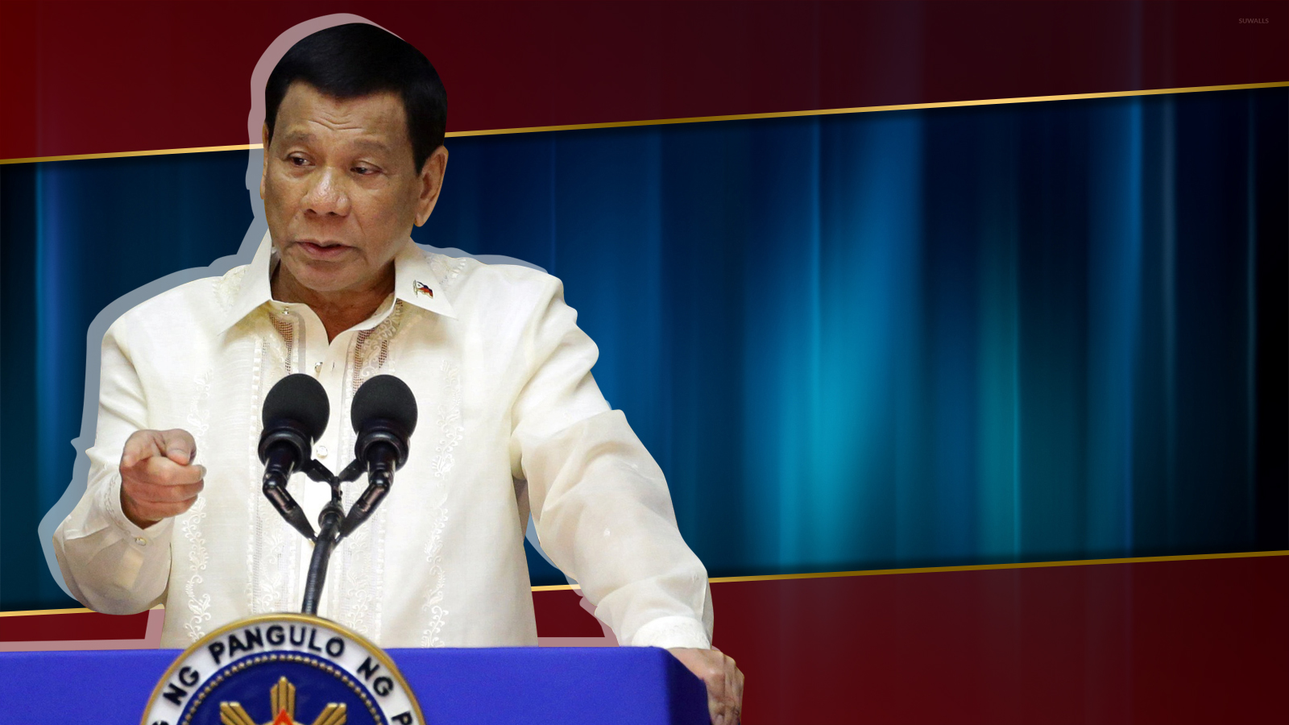
“
I will dedicate the remaining months in office
FIGHTING CORRUPTION
And RED-TAPE !!!
”
Notes:
Eradicating corruption in government is one of the major highlights of the President’s campaign promises. In fact, As stated by the President himself on numerous occasions, that he shall dedicate his remaining months in office fighting corruption and eliminating bureaucratic red tape in government.
19

Slide 20

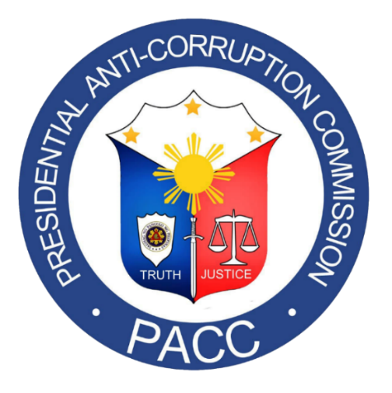
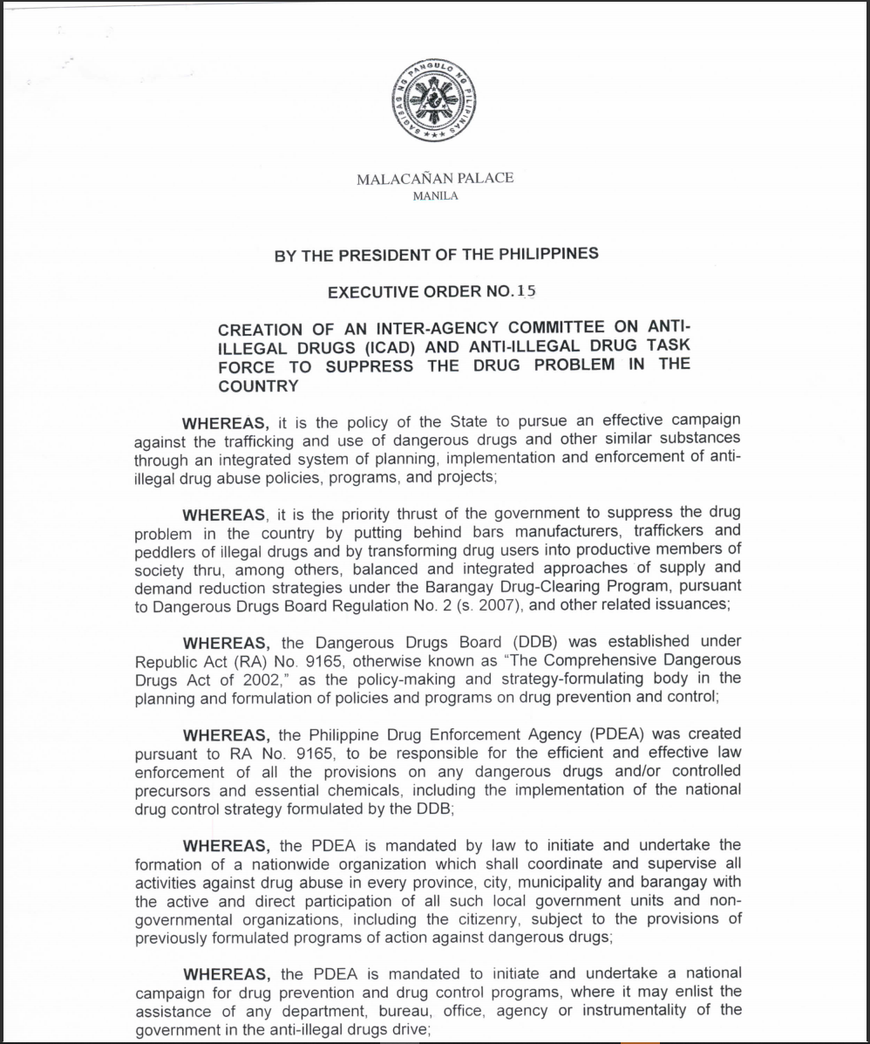
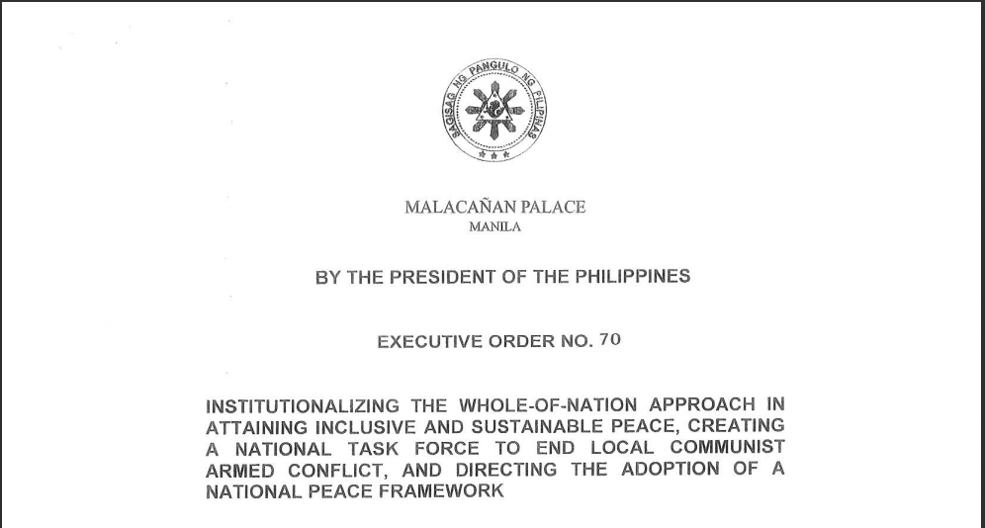
Creation of ELCAC and ICAD
Notes:
In 2017, as part of the anti-drug campaign of the administration, the President signed EO 15 creating the Inter-Agency Committee on Illegal Drugs to suppress the drug problem in the country.
On the otherhand, EO 70, which was signed by President R. Duterte in December 2018, created NTF ELCAC that institutionalized a whole-of-nation approach in obtaining exclusive and sustainable peace - giving us an effective solution against communist-terrorists.

Slide 21

1
Creation of Anti Corruption Coordinating Council
Notes:
it only follows that a body similar to the ICAD and ELCAC should be created to address the lingering problem of our country which is corruption.
Thus, we have propsed and initiated the creation of the Anti-Corruption Coordinating Council that shall be responsible for coordinating all government matters relative to corruption.

Slide 22
Creation of Anti-Corruption Coordinating Council
Implement a simplified bureaucratic workflow to speed up coordination;
Shall receive, record and transmit information or reports of the respective agencies;
Function as a communication link through agreed protocols;
Implement the anti-corruption plan of the President;
Educate the public and enlist their support in combatting corruption.
Notes:
it shall implement a simplified bureaucratic workflow to speed up coordination between our respective offices. it will be responsible in receiving, recording and transmitting information or reports of the agencies and will function as the communications link, where information and instructions may be disseminated quickly through agreed protocols.
22

Slide 23
2
Creation of Anti-Corruption Committees
Notes:
As part of the intensified campaign of the President against corruption, we have also initiated the creation of Anti-Corruption Committees which shall be established in every government agencies/offices.

Slide 24

Functions of Anti-Corruption Committee
Monitor and report corruption-related cases, investigations and actions taken;
Validate information from other sources;
Formulate the agency’s anti-corruption policies, programs and activities;
Spearhead the agency’s Anti-Corruption Campaign Plan of Action;
Identify corruption-prone processes in the agency;
Create a streamlined Complaint Action Center (hotline);
Organize stakeholders to complement the committee; and
Conduct public information campaigns to generate support for the government’s anti-corruption programs.
Notes:
The functions of the Anti-Corruption Committees are the following:

Slide 25
Deliverables of the Anti-Corruption Committee
Coordinate the issuance of Agency administrative order for the creation of the Anti corruption committee in the main office and in the regional/district levels, its composition and their respective duties and responsibilities;
Submission of daily corruption incident reports;
Validation of reports from other agencies/sources;
Develop an anti corruption campaign action plan;
Organize stakeholders within their areas of jurisdiction and recommend their official deputation by the PACC;
Conduct God-centered Anti-Corruption Advocacy seminars;
Notes:
The functions of the Anti-Corruption Committees are the following:

Slide 26
Deliverables of the Anti-Corruption Committee
7. Conduct regular monthly committee business meetings;
8. Establish anti corruption complaints center or hotline;
9. Submission of list of personnel who were complained of, investigated, charged and sanctioned;
10. Recommend Agency’s contact person to the Anti Corruption Coordinating Council;
11. Assist the agency contact person when attending the regular monthly meeting of the Anti Corruption Coordinating Council.
Notes:
The functions of the Anti-Corruption Committees are the following:

Slide 27
COMPOSITION OF THE ANTI-CORRUPTION COMMITTEE
CHAIRMAN
PACC Resident Evaluator
Admin/ Human Resources;
Internal Affairs Office;
Legal Service;
IT Officer;
Stakeholders Representative (media, religious org, NGO)
Notes:
The functions of the Anti-Corruption Committees are the following:

Slide 28
CORRUPTION INCIDENT REPORT FORMAT
Reference Number: BOC-0001-21
Date of Report: June 28, 2021
Subject: ________________________________________________
Place of Report:__________________________________________
Date Acquired: June 27, 2021
Source: ________________________________________________
1. Background:
i. What are the circumstances surrounding the report?
ii This paragraph may include agency policies, directives and operating procedures that has relevance to the report.
Notes:
The functions of the Anti-Corruption Committees are the following:

Slide 29
CORRUPTION INCIDENT REPORT FORMAT
2. Details of the Report:
  Should include the basics of a report such as the 5 W’s and 1H. (Who, What, Why, When,
  Where and How)
  Complete description of the incident.
  The narrative shall contain facts only and shall be reported in an objective manner.
Notes:
The functions of the Anti-Corruption Committees are the following:

Slide 30
CORRUPTION INCIDENT REPORT FORMAT
3. Remarks/Comment
  Discussion or interpretation of the report
4. Action Taken:
  Action taken should be specific
  Report or agency evaluation and or insights.
  Theories formed based on the facts and the background of the report.
  Action taken should be specific
Notes:
The functions of the Anti-Corruption Committees are the following:

Slide 31
CORRUPTION INCIDENT REPORT FORMAT
5. Recommendation:
  Action – oriented
  Feasible
6. Attachment/s:
  Pictures or videos of the incident
  Other reports collaborating the incident (witness report; police report)
  Sketches and diagrams.
7. Reported By:
_________________________________
(Signature over Printed Name)
Notes:
The functions of the Anti-Corruption Committees are the following:

Slide 32
3
Deputation of Private Sector
Notes:
As part of the Anti corruption Council, we recommend that the private sector / stakeholders are represented in the council. These organizations would be able to share their experiences and situations regarding the agencies’ processes and treatment of their clients. They may serve as a feedback mechanism and validators of corruption incidents. Some private organizations may sometimes be hesitant in reporting incidents of corruption due to fear of reprisal, hence, they may be able to relate their experiences through the private sector representative to preserve their anonymity.

Slide 33

Pursuant to EO 43, the Presidential Anti-Corruption Commission has been authorized to deputize the private sector in connection with the conduct of lifestyle and fact-finding investigations of the Commission.
Deputation of Private Sector
Notes:
The Commission conceptualized the accreditation of organizations and individuals wherein in their private capacity and through their cooperation and voluntary service they will be able to assist the administration in its fight against corruption.

Slide 34

Deputation of Private Sector
Promote and educate the public regarding the administration’s anti-corruption campaign;
Increase the reach of the Commission as force multipliers;
Help validate and gather more information regarding corruption in their areas.
Notes:
The deputation of the Barangay Officials and other private individuals will (1) promote and educate the public regarding the administration’s anti-corruption campaign, (2) increase the reach of the Commission as force multipliers, and (3) help validate and gather more information regarding corruption in their areas.
With this, we hope that your organization would be able to join us in the fight against corruption by supporting project kasangga. We hope that all LGU’s would also create their own Anti Corruption Council that would be able to coordinate and connect with the National Anti Corruption Council that is currently being formalized with all the agencies in the executive branch.
The fight against corruption cannot be made by one man or one agency alone. It is all our shared responsibility to create a more transparent and corruption-free government not only for us, but also our future generations.
Thank you.

