Slide 1
IMPLEMENTATION OF THE SUPREME COURT DECISION ON THE MANDANAS-GARCIA PETITIONS
MA. EUNICE R. DELOS SANTOS
DEPARTMENT OF BUDGET AND MANAGEMENT
MIMAROPA REGIONAL OFFICE

Slide 2
OUTLINE OF PRESENTATION
1
Internal Revenue Allotment and the Supreme Court Ruling in the Mandanas Case
2
Executive Order No. 138 on Full Devolution of Functions and Services to LGUs

Slide 3
INTERNAL REVENUE ALLOTMENT
AND THE SUPREME COURT RULING
ON THE MANDANAS CASE

Slide 4
IRA AND THE SC RULING ON THE MANDANAS CASE
INTERNAL REVENUE ALLOTMENT
LGUs shall have a just share, as determined by law, in the national taxes which shall be automatically released to them.
Forty percent (40%) of the share in the national internal revenue taxes (NIRT) based on the collection of the third fiscal year preceding the current fiscal year will be given to LGUs

Slide 5
IRA AND THE SC RULING ON THE MANDANAS CASE
SUPREME COURT RULING ON THE MANDANAS CASE
The Supreme Court (SC) ruled that the just share of LGUs from the national taxes is not limited to “national internal revenue taxes” collected by the Bureau of Internal Revenue (BIR) but includes collections (customs duties) by the Bureau of Customs (BOC).
BEFORE MANDANAS RULING
IRA
NG
NATIONAL TAXES

Slide 6


FULL DEVOLUTION AS A MEASURE TO MITIGATE THE FISCAL IMPACT OF THE MANDANAS RULING
Sec. 17 of the LGC mandated the devolution of several functions to LGUs.
However, many national agencies continues to implement these functions
For fiscal sustainability, the devolved functions must permanently be taken out from the national agencies to empower the LGU to assume them.
Adapted from Powers and Devolved Services of Local Government Units (LGUs) by Dr. Maria Ela Atienza (Professor and Chair), Asst. Prof. Jan Robert Go (Assistant Professor), and Herby Jireh Esmeralda (Research Assistant). Retrieved from https://halalan.up.edu.ph/powers-and-devolved-services-of-local-government-units-lgus/
IRA shares
NG fiscal resources

Slide 7
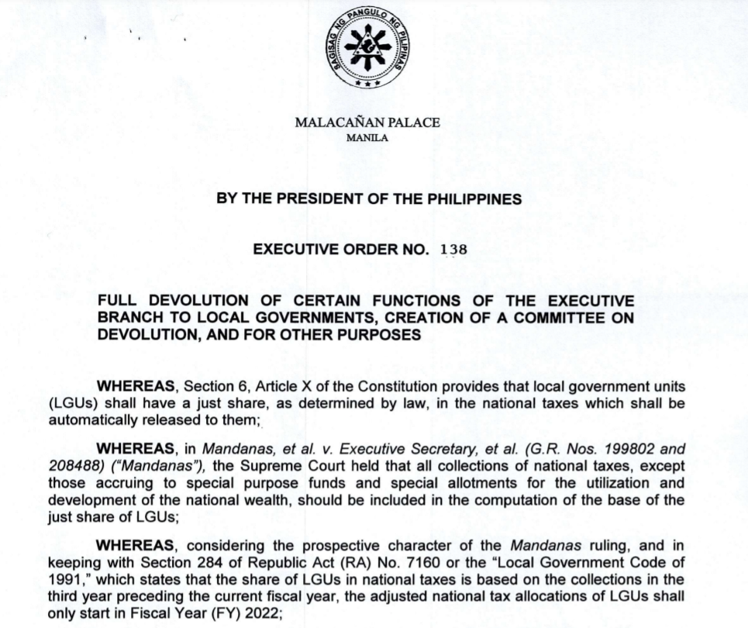
EXECUTIVE ORDER NO. 138 DATED JUNE 1, 2021 - FULL DEVOLUTION OF CERTAIN FUNCTIONS OF THE EXECUTIVE BRANCH TO LOCAL GOVERNMENTS

Slide 8




SALIENT FEATURES OF EXECUTIVE ORDER No. 138
Delineation
of NG and
LGU Roles
Preparation of Devolution Transition Plans
Creation of Committee on Devolution
Establishment of Growth Equity Fund

Slide 9

EXECUTIVE ORDER DIRECTING THE FULL DEVOLUTION OF CERTAIN FUNCTIONS OF THE EXECUTIVE BRANCH TO LOCAL GOVERNMENTS
SALIENT FEATURES
Capacity
Building
for LGUs
Roles of LGUs
Strengthening of Planning, Investment Programming, and Budgeting Linkage and M&E Systems
Options for Affected NGA Personnel

Slide 10
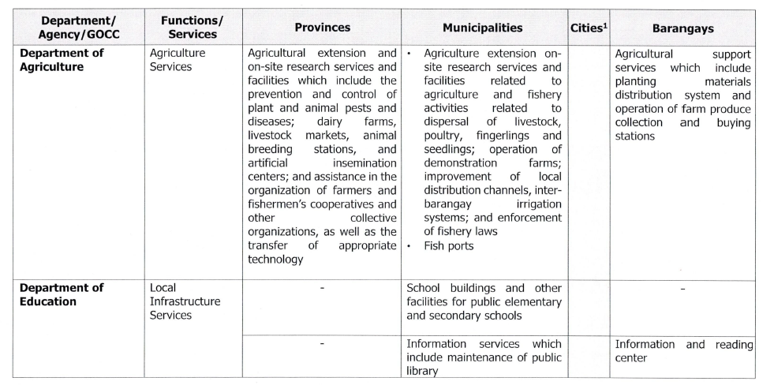

Slide 11
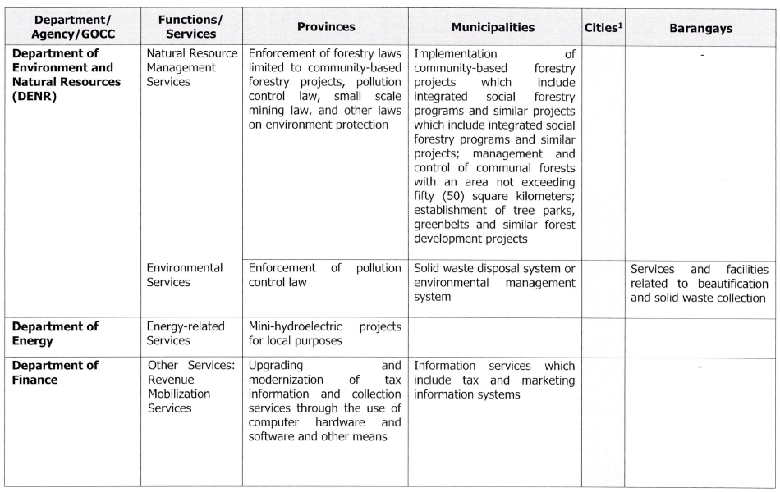

Slide 12
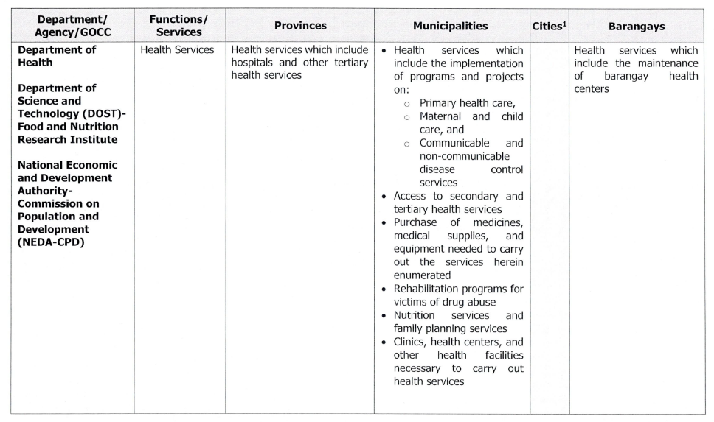

Slide 13
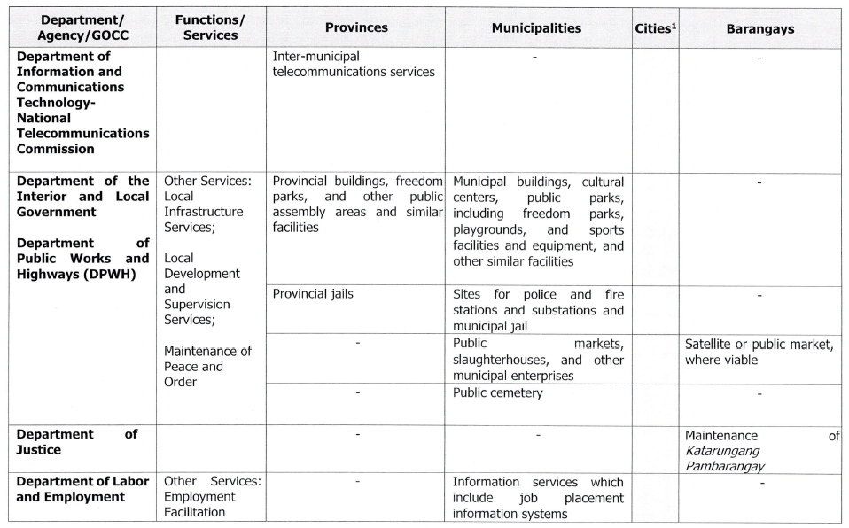

Slide 14
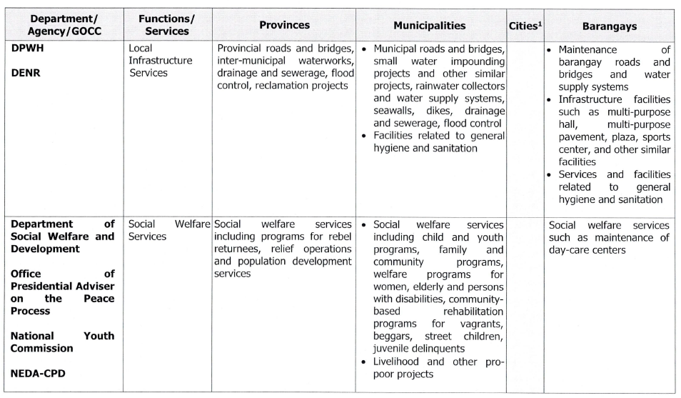

Slide 15
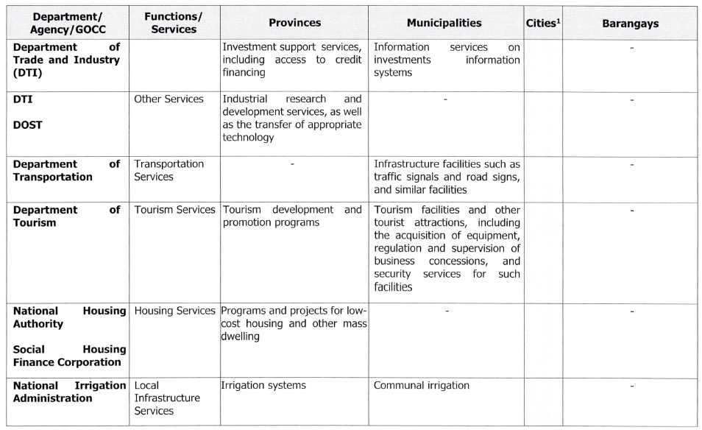

Slide 16
Thank you!

