Slide 1

Requirements for Foreshore Lease Agreement (FLA), Forest Land-use Agreement for Tourism (FLAgT) and Special Use Agreement in Protected Area (SAPA) Applications and
List of Approved FLAs, FLAgT and SAPA
Presented by:
MARIA LOURDES G. FERRER, CESO III
Regional Executive Director
DENR MIMAROPA Region

Slide 2
Section 3, Article XII of the 1987 Constitution
Classification of Lands of the Public Domain
1. Agricultural (Alienable & Disposable Land)
2. Forest or Timberland
3. Mineral Land
4. National Park

Slide 3
For Tourism Purposes:
1. Agricultural Land
2. Forest or Timberland
3. National Park

Slide 4
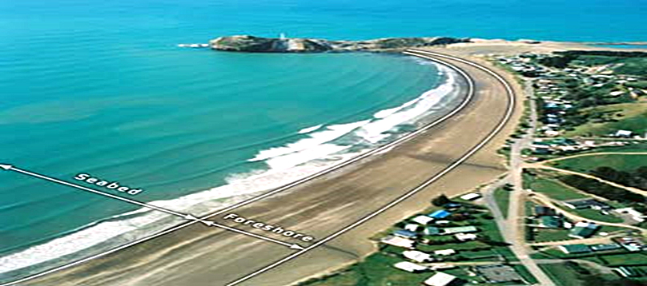
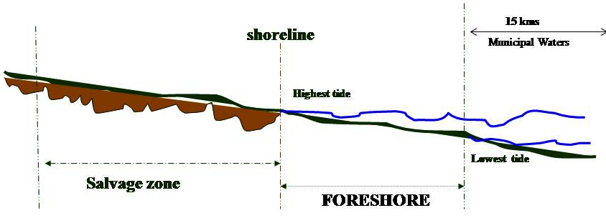


Slide 5
Commonly used terms in the Foreshore/Miscellaneous
Lease Application
Foreshore Land – the part of the shore which is alternately covered and uncovered by the ebb and flow of the tide.
Foreshore Lease Application – the type of application covering foreshore lands. It may also cover marshy lands or lands covered with water bordering upon the shores or banks of navigable lakes or rivers for commercial, industrial or other productive purposes other than agriculture.
Miscellaneous Lease Application – the type of application wherein the proposed or existing improvements falls within a dry land which is part of the shore or permanently underwater.
Provisional Permit – a permit issued for the temporary occupation and use of a tract of land covered by a prescribed public land application.

Slide 6
Foreshore/Miscellaneous Lease Agreement (FLA/MLA)
  is an agreement executed by and between the DENR and the applicant to occupy, develop, utilize and manage the foreshore lands. It may also cover marshy lands or lands covered with water bordering upon the shores or banks of navigable lakes or rivers.

Slide 7
Foreshore Lease Agreement (FLA)
Legal basis : C.A. No.141 Public Land Act- Nov. 7, 1936
: DAO 2004-24- Aug. 24, 2004
: DAO 98-20- May 20, 1998
: DAO 2010-26- Oct. 13, 2010
: LAO 8-3, - Arpril 30, 1936
Area : depends upon the area requirement of the project
Application Fee : 1,000.00 (for Corporation)
: 500.00 (for Individual)
Duration : 25 years renewable for another 25 years
Approving Authority : DENR Secretary

Slide 8

List of Requirements for FLA/MLA Application
(DAO 2004-24)
Appropriate Application Form;
Evidence of Competent Identity;
Approved Survey Plan and technical description of the land applied for;
If the applicant is a naturalized Filipino citizen, a copy of his/her certificate of naturalization duly issued by the proper agency;
If the applicant is a corporation, association or partnership:
  Articles of Incorporation and Certificate of Registration from Securities and Exchange Commission (SEC)
  Board Resolution authorizing the named representative to represent the said Corporation attached therewith a competent identification of the designated representative.
If the applicant is the littoral or riparian owner:
  Authenticated Copy of Title of the adjacent lot .
If the applicant is not the littoral or riparian owner.
  Waiver of rights from the owner of the adjacent lot.

Slide 9

List of Requirements for FLA/MLA Application
(DAO 2004-24)
7. Development Plan of the area stating among others, the financial and technical capability of
the applicant to undertake the project;
8. Certification from following agencies/offices having jurisdiction over the area that the land
applied for is not needed for public use:
a. District/City Engineer, DPWH with the concurrence of the Regional Director of DPWH
b. Local Port Authority concerned and/or concurrence of the General Manager of PPA
c. Department of Tourism (for beach resort purposes)
d. CEO or President of the Special Economic Zone if the area is within their jurisdiction
9. Cost estimate of the proposed and/or existing improvements

Slide 10
Government Share
3% per annum of the value of the land based on the recent BIR zonal value of the nearest commercial or industrial area or the market value thereof, whichever is higher; plus
1% per annum of the value of the improvements existing or to be erected thereon

Slide 11
Approved FLA/MLA within MIMAROPA Region
PROVINCE | FLA/MLA
 | No. | Area (has.)
Occidental Mindoro | 2 | 0.4122
Oriental Mindoro | 4 | 1.2969
Marinduque | 0 | 0.0000
Romblon | 1 | 0.1952
Palawan | 8 | 61.9711
TOTAL: | 15 | 63.8754
Note: Only 5 FLAs/MLAs are for Tourism Purposes

Slide 12

NAME OF ESTABLISHMENT & HOLDER | TENURE NO. & TYPE | LOCATION | AREA (SQ.M.) | DATE OF ISSUANCE | DATE OF EXPIRATION | ANNUAL RENTAL
Nicanor Hernandez | FLA (IV-26) 156 | Bacungan, Puerto Princesa City, Palawan | 8,183 | 08/12/1996 | 08/12/2021 | 2,504.90
SEVEN SEAS RESORTS AND LEISURES INC. | FLA 045316-122 | Cuyo, Palawan | 114,336 | 08/27/1998 |  | 953,367.39
Vicente Tan | FLA (IV-26) 157 | Puerto Princesa City, Palawan | 3,787 | 05/14/1997 | 05/14/2022 | 3,908.30
Premium Megastructure Inc. | PPA No. 045206-01 (PROVISIONAL PERMIT) | Kawit, Gloria, Oriental Mindoro | 5,758 | 05/17/2021 | 05/17/2022 | 371,178.72
Rio Tuba Nickel | FLA (IV-29) 00001-A | Bataraza, Palawan | 20,634 | 11/15/2001 | 11/15/2026 | 544.26
Rio Tuba Nickel | FLA (IV-29) 00001-B | Bataraza, Palawan | 46,218 | 04/04/2005 | 04/04/2030 | 30,200.00
Fisherman's Cove | FLA-045211-26 | Puerto Galera, Oriental Mindoro | 2,123 | 02/23/2006 | 02/23/2031 | 8,942.00
CITRA MINA SEAFOOD CORP. | FLA-045316-129 | Puerto Princesa City, Palawan | 5,446 | 05/01/2006 | 05/01/2031 | 46,891.80
Squares Café and Apartments rep. by Rosalina Roxas | FLA No. 045211-42 | Tabinay, Puerto Galera, Oriental Mindoro | 121 | 05/15/2006 | 05/15/2031 | 593.55
University of Perpetual Help | FLA-045101-13 | Abra de Ilog, Occidental Mindoro | 4,122 | 12/18/2006 | 12/18/2031 | 35,938.00
El Galleon Beach Resort | MLA-045210-14 | Puerto Galera, Oriental Mindoro | 4,967 | 07/30/2007 | 07/30/2032 | 15,000.00
Rolando Macalam | MLA-04910-14 | Romblon, Romblon | 1,952 | 02/03/2009 | 02/03/2034 | 10,520.00
Berong Nickel | FLA-045317-06-01 | Quezon, Palawan | 535,443 | 05/06/2010 | 05/06/2035 | 823,908.22
Berong Nickel | FLA-045317-06-01A (PROVISIONAL PERMIT) | Quezon, Palawan | 128,323 | 10/04/2013 |  | 178,985.22

Slide 13
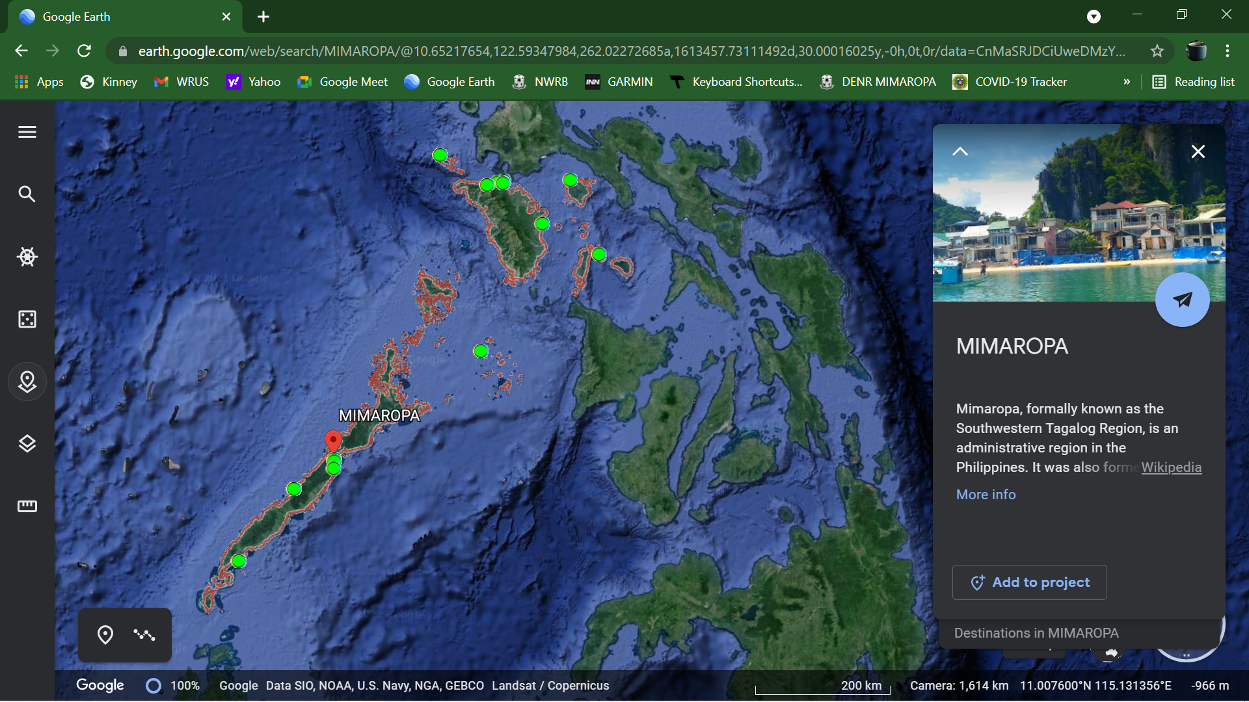

Existing Foreshore Lease Agreement/ Miscelaneous Lease Agreement (FLA/MLA)

Slide 14
Forest Landuse Agreement for Tourism Purposes (FLAgT)
a contract between the government and a second party to temporarily occupy, manage and develop in consideration of a government share, any forestland of the public domain for tourism purposes
Legal basis : DAO No. 2004-28 dated August 25, 2004
Area : depends upon the area requirement of the project
Duration : 25 years renewable for another 25 years
Application Fee : Php 500.00
Approving Authority : Undersecretary for Field Operations

Slide 15
FLAgT Projects
Bathing establishment
Camp site
Ecotourism
Hotel site (inclusive of related resort facilities)
Other tourism purposes

Slide 16
List of Requirements for FLAgT Application
Application form duly accomplished;
Official Receipt of Payment of Application fee;
Pertinent documents showing proof that the applicant is a legitimate entity qualified to be a holder of a forestland tenurial instrument or agreement, as follows:
  For an individual applicant, certified copy of birth certificate or, if applicant is naturalized Filipino citizen, a certified copy of his/her Certificate of Naturalization.
  For a corporation, association or partnership:
    certified copy of SEC registration certificate and Articles of Incorporation/partnership, and
    a resolution of the corporate governing body (Board of Directors, Board of Trustees, etc.) designating the authorized representative of said corporation, association or partnership to apply/sign documents for and in behalf of the company.
  For cooperative, certified copy of certificate of registration with the Cooperative Development Authority (CDA).

Slide 17
List of Requirements for FLAgT Application
4. Proof of available capital to undertake developmental activities;
5. Appropriate clearance from the NCIP;
6. Certificate of Non-Overlap or
  Free and Prior Informed Consent (FPIC) and Certification of Precondition (CP)
7. If the area applied is located in PALAWAN, clearance from Palawan Council for
Sustainable Development (PCSD).
8. Tourism Development Plan (TDP) prepared by the Local Government Unit (LGU) and
duly approved by the Department of Tourism.
  if not yet available, clearance/certification issued by the municipal tourism officer. The certification should manifest that the proposed or existing tourism facilities is within the ambit of the forest land use plan as incorporated in its comprehensive land use plan and approved tourism framework plan for the locality.

Slide 18
List of Requirements for FLAgT Application
9. Comprehensive Development and Management Plan (CDMP);
10. LGU Indorsement (resolution);
11. Indorsement from •CENRO and •PENRO concerned
  Inspection Report;
    100% timber inventory
    Geo-tagged photos
    most recent BIR zonal value of the commercial zone within the Barangay, or the nearest and adjacent barangay within the Municipality Metes and bounds of the FLAgT area, defined by the technical description and final map at a scale of 1:20,000 and geo-referenced to the Philippine Reference System (PRS 92).

Slide 19

List of Requirements for FLAgT Application
UPON ISSUANCE OF FLAgT:
12. Environmental Compliance Certificate (ECC) issued by the Environmental
Management Bureau of DENR (prior to conduct of any activity in the area);
13. Performance bond which is twice the annual rental or users fee as the case maybe, but
not less than P10,000. Provided, that 50% of the computed bond deposit shall be posted
in CASH and the balance in the form of surety bond with a duration of five (5) years
renewable every five (5) years in case of a lease or management agreement or
coterminous to a permit. Provided, further, that the face value of the surety bond shall be
increased by 25%. (DAO No. 2004-16 Section C Item 10) The performance bond shall
be posted within thirty (30) days upon issuance of the FLAgT.

Slide 20
Government Share
Five percent (5%) per annum of the value of the land based on the most recent BIR zonal value of the commercial zone within the barangay, or the nearest and adjacent barangay within the municipality.
The revaluation shall be undertaken every five (5) years thereafter. Failure to pay the user’s fee within the prescribed period shall be subject to surcharges of 8.33% monthly for late payment or 100% for one (1) year.

Slide 21
Approved/Existing FLAgT within MIMAROPA
PROVINCE | FLAgT
 | No. | Area (has.)
Occidental Mindoro | 5 | 4.9500
Oriental Mindoro | 0 | 0.0000
Marinduque | 1 | 10.2000
Romblon | 0 | 0.0000
Palawan | 25 | 233.9563
TOTAL: | 31 | 249.1063

Slide 22

 | NAME OF ESTABLISHMENT & HOLDER | LOCATION | AREA (SQ.M.) | DATE OF ISSUANCE | DATE OF EXPIRATION | GOVERNMENT SHARE (Based on Contract)
1 | Club Paradise - Euro Pacific Resorts, Inc. | Dimakya Island, Barangay San Jose, Coron, Palawan | 140,000 | 12/16/2004 | 12/31/2029 | 217,825.12
2 | Bacuit Bay Development Corporation | Apulit Island, Maytegued, Taytay, Palawan | 115,000 | 12/24/2004 | 12/31/2029 | 172,500.00
3 | Bacuit Bay Development Corporation | Apulit Island, Maytegued, Taytay, Palawan | 60,000 | 12/24/2004 | 12/31/2029 | 90,000.00
4 | Bacuit Bay Development Corporation | Apulit Island, Maytegued, Taytay, Palawan | 18,100 | 12/24/2004 | 12/31/2029 | 27,150.00
5 | Besaga Beach Front Bed and Breakfast – Ms. Emelie L. Besaga | Port Barton, San Vicente, Palawan | 14,000 | 11/23/2005 | 11/30/2030 | 1,575.00
6 | Ten Knots Philippines, Inc. (Ten Knots Development Corporation) | Miniloc Island, Barangay Bebeladan, El Nido, Palawan | 48,700 | 11/23/2005 | 11/30/2030 | 73,050.00
7 | Winther's, Inc. | Popototan Island, Barangay Maglalambay, Busuanga, Palawan | 10,000 | 11/23/2005 | 11/30/2030 | 1,125.00
8 | Ten Knots Philippines, Inc. (Ten Knots Development Corporation) | Lagen Island, Barangay Aberawan, El Nido, Palawan | 50,000 | 12/27/2005 | 12/30/2030 | 75,000.00
9 | Ten Knots Philippines, Inc. (Ten Knots Development Corporation) | Pangulasian Island,Barangay Bebeladan, El Nido, Palawan | 50,000 | 12/27/2005 | 12/30/2030 | 75,000.00
10 | Ten Knots Philippines, Inc. (Ten Knots Development Corporation) | Cadlao Island, Barangay Buena Suerte, El Nido, Palawan | 32,060 | 12/27/2005 | 12/30/2030 | 48,090.00

Slide 23

 | NAME OF ESTABLISHMENT & HOLDER | LOCATION | AREA (SQ.M.) | DATE OF ISSUANCE | DATE OF EXPIRATION | GOVERNMENT SHARE (Based on Contract)
11 | Sigmund S. Salamat | Ambil Island, Brgy. Tambo, Looc, Occidental Mindoro | 9,900 | 02/21/2006 | 02/28/2031 | 1,980.00
12 | Vicente M. Warns | Ambil Island, Brgy. Tambo, Looc, Occidental Mindoro | 9,900 | 02/21/2006 | 02/28/2031 | 1,980.00
13 | Benjamin C. Salamat | Ambil Island, Brgy. Tambo, Looc, Occidental Mindoro | 9,900 | 02/21/2006 | 02/28/2031 | 1,980.00
14 | Marian P. Warns | Ambil Island, Brgy. Tambo, Looc, Occidental Mindoro | 9,900 | 02/21/2006 | 02/28/2031 | 1,980.00
15 | Lamberto M. Reyes | Ambil Island, Brgy. Tambo, Looc, Occidental Mindoro | 9,900 | 02/21/2006 | 02/28/2031 | 1,980.00
16 | Bella Roca Island Resort and Spa – Gold Barrel Social Club Resort Capital, Inc. | Elephant Island, Barangay Tungib, Buenavista, Marinduque | 102,000 | 05/04/2006 | 04/30/2031 | 25,500.00
17 | Starfish Sandbar Resort - Ma. Isabel B. Gallardo | Sta. Lourdes, Puerto Princesa City, Palawan | 26,300 | 06/02/2008 | 10/15/2032 | 85,475.00
18 | Sangat Island Resort - Edith S. Pownall | Sangat Island, Brgy. Bintuan, Coron, Palawan | 10,000 | 02/02/2010 | 11/30/2034 | 37,500.00
19 | Last Escape Development Corporation | Cagdanao Island, Barangay Casian, Taytay, Palawan | 49,300 | 02/09/2010 | 02/13/2035 | 110,925.00
20 | Rollway Realty Development Corporation | Malaroyroy Island, Barangay Bulalacao, Coron, Palawan | 60,000 | undated | 03/02/2035 | 180,000.00

Slide 24

 | NAME OF ESTABLISHMENT & HOLDER | LOCATION | AREA (SQ.M.) | DATE OF ISSUANCE | DATE OF EXPIRATION | GOVERNMENT SHARE (Based on Contract)
21 | Mr. Winthrop Hawthorne R. Bañez | Napulan Island, Barangay Galoc, Culion, Palawan | 40,000 | 04/07/2010 | 04/08/2035 | 150,000.00
22 | Ms. Jennifer B. Corpuz | Sitio Lahid-Tahom, Barangay Galoc, Culion, Palawan | 31,000 | 04/07/2010 | 04/08/2035 | 116,250.00
23 | Roland F. Rodriguez | Arena Island, Barangay Panacan, Narra, Palawan | 25,963 | 04/07/2010 | 04/08/2035 | 116,833.50
24 | Esperanza Delmo Butikofer | Albaguen Island, Barangay Port Barton, San Vicente, Palawan | 20,000 | 04/16/2010 | 04/17/2035 | 150,000.00
25 | Island Resort Group (Leisure) Corporation | Ariara Island, Barangay San Miguel, Linapacan, Palawan | 113,600 | undated | 05/25/2035 | 340,800.00
26 | Diwaran Resorts Philippines, Inc. | Diwaran Island, Brgy. Marcilla, Coron, Palawan | 550,500 | 05/26/2010 | 05/27/2035 | 2,064,375.00
27 | Dos Palmas Arreceffi Island Resort - Ivy Michelle A. Lim | Arreceffi Island, Barangay Manalo, Puerto Princesa City, Palawan | 240,000 | 06/09/2010 | 06/10/2035 | 780,000.00
28 | Palawan Cove Corporation | Boayan Island,Sitio Daplac, Barangay Poblacion, San Vicente, Palawan | 240,000 | 02/27/2012 | 02/27/2037 | 900,000.00
29 | Mangenguey Inc. | Manguenguey Island, Barangay Maglalambay, Busuanga, Palawan | 90,140 | 11/04/2013 | 10/29/2038 | 10,140.75
30 | Scottland Inc. | So. Tandul, Bintuan, Coron, Palawan | 163,000 | 02/03/2015 | 02/02/2040 | 163,000.00
31 | Secret Paradise Retreat Corporation (SPRC) | Sitio Barongbong, Barangay Port Barton, San Vicente, Palawan | 141,900 | 10/02/2019 | 10/02/2044 | 1,064,250.00

Slide 25
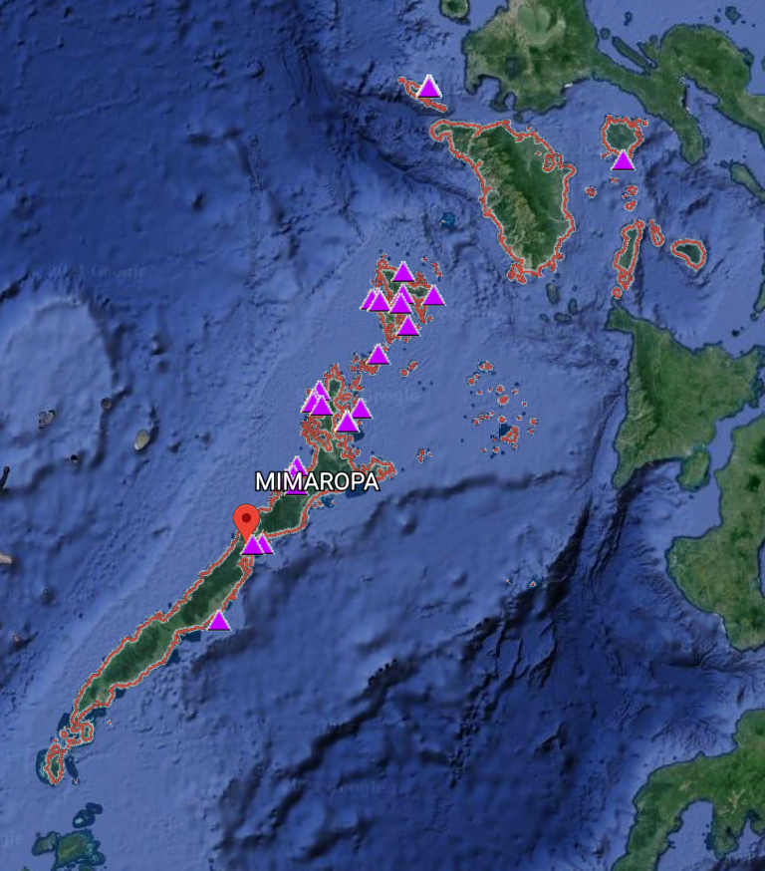

Existing Forest Landuse Agreement for Tourism (FLAgT)

Slide 26
Special Use Agreements in Protected Areas
Legal basis : DAO 2007-17
: DAO 2018-05
: DAO 2019-05/ ENIPAS IRR
: Section 25, RA 11038
Area : depends upon the area requirement of the project
Application Fee : 5,000.00
Duration : 25 years renewable for another 25 years
Approving Authority : DENR Secretary

Slide 27
No. | SAPA Requirements | Legal Basis
General Requirements
1 | Accomplished Application Form | DAO 2007-17
2 | Certified copy of birth certificate (for individuals) or ownership (for corporations) | DAO 2007-17
3 | Project description supported by maps and pictures of the proposed area, development plan, timetable and description of activities from preparation to project implementation. The description should show sustainable management and development | DAO 2007-17
4 | Proof of financial capability to manage and develop the area applied for based on paid-up capital and/or collaterable real properties | DAO 2007-17
5 | Free and Prior Informed Consent (FPIC) of concerned IPs, as the case maybe | DAO 2007-17

Slide 28
For Individual Applicants
6 | For tenured migrant/s, a certification from the concerned Protected Area Superintendent | DAO 2007-17
7 | In case of application of qualified applicants other than the PACBRMA holder within PACBRMA areas, a MOA between the proponent and PACBRMA holder is necessary | DAO 2007-17

Slide 29
For Groups/Corporations/Associations/Cooperatives/NGOs
8 | Copy of SEC registration, Articles of Incorporation and by-laws. A resolution of the governing board designating the authorized representative of the said corporation, association, or partnership, if applicable | DAO 2007-17
9 | Copy of the Resolution or Ordinance approved by the respective Sangguniang Panlalawigan/Panlungsod/Bayan, if the applicant is a Local Government Unit. It shall specify the authority of the Local Chief Executive of the concerned LGU that he/she is authorized to enter into a contract and she/he acts for and on behalf of the LGU | DAO 2007-17
10 | For cooperatives, a Certificate of Registration with the Cooperative Development Authority | DAO 2007-17

Slide 30
Other Requirements
11 | Clearance/Disapproval of the Application issued by RED | DAO 2007-17
12 | Comprehensive Development and Management Plan | DAO 2007-17
13 | Environmental Compliance Certificate | DAO 2007-17
14 | PAMB resolution recommending the approval of SAPA application | DAO 2007-17
15 | SAPA shall be confined only to the management zones of the protected area appropriate for the purpose (Multiple Use Zone) | DAO 2007-17
16 | Administrative Fee amounting to PhP 5,000.00 | DAO 2018-05

Slide 31
17 | Rehabilitation Plan | DAO 2019-05
18 | Posting of Rehabilitation/Performance bond in a form of surety bond or cash equivalent to 25% of the rehabilitation cost as reflected in the development plan (CDMP) | DAO 2019-05
19 | Constructing any permanent structure within the forty (40)-meter easement from the high water mark of any natural body of water or issuing a permit for such construction pursuant to Article 51 of Presidential Decree No. 1067: Provided, That construction for common usage wharves and shoreline protection shall be permitted by the PAMB only after thorough EIA. | DAO 2019-05

Slide 32
Government Share
Five percent (5%) per annum of the value of the land based on the most recent BIR zonal value of the commercial zone within the barangay, or the nearest and adjacent barangay within the municipality; plus
1% per annum of the value of the improvements;
revaluation shall be undertaken every five (5) years thereafter. Failure to pay the user’s fee within the prescribed period shall be subject to surcharges of 8.33% monthly for late payment or 100% for one (1) year.

Slide 33
 | NAME OF ESTABLISHMENT & HOLDER | LOCATION | AREA (SQ.M.) | DATE OF ISSUANCE | DATE OF EXPIRATION | GOVERNMENT SHARE (Based on Contract)
1 | Maritess Allen (Universal Lifestyle Fengshui Incorporated | So. Nasirocan, Lagen Island, Brgy. Aberawan, El Nido, Palawan | 9,628 | 11/18/2019 | 11/18/2044 | 558,356
2 | Roderick C. Amigos (Royal Premiere Leisure and Development Corporation) | So. Bariring, Brgy. Pasadena, El Nido | 300,000 | 09/18/2020 | 09/18/2045 | 19,684,650.52
3 | Angeli Natasha (Narayani Corporation) | So. Maramegmeg, Corong corong, El Nido | 21,410 | 09/13/2017 | 9/13/2022 | 1,613,848
4 | Angeli Natasha (Sabang X Zipline Corporation/ Via Ferrata Naturre Interpretation) | Brgy.Maligaya, El Nido | 90,321 | 9/21/2015 | 9/21/2020 | 28,514

Slide 34
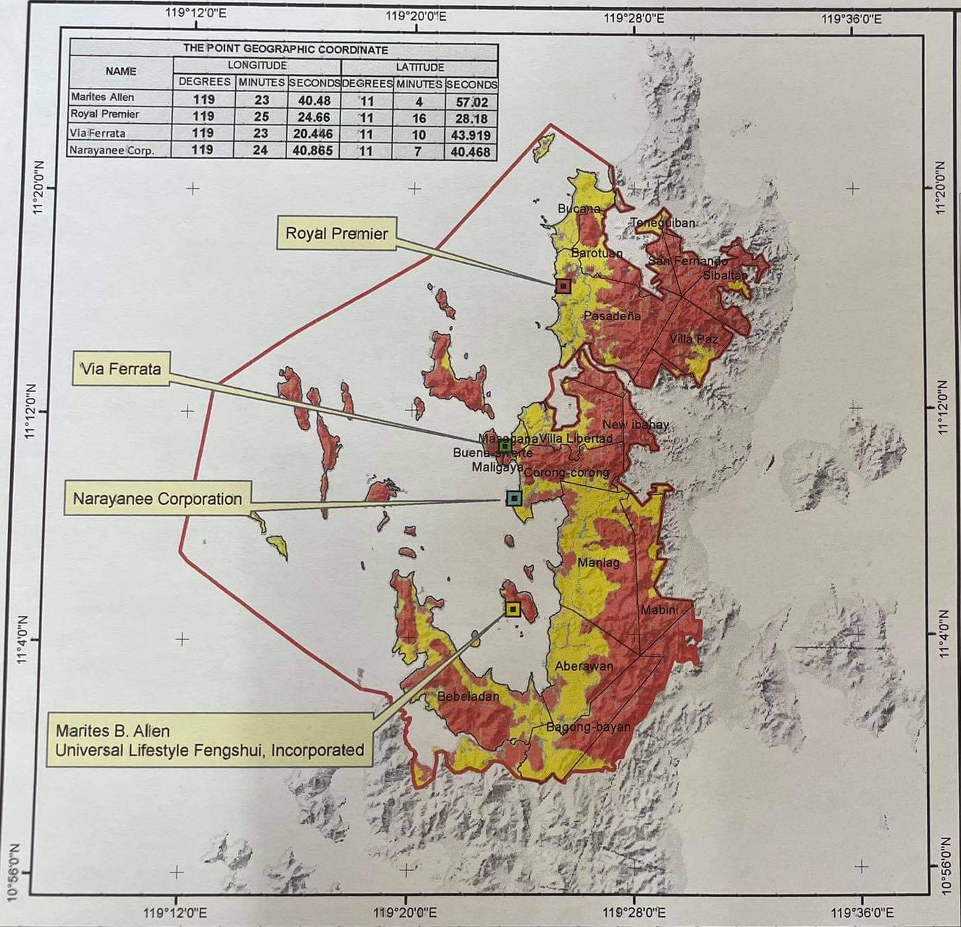

Slide 35
Maraming
Salamat Po!

