Slide 1
PUERTO PRINCESA CITY
QUARANTINE UPDATE AS OF JUNE 22, 2021
toto alvior

Slide 2
QUARANTINE STATUS | MECQ (Until June 30)
TOTAL ACTIVE COVID 19 CASES (as of June 22) | 760
TOTAL RECOVERED – June 22 | 88
TOTAL DEATH - June 22 | 3
CUMULATIVE CASES YEAR 2020 – JUNE 2021
TOTAL CONFIRMED CASES | 6,467
TOTAL RECOVERED | 5,552
TOTAL DEATH | 155

Slide 3
Facility / Hospital | ICU BED | ISO BED | TTMF Beds Available | Covid + Beds Available | Admitted (being used) | Occupancy Rate
PPC-IMT (7)FACILITIES (Mild – Moderate) | 0 | 109 | 603 | 421 | 291 | 41%
COOP HOSPITAL (Moderate – Severe) | 0 | 17 | 0 | 1 | 16 | 94%
OSPITAL NG PALAWAN (Moderate – Severe) | 9 | 52 | 0 | 8 | 53 | 86%
ADVENTIST HOSPITAL (Moderate – Severe) | 0 | 7 | 0 | 0 | 7 | 100%
Facility / Hospital | Total Ventilators | Ventilators being Used | Utilization Rate
COOP Hospital (Moderate – Severe) | 2 | 0 | 0%
OSPITAL NG PALAWAN (Moderate – Severe) | 9 | 6 | 67%
ADVENTIST Hospital (Moderate – Severe) | 3 | 3 | 100%

Slide 4
POSITIVITY RATE OF TAVELLERS ARRIVED IN PUERTO PRINCESA CITY
MONTH Y 2021 | TOTAL TESTED |  |  | POSITIVITY %
 | LSI | ROF | APOR | LSI% | ROF% | APOR%
JANUARY | 356 | 76 | 476 | 0 | 0 | 1% (4)
FEBRUARY | 364 | 73 | 550 | 1% (4) | 0 | 1% (6)
MARCH | 18 | 34 | 1,058 | 28% (5) | 3% (1) | 1% (11)
APRIL | 10 | 4 | 282 | 0 | 0 | 0
MAY | 16 | 66 | 186 | 0 | 0 | 2% (4)
JUNE | 5 | 7 | 255 | 0 | 0 | 7% (18)

Slide 5
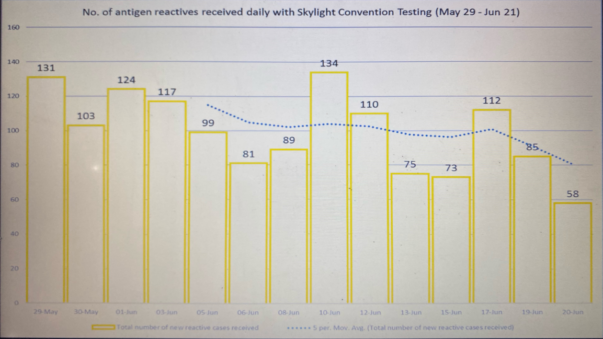

Slide 6
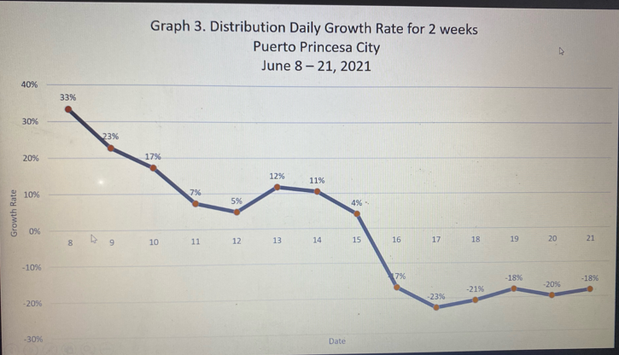

Slide 7
OTHER UPDATES:
> TRAVEL BAN UNTIL JUNE 30
> ALLOWED DINE-IN UP TO 10% AND 50% IF AL FRESCO FOR ESTAURANTS
(Provided that all guest will register via STAY SAFE)
> NO REQUIREMENTS NEED FOR THOSE TRAVELLERS FROM OTHER MUNICIPALITIES OF PALAWAN GOING TO PUERTO PRINCESA
> MOLECULAR LABORATORY – For final/Actual inspection of DOH on June 23 and conduct proficiency test.

Slide 8
END !!!

