Slide 1
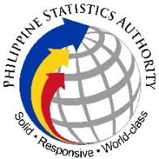
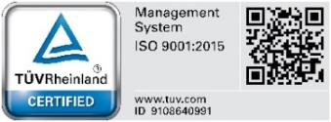
Republic of the Philippines
Philippine Statistics Authority
32nd National Statistics
Month Celebration
RCCB/RSC Third Quarter Joint Meeting
13 August 2021
Updates from the Standards Service

Slide 2

Republic of the Philippines
Philippine Statistics Authority
32nd National Statistics Month
About the NSM
Objectives
Legal Basis
promote, enhance, and instill nationwide awareness and appreciation of the importance and value of statistics to the different sectors of society
elicit the cooperation and support of the general public in upgrading the quality and standards of statistics in the country.
Presidential Proclamation No. 647
“Declaring the Month of October of Every Year as the National Statistics Month” September 20, 1990 by then President Corazon C. Aquino
Updates from the Standards Service

Slide 3


Republic of the Philippines
Philippine Statistics Authority
32nd National Statistics Month
Theme:
“NSM@32: Revving up for Economic and Social Recovery
Through Evidence-Based Policies”
The theme accentuates the importance of statistics as bases for policy decisions to address the socioeconomic impact of COVID-19.
It emphasizes that using relevant statistics as solid evidence will guide and boost the nation’s efforts towards socioeconomic recovery.
Hosts:
32nd NSM Opening Ceremony | 32nd NSM Closing Ceremony
Department of Labor and Employment (DOLE) | Bangko Sentral ng Pilipinas (BSP)*
1 October 2021 | 29 October 2021
*Regional Closing Ceremonies will be hosted by the BSP Regional Offices.
Updates from the Standards Service

Slide 4
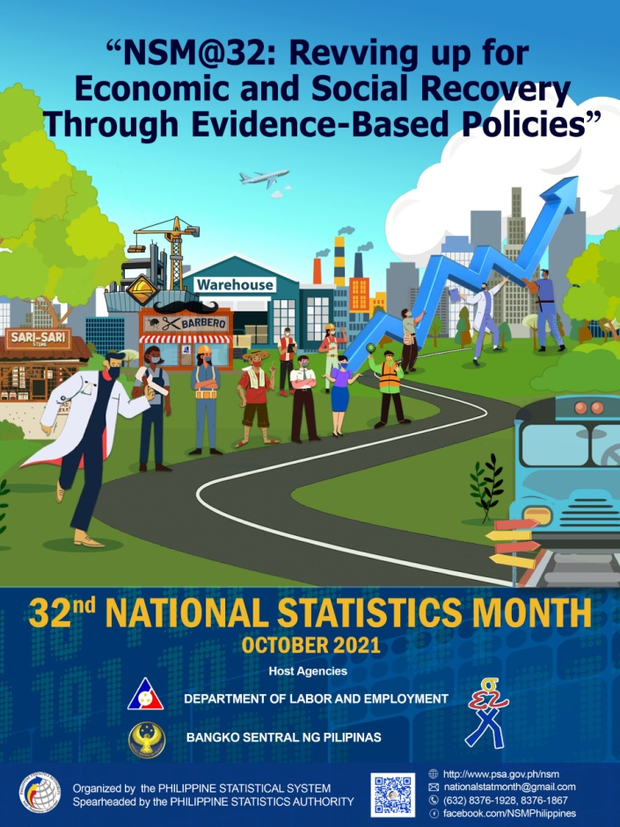
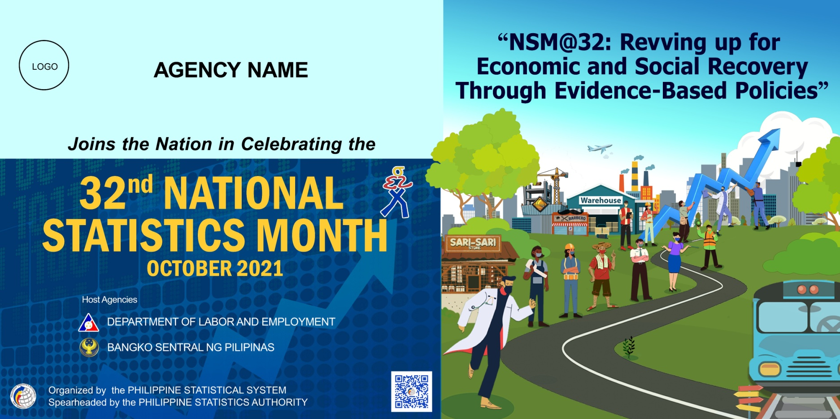
Republic of the Philippines
Philippine Statistics Authority
32nd National Statistics Month
Poster and Streamer Layout
Updates from the Standards Service

Slide 5
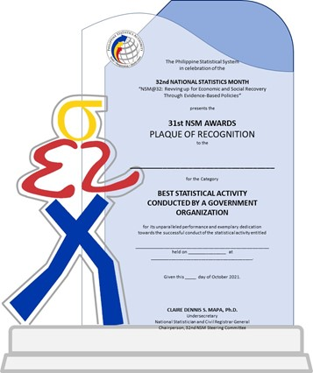
Republic of the Philippines
Philippine Statistics Authority
32nd National Statistics Month
Important Dates
Submission of calendar of activities | 30 August 2021
Submission of entries for the 31st NSM Awards | 31 August 2021
Memorandum Circular and other advocacy materials will be disseminated upon clearance.
Winners of the 31st NSM Awards will be announced during the 32nd NSM Closing Ceremony on 29 October 2021.
Budget requirements for the conduct of interagency activities at the regional level shall be chargeable against RSSO funds.
Updates from the Standards Service

Slide 6





Republic of the Philippines
Philippine Statistics Authority
Thank you!
http://www.psa.gov.ph
http://openstat.psa.gov.ph
https://twitter.com/PSAgovph
https://www.facebook.com/PhilippineStatisticsAuthority
Updates from the Standards Service

