Slide 1
Updates on the
Provincial Product Accounts (PPA)
Regional Statistics Committee 2021 3rd Quarter Meeting
13 August 2021 | 1:30 PM

Slide 2
Outline
Introduction
Updates on Data Collection
Activities of PPA in 2021

Slide 3
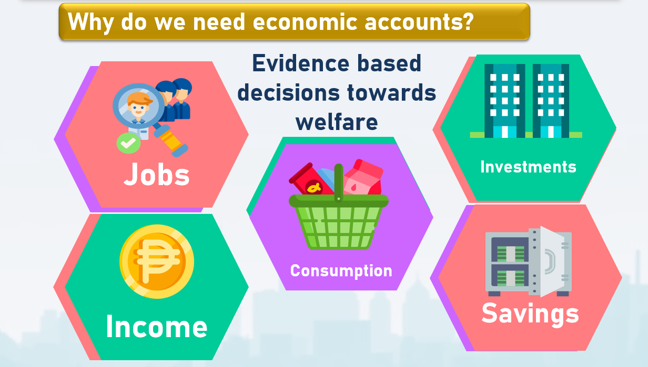

Slide 4
What is PPA and why is it important?
aim to presents a comprehensive picture of the provincial economies by providing a more appropriate measure and assessment of a province’s economic performance;
will serve as an important tool in economic planning and policy formulation at the sub regional levels to supplement the GDP at the national and regional levels;
viewed as a means to strengthen the planning and decision-making of provincial policymakers and other stakeholders;
monitor the economic development at the local level and assess the progress through time, e.g PDPs, SDGs
9

Slide 5
Status of Data Collection of the
List of Establishments by Industry

Slide 6
Updates on Data Collection
List of Top 25 Establishments by Industry
Province | No. of LGUs | No. of LGUs with submission | % submitted
Marinduque | 6 | 6 | 100%
Occidental Mindoro | 11 | 11 | 100%
Oriental Mindoro | 15 | 15 | 100%
Palawan | 24 | 24 | 100%
Romblon | 17 | 17 | 100%
Total | 73 | 73 | 100%

Slide 7
Updates on Data Collection
List of All Establishments by Industry
Province | No. of LGUs | No. of LGUs with submission | % submitted
Marinduque | 6 | 6 | 100%
Occidental Mindoro | 11 | 11 | 100%
Oriental Mindoro | 15 | 15 | 100%
Palawan | 24 | 24 | 100%
Romblon | 17 | 17 | 100%
Total | 73 | 72 | 99%

Slide 8
Updates on Data Collection
List of Businesses Classified as Informal Sector
Province | No. of LGUs | No. of LGUs with submission | % submitted
Marinduque | 6 | 6 | 100%
Occidental Mindoro | 11 | 9 | 82%
Oriental Mindoro | 15 | 14 | 93%
Palawan | 24 | 24 | 100%
Romblon | 17 | 16 | 94%
Total | 73 | 69 | 95%

Slide 9
Updates on the Data Collection of Hard Indicators

Slide 10
Updates on the Data Collection of Hard Indicators

Slide 11
Updates on the Data Collection of Hard Indicators

Slide 12
Activities of PPA for 2021

Slide 13
Activities Conducted
Activity | Timetable |  | Results/Outcome
 | Start | End
Briefing/Workshop with Stakeholders Towards the Compilation of PPA in MIMAROPA Region | 18 Mar 2021 | 19 Mar 2021 | Gathering of data users, data producers, and other stakeholders Understanding the provincial accounting Preliminary data inventory and assessment

Slide 14
Activities Conducted
Activity | Timetable |  | Results/Outcome
 | Start | End
Briefing on the Data Requirements for the Generation of PPA Oriental Mindoro (April 5) Oriental Mindoro (April 6) Romblon (May 5) | 05 Apr 2021 | 05 May 2021 | Capacitated the LGUs with the standard classification systems being used by the Philippine Statistics Authority to guide them in the preparation of the list of establishments by industry

Slide 15
Activities Conducted
Activity | Timetable |  | Results/Outcome
 | Start | End
Workshop/Training for PSA RSSO and PSO Staff (From Data to Accounts) | 26 May 2021 | 28 May 2021 | Discussed topics on: Basic concepts of national accounting Data needs by industry Translating data to accounts Filling data gaps How to analyze national accounts
 |  |  | Training of technical staff of PSA Regional and Provincial Offices

Slide 16
Activities Conducted
Activity | Timetable |  | Results/Outcome
 | Start | End
Technical Visit to Key Establishments and Industries in Oriental Mindoro | 29 Jun 2021 | 30 Jun 2021 | Further validate the regional economic performance as well as to enhance the PSNA through better understanding of the data mechanisms in the regions; Advocate the relevance of the economic accounts to the data producers; Gather support from the establishments and industries for the provision of data to the PSA.

Slide 17
Activities Conducted
Activity | Timetable |  | Results/Outcome
 | Start | End
Orientation on the Data Requirements for the Compilation of PPA to the Data Providers of Marinduque | 09 Jul 2021 | 09 Jul 2021 | Oriented the data providers on the data requirements for the compilation of PPA

Slide 18
Activities to be Conducted
Activity | Timetable |  | Expectations
 | Start | End
Provincial Consultation Workshop with Stakeholders in Agriculture and Fishery Sector as Input in the Compilation of PPA | 17 Aug 2021 | 17 Aug 2021 | To provide an overview on the generation of Value of Production in Agriculture and Fisheries both at the national and regional levels To solicit inputs on the identification of commodities to be highlighted for each province; and To identify the issues and concerns related to agricultural statistics and provide recommendations on how to address them.

Slide 19
Activities to be Conducted
Activity | Timetable |  | Expectations
 | Start | End
Capacity Building on the 2019 Updates to the 2009 PSIC for LGUs of MIMAROPA | 23 Aug 2021 | 24 Aug 2021 | To train and capacitate the BPLOs, City/Municipal Treasurers, and Planning Development Officers in the province in using the 2019 Updates to the 2009 PSIC; To harmonize the local business classification within the city/province; and To present the 2019 Updates to the 2009 PSIC, and to ensure that the province business data requirements are met.

Slide 20
Activities to be Conducted
Activity | Timetable |  | Expectations
 | Start | End
Data to Accounts Workshop/Training for Non-benchmark Estimates | 01 Sep 2021 | 03 Sep 2021 | Awareness of the PPA compilers on the data requirements and methodologies between benchmark and non-benchmark estimation of PPA Generate initial non benchmark estimate for validation and reconciliation

Slide 21
Activities to be Conducted
Activity | Timetable |  | Expectations
 | Start | End
Consultation Workshop with the Stakeholders, Validation and Technical Visits at the Pilot Regions and Provinces | 14 Sep 2021 | 16 Sep 2021 | Inform province-level stakeholders of their economic structure and as reference on the behaviour of their economy based on the series data that will be released in the future Gather inputs/feedback from the planners/ policy makers on the overall economic structure as reference in improvement of generating their PPA estimates Strengthen collaboration with local level partners Improve data requirements for completeness in recording of industry GVA

Slide 22
Activities to be Conducted
Activity | Timetable |  | Expectations
 | Start | End
Non-benchmarking estimation workshop | 01 Sep 2021 | 31 Oct 2021 | Finalize PPA estimates for years 2019 and 2021

Slide 23
Activities to be Conducted
Activity | Timetable |  | Expectations
 | Start | End
Writeshop for PPA Report and IEC Preparation | 15 Nov 2021 | 19 Nov 2021 | Crafting of the PPA report template Formulation of IEC materials (Primer, Brochure, Social Card, Infographics, Videographics, Audio-video presentation) Organize the content of PPA webpages

Slide 24
Activities to be Conducted
Activity | Timetable |  | Expectations
 | Start | End
Dissemination Forum | MIMAROPA: Oriental Mindoro Occidental Mindoro Palawan and Puerto Princesa City Marinduque Romblon | 06 Dec 07 Dec 08 Dec 09 Dec 10 Dec | Report to the stakeholders the economic performance of the province for the years 2018 to 2020

Slide 25





Thank you!
http://www.psa.gov.ph
http://openstat.psa.gov.ph
https://twitter.com/PSAgovph
https://www.facebook.com/PhilippineStatisticsAuthority

