Slide 1
Surveys Cleared Under the SSRCS
May 1 – July 6, 2021
13 August 2021
RCCB and RSC Joint Meeting
Virtual Meeting

Slide 2
Updates on SSRCS
Figure 1. Number surveys granted clearance: May 1 – July 6, 2021
14
surveys granted clearance
4 surveys
1 surveys

Slide 3
Surveys granted clearance
Table 1. Number of surveys granted clearance, by proponent agency: May 1 – July 6, 2021
Proponent agency | Number of surveys granted clearance | Title of survey
PSA | 8 | Quarterly Aquaculture Survey Quarterly Commercial Fisheries Survey Quarterly Inland Fisheries Survey Quarterly Municipal Fisheries Survey Labor Force Survey Commercial Livestock and Poultry Survey Backyard Livestock and Poultry Survey 2021 Family Income and Expenditure Survey

Slide 4
Surveys granted clearance
Table 1. Number of surveys granted clearance, by proponent agency: May 1 – July 6, 2021
Proponent agency | Number of surveys granted clearance | Title of survey
ADB | 1 | 2021 Survey on Retail Prices of Household Goods and Services for the International Comparison Program
PCC | 1 | 2021 National Survey on the Awareness of Private Firms on the Philippine Competition Act and the Philippine Competition Commission
DOST | 1 | 2019-2021 Survey on Research and Development Expenditures and Human Resources

Slide 5
Surveys granted clearance
Table 1. Number of surveys granted clearance, by proponent agency: May 1 – July 6, 2021
Proponent agency | Number of surveys granted clearance | Title of survey
BSP | 1 | 2021 Corporate Financial Trends Survey
NEDA | 1 | Ex-Post Evaluation of the Angat Water Utilization and Aqueduct Improvement Project Phase II
PIDS | 1 | PIDS - Monash University Online Survey of Small and Medium-sized Enterprises in the Philippines

Slide 6

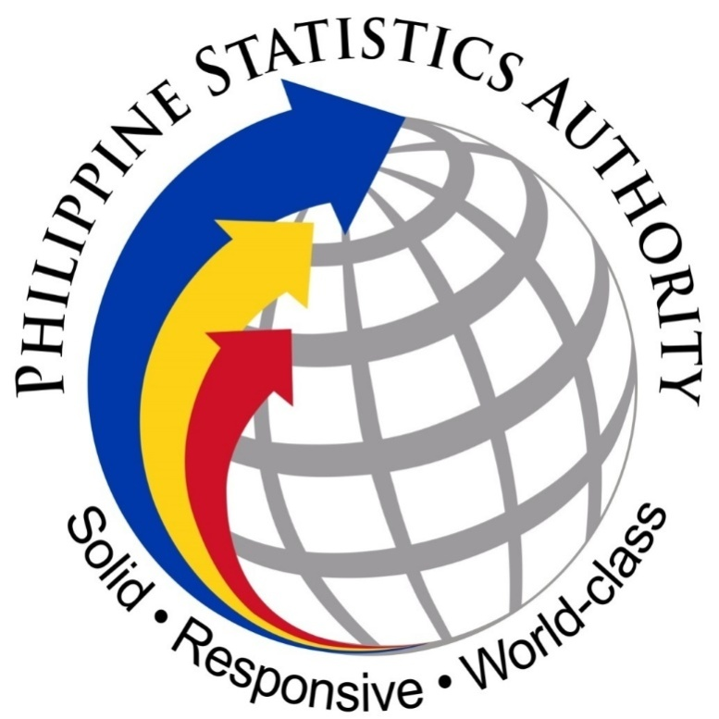


Thank You!
http://www.psa.gov.ph/ssrcs
/PhilippineStatisticsAuthority
@PSAgovph

