Slide 1
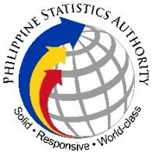

Republic of the Philippines
Philippine Statistics Authority
Updates from the
Standards Service
Leni R. Rioflorido
Regional Director
RCCB/RSC Third Quarter Joint Meeting
August 13, 2021
Updates from the Standards Service

Slide 2
Republic of the Philippines
Philippine Statistics Authority
Outline of the Presentation
Philippine Standard Geographic Code Revision 1
Inclusion of the Philippine Standard Industrial Classification in the Unified Business Permit Form
6th RSC Summit
Updates from the Standards Service

Slide 3
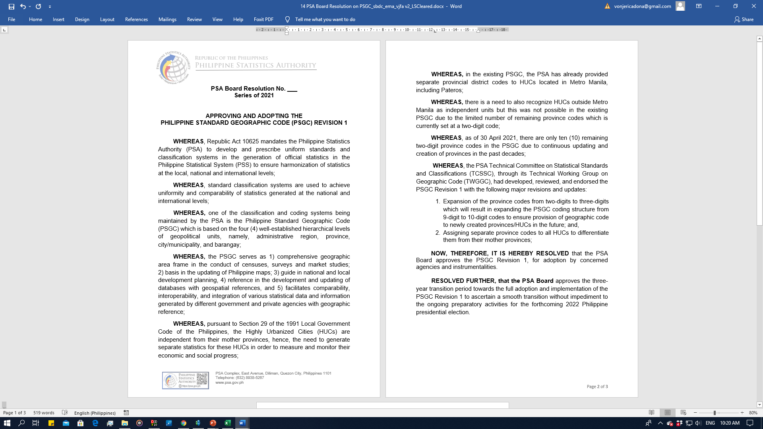


Republic of the Philippines
Philippine Statistics Authority
I. Philippine Standard Geographic Code Revision 1
Philippine Standard Geographic Code (PSGC) Revision 1
Salient Features
First revision of the PSGC since its creation in 1976
Expanded the existing provincial code from two digits to three digits
All Highly Urbanized Cities (HUCs) will now have its own unique 3-digit Province Code
Existing 2-digit NCR provincial codes to be discontinued
New coding structure from 9-digit code to 10-digit code
Three-year transition period
Approved by the PSA Board on 11 May 2021
PSA Board Resolution No. __ series of 2021 - "Approving and Adopting the PSGC Revision 1“
Development of Standard Classification Systems

Slide 4
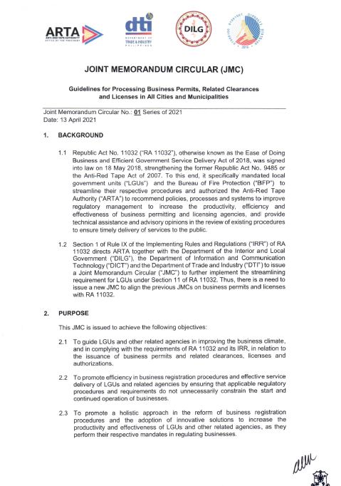
Republic of the Philippines
Philippine Statistics Authority
II. Inclusion of PSIC in the Unified Business Permit Form
Joint Memorandum Circular (JMC) No. 01 S. 2021
Guidelines for Processing Business Permits, Related Clearances and Licenses in the New Normal in all Cities and Municipalities dated
Issued on 13 April 2021
In accordance with the provisions of Republic Act 11032 or the Ease of Doing Business and Efficient Government Service Delivery Act of 2018
Cities and municipalities are directed to transition to an electronic business one stop shop (eBOSS)
Updates from the Standards Service

Slide 5
Republic of the Philippines
Philippine Statistics Authority
II. Inclusion of PSIC in the Unified Business Permit Form
Electronic Business One Stop Shop (eBOSS)
Online portal/website with the following functionalities and specifications:
Accepts online or electronic submission of application
Issues electronically the tax bill/order of payment
Accepts online payments
Issues electronic versions of permits, licenses and clearances
Provides gateway facility linked to courier service for applicants who prefer to receive hard copy of permits
Updates from the Standards Service
5

Slide 6
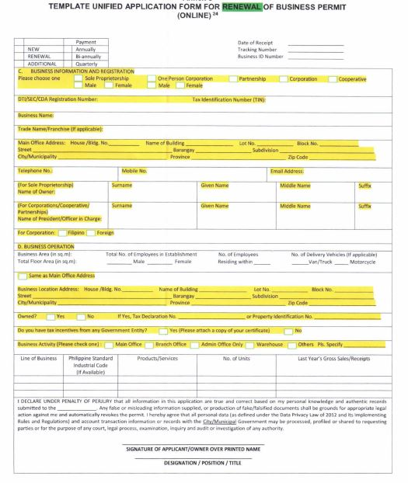
Republic of the Philippines
Philippine Statistics Authority
II. Inclusion of PSIC in the Unified Business Permit Form
PSIC in the Unified Business Permit Form
Updates from the Standards Service
6

Slide 7
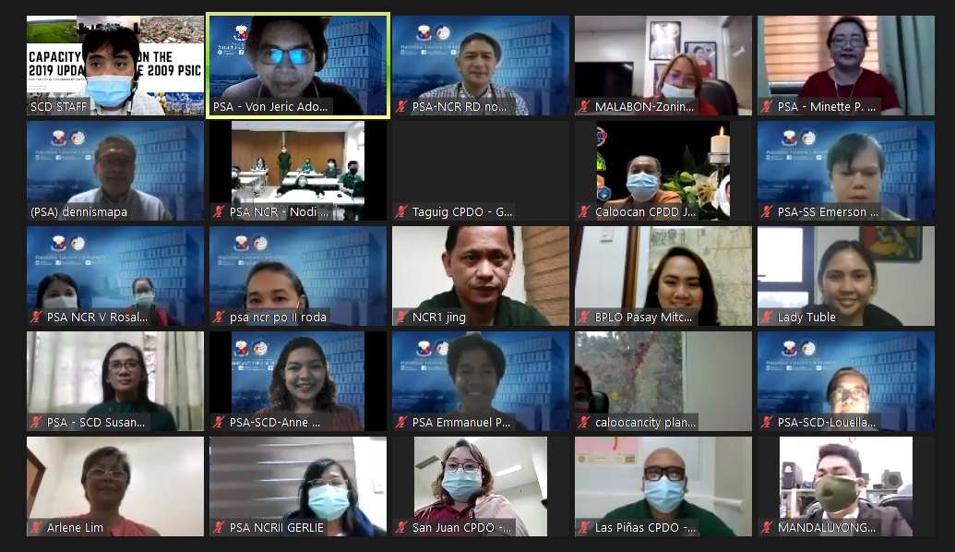
Republic of the Philippines
Philippine Statistics Authority
II. Inclusion of PSIC in the Unified Business Permit Form
Online Capacity Building on the 2019 Updates to the 2009 PSIC for Local Government Units
Region | No. of Participants
For Local Government Units in the National Capital Region (02-03 June 2021) | 49 | Total
 | 16 | PSA RSSO/PSO
 | 33 | LGUs
For Local Government Units in Region X – Northern Mindanao (10-11 June 2021) | 333 | Total
 | 5 | PSA CO
 | 29 | PSA RSSO/PSO
 | 297 | LGUs
 | 2 | Line Agencies
Updates from the Standards Service

Slide 8
Republic of the Philippines
Philippine Statistics Authority
II. Inclusion of PSIC in the Unified Business Permit Form
Online Capacity Building on the 2019 Updates to the 2009 PSIC for Local Government Units
Region | No. of Participants
For Local Government Units in Region VII – Central Visayas (14-15 July 2021) | 350 Approx.
Updates from the Standards Service

Slide 9
Republic of the Philippines
Philippine Statistics Authority
II. Unified Business Permit
LGU Capacity Building on Statistical Standard Classification Systems
Online Training on the 2019 Updates to the 2009 PSIC
Participants from Region VII were asked to answer this question before and after the training:
“ What is your level of knowledge on the Philippine Standard Industrial Classification (PSIC)?”
Results
Level of knowledge | Before the Training | After the Training
Very high | 1% | 5%
High | 7% | 30%
Medium | 31% | 60%
Low | 48% | 5%
Very low | 12% | 0%
Capacity Building on Statistical Standards and Classification Systems

Slide 10
Republic of the Philippines
Philippine Statistics Authority
II. Inclusion of PSIC in the Unified Business Permit Form
Online Capacity Building on the 2019 Updates to the 2009 PSIC for Local Government Units
Pre-Training and Post-Training Assessment of Participants in Region VII on their level of knowledge on the PSIC
Updates from the Standards Service

Slide 11

Republic of the Philippines
Philippine Statistics Authority
III. 6th Regional Statistics Committee Summit
About the RSC
The RSC is the regional counterpart of the
PSA Board which was established to:
improve statistical planning, programming, and coordination at the subnational level
ensure effective organization within the Regional Statistical System (RSS)
strengthen the local data ecosystem
Legal Bases
Republic Act No. 10625 “Philippine Statistical Act of 2013”
Section 9e. PSA Board shall prescribe appropriate frameworks for the improvement of statistical coordination and establish mechanisms for statistical coordination at the regional and LGU levels.
Executive Order No. 135
SEC. 1. A well-coordinated statistical system at the local level that is:
(1) responsive to planning and monitoring requirements at the local level; and (2) capable of producing statistics which can be integrated and harmonized with statistics being produced at the national level, shall be established.
PSA Board Resolution No. 05, s. 2015, “Establishing the Regional Statistics Committees (RSCs)” establish the RSCs to serve as the policymaking body on statistical matters; and venue for discussion and resolution of statistical issues at the local level.
Updates from the Standards Service

Slide 12

Republic of the Philippines
Philippine Statistics Authority
III. 6th Regional Statistics Committee Summit
Hybrid Event (Online and Face-to-Face)
24 September 2021 (Tentative schedule)
Back-to-back event to the PSDP 2018-2023 Update Workshop (PSS-Wide, Environment and Multi-Domain Cluster) 22-23 September 2021
Face-to-Face Participants: PSA Executive Committee, RDs, Secretariat and Support Staff
Online Participants: RSC Chairs, PSA Board Members, PSA ManCom, SOCDs and RSC Members (at least one per region)
Updates from the Standards Service

Slide 13

Republic of the Philippines
Philippine Statistics Authority
III. 6th Regional Statistics Committee Summit
Best RSC Award for 2021
Requirements:
Agenda items in meetings held from 3rd Quarter of 2020 to
2nd Quarter of 2021
RSC Resolutions approved from 3rd Quarter of 2020 to
2nd Quarter of 2021
Meeting attendance sheets (including RSC resolution providing for the membership/composition of RSC)
Deadline of submission:
15 August 2021
Other outputs/accomplishments (activities initiated and organized by the RSC, and other outputs such as RDC Resolutions adopted from RSC-endorsed policies, recognitions from reputable organizations, RDC agenda where presentation on statistical policies is included (if any)).
Best RSC Awards criteria for 2021 will be sent upon clearance.
Updates from the Standards Service

Slide 14





Republic of the Philippines
Philippine Statistics Authority
Thank you!
http://www.psa.gov.ph
http://openstat.psa.gov.ph
https://twitter.com/PSAgovph
https://www.facebook.com/PhilippineStatisticsAuthority
Updates from the Standards Service

