Slide 1
Revisiting RSC
Resolution No. 2019-03
13 August 2021
RCCB and RSC Joint Meeting
Virtual Meeting

Slide 2
Outline of the Presentation
Introduction
Composition of PSCs
PSC Secretariat
Functions and Responsibilities

Slide 3
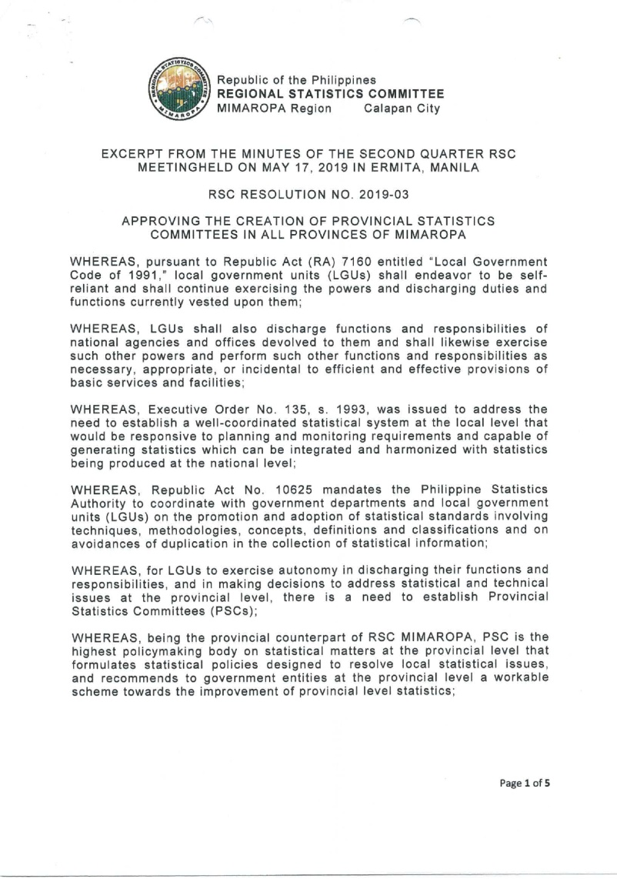
Introduction
RSC Resolution No. 2019-03 “Approving the Creation of Provincial Statistics Committees in All Provinces of MIMAROPA
  was approved on 17 May 2019

Slide 4
Composition of PSCs
Chairperson:
Provincial Planning and Development Coordinator
Provincial Planning and Development Office (PPDO)
Vice Chairperson:
Provincial Statistics Officer
PSA Provincial Statistical Office
Notes:
The PSCs is headed by Provincial Planning and Development Coordinator of the Provincial Planning and Development Office (PPDO) as the Chairperson while the Provincial Statistics Officer of PSA Provincial Statistical Office as the Vice Chairperson.

Slide 5
Composition of PSCs
Members:
Heads of Provincial Executive Offices
Provincial Agriculture Office
Provincial Agrarian Reform Office
Provincial Budget Office
Provincial Environment and Natural Resources Office
Department of the Interior and Local Government
Provincial Health Office
Division Superintendent of Schools
Philippine National Police
Provincial Engineering Office
Provincial Public Employment Services Office
Provincial Social Welfare and Development Office
Provincial Tourism Office
Provincial Cooperative and Enterprise Development Office
Representatives from:
Philippine Statistical Association, Inc.
Academe / State Universities and Colleges
Private Sector
Notes:
Members of the committee are the heads of Provincial Executive Offices with devolved functions from national agencies including but not limited to the following:
Provincial Agriculture Office (PAO)
Provincial Agrarian Reform Office (PARO)
Provincial Budget Office (PBO)
Provincial Environment and Natural Resources Office (PENRO)
Department of the Interior and Local Government (DILG)
Provincial Health Office (PHO)

Slide 6



PSC Secretariat
Head:
Supervising Statistical Specialist
PSA Provincial Statistical Office
document proceedings and prepare highlights of meetings and business arising
submit to the Regional Statistical Service Office (RSSO) copies of PSC meetings' attendance sheets and agenda along with the approved PSC resolutions and memorandum orders
submit periodic reports to the RSSO
Notes:
The Supervising Statistical Specialist for statistical operations of the PSA Provincial Statistical Office (PSO) shall serve as the Head of the PSC Secretariat. The PSC Secretariat shall:
document proceedings and prepare highlights of meetings and business arising;
submit to the Regional Statistical Services Office (RSSO) copies of PSC meetings' attendance sheets and agenda along with the approved PSC resolutions and memorandum orders; and,
submit periodic reports to the RSSO.

Slide 7
Functions and Responsibilities
  oversee the implementation of policy decisions made by the PSC, RSC and the PSA Board, and the adoption of prescribed statistical standards and classification systems in the provinces
  formulate statistical policies to resolve statistical issues in the provincial level
  recommend workable schemes towards the improvement of provincial level statistics
Notes:
The PSC shall have the following functions and responsibilities:
oversee the implementation of policy decisions made by the PSC, RSC and the PSA Board, and the adoption of prescribed statistical standards and classification systems in the provinces;
formulate statistical policies designed to resolve provincial statistical issues and recommend workable schemes towards the improvement of provincial level statistics;

Slide 8
Functions and Responsibilities
  institute measures to strengthen the statistical capacity of
  the provincial statistical system including institutions and
  the personnel thereof
  elevate to the RSC, through proper channels, statistical matters which cannot be resolved at the provincial level
Notes:
3. institute measures to strengthen the statistical capacity of the provincial statistical system including institutions and the personnel thereof; and
4. elevate to the RSC, through proper channels, statistical matters which cannot be resolved at the provincial level.

Slide 9

PSC Meetings
PSC meetings shall be convened a month prior to the RSC's quarterly meetings.
This will ensure that unsettled PSC issues that need to be elevated to the RSC are addressed swiftly, whenever necessary.
Notes:
PSA Board Resolution No. 01, s. 2018, specifies that the RSCs shall meet quarterly or more than once a quarter as the need arises at such date, time, and place it may decide. Hence, PSC meetings shall be convened a month prior to the RSC's quarterly meetings. This will ensure that unsettled PSC issues that need to be elevated to the RSC are addressed swiftly, whenever necessary.
Additional details on the meeting process are specified in the Rules of Procedure for PSC meetings (Annex 195501-017-02).

Slide 10
Maraming Salamat Po!
Notes:
For more details or inquiries, you may visit us at our website, https://psa.gov.ph or send us an e-mail through psamimaropa@yahoo.com / statisticsr4b@yahoo.com.

