Slide 1


TULONG TRABAHO SCHOLARSHIP PROGRAM
Retooling and Upskilling of Workers under the New Normal

Slide 2

R.A. 11230
or the
Tulong Trabaho Act
The Tulong Trabaho Act aims to:
Strengthen the qualifications of the Filipino workforce
Address unemployment and job-skill mismatch
Facilitate access to quality TVET
Encourage participation of industry and communities in competencies formation
with the New Normal:
Provide assistance to displaced workers and support distressed Industry Groups and enterprises
Notes:
RA No. 11230, signed into law in Feb 2019, is an act instituting a Philippine Labor Force Competencies Competitiveness Program and Free Access to TVET, and appropriating funds therefor. The Tulong Trabaho Act aims to:
a) Strengthen the qualifications of the Filipino workforce to meet the challenges of the rapidly evolving workplaces and work structures;
b) Provide for more innovative approaches to TVET linked to the requirement of industry to primarily address unemployment and job-skill mismatch;
c) Facilitate access to quality TVET; and
d) Encourage the participation of industry and communities in competencies formation and upgrading towards a more competitive workforce.

Slide 3

Qualified Recipients
Walk-in/Online
Individual Applicants
TESDA-recognized
Industry Groups/Enterprises

Slide 4

Walk-in/Online Individual Applicants
NEET individuals
at least fifteen (15) years of age
Employed workers
(except those who are currently trained by their employers)

Slide 5
TESDA-recognized Industry Groups/ MSMEs
Industry groups recognized under the Recognition of Industry Bodies (RIBs) Program
Industry groups with existing partnership or collaboration with TESDA through an MOU/MOA or any engagement at the national/local levels
Other industry groups subject for the approval of the TESDA Director General

Slide 6

Scholarship Coverage
Training fees
Assessment and Certification Fees (Issuance of NCs)
1-year Accident Insurance Coverage
Training Support Fund (P160/day)
Allowance for H/PPE and Internet (P1000/scholar/training)

Slide 7
Training delivery schemes
STPs may be delivered thru Institution-based Training, Enterprise-Based Training, Community-based-Training, and thru any flexible learning delivery mode.
The trainings may be be delivered by:
Qualified Training Institutions
  TTIs/TVIs
  SUCs, LUCs, private HEIs, etc.
Conducted entirely by a company/MSME, and industry group

Slide 8

Program Recognition for Enterprises
Requirements:
Letter of Intent/Application
Business Registration
Competency-Based Curriculum/Training Plan
List and Profile of Trainers/Supervisors
Notarized Affidavit of Undertaking
Notes:
As a matter of policy, all programs to be covered by the Tulong-Trabaho Fund will have to be registered under UTPRAS.

Slide 9
Scholarship requirements
The following prescribed templates for the documentary requirements necessary for the implementation of the scholarship program have been developed and will be included in the updates to the Tulong Trabaho guidelines:
List of Qualified Recipients (Annex C)
Qualification Map (Annex D)
Project Proposal (Annex E)
Notice to Proceed (Annex F)

Slide 10
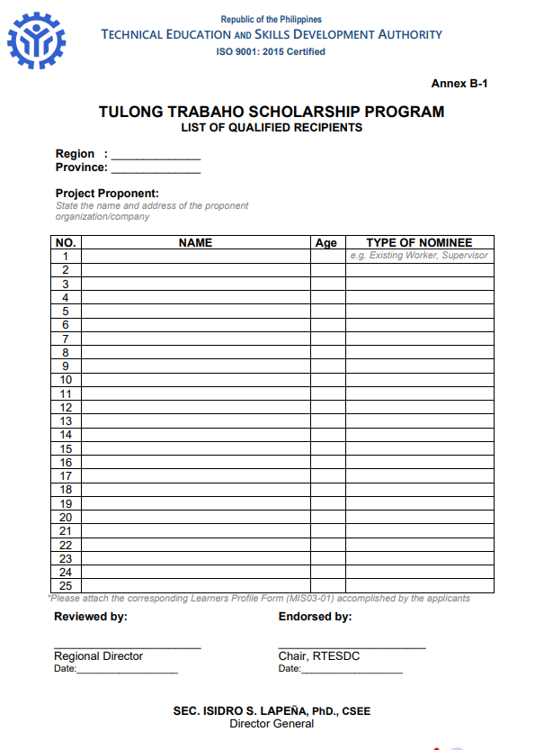
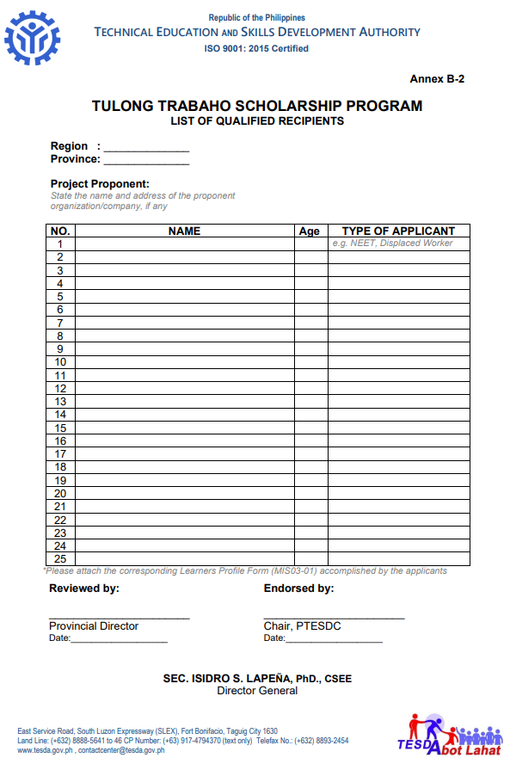
Notes:
B-1 Nominees of Industry Groups/Companies
B-2 Individual Applicants

Slide 11
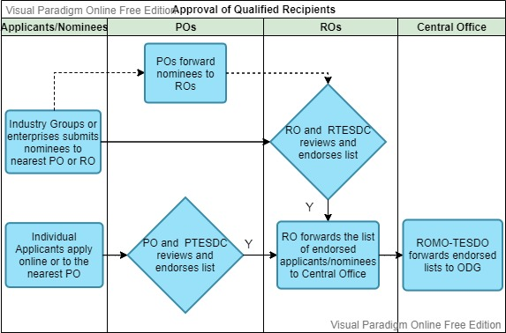
Approval of Qualified Recipients

Slide 12
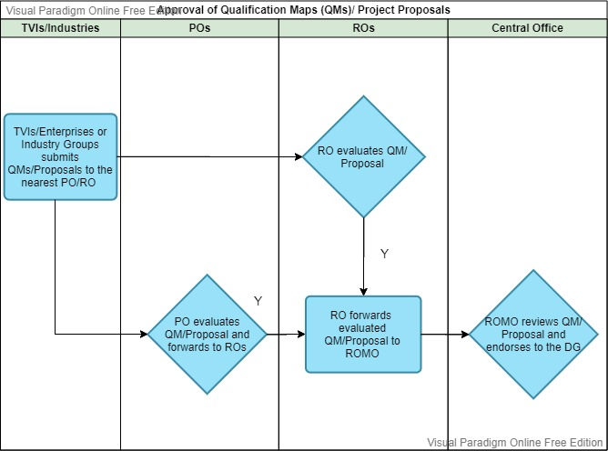
Approval of QMs/Project Proposals

Slide 13
Way forward
Identification of target Companies/MSMEs for prioritization
Mobilization of P/RTESD Committees
Timeline in Preparation and Submission of QMs/Project Proposals

Slide 14
2021 Tulong Trabaho Scholarship Program
As of September 2021
Province | Slots | Amount in QM | Beneficiaries | Status
Marinduque | 50 | 776,240.00 | NEET | Submitted to CO – 8/19/2021
Occidental Mindoro | 25 | 533,720.00 | NEET | Submitted to SMD – 9/7/2021
Oriental Mindoro | 50 | 807,890.00 | NEET | Submitted to SMD – 9/6/2021
Oriental Mindoro | 405 | 9,489,158.00 | NEET | Submitted to SMD – 9/7/2021
Palawan | 300 | 7,395,180.00 | NEET | Submitted to SMD – 9/7/2021
MIMAROPA | 830 | 19,002,188.00

Slide 15
Thank you!

Slide 16
2021 Tulong Trabaho Scholarship Program
As of September 2021
Allocation | 19,593,000.00
Less: Admin. Cost | 587,790.00
Amount for QM | 19,005,210.00
QMs submitted | 19,002,188.00
Balance | 3,022.00

