Slide 1
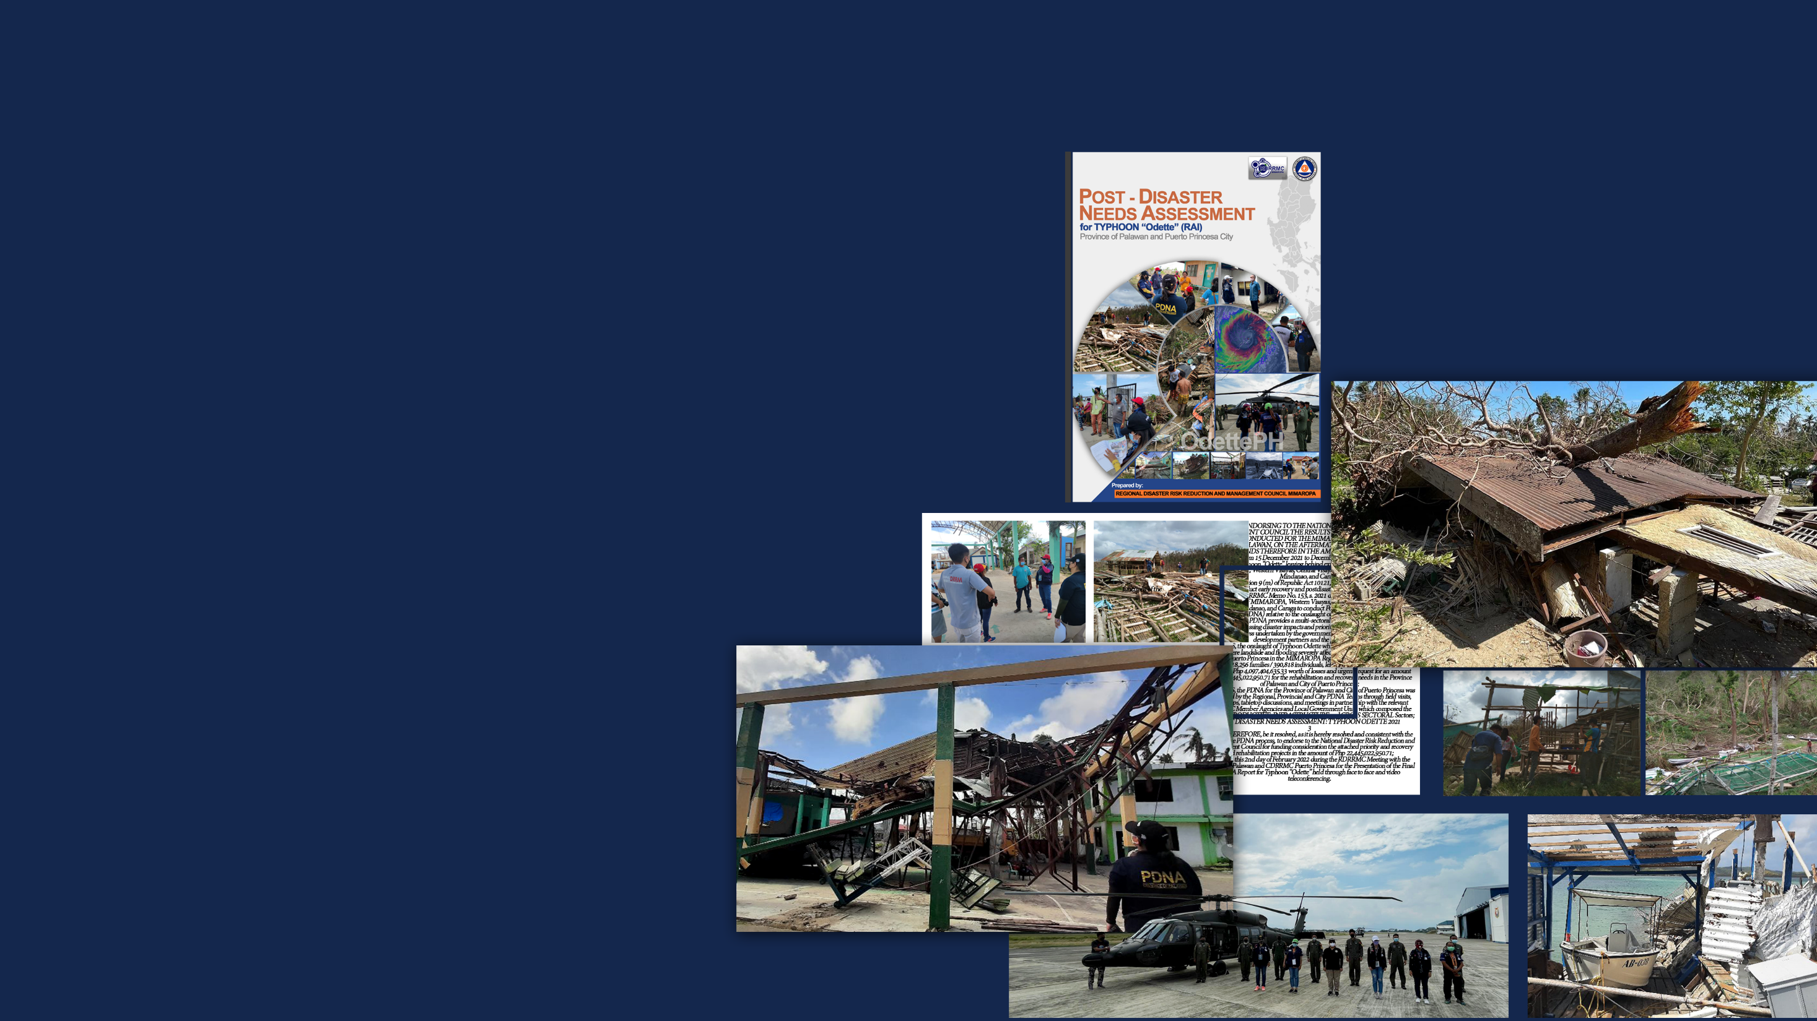



Post Disaster Needs Assessment (PDNA)
Re Typhoon “Odette” (RAI)
16 February 2022

Slide 2
INFRASTRUCTURE SECTOR

Slide 3
INFRASTRUCTURE CLUSTER
Overview
The province of Palawan and Puerto Princesa City was severely devastated by Typhoon Odette. Transportation, communication, irrigation, power, and water supply system was greatly affected during the onslaught of the said typhoon.
There are road closures along our national roads and secondary road networks during the occurrence of the typhoon. This is due to bridge collapses, soil collapses, and debris flows along with these road networks. Ports, wharves, and fish landings were damaged and destroyed. Days of communication and power shutdown were also experienced. Damaged and destroyed irrigation and water supply system leaving citizens of Palawan and Puerto Princesa City days of a temporary water supply outage.
But with the combined effort of the Local Government Units of Palawan & Puerto Princesa City, Palawan 1st & Palawan 3rd DPWH District Engineering Offices, National Telecommunication Commission, National Irrigation Administration, City/Local Water District, and Local Electric Cooperative, government infrastructure was restored and fully functional immediately
Impact
Typhoon Odette that hit Palawan Province resulted in infrastructure damage cost accumulated to Php 399,487,616.66. An amount Php 99,669,511.46 was computed as losses due to temporary repairs and conducted clearing operations and losses in incomes. While the total estimated amount for rehabilitation adopting the build-back-better principle to reconstruct and restore the damaged structures and facilities sums up to Php 1,160,104,101.96.

Slide 4
INFRASTRUCTURE CLUSTER
Sector | Damages | Losses | Needs
Transportation
Roads | 81,098,625.00 | 6,792,503.08 | 302,782,549.20
Bridges | 159,980,000.00 | 3,847,000.00 | 572,198,791.13
Flood Control | 20,764,500.00 | 25,500.00 | 43,792,700.00
Irrigation Facilities | 28,225,682.76 | 120,000.00 | 35,161,738.79
Ports (Airports/ Seaport) | 16,755,175.00 | 170,000.00 | 38,852,062.05
Power | 57,266,405.90 | 39,764,228.35 | 115,642,994.87
Water | 35,397,228.00 | 48,955,280.03 | 51,673,265.92
Telecommunications | - | - | -

Slide 5
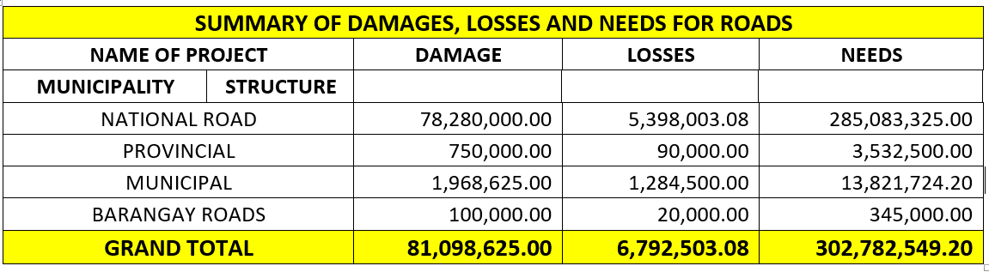
INFRASTRUCTURE CLUSTER

Slide 6
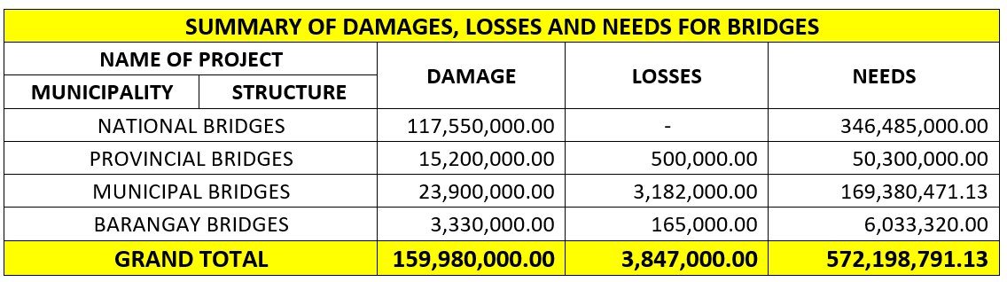
INFRASTRUCTURE CLUSTER

Slide 7
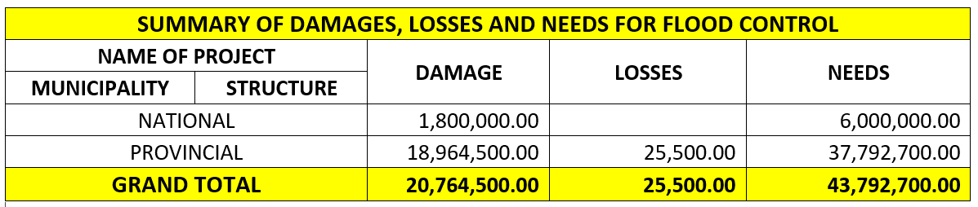
INFRASTRUCTURE CLUSTER

Slide 8
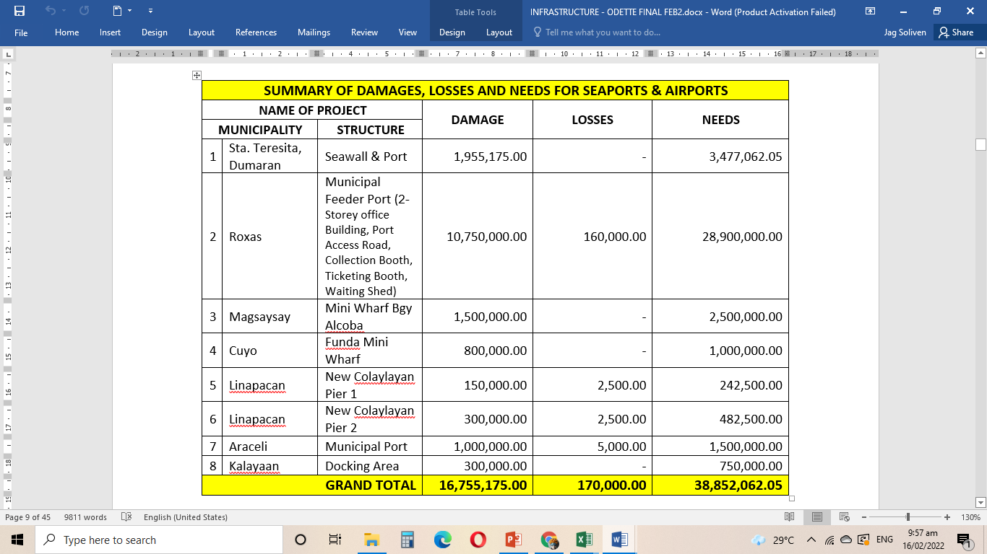
INFRASTRUCTURE CLUSTER

Slide 9
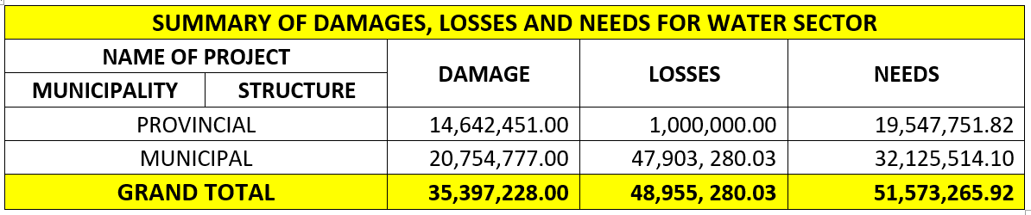
INFRASTRUCTURE CLUSTER

Slide 10
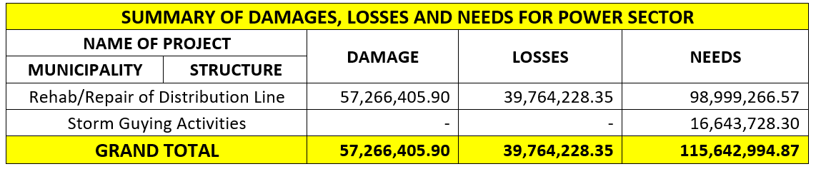
INFRASTRUCTURE CLUSTER

Slide 11
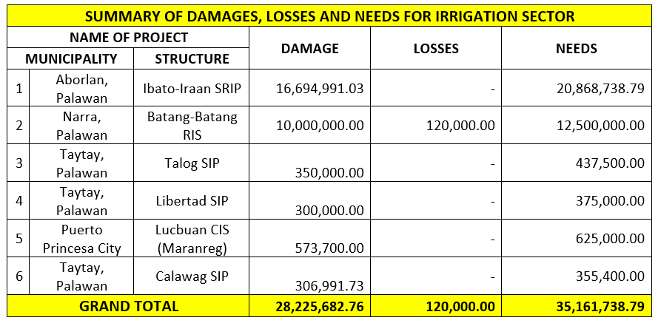
INFRASTRUCTURE CLUSTER

Slide 12
Total Investment Requirement by Source of Fund
INFRASTRUCTURE CLUSTER
Source of Fund | Number of Projects | Investment Requirement (in PHP) | Needs
Governance & DRRM |  | Short-Term | Medium-Term | Total
NDRRM Fund | 85 | 41,580,333.29 | 281,205,715.33 | 322,287,048.62
Regular Agency Budget | 66 | 701,170,387.05 | 115,642,994.87 | 816,813,381.92
LGU | 4 | 956,919.60 | 0 | 956,919.60
Non-Government (i.e. Private Sector/ Development Partners) | 6 | 19,547,751.82 | 0 | 19,547,751.82
Total | 161 | 763,255,391.76 | 396,848,710.20 | 1,160,104,101.96

Slide 13
Total Investment Requirement by Sector/ Subsector
INFRASTRUCTURE CLUSTER
Source of Fund | Number of Projects | Investment Requirement (in PHP) | Needs
Governance & DRRM |  | Short-Term | Medium-Term | Total
Transportation | 110 | 711,582,125.84 | 281,205,715.33 | 992,787,841.17
Power | 14 | 0 | 115,642,994.87 | 115,642,994.87
Water | 37 | 51,673,265.92 | 0 | 51,673,265.92
Telecommunications | - | - | - | -
Total | 161 | 763,255,391.76 | 396,848,710.20 | 1,160,104,101.96

Slide 14


End of Presentation
Thank you

Slide 15
Thank you!

