Slide 1
Pdna coordination meeting
Review of pdna

Slide 2
PARTS OF PDNA REPORT
Acknowledgement
Executive summary
SUMMARY OF DAMAGES, LOSSES AND NEEDS

Slide 3
SUMMARY OF DAMAGES, LOSSES, AND NEEDS
SECTOR | DAMAGE (PHP) | LOSS (PHP) | NEEDS (PHP)
SOCIAL
HOUSING- NHA/DHSUD
HEALTH –DOH
EDUCATION-DEPED/TESDA/CHED
Sub-total
PRODUCTIVE
AGRICULTURE-DA/BAI HVCC RICE ANIMALS
FISHERIES-BFAR
TOURISM-DOT
Industry trade & Services -DTI
Irrigation Facilities-NIA MINING - DENR
Sub-total

Slide 4
INFRASTRUCTURE
ROADS –DPWH
BRIDGES-DPWH
TELCO-DICT
SEAPORT-MARINA/PPA
AIRPORT-CAAP
FLOOD CONTROL-DPWH
WATER-LWUA/WATER COOP
POWER-DOE
Sub-total
CROSS SECTORAL
GOVERNMENT AND DRRM HRNA-DILG/DSWD
ENVIRONMENTAL ASSESSMENT-DENR
MACRO-ECONOMIC ANALYSIS-NEDA
Sub-total=
GRAND TOTAL =

Slide 5
WRITE –UP PER SUB SECTOR
Describe the sectors assessment based on your gathered reports on the ground
SAMPLE:
housing- the assessment is focused on the totally and partially damaged houses based on the reports from p/c/mswdo and p/c/mdrrmos in the affected city and municipalities of the 1st district of the province. for the 3,702 total damaged houses the estimated total amount of damages is php 117,535,000.00 and the 12,906 partially damaged houses with estimated damages amounting to php 169,659,000.00. the losses incurred in housing sector is about php104,121,000.00 covering the initial distribution of construction materials purchased by the community. the reconstruction and recovery needs amounting to p281,564,000.00

Slide 6
Table of contents
ACRONYMS AND ABBREVIATION
INTRODUCTION
Part1- hazard and vulnerability assessment
Hazard assessment of the region/province
ALL ABOUT THE TYPHOON –How the TY started from lpa into a TY, up to landfall and devastation(Pls. include the track of TY)
VULNERABILITY AND EXPOSURE
Part II – DAMAGES, LOSSES AND NEEDS ASSESSMENT
Definitions of DAMAGES, LOSSES, AND NEEDS
METHODOLOGY

Slide 7
Regional pdna team sectors and sub-sectors
SECTOR | SUBSECTORS | LEAD
Social sector |  | DSWD
HOUSING |  | DSWD/NHA/DHSUD
HEALTH |  | DOH, PHO, MHO
EDUCATION |  | DepEd, CHED, TESDA

Slide 8
SUMMARY OF DAMAGES, LOSSES AND NEEDS FOR THE SOCIAL SECTOR
SECTORS/SUB- SECTORS | DAMAGES | LOSSES | NEEDS
Social sector
HEALTH
EDUCATION
HOUSING

Slide 9
Social sector
Housing sector
PREPARE WRITE UPS OF THE FOLLOWING:
Overview- Describe the housing sector in the area (made of wood, concrete, 2 story,light materials) how the houses were destroyed) by strong winds? or storm surge?
Impact – After those houses were destroyed what is the impact to the community(stay in the evacuation center for 1 week or months)
Damages, losses and needs
Describe how pdna covers the affected area INDICATE THE NO. OF TOTALLY DAMAGED HOUSES INCLUDING OVERALL AMOUNT AND PARTIALLY DAMAGED HOUSES WITH OVERALL AMOUNT
Table I – DAMAGES, LOSSES AND NEEDS
Province City/ Municipality | Partially Damaged |  | Totally damaged |  | LOSSES | NEEDS
 | Quantity | Amount | Quantity | Amount
Calapan City | 274

Slide 10
Reconstruction and recovery needs
Enumerate how are you going to implement recons and Recov needs
Sample 1. direct financial assistance for purchase of housing materials to eligible individuals and families for repair and reconstruction of damaged houses thru AND DHSUD
Conduct skills training cum production on masonry,carpentry works, electrical and plumbing to capacitate the beneficiaries in the reconstruction of their respective houses
Table on the priority ranking for reconstruction and recovery needs for housing Sector
PROGRAMS/ PROJECT | Status (C,O,PL,P) | CRITERIA |  |  | Score | Rank
 |  | IMPORTANCE RX(Weight)1 | Impact (Weight)2 | Capacity (Weight) 3
Land acquisition
Core shelter assistance
Photo Creditm.elmostrador.cl
Photo Credit: www.developpment.asia.com
PDNA

Slide 11
PRIORITY RECONSTRUCTION AND RECOVERY NEEDS FOR HOUSING SECTOR
Rank | Priority/Project Activities | Location | Amount Php |  | Proposed Funding |  | Timeline | Remarks
 |  |  | Report of Damages | Recommended Funding | Funding Source | Implementing
1 | Land Acquisition | Calapan City | 1,570,000.00 | 2,800,000.00 | NDRRMF/ PDRRMF | NHA/LGU | 2020-2022 | With available lots
POLICY AND PROGRAM RECOMMENDATION
Strict implementation of No. Build Zone eg. River bank, assessment, coastal lines, etc. to control the construction of residential houses to disaster prone
Strict implementation of the IPRA Law especially on the Ancestral Domain for the indigenous people for them to have a permanent and owned residential lot
Conduct of an inventory and assessment of public lands that may be suitable and utilized for permanent resettlement sites, whether for regular housing and resettlement projects or for post disaster housing and encourage the practice of land banking among concerned government agencies and local
PDNA

Slide 12
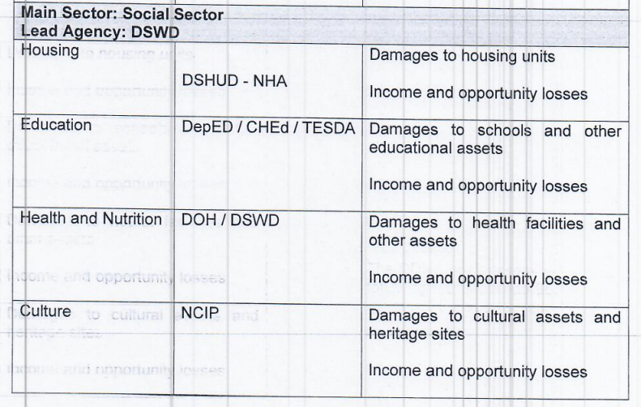
S
O
C
I
A
L

Slide 13
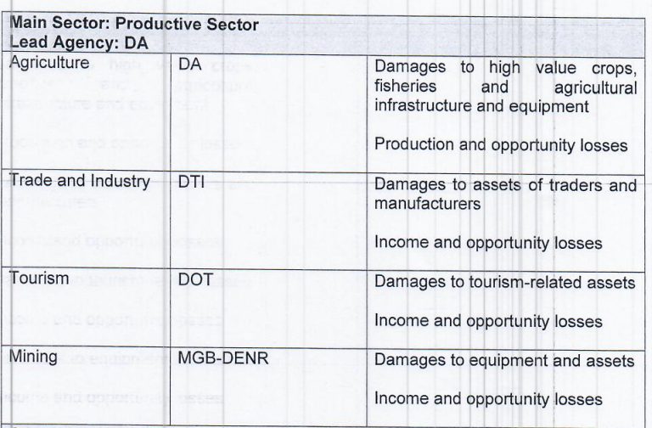
P
R
O
D
U
C
T
I
V
E

Slide 14
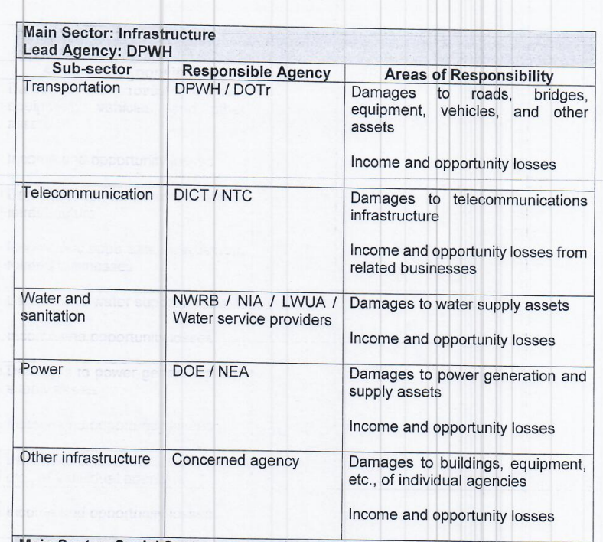
I
N
F
R
A
S
T
R
U
C
T
U
R
E

Slide 15
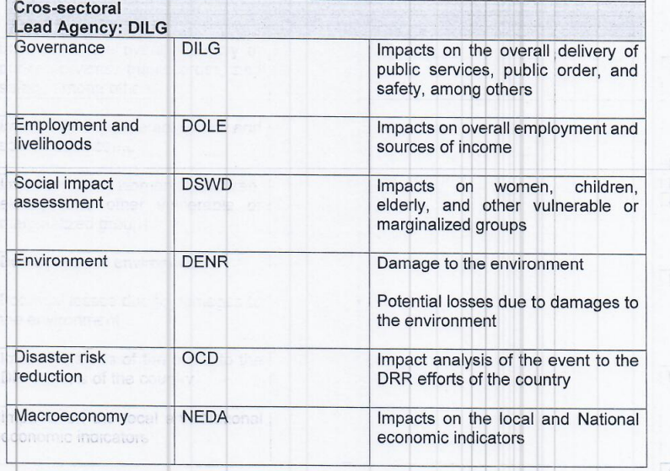
C
R
O
S
-
S
E
C
T
O
R
A
L

Slide 16
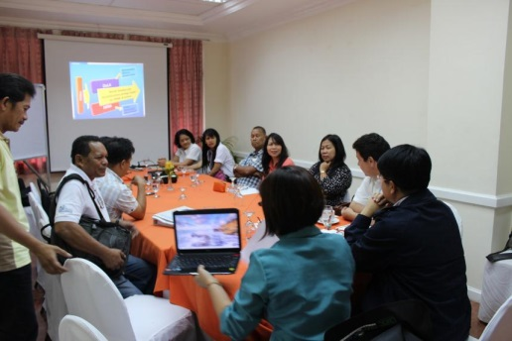
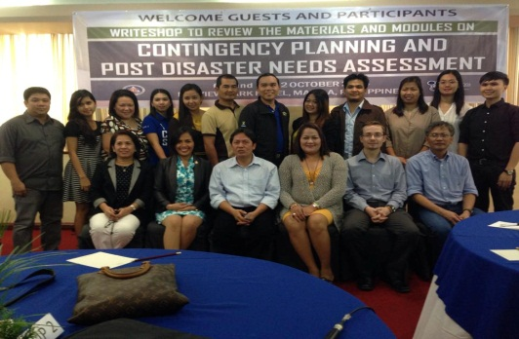
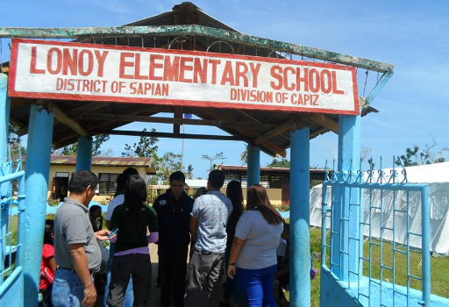
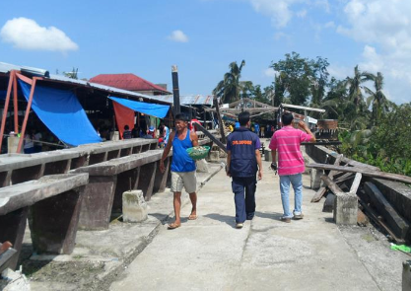
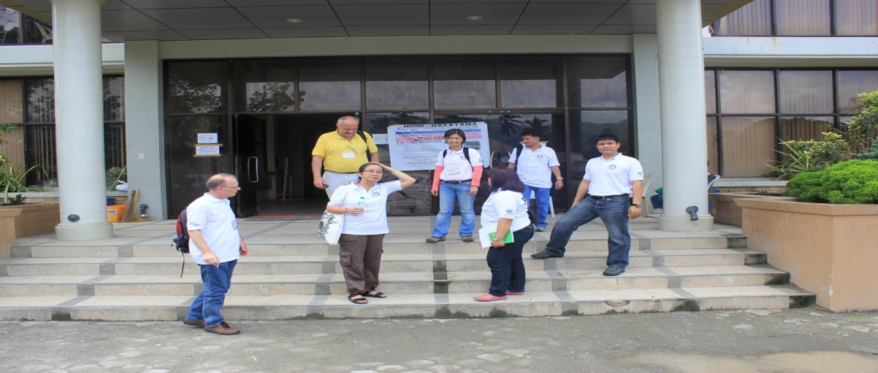
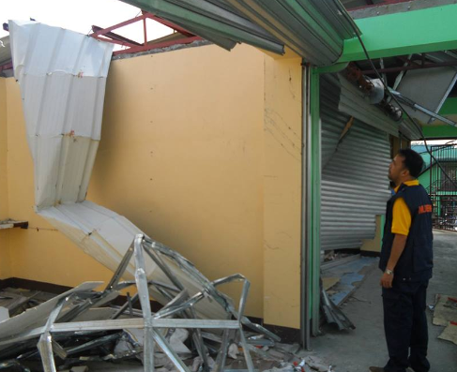
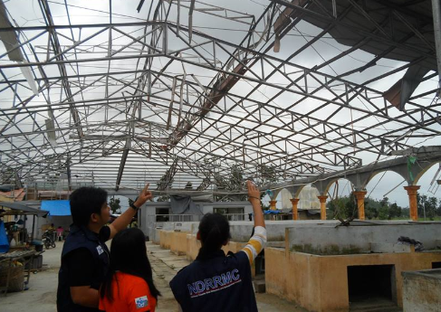
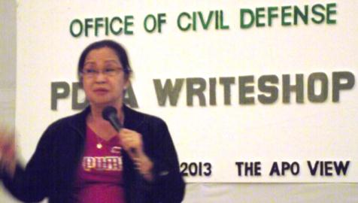
Damages, Losses and Needs Assessment
Notes:
16
What are the distinctive features of HRNA?

Slide 17
Computation of damages

Slide 18
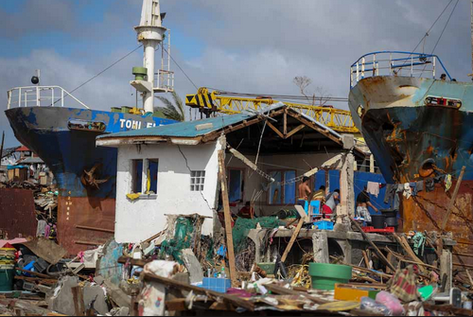
Damages
The value of asset such as structures, equipment and other related physical properties that are affected at or immediate after the disaster occurrence
Photo Credit: abs-cbnnews.com
Notes:
Damages refer to the value of affected asset such as structures, equipment and other related physical properties- houses, schools, hospitals, equipment
Examples, bridges, roads. materials/ equipment inside a structure/ building, appliances inside the houses
More of this will be explained in the upcoming modules since this is just an introduction

Slide 19
Damages
The value of directly / immediately affected asset (physical assets or infrastructure, final goods, raw materials, equipment and other properties).
Estimated in terms of physical units of assets that may be totally or partially destroyed
The costs of bringing back the affected structures, equipment, machinery and other assets up to their pre-disaster levels or state
Photo Credit: abs-cbnnews.com
Notes:
Damages refer to the value of affected asset such as structures, equipment and other related physical properties- houses, schools, hospitals, equipment
Examples, bridges, roads. materials/ equipment inside a structure/ building, appliances inside the houses
More of this will be explained in the upcoming modules since this is just an introduction

Slide 20
Classification
    Totally damaged: visibly completely destroyed or unusable and needs replacement.
    Partially damaged: can be repaired or reused and whose structural integrity has not been compromised.
Notes:
Damages can be classified as follows:
Totally destroyed: Structures, equipment, educational materials, etc. which are visibly completely destroyed or unusable and needs replacement. – in other words, wala nang pakinabang
Partially damaged: Affected structures, equipment, educational materials, etc that can be repaired or reused and whose structural integrity has not been compromised. - in other words, may pagasa pa

Slide 21
Value of Damages
Replacement cost - the value of the asset before it was totally destroyed (pre-disaster value). The valuation can be estimated by:
  the market value of the asset before destruction;
  acquisition cost less depreciation;
  insurance value.
Repair cost
For partially damaged assets
Repair cost is the amount required to put the asset back into its condition just before its partial destruction.
Notes:
Damages are measured in terms of the costs, which are classified as follows:
Replacement cost - the value of the asset before it was totally destroyed (pre-disaster value). The valuation can be estimated by:
the market value of the asset before destruction;
acquisition cost less depreciation;
insurance value.
This applies for totally damaged structures

Slide 22
Computation of losses

Slide 23
Losses
The value of unavoidable revenue due to:
Foregone Income Opportunities - production declines, reduced incomes and increased expenditures over a time
Higher operating or production costs - additional expenses to produce same output of goods and/or services (eg, cost of replanting new crops, temporary power and/or water supply, rent of temporary offices /firms
Unexpected expenses –such as debris clean up, temporary shelters, water supply, medicines, food supply, etc. for the government.
Notes:
Losses refer to the value of unavoidable revenue that was affected after the disaster such as decrease in the production figure due to the reduction of workforces and increase in expenses in the production.
Examples, additional operational expenses for clearing of debris, loss of workforce, loss of crops. In other words, “Pera na, nagging bato pa”
More of this will be explained in the upcoming modules since this is just an introduction

Slide 24
Losses
Changes in economic flows which can extend beyond the year the disaster occurred.
Whether public or private, the values of losses are measured in the amount in pre-disaster prices
POST-DISASTER ESTIMATES
PRE-DISASTER ESTIMATES
LOSSES
Notes:
Losses are changes in economic flows which can extend beyond the year the disaster occurred.
In other words, losses is equal to pre-disaster estimates minus post-disaster estimates of economic flows
Examples will be presented later to differentiate damage and losses.

Slide 25
Examples
Damages - cost of repair or replacement of: | Losses - values of:
Taxi
Lost Income
Buildings, Houses and contents
Lost income from rent
Airport structure and/or equipment
Lost income
Cost of Cleaning
Roads and bridges
Construction of temporary bridges
Hospital buildings, medicines and equipment
Income
Notes:
Here’s a matrix showing the differences between damages and losses
Explain each.

Slide 26
Importance of Losses
In the past, the cost of disasters was identified only in terms of damages.
Immediate cost estimates for reconstruction financing cannot be determined by damages alone.
Losses allow estimation of the total effects of disasters (eg. social needs and economic impacts.
Notes:
Why do we need to analyze and determine the losses?
In the past, the cost of disasters was identified only in terms of damages. – some even combine them. In PDNA, damage and losses cannot be combined
Immediate cost estimates for reconstruction financing cannot be determined by damages alone. - you will know the value of these losses to the LGU in the upcoming years (eg unrestored bridge = bigger losses)
Losses allow estimation of the total effects of disasters (eg. social needs and economic impacts. – you can determine the impact based on the losses

Slide 27
Computation of needs needs- analysis of disaster impacts that will provide basis for recovery and restoration programs

Slide 28

Recovery Needs
The amount needed to bring back normalcy, valued in consideration of inflation and international prices, as necessary. for rehabilitation of damaged assets; resumption of the disrupted functions, process and access to basis needs; as well as, recovery of losses; and incorporating risk reduction measures towards building back better.
Rehabilitation
Reconstruction
Risk Reduction (BBB)
Notes:
28
Impacts

Slide 29
Recovery and reconstruction can be achieve through:
Policy measures-reforms intended to alleviate personal/household level suffering (suspension of payments for housing loan); limited reduction of taxes for certain businesses; other measures to enable the community an economy to return to pre-disaster levels as quickly as possible

Slide 30
RECOVERY & RECONSTRUCTION CAN BE ACHIEVED THROUGH
PROGRAMS AND PROJECTS – THE ACTIVITIES THAT USUALLY FOLLOW PUBLIC INVESTMENT PROCESS WITH FOREIGN PARTNERS AND THE PRIVATE SECTOR

Slide 31
Rehabilitation
Measures that ensure the ability of government to resume their disrupted functions and business operations as well as for affected communities/areas to restore their normal of functioning by rebuilding livelihood and damaged infrastructures and increasing the communities’ organizational capacity.
Reconstruction
Reconstruction after disasters are calculated on the basis of the quantitative estimations of destruction of physical assets that need to be rebuilt. Reconstruction needs are defined on the basis of the estimated value of damage, as derived during the assessment.

Slide 32
NEEDS
RELOCATION WHEN, NEEDED
Reconstruction needs: Value of damage + cost of quality improvement + technological IMPROVEMENT + relocation, when needed + DRR features + multi annual inflation.
VALUE OF DAMAGE
COST OF QUALITY IMPROVEMENT
TECHNOLOGICAL IMPROVEMENT
DRR FEATURES
MULTI ANNUAL INFLATION RATE
NEEDS

Slide 33
SETTING OF PRIORITIES FOR THE NEEDS
TO BE STRATEGIC IN DECISION MAKING
BY GOING THROUGH PRIORITIZATION PROCESS DECISIONS CAN BE MADE FASTER AND CHOICES CAN BE JUSTIFIED, ESPECIALLY IF RESOURCE ARE LLIMITED.
DECISIONS

Slide 34
Why Set Priorities for the Needs?
Prioritization of Recovery and Reconstruction Needs
To be strategic in decision making
To have a rapid decision and justified choices
To ensure transparency through consultation and engagement of stakeholders
Notes:
Before we discuss the process of prioritization of needs, let us determine why we need to set priorities for the needs.
First, we have to be strategic in our decision- making. To achieve this, we need to determine the priorities. A distinctive feature of PDNA is that we have the recovery framework and strategy in our report.
To have a rapid decision and justified choices by going through the prioritization process, decisions can be made faster and choices can be justified, particularly if resources are limited. This means that all of our recommendations are rationalized and are not just hastily developed. Remember that time is very vital during the recovery and reconstruction period.
To ensure transparency through consultation and engagement of stakeholders- As discussed in The PDNA Framework, consultation with stakeholders must be acknowledged in the identification and prioritization of needs. They should be involved in the decision making since they are the recipient of the PPAS. For this reason, the PDNA Report will undergo a series of writeshops and consultations to ensure transparency.

Slide 35
3 Step Prioritization Process
Review
Agree
Evaluate
Notes:
Now, let us discuss the 3- Step Prioritization Process. Here is a brief outline of each step
Review of the current programs
Agreement on a specific set of criteria
Evaluate the programs, projects and activities against the agreed criteria
Each process has its own corresponding output that will be discussed in the next slides

Slide 36
Activities |  | Output
1. | Review the current list of Projects, Programs and Activities (PPAs) | List of PPAs with status*
**STATUS:
C | - | Completed
O | - | On-going | - | Regular, continuing, already operational
PL | - | In the Pipeline | - | Committed, with funding
P | - | Proposed | - | Planned, needs funding
Notes:
1. Review the current list of program and projects
First, we need to review the current list of programs and projects for each sub-sector. You need to gather these data through coordination among stakeholders and government agencies . After consolidation of the current list of PPAS, you shall indicate the status of the programs and projects as:
Completed (C)– Completed
Ongoing (O)– Regular, continuing, already operational
In the pipeline (PL)– Committed with funding
Proposed (P)– Planned, needs funding
The output of Step 1 is a list of programs and projects with their corresponding status.

Slide 37
Activities |  | Output
2. | Agree on a set of criteria and their weights | Set of Criteria for prioritization
CRITERIA
Impact- Urgency to meet the immediate needs of the greater number of people.
Capacity- May Includes available skills and resources, sustainability and efficiency.
Importance - Supports/contributes to the implementation of the overall Recovery and Reconstruction Framework
WEIGHTS
Weight - Use 100 percent scale to indicate the weight for each criterion
Example: Weight
Impact - 3
Capacity - 1
Importance - 2
Notes:
Agree on the criteria and weights
The second step involves coming up with an agreed- upon set of criteria for prioritization and the weights of the criteria.
The list of criteria are the following:
Impact- urgency to meet the immediate needs of the greater number of people.
Capacity- includes available skills and resources, sustainability and efficiency. You need to assess if the identified implementing agency has the capacity to execute the proposed PPAS
Importance - The importance of the programs and projects needs to be considered as well. This involves the extent to how a program or activity can support or contribute to the implementation of the Recovery and Reconstruction Framework.
For the weight, use a 100 percent scale to indicate the weight for each criterion.

Slide 38
Activities |  | Output
3. | Evaluate the PPAs against the agreed criteria | List of prioritized PPAs with status
Rate each program/project/activities by using the following:
1= Low
2= Medium
3= High
The higher the score, the higher the priority
Notes:
Evaluate the programs against the criteria
The last step in the prioritization process is the evaluation of the programs against the criteria. Each program or project must be rated by using the following figures:
1 = Low priority
2 = Medium priority
3 = High priority
Rank the projects/programs according to their score from 1 to n. The higher the score, the higher the priority.
The output for Step 3 is a list of prioritized programs and projects with their status.

Slide 39
Sample Priority Criteria for Importance/Impact
Priority No. | Description | Rate (Importance/ Impact)
1 | a. Major link/Major lifeline b. Road section directly link to areas in delivery of goods and are used as access to recovery and reconstruction activities | 3
2 | All road section linking to major roads as secondary road going to barangay roads | 2
3 | Flood control/seawall/slope protection except if it: is in a Hazard Prone Area Needs relocation | 1
Notes:
Here is the example of prioritization criteria used by transportation sub-sector that consider importance and impact.

Slide 40
Sample using DBM Form
Programs/Projects/Activities | Status | CRITERIA |  |  | SCORE | RANK
 |  | Importance (W =2) | Impact (W = 3) | Capacity (W = 1)
 |  | R x W | R x W | R x W
1. Reconstruction /Improvement of Bagong Bridge, Brgy. Bagong, Silang, Cagayan | P | 3 x 2 | 3 x 3 | 3 x 1 | 18 | 1
2. Repair of Daang National Road, Tugeugarao | O | 3 x 2 | 3 x 3 | 3 x 1 | 18 | 1
3. Rehabilitation /Improvement of Lumang Flood Control Revetment, Brgy. Lumang, Silang, Cagayan | PL | 1 x 2 | 1 x 3 | 3 x 1 | 8 | 3
Notes:
Using the sample agreed criteria and rating of the previous slide lets us now rank the PPAs.
For Capacity since the Bagong Bridge is national road, the rate for its importance and impact is 3( since it is a major lifeline) as well as for Daang national Road.
For Lumang Flood Control the rate for importance and impact will be 1.
In ranking of PPAs, there will instances that multiple projects maybe rank as top 1 or top 2.

Slide 41

Step 8: Analyze Financing Options
Rehabilitation and Reconstruction Fund
Quick Response
Fund
NDRRM Fund
Disaster Risk Finance and Insurance Payout Proceeds
Official Development Assistance (ODA) loans and grants
Government Financial Institutions
Allocation from Agency Regular Budget
Private sectors
Municipal Development Fund (MDF)
Private Savings
Notes:
We must remember that some financing options should be clearly indicated, especially for recovery needs. Priority needs will be given priority resources.
Possible financial sources are the Quick Response Fund, NDRRM Fund, ODA loans and grants, private sectors, and private savings, Rehabilitation and Recovery Fund, Disaster Risk Finance and Insurance Payout Proceeds, Government Financial Institutions and Municipal Development Fund.
However, it must be emphasized that financing options should carefully be analyzed as some international donors may offer help but they are intended as soft loans or payments for their consultants. In the case of private sectors, they are generally willing to help as part of CSR and as long as they will have privileges, such as tax exemptions. Also, agencies with QRF can use their funds.
The final decision for financing options is made at the NDRRMC level with substantial inputs from NEDA and DBM, amongst others.
Therefore , the involvement of the DBM is very important. The DBM should have all the data about the funds and financing options for ongoing projects.
Detailed information about source of funding will be discussed in Module No. 9

Slide 42
Cross sectoral concerns

Slide 43
HRNA Definition
Assessment of the consequences of disasters on human development as guided by the concept of human development
Considering social-cultural aspects in addition to macro economic imperatives
focusing on the distinct needs and priorities of the affected communities and population in restoring and, where possible, improving the pre-disaster status of human development

Slide 44
HRNA: a people-centered approach
Provides enabling environment to restore people’s abilities to reach their full potential through equitable access to secure essential requirements for recovery and development.
Empowers and strengthens capabilities to help self and spontaneous recovery and meet the added challenges.
HRNA is all about the welfare of people, all about human recovery. You look at human development pre-disaster and human development post-disaster
Notes:
HRNA: a people-centered approach. It is guided by the concept of human development that:
Provides measures to restore people’s abilities to reach their full potential
Provides equitable access to secure essential requirements for recovery and development.
Empowers and strengthens capabilities to help recover and meet the added challenges.
In a nutshell, HRNA is all about the welfare of people, all about human recovery. You look at human development pre-disaster and human development post-disaster.

Slide 45
Social impacts
Impacts at the household and individual level
Carried out for each relevant sector of the dala
Example:
Decline in income due to loss of employment may impact on education, health and nutrition of children (AT THE HOUSEHOLD LEVEL)

Slide 46
SOCIAL IMPACTS
CARRIED OUT THROUGH AN ASSESSMENT OF QUANTITATIVE DATA COLLETED IN THE DALA, AS WELL AS QUALITATIVE RAPID ASSESSMENT
The qualitative assessment also addresses issues such as the impact of the disaster on how community members live, work aand relate to each other; how they participate in community life and how they relate to institutions and policies

Slide 47
Social impacts
Gender impacts are summarized in the social impacts assessment, but should be addressed throughout the dala and should be included in the guidelines
Should address topics s double burden on women and increased vulnerability
Data should be gathered based on a breakdown by gender

Slide 48
Objectives
Restoration of governance systems
Measures to ensure access for all to reconstructed infrastructure
Approaches to fully restore livelihood systems
Pressing basic needs and services
Re-establishment of community functioning
Support spontaneous recovery
Post disaster capacity building
Enhancing resilience & disaster risks reduction
Notes:
Based on our previous discussion of what HRNA is, here are the objectives:
Restoration of governance systems – if the governance is not working, delivery of social services is disrupted.
Measures to ensure access for all to reconstructed infrastructure
Approaches to fully restore livelihood systems
Pressing basic needs and services – from humanitarian phase to early recovery to full rehabilitation and recovery
Re-establishment of community functioning – how do we bring the community to normal level of functioning
Support spontaneous recovery – coping mechanisms
Post disaster capacity building
Enhancing resilience & disaster risks reduction – refer to the three building blocks of HRNA: access, process and risks. HRNA looks at how resiliency can be ensured by looking at these three building blocks

Slide 49
Distinctive Features
Focuses on households and communities
Seeks to include the impacts which are not always visible and measurable
Includes several concepts which are not included in the DALA: gender equity, human rights, social justice, etc.
Involves qualitative aggregation of the cluster effects of the disaster
Identifies early recovery interventions as well as long-term recovery needs.
Notes:
Focuses on households and communities - HRNA takes a micro-perspective assessment by focusing on households and communities
Seeks to include the impacts which are not always visible and measurable – emphasize that HRNA assesses impacts are not visible, HRNA cannot be done by merely desk work because we cannot understand invisible impacts unless we immerse at the ground
Includes several concepts which are not included in the DALA: gender equity, human rights, social justice, etc.
Involves qualitative aggregation of the cluster effects of the disaster – highlight that it should not be quantitative, DaLa is the quantitative approach
Identifies early recovery interventions as well as long-term recovery needs. - highlight that both short term and long term needs are identified by HRNA

Slide 50
Tools in conducting social impact assessment
Focus group discussions (FGD)
Opinions/voices of all people in the sectors across all income levels are represented
In-depth interviews
Sensitive issues like social cohesion, power struggles. . can be generated by this method. In-depth interviews normALLY COVER FEW ISSUES BUT DELVE DEEPER ON THESE ISSUES

Slide 51
TOOLS IN CONDUCTING SOCIAL IMPACT ASSESSMENT
INFORMAL DISCUSSIONS AND PARTICIPANT OBSERVATION
SOCIAL RELATIONS BETWEEN GROUPS CAN BE GATHERED BY CASUAL TALK AND OBSERVING HOW PEOPLE INTERACT IN THE DISASTER AREA
SIMPLE SURVEYS
RELIABLE IN GATHERING SIMPLE AND CONCRETE DATA SUCH AS WAGE, PRICES, DEBTS AND INTEREST RATES, AMONG OTHERS

Slide 52
Macro- economic impact

Slide 53
impacts
Changes brought about by the disaster (The damages and losses) are analyzed at different levels:
MACRO-ECONOMIC
SOCIAL
CROS-CUTTING CONERNS(ENVIRONMENT,GENDER, ETC0
Disaster risk

Slide 54
Impacts
Changes in macroeconomic variables, social factors, environmental conditions and disaster risk situations due to disaster
Carried out through an assessment of quantitative data collected as well as qualitative rapid assessment.
Serve as the baseline for the future monitoring of recovery.
Notes:
Impacts are changes in macroeconomic variables, social factors, environmental conditions and disaster risk situations due to disaster
eg,. GDP, poverty rate, exposure to hazard and other impacts
More of this will be explained in the upcoming modules since this is just an introduction

Slide 55
impacts
Changes in macroeconomic variables, social factors, environmental conditions and disaster risk situations due to disaster

Slide 56
Macro-economic impacts
Gdp/grdp
Budget balance
Taxes or revenues
Debt
Inflation
Employment
Balance of trade and payments

Slide 57
Example of Macroeconomic Impacts
• Damages to roads, bridges, ports and airport will:
Add costs to businesses which will cause higher prices (inflation);
Possible food shortages;
Loss of income and employment to specific sectors like tourism;
Loss or difficulty of access to health centers, schools and other social services;
Increased vulnerability in travelling;
Exacerbate poverty and inequality

Slide 58
Macro-economic impacts
Damages to roads, bridges,pots and airport may result in:
Additional costs to businesses which will cause higher prices (inflation)
Possible food shortages
Loss of income and employment to specific sectors like tourism

Slide 59
Example of Impacts
• Losses due to damages to roads, bridges, ports and airport can:
Shrink economic growth (GDP) due to lower productivity;
Increase national indebtedness if road repairs will funded by loans;
Lower tax collection and exacerbate fiscal position since businesses are down at the time that the government has to spend more;
Balance of payment consequences if more cement will be imported to repair roads and bridges;

Slide 60
Disaster risk reduction (ocd/LDRRMOs)
Disasters may Increase the vulnerabilities of certain sectors, areas and population groups. (E.G. CERTAIn TYPHOON THAT MAY INCREASE HAZARDS AND VULNERABILITIES (BUILD ZONE 40M TO 60M)
Example: the destruction of dikes may increase the vulnerability from floods; strength of infrastructures could have been weakened after an earthquake
Impacts can also be viewed as disaster risk factors:
Notes:
Disaster Risk – Impacts can also be viewed as disaster risk factors:
Disasters may increase the vulnerabilities of certain sectors, areas and population groups. Eg certain typhoon that may increase hazards and vulnerabilities (Build Zone 40m to 10m)
Examples: the destruction of dikes may increase the vulnerability from floods, strength of infrastructures could have been weakened after an earthquake – Based on this example of impact, it is important to consider relocating the evacuation center to less risky areas

Slide 61
Environmental Impacts (DENR)
Impacts on the environment should cover the possible effects on the following:
The adverse changes in
  a. bio-diversity;
  b. air and terrestrial pollution;
  c. other aspects related to the eco-systems.
Notes:
Environmental Impacts - Impacts on the environment should cover the possible effects on bio-diversity, air and terrestrial pollution as well as other aspects related to the eco-systems.

Slide 62
GOVERNANCE (dilg)
Restoration of governance systems – if the governance is not working, delivery of social services is disrupted.
Measures to ensure access for all to reconstructed infrastructure
Government infrastructure: Brgy Hall, covered court, municipal hall, day care center

Slide 63
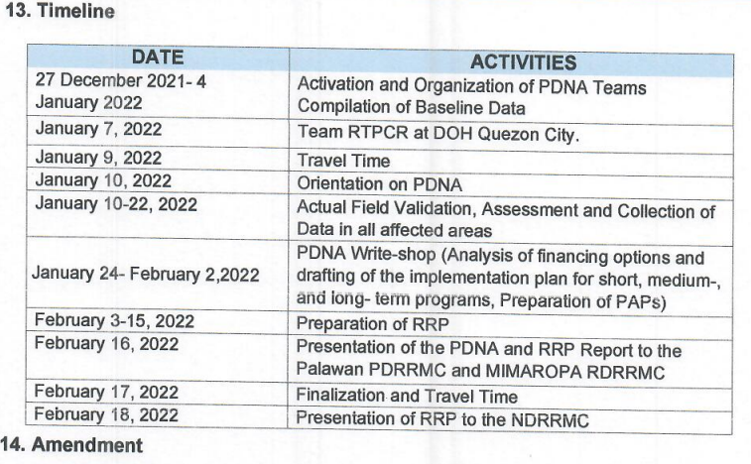

Slide 64
Regional timeline
ACTIVITY | OPR | TIMELINE
Activation and Organization of Teams | OCD | Dec 29, 2021-January 4, 2022
Orientation of the teams/PDNA Strategy | OCD | January 10, 2022
Compilation of Data (All Sectors) | PDNA R/P/C/M | January 10-15, 2022
Field Validation computation of Damages, Losses and Needs and write-up per sector/sub-sector | PDNA R/P/C/M | January 16 – 30,2021
Submission of outputs with write-up of all sub-sectors to Lead Agencies | Social- DSWD,Productive-DA,Infra-DPWH and Cros-Sectoral: DILG | January 31, 2022
Preparation of RRP | NEDA | February 1-13,2022
Submission of final PDNA report for review to OCD in complete package | Lead Sectors | February 14, 2022
Presentation of final PDNA report to RDRRMC and PDRRMC for comments/approval with resolution | NEDA for RRP Summary of Damages, Losses and Needs (OCD) | February 15, 2022
Finalization of complete package of PDNA and RRP | NEDA & OCD | February 16, 2022
Presentation of RRP to NDRRMC | NEDA | February 18, 2022

Slide 65
End of Presentation

