Slide 1
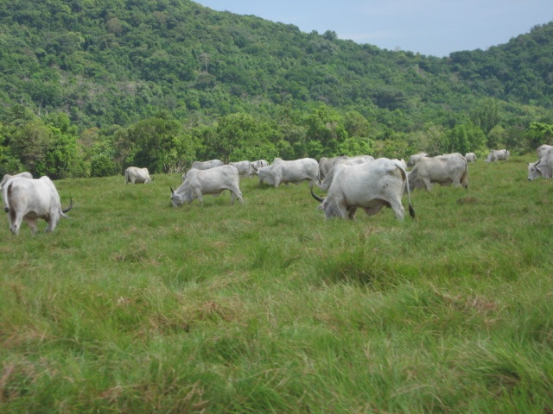

BUSUANGA PASTURE RESERVE
FOREST
MANAGEMENT
BUREAU
Harnessing forestry science for sustainable development
Briefing Document

Slide 2

Background/Legal Basis of BPR
Law/Policies | Date | Issued By | Subject
Presidential Proclamation No. 1387 | February 13, 1975 | Pres. Ferdinand E. Marcos | Establishes the Busuanga Pasture Reserve (BPR) in the Island of Busuanga, Palawan
Presidential Proclamation No. 2057 | May 7, 2010 | Pres. Gloria Macapagal - Arroyo | Authorizes the Philippine Forest Corporation (PhilForest) to administer development of BPR
Presidential Proclamation No. 663 | October 14, 2013 | Pres. Benigno Simeon Aquino III | Repeals PP 2057 and transfers the administration of BPR to the DENR – Forest Management Bureau

Slide 3
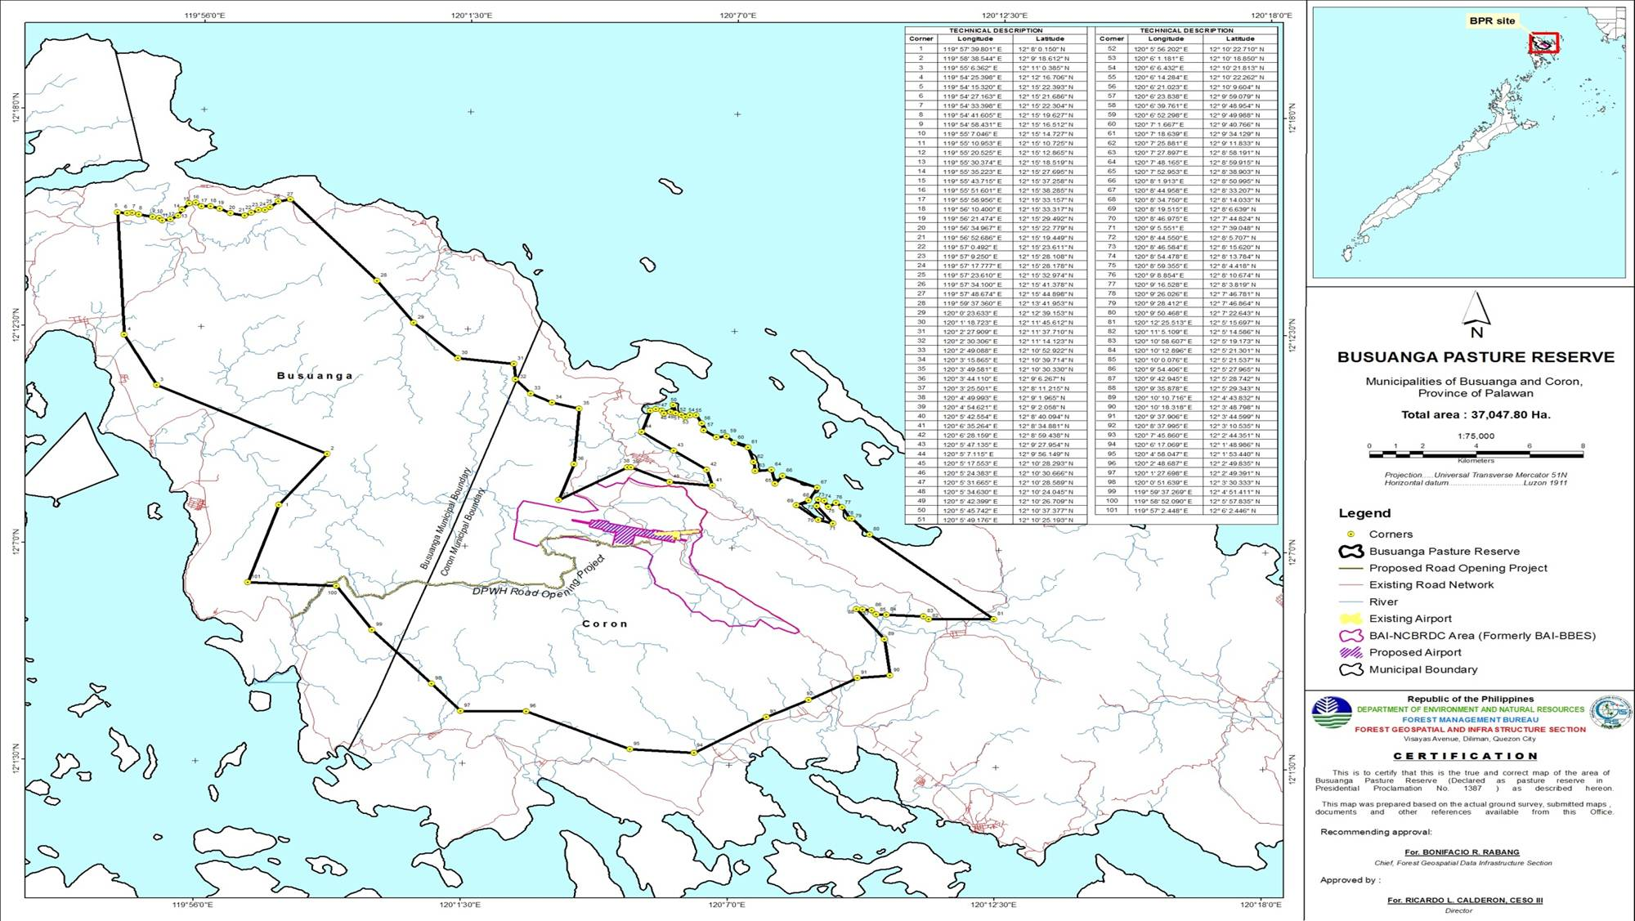
Map Showing the Delineated Boundary of BPR

Slide 4
Other Gov’t Agency (OGA) Projects Within BPR
Other Government Agencies | Project | Status
Department of Agriculture - Bureau of Animal Industry | National Beef Cattle Research and Dev’t Center | A Memorandum of Agreement (MOA) between the DENR and DA for the utilization of parcel of land covering 2,217 hectares within BPR by the Bureau of Animal Industry was signed on 01 June 2018.
Department of Transportation – Civil Aviation Authority of the Philippines | Busuanga Airport Expansion and Reorientation Project | The MOA was already signed and referred to DOTr for notarization
Department of National Defense – Philippine Navy (Marines) | Training Camp | The latest draft MOA was endorsed to Office of the Undersecretary for Field Operations on 23 September 2021.

Slide 5
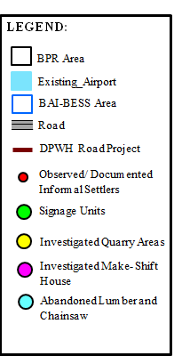
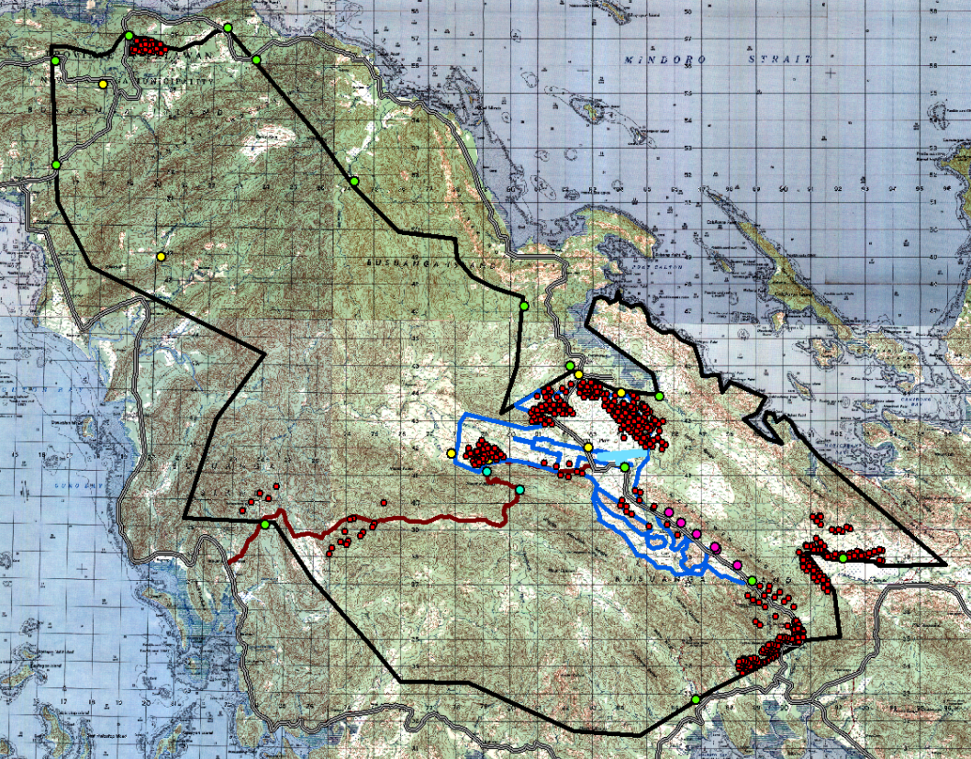
Location of OGA projects, BPR Signages, Quarry Areas and Informal Settlers
Quezon, Busuanga
Decalachao, Coron
Long Paddock, Decalachao, Coron
BAI-NBCRDC Area
San Jose, Coron
Santo Nino, Busuanga
Bintuan, Coron
Guadalupe, Coron
San Nicolas, Coron
Notes:
Maglagay ng dialogue box with barangay/sitio/municipality

Slide 6
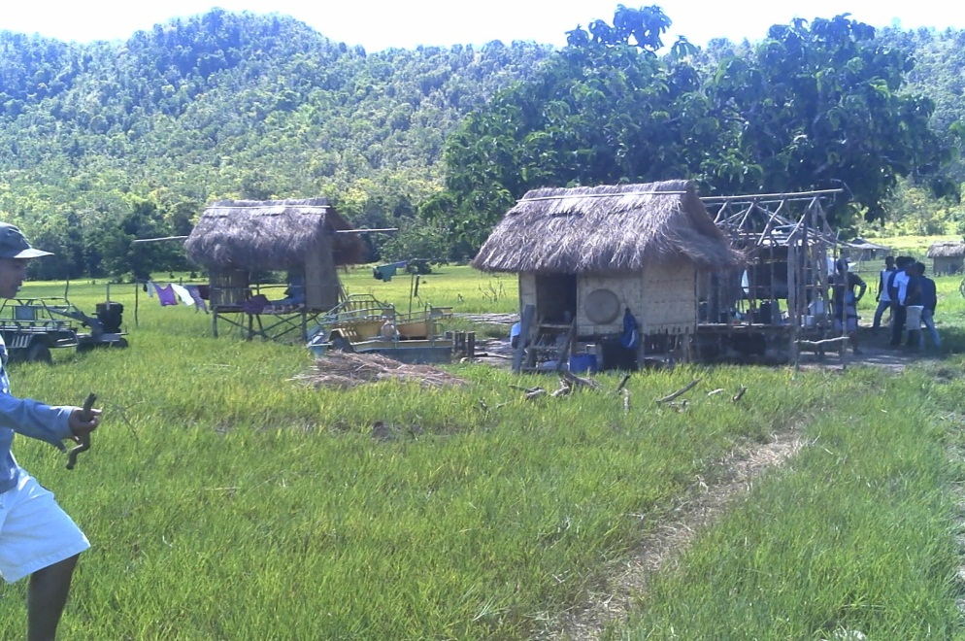
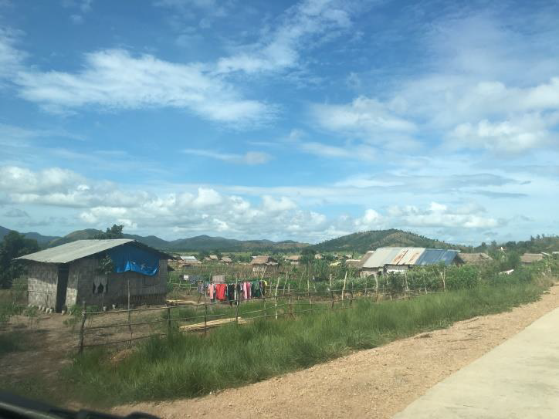
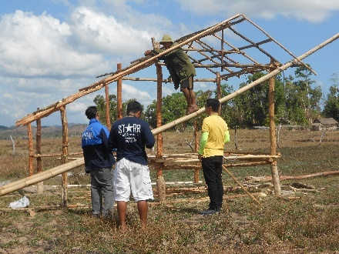
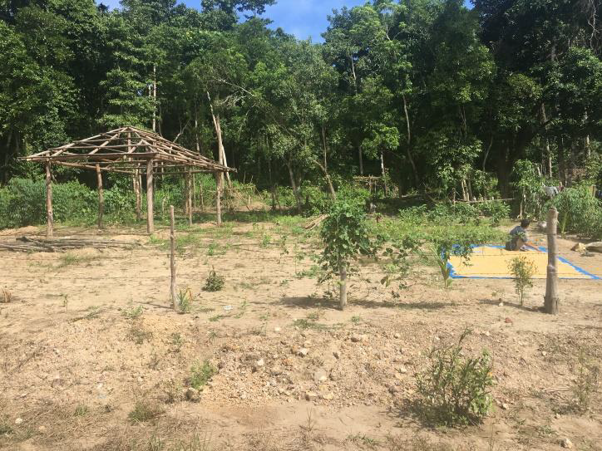
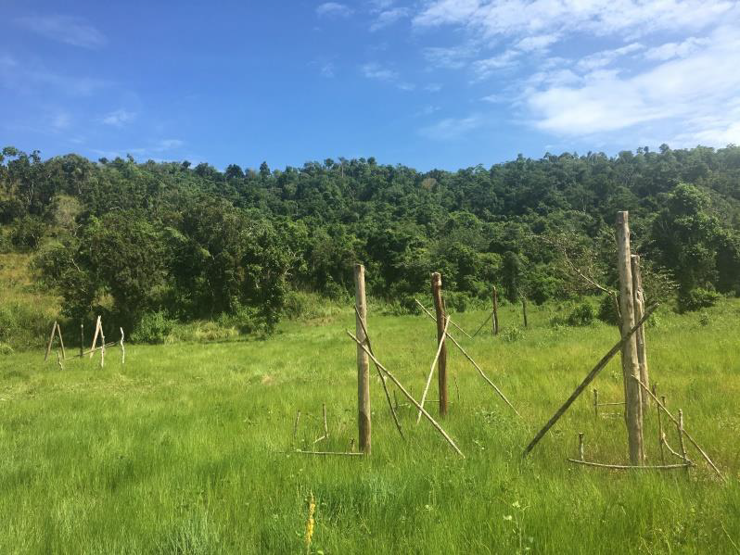
INFORMAL SETTLERS WITHIN BPR
CORON |  | BUSUANGA |  | TOTAL
INDIVIDUALS | HOUSEHOLDS | INDIVIDUALS | HOUSEHOLDS | INDIVIDUALS | HOUSEHOLD
2,510 | 736 | 545 | 145 | 3,055 | 881
Based on the result of April 2017 profiling of Informal Settlers

Slide 7
ISSUES and CONCERNS
One group of informal settlers found illegally occupying inside BPR is PESANTE Pilipinas/Climate Change Congress of the Philippines Inc. The concentration of their occupation is within and around the DA-BAI area.
The unlawful occupation is in violation of the provisions of Proclamation 1387 which reserves the area for pasture purposes.
It is emphasized that the eligible tenure instrument within BPR is FLGMA.
Under the DA-DENR Memorandum of Agreement (MOA), BAI is given the responsibility to protect its area from illegal occupation.

Slide 8
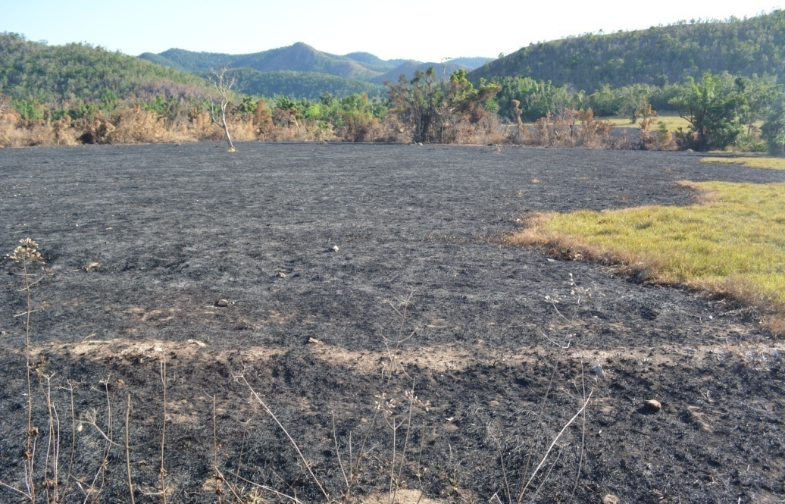
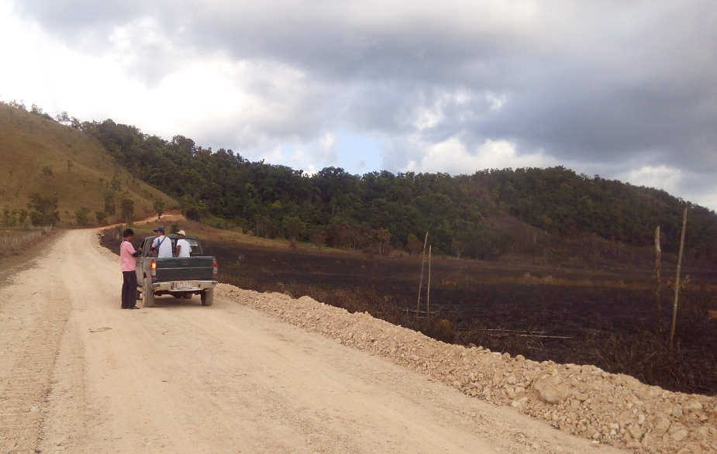
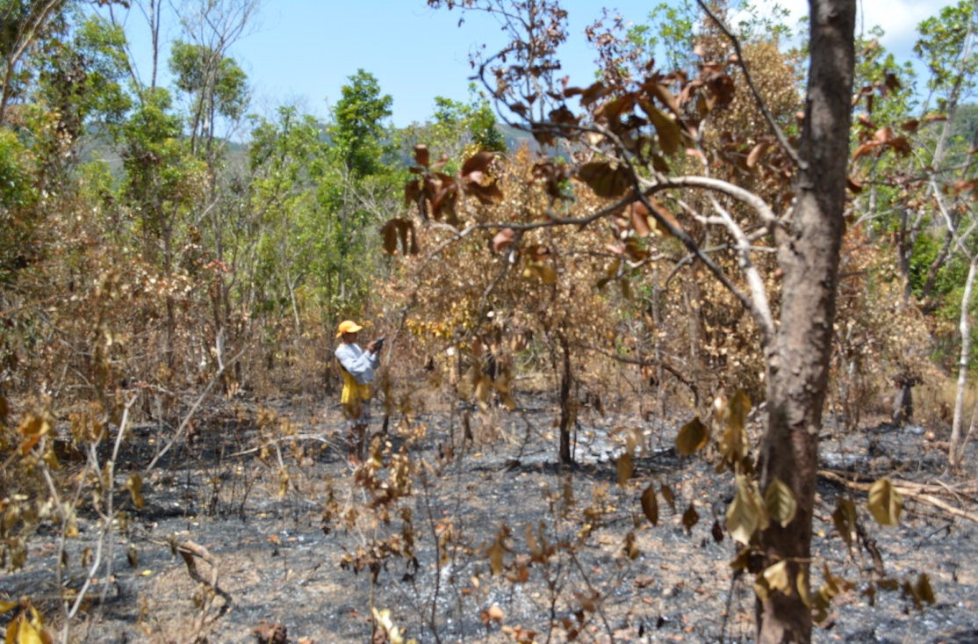
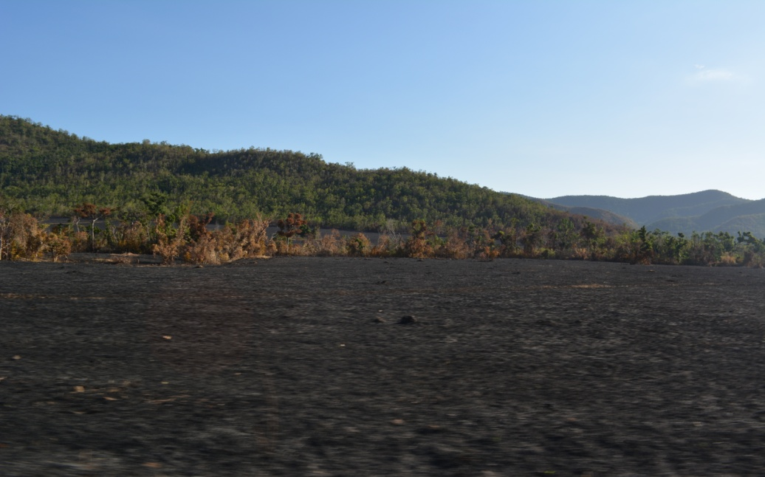
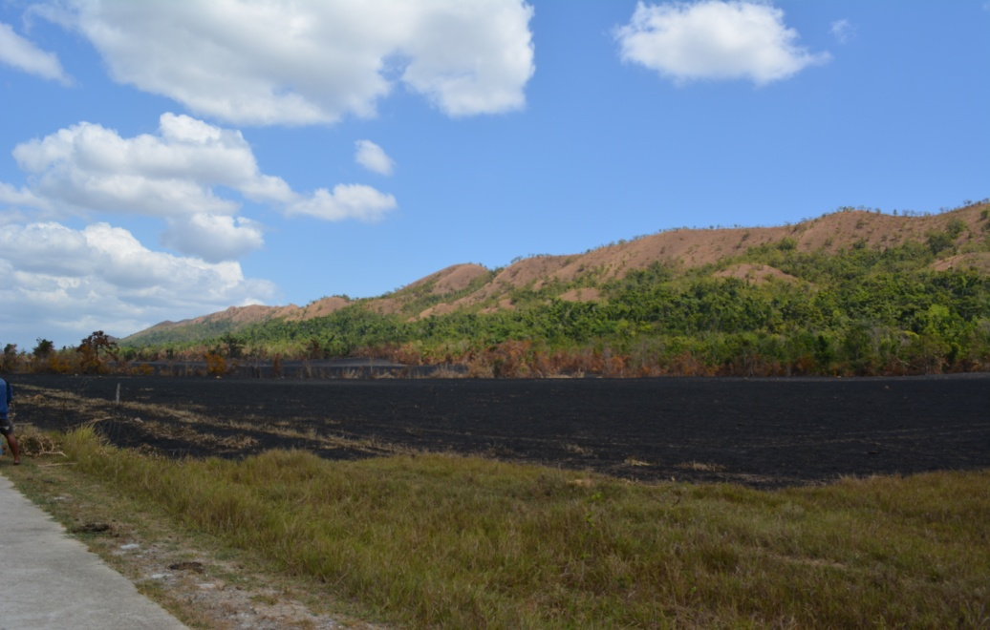
ISSUES/CONCERNS
Occurrence of Forest/Grass Fire
Notes:
Dagdagan ng pictures, unahin ang illegal occupation, next time geotagged photos, exact location

Slide 9
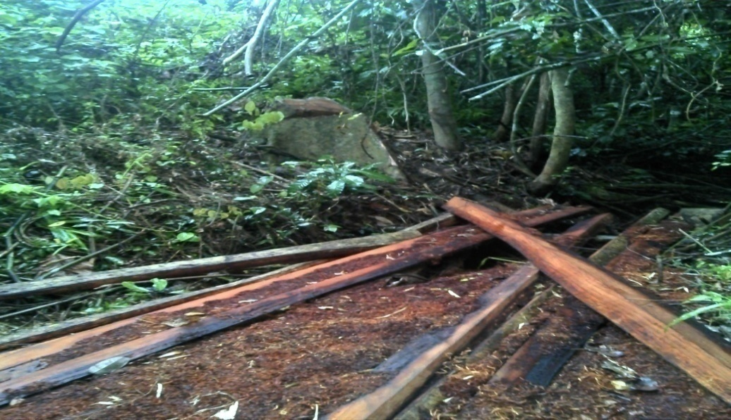
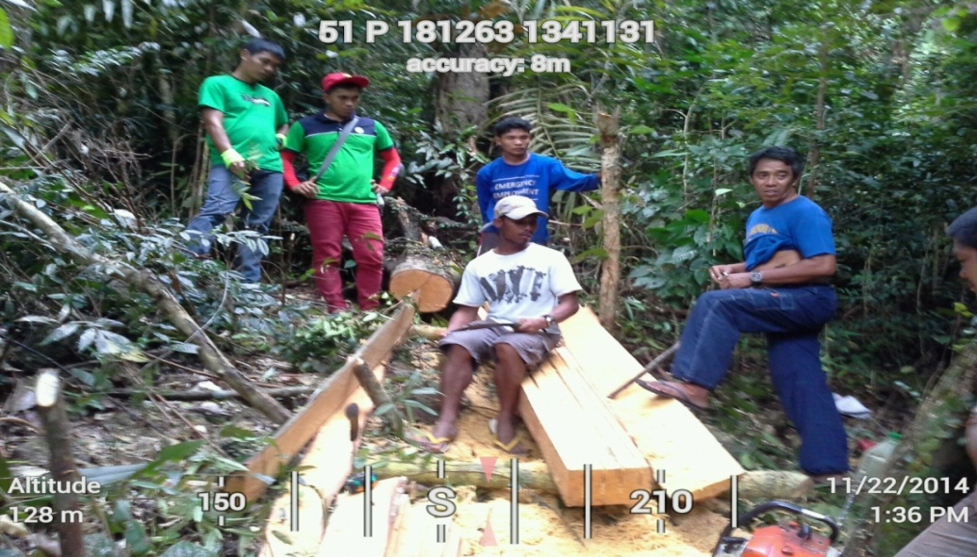
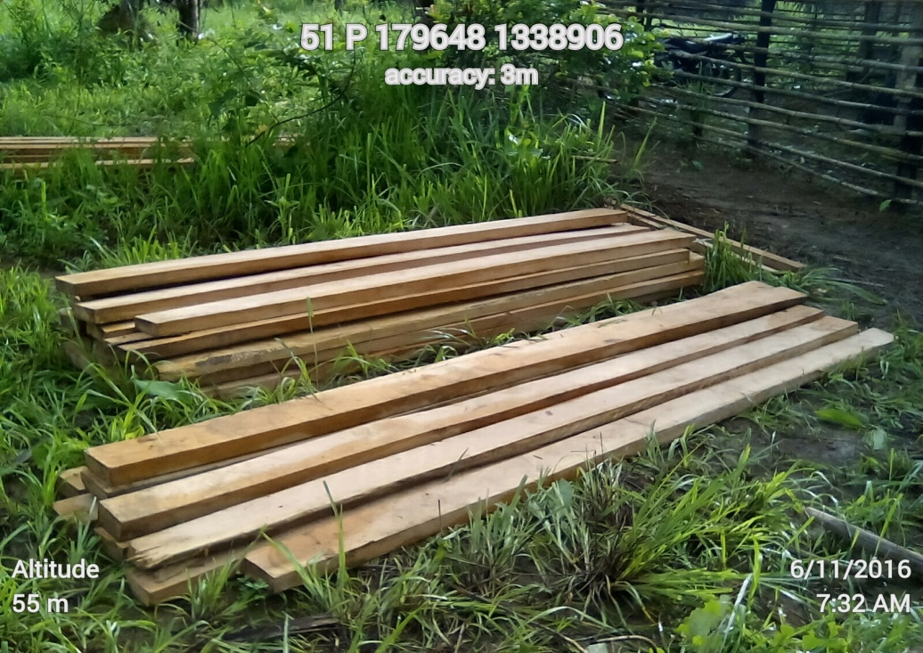
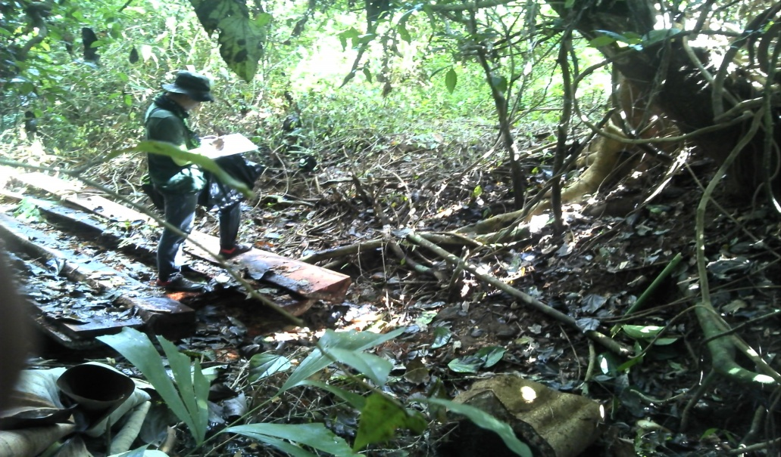
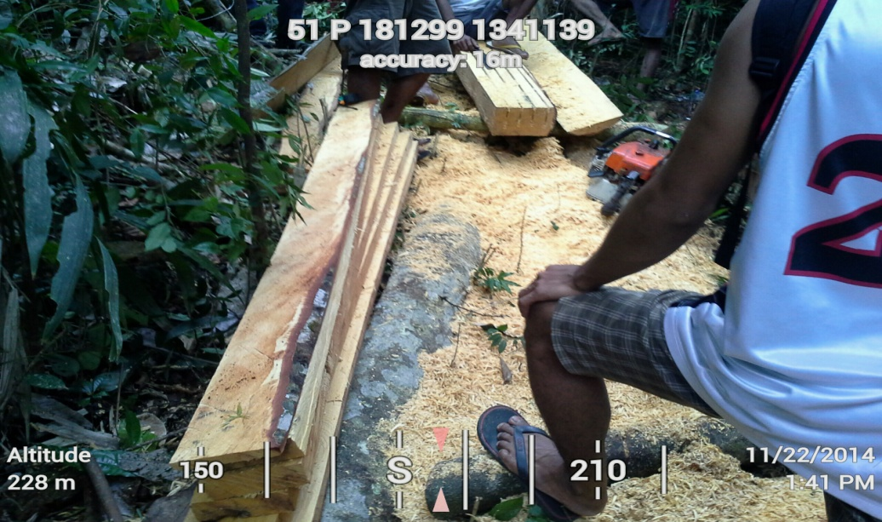
ISSUES/CONCERNS
Timber Poaching
Notes:
Dagdagan ng pictures, unahin ang illegal occupation, next time geotagged photos, exact location

Slide 10
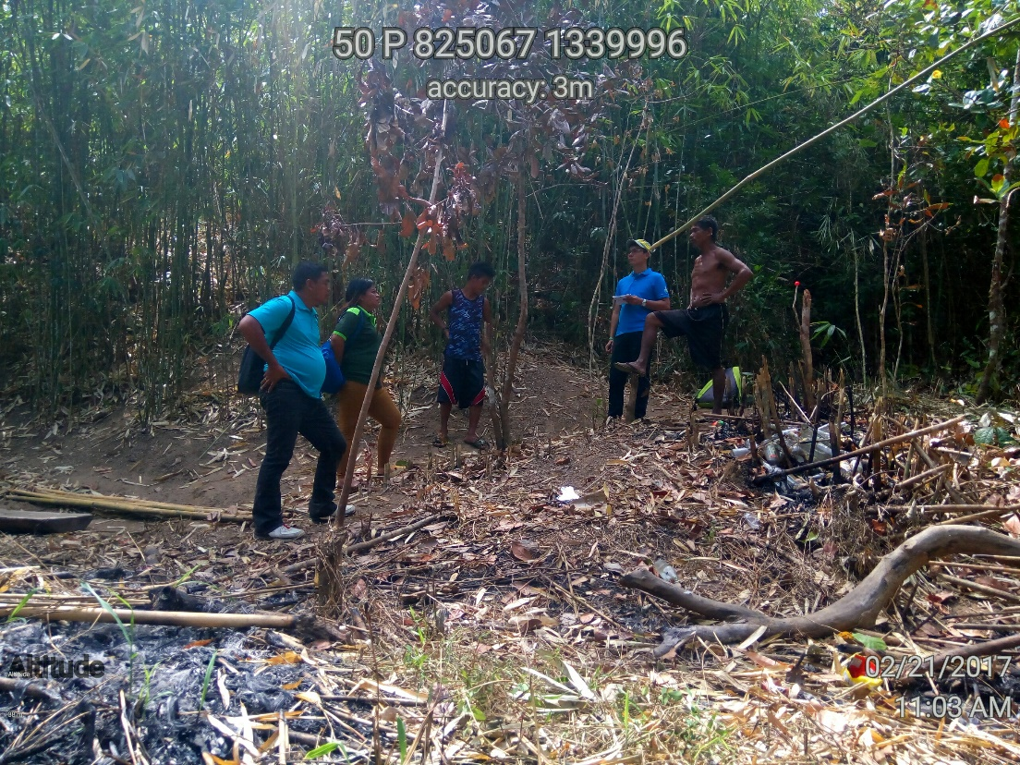
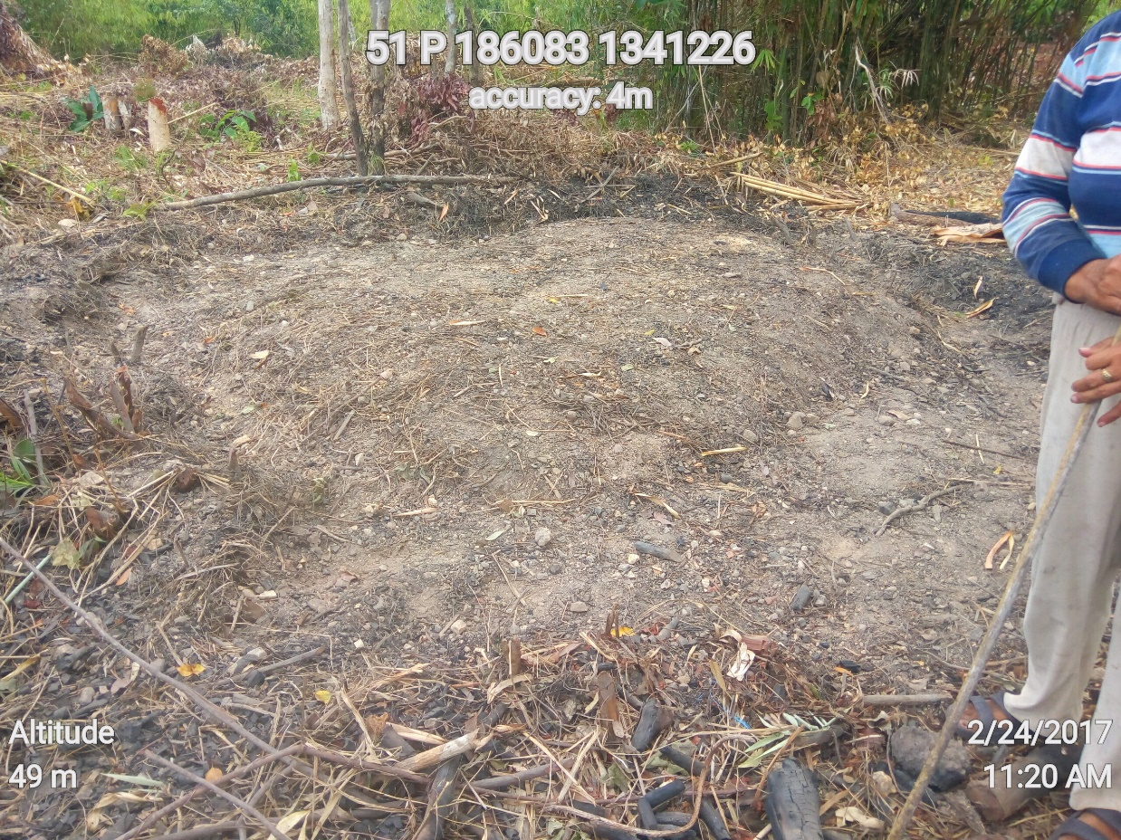
ISSUES/CONCERNS
Charcoal Making

Slide 11
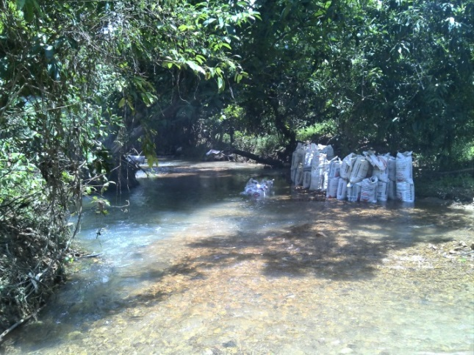
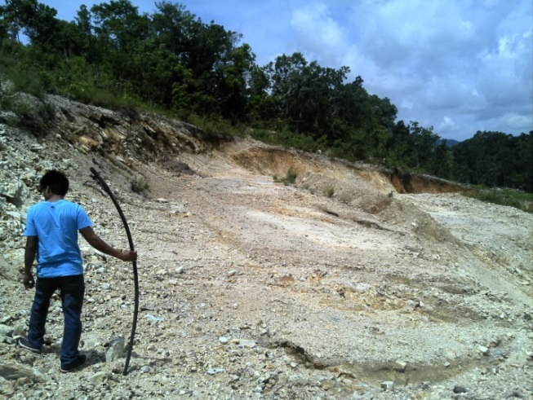
ISSUES/CONCERNS
Quarrying
Earth Quarrying for road filling materials
Sand and Gravel (SAG) quarrying

Slide 12
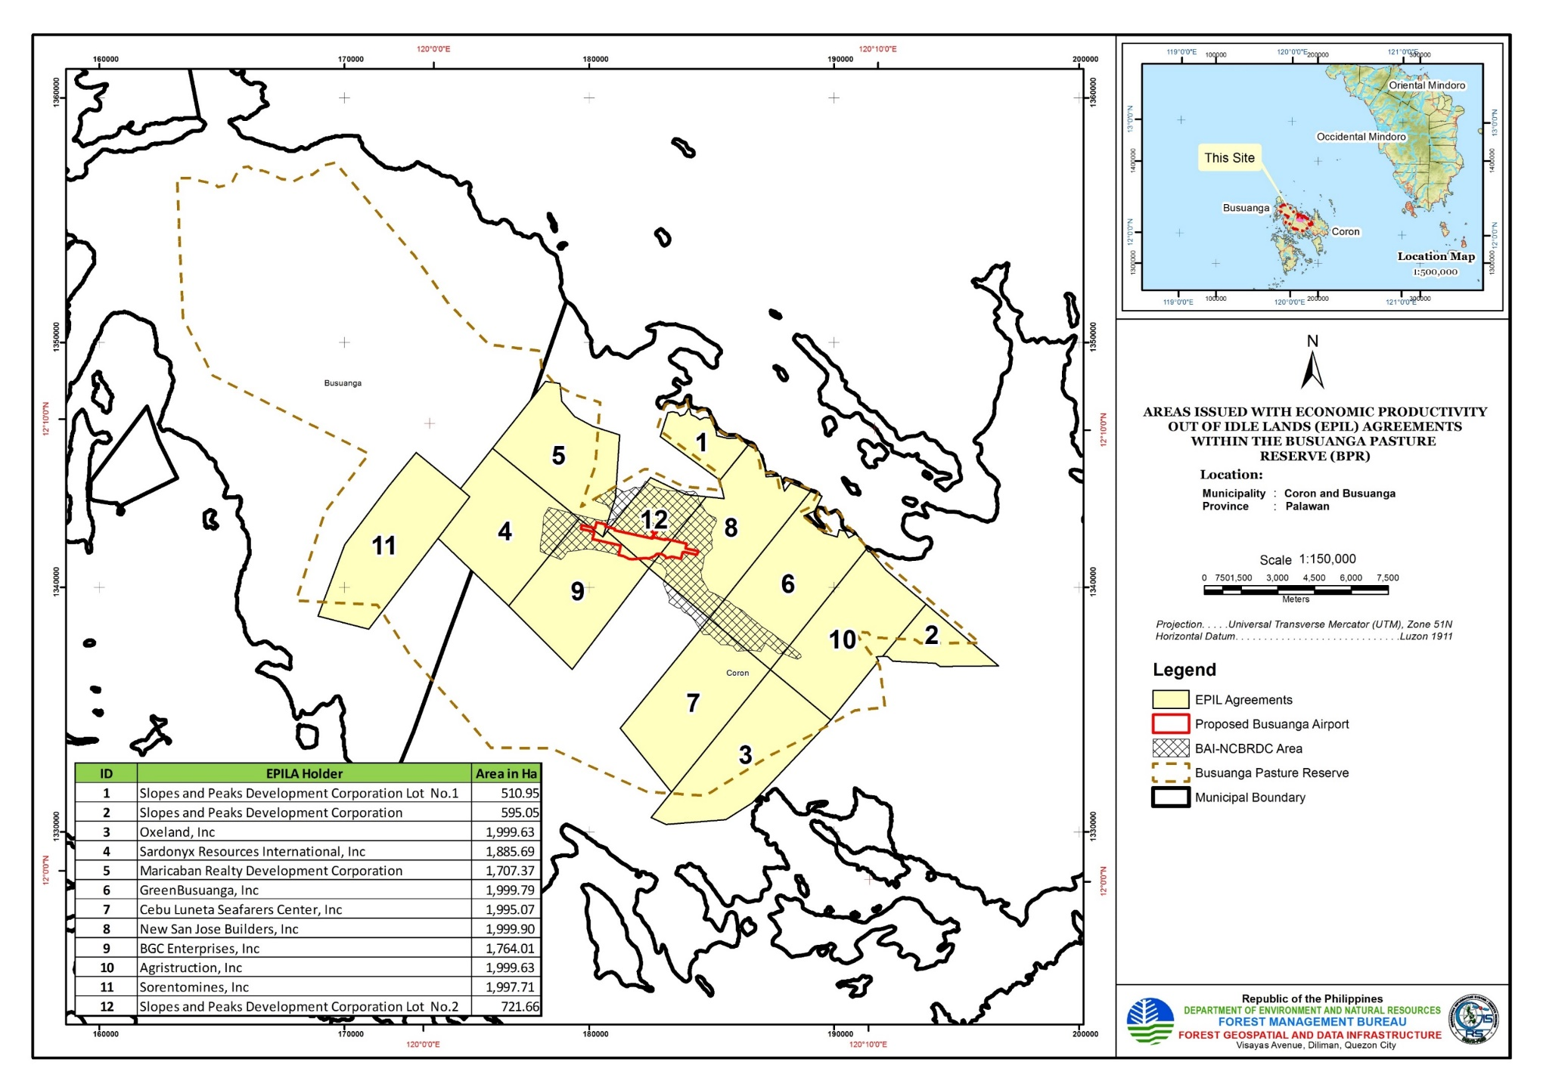
ISSUES/CONCERNS (EPILA issued by PhilForest)

Slide 13
ISSUES/CONCERNS (EPILA issued by PhilForest)*
Economic Productivity Out of Idle Lands (EPIL) Agreements issued to 10 corporations by PhilForest Corporation (former Administrator of BPR)
EPIL Agreements cancelled by PhilForest on 09 December 2011
FMB affirmed the cancellation of EPIL Agreements in 2015 (upon the transfer of administration from PhilForest to FMB)
New San Jose Builders Inc. (EPILA holder) filed a complaint on 14 February 2014 against PhilForest for breach of contract and specific performance with damages (Civil Case No. R-QZN-14-01501-CV)
  FMB received a letter dated 04 June 2020 from the Legal Counsel of New San Jose Builders Inc., Atty. Jeric J. Jucaban, proposing for the termination of the case through a compromise agreement
Agristruction, Inc. (EPILA holder) filed a complaint on 03 April 2018 against PhilForest with prayer for the nullification of the cancellation of the EPIL Agreement and for payment of actual and compensatory damages amounting to 1 Million Pesos (Civil Case No. R-QZN-18-03506-CV)
  Regional Trial Court issued an Order on 05 December 2019 approving the Compromise Agreement between the Agristruction Inc. and Forest Management Bureau dated 22 November 2019
  *PhilForest/EPILA cases within BPR handled by then FMB Legal Officer

Slide 14
ISSUES and CONCERNS (Executive Order No. 75)
Executive Order No. 75 was issued by President Duterte on February 2019 directing DAR to dispose of government-owned lands to qualified agrarian reform beneficiaries.
On 19 November 2019, the DAR Validation Committee sent a letter to Sec. Cimatu requesting for execution of a Deed of Transfer (DOT) of certain landholdings inside BPR.
On 17 February 2020, the DAR issued a Notice to Proceed Acquistion (NTPA) because of failure to execute the DOT within fifteen (15) days upon receipt of request.

Slide 15
ISSUES and CONCERNS (Executive Order No. 75)
The DENR through FMB has undergone a series of conciliation proceedings with DAR but failed to reach a settlement and was terminated on 17 August 2020.
The FMB filed a protest on 11 September 2020 with the DAR Adjudication Board (DARAB), arguing for the cancellation of the NTPA. The DARAB ordered both DAR and FMB to file their respective position papers within 10 days. DAR filed a position paper on 14 January 2021 praying for to dismiss FMB’s protest.
FMB Filed a Motion to Admit Protestant’s Position Paper and Position Paper to DARAB on 27 October 2021 regarding the cancellation of the Notice to Proceed Acquisition dated 17 February 2020 pursuant to EO No. 75 series of 2019.

Slide 16
ISSUES and CONCERNS (Executive Order No. 75)
Issue: The CLOA signed by DAR Secretary John R. Castriciones covers Lot No. 535 and Lot No. 385, CAD 1150-D and Lot Number 697, CAD 1150-Case D with an area of 27.5807, 127.5156, and 427 hectares, respectively within BPR was issued despite the pending protest of this Office and in the absence of validation of the area.
Status: FMB issued a letter dated 20 October 2021 to Undersecretary Elmer Distor, Field Operation, Department of Agrarian Reform (DAR) requesting the said office to immediate hold in abeyance the issuance of CLOAs within BPR until the issues surrounding the matter has been resolved.

Slide 17
Status of Cases Filed*
Case No. | Date Filed | Name | Status | Remarks
Docket No. IV-08-INV-18G-0397 Criminal Case No. 3965 | July 17, 2018 | Moises Rodolfo Julie Lucena Arlen Sison Melchor Andico Monaliza G. Razote Lorma Basallo Yolanda Borja Mercedes Ancheta Benjamin Naoe | Court decision: 1 year of imprisonment Fine : Php 10,000 Payment of: Php 39, 223.00 for annual rental and/or other charges (2016-2018) | -The Court rendered its decision in favor of the DENR signed by signed by Lovelle Moana R. Hitosis of MCTC (Coron-Busuanga) on the on 30th of September 2021 .
Docket No. IV-08-INV-6A-0034 Criminal case No. 3855 | January 21, 2016 | Cholly Vidal | Notice to Vacate: September 1, 2015 | - The Court rendered its Decision in favor of the DENR signed by Lovelle Moana R. Hitosis of MCTC (Coron-Busuanga) on the 22nd of June 2018.
 |  |  | Final Notice to Vacate: October 18, 2015
 |  |  | Court Hearing: started August 2016
 |  |  |  | - Appealed to the Regional trial court on October 29, 2018
 |  |  |  | - On august 8, 2019 a court decision was issued by the RTC signed by Arnel P. Cezar.
Docket No. IV-08-INV-6A-0035 Criminal Case No. 3846 | January 21, 2016 | Harilyeto Panginaban | Court Hearing: started August 2016 | - The court rendered its order based on Compromise Agreement that the DENR and Mr. Panganiban agreed upon which to demolish the structures within his occupied area.
*cases handled by the DENR Legal Affairs Service

Slide 18
YOLANDA PERMANENT HOUSING PROJECT WITH BPR
DENR Stand: Based on the result of the investigation of DENR MIMAROPA, it is not possible for the DENR to lift the hold in abeyance order therefore the project cannot proceed. With that, the DENR recommends for NHA to identify other areas that are within public lands but not within BPR anymore, which the DENR may be of assistance as presented during the YPHP TWG Meeting last March 8, 2022.
Latest Update: The Office of The Undersecretary for Legal, Administration, Human Resources, and Legislative Affairs released the Legal Opinion regarding the matter through Memorandum dated 19 April 2022.
“DENR MIMAROPA Region should be instructed to conduct the necessary procedure for purposes of instituting reversion proceedings”
Way Forward: (?)

Slide 19
FMB-DENR Management Initiatives in the BPR
Delineated the boundary of the reservation;
Established and maintained BPR Management Office (BPRMO) and monitoring station in Coron, Palawan;
Conducted inventory and profiling of informal settlers;
Implemented Forest Protection and Law Enforcement through LAWIN;
Assisted CENRO in case build-up for the filing of cases concerning violation of Section 68 and 69 of PD 705, as amended.
Conducted Land Capability and Suitability Assessment of BPR using GIS.

Slide 20
WAYS FORWARD
Preparation of Comprehensive Management Plan of BPR in consonance with the Busuanga Island Chain Master Plan.
Propose Presidential Proclamation amending PP 663 for the administration of BPR.

Slide 21
WAYS FORWARD
Propose Presidential Proclamation amending PP 663 for the administration of BPR.
The proposed policy aims to provide a more efficient and strategic management of BPR since the DENR MIMAROPA has the line functions and has jurisdiction over CENRO Calamianes Islands, where the BPR is also located.
Status: The draft policy was presented to and concurred by the DENR MIMAROPA and DENR Legal Affairs Service in a meeting dated 04 March 2022.
Latest Update: The Office of the DENR Secretary requested the FMB to limit the Memorandum for the President into three (3) pages. Furthermore, a Certificate of Completed Staff Work and Certificate of Concurrence (COC) is requested from FMB.

Slide 22
Personnel Complement (COS) based on FY 2022 WFP:
Approved Personnel for Hiring | Approved Number of Personnel | Hired Personnel (no.) | Vacant Personnel
Project Operations Control Officer | 1 | 1 | 0
Project Development Officer | 2 | 2 | 1
Administrative Assistant | 1 | 1 | 0
Bantay Gubat | 9 | 9 | 2
TOTAL | 13 | 13 | 3

Slide 23
THANK YOU!

