Slide 1
BEFORE AND AFTER ODETTE PUERTO PRINCESA SATELLITE IMAGES
Attachment 3. Vegetative cover before and after Odette
BASE ON NDVI BAND COMBINATION

Slide 2
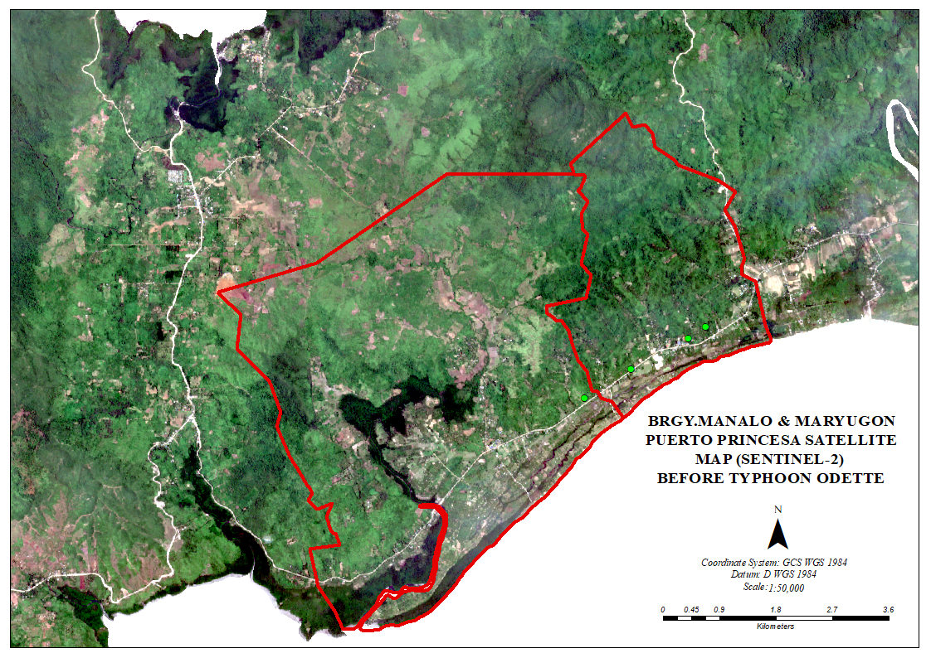
Brgy. Manalo & Maryugon, Puerto princesa city before odette
12/21/2021

Slide 3
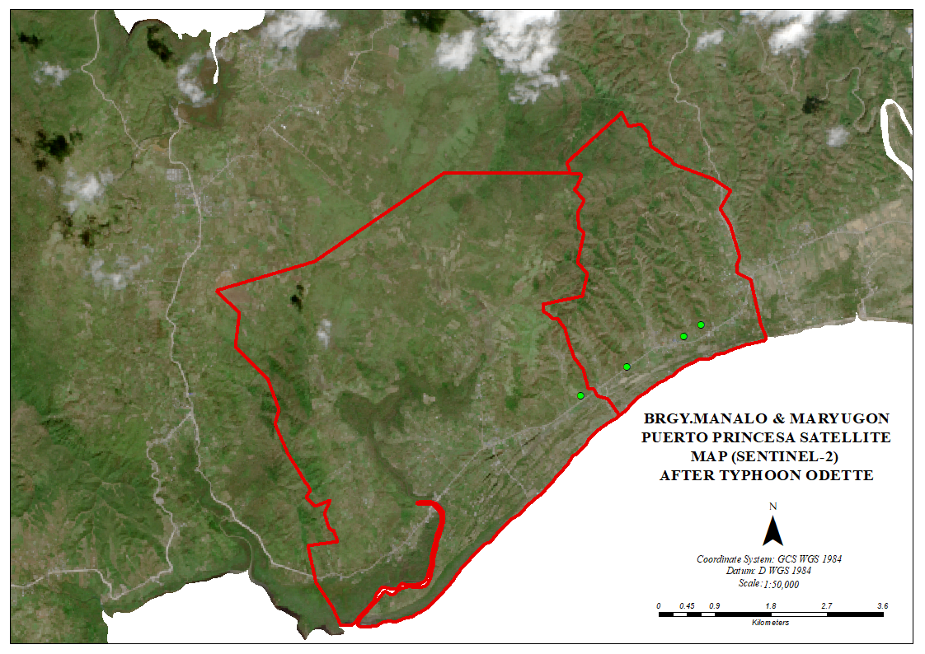
Brgy. Manalo & Maryugon, Puerto princesa city after odette
12/21/2021

Slide 4
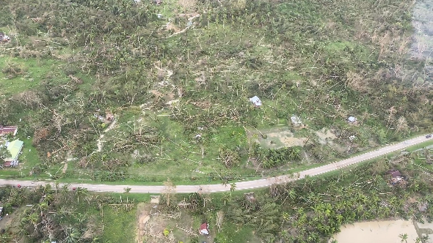
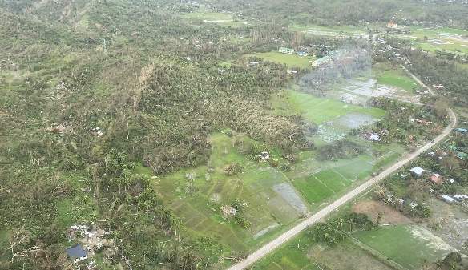
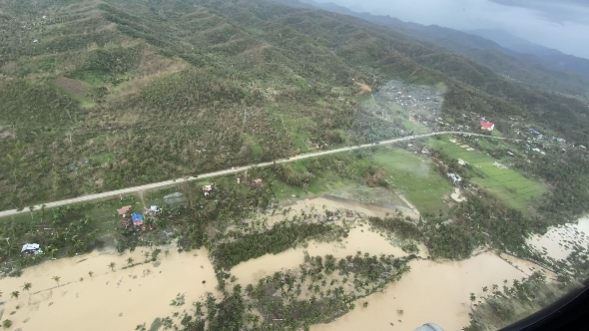
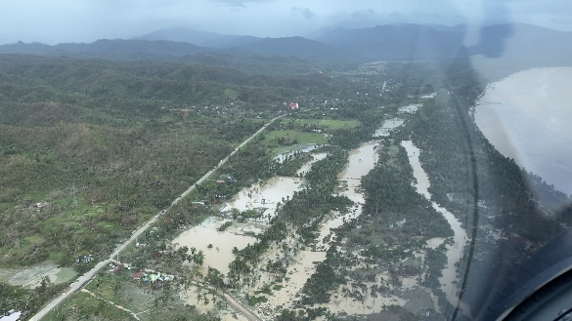
Brgy. Manalo & Maryugon, Puerto princesa city after odette
12/21/2021

Slide 5
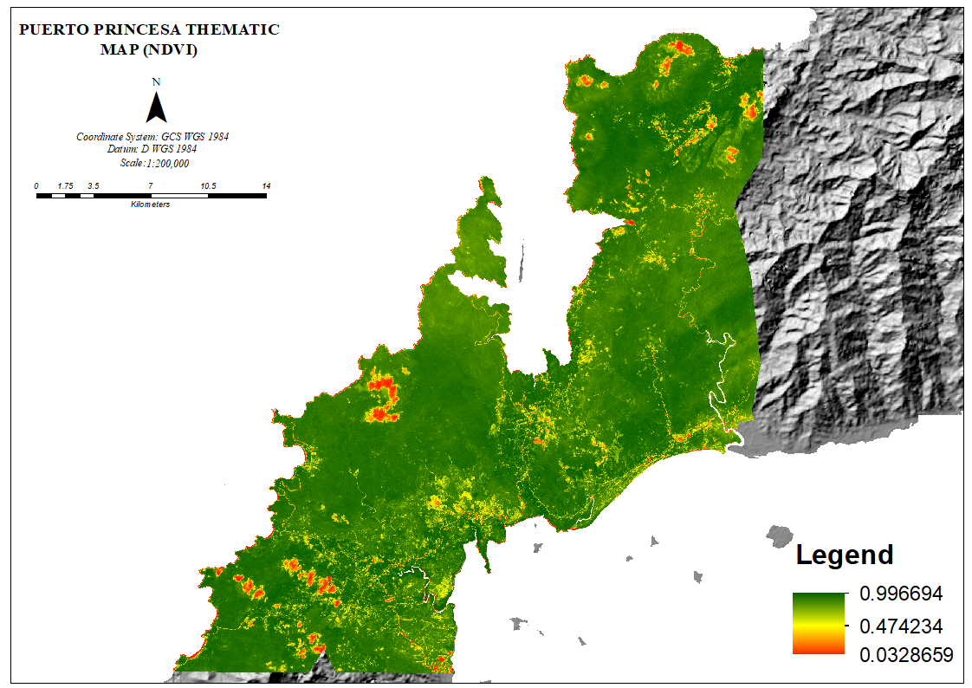
Before Odette
Municipality of Roxas, and San Vicente
08/13/2021

Slide 6
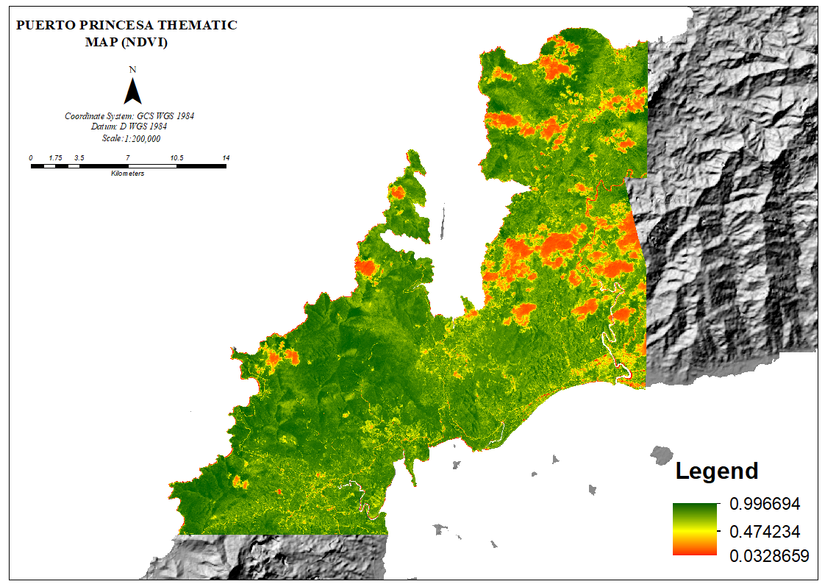
After Odette
Municipality of Roxas and San Vicente
12/21/2021

