Slide 1
YOLANDA PERMANENT HOUSING PROGRAM (YPHP)
NHA R4-MIMAROPA DISTRICT

Slide 2
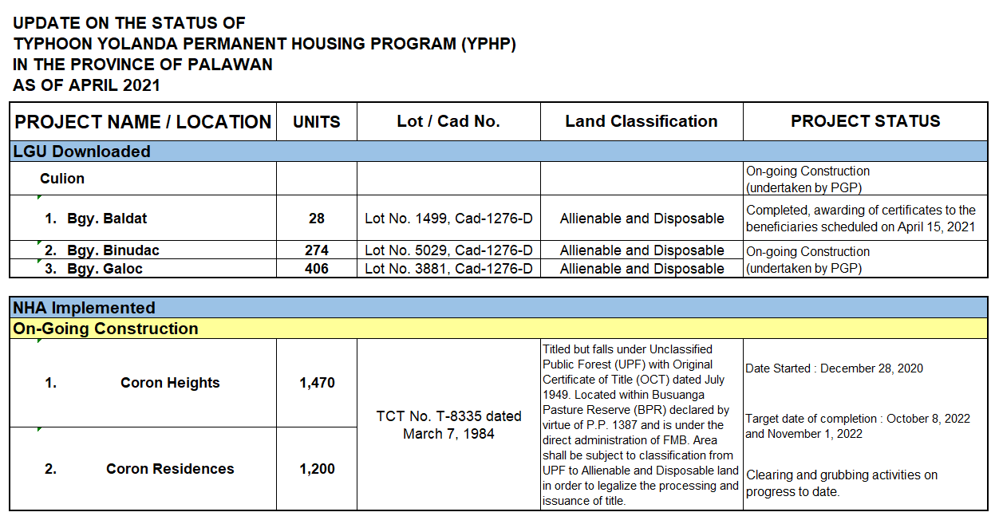

Slide 3
