Slide 1

Update on the Status of NHA’s Yolanda Permanent Housing Program (YPHP)
in The Province of Palawan
3 July 2021

Slide 2
Background Information:
Based on the total no. of families affected by Typhoon “Yolanda” in Palawan Province, some 8,760 house and lot units intended for affected families will be implemented by the Provincial Government of Palawan (PGP) through a Memorandum of Agreement (MOA) entered into between PGP and NHA on 05 February 2015.
Under NHA Resolution No. 6569 dated 28 August 2019, the Board has approved and confirmed the mutual termination of the original MOA with an amendment for PGP to undertake the remaining 708 units in the Municipality of Culion. The remaining balance shall be implemented by NHA thru regular procurement in accordance with the provisions of 2016 Revised IRR of R.A 9184, as amended.

Slide 3
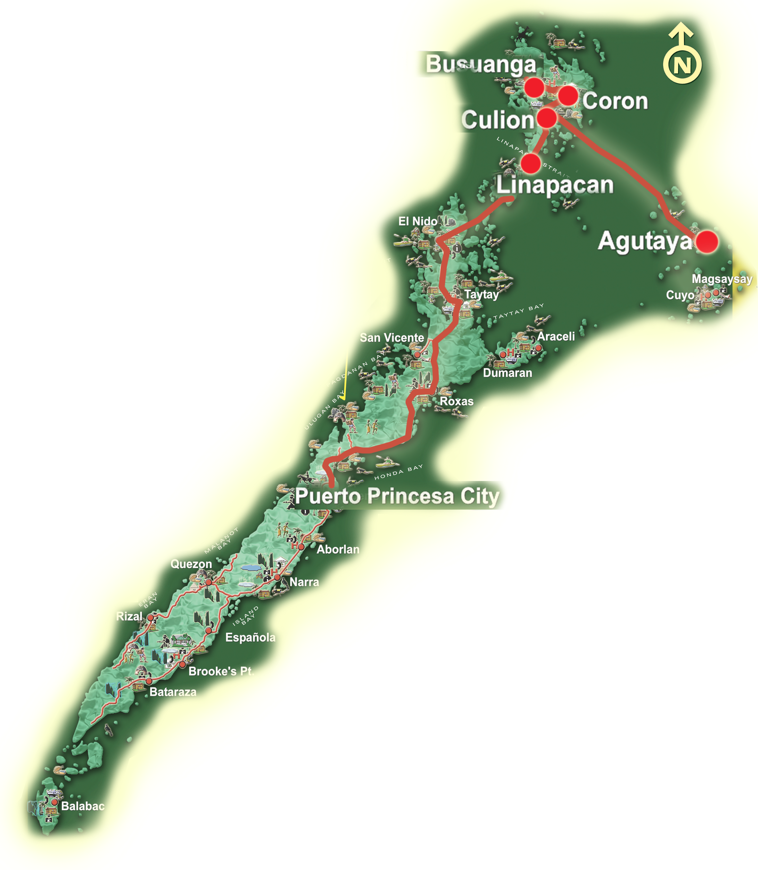
Magnitude No. of Families for provision of Permanent Resettlement Sites outside the “Unsafe Zones”
618 -
- 4,500
Location No. of Units
2,164 -
Busuanga – 618
Coron – 4,500
Culion – 2,164
Agutaya – 200
Linapacan – 1,278
TOTAL : 8,760
1,278 -
200 -

Slide 4
Update on the Status of the Remaining House & Lot Units within the Province of Palawan under the Yolanda Permanent Housing Program (YPHP)
(As of 25 June 2021)
No. | Location/Municipalities in the Province of Palawan | No. of Units for Completion | Remarks/Status
1. | Coron | 2,670
 | 1. Coron Heights | 1,470 | 8.44 % On-going land development
 | 2. Coron Residences | 1,200 | 7.77 % On-going land development
2. | Culion | 708 | For completion by the Prov. Government of Palawan (PGP).
3. | Cambian Ville Brgy. Cambian, Agutaya | 104 | The proposed project was confirmed by the NHA Board on June 29, 2021. Subject for issuance of Notice of Award.
4. | Safari Ville Brgy. Salvacion, Busuanga | 328 | The proposed project was confirmed by the NHA Board on June 29, 2021. Subject for issuance of Notice of Award.
5. | San Pablo Homes Brgy. Osmeña, Culion | 796 | The proposed project was confirmed by the NHA Board on June 29, 2021. Subject for issuance of Notice of Award.
6. | Tarabidan Ville Linapacan | 684 | The proposed project was confirmed by the NHA Board on June 29, 2021. Subject for issuance of Notice of Award.
TOTAL |  | 5,290

Slide 5
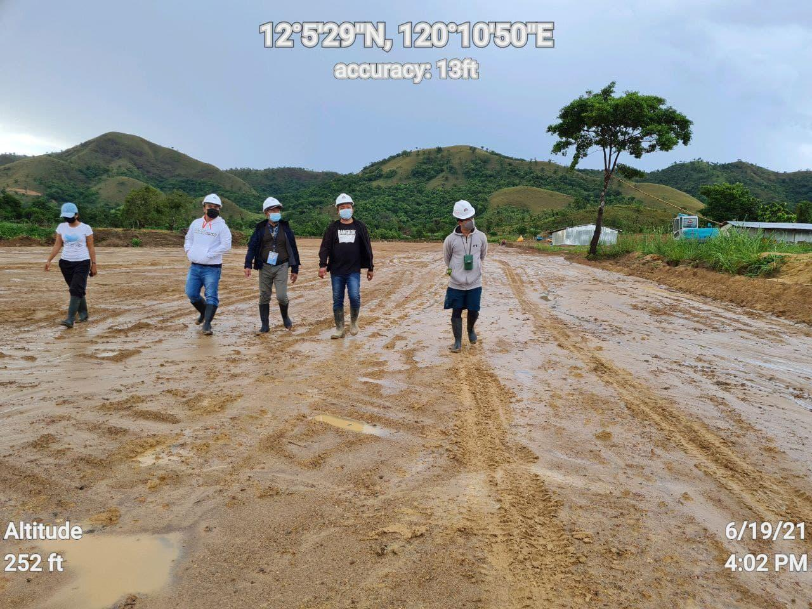
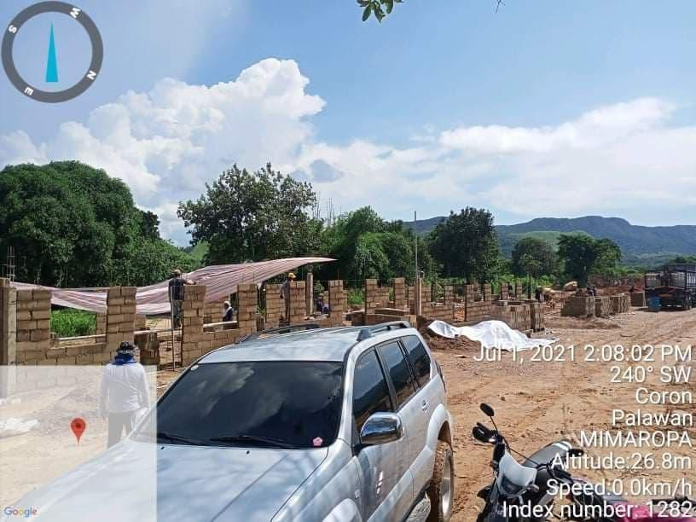
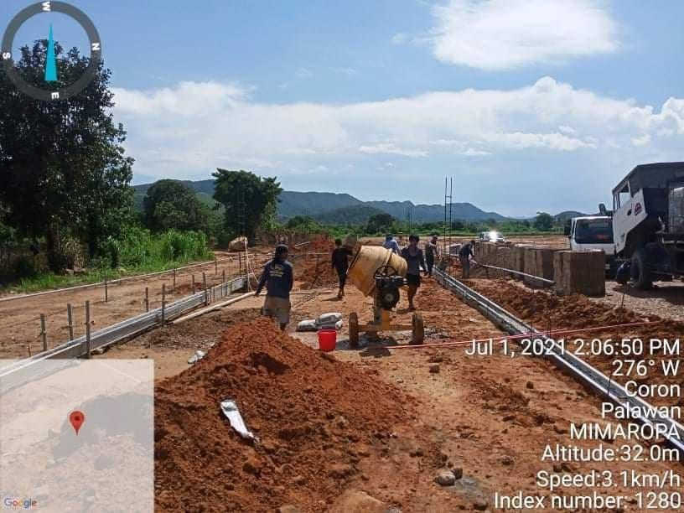
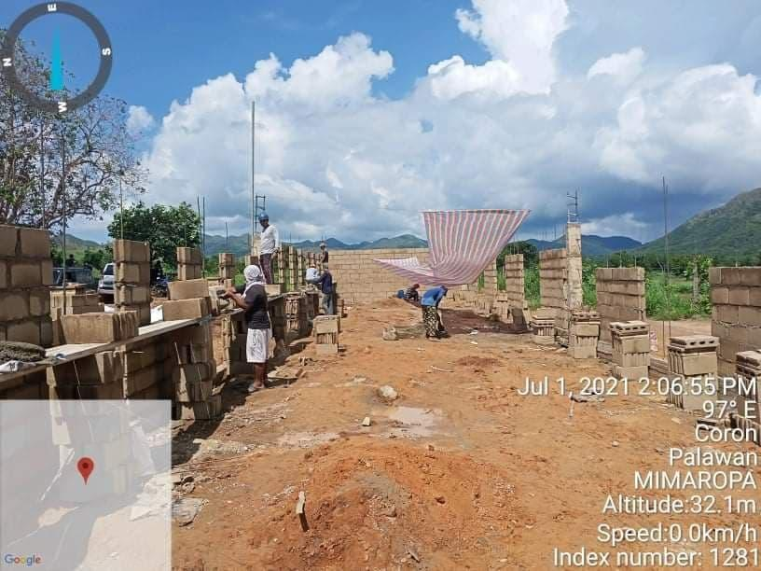
ON-GOING LAND DEVELOPMENT
AND HOUSING CONSTRUCTION AT BGY. SAN NICOLAS, CORON, PALAWAN

Slide 6
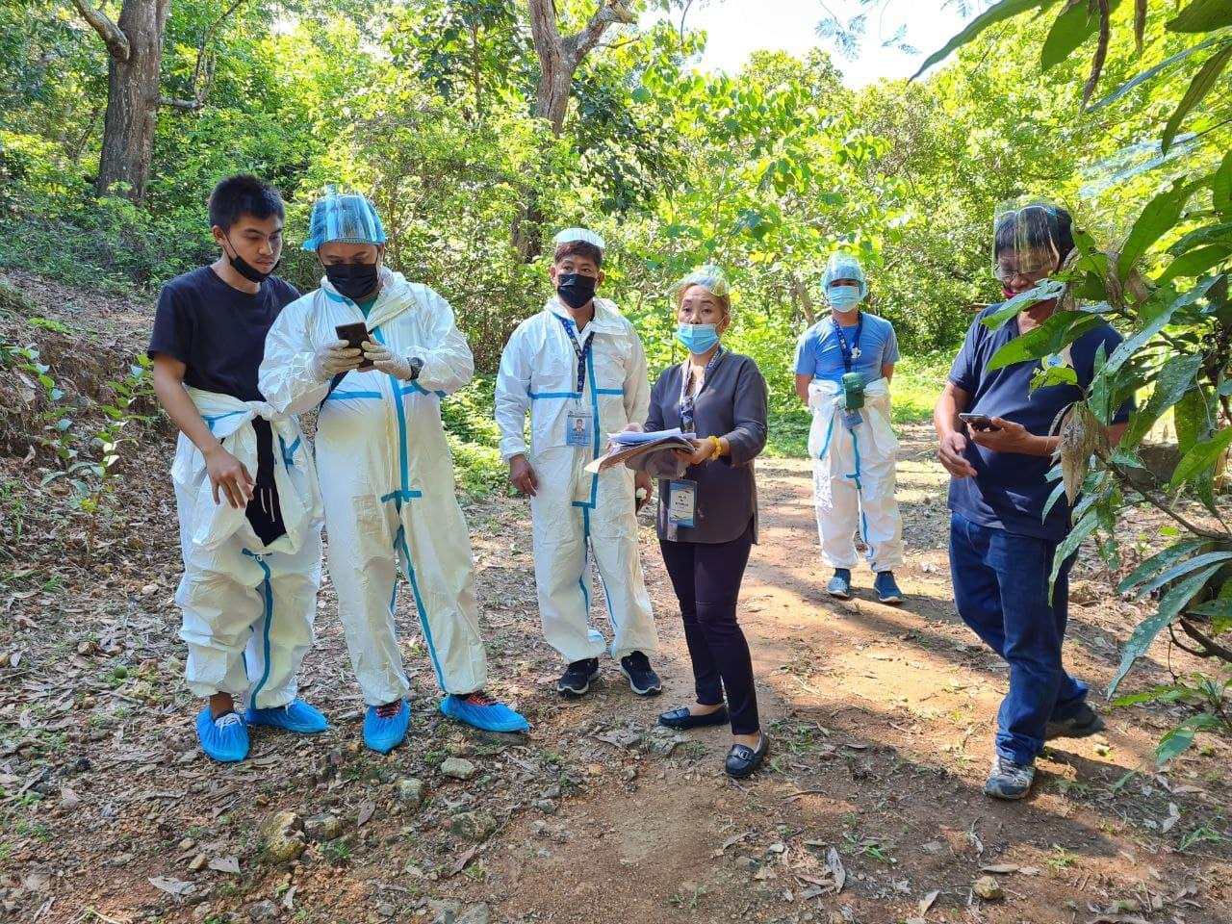
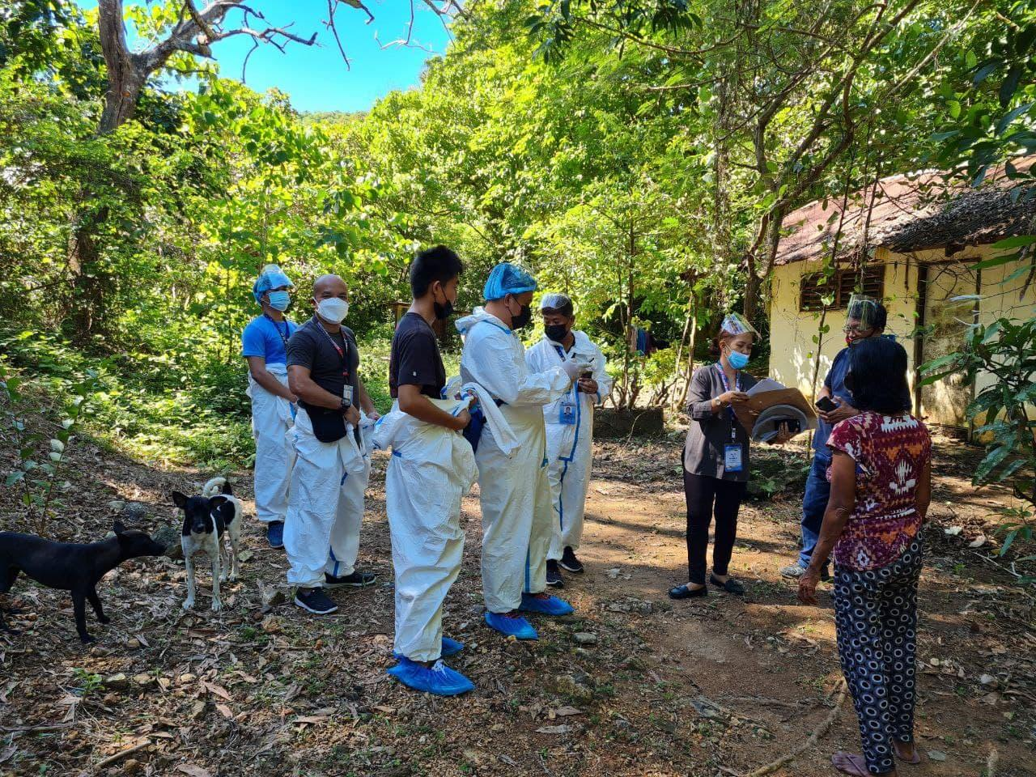
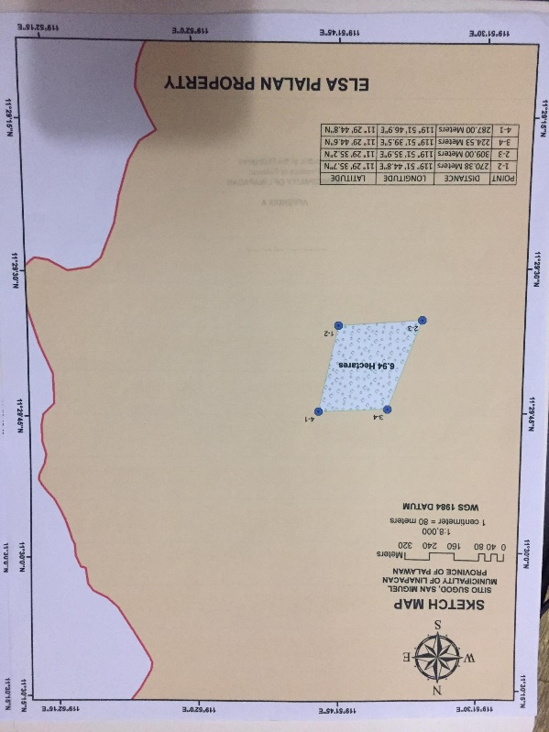
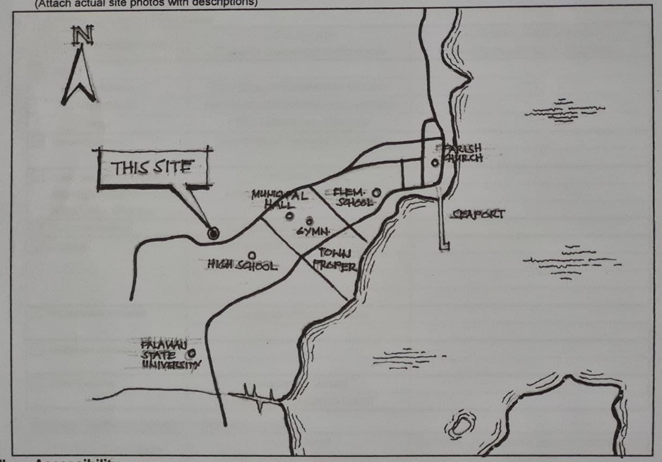
SITE INSPECTION AND EVALUATION
IN THE MUNICIPALITY OF LINAPACAN, PALAWAN

Slide 7
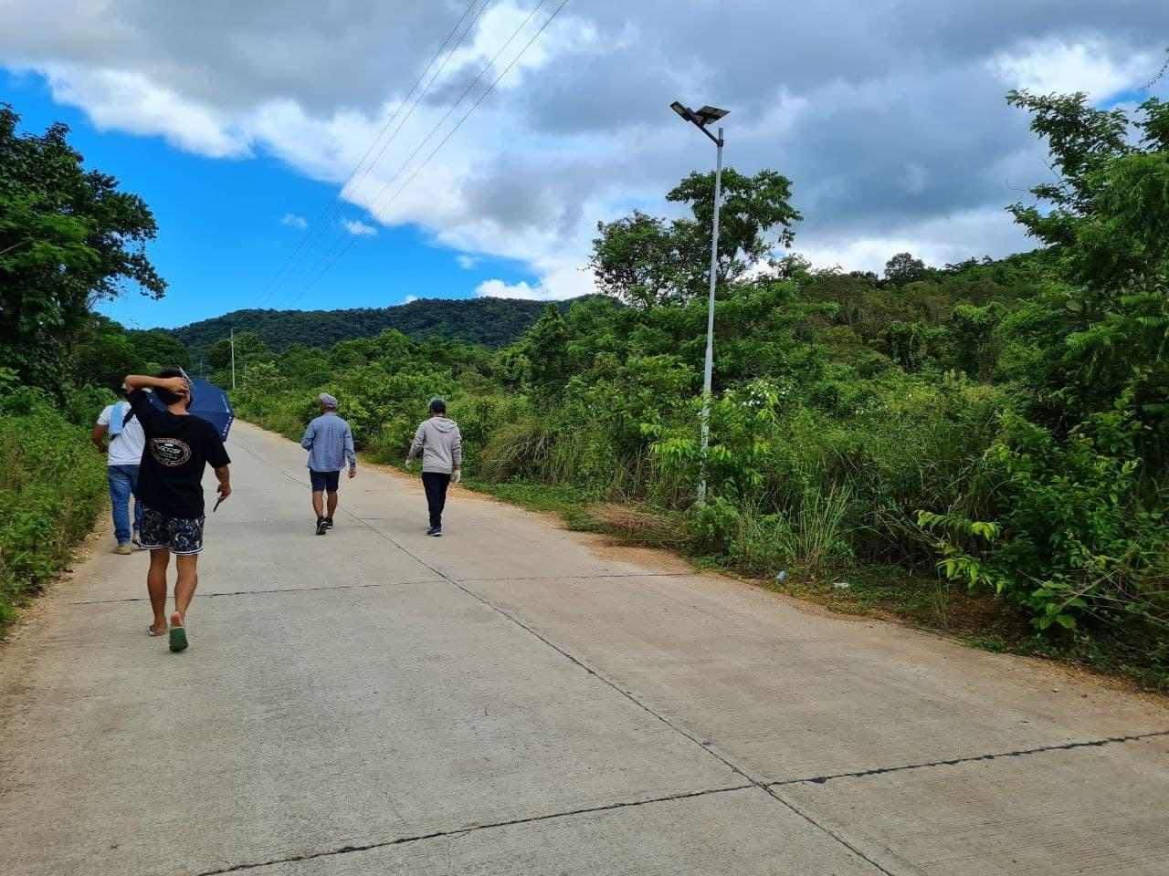
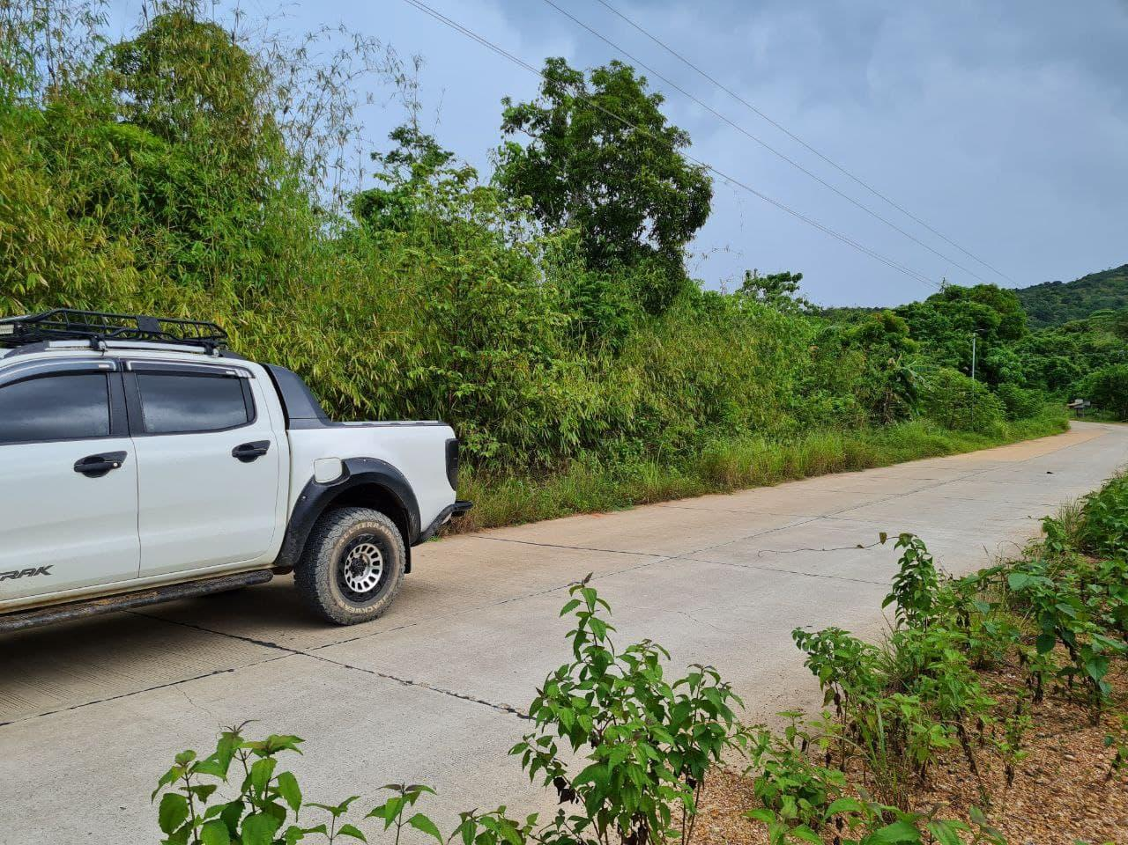
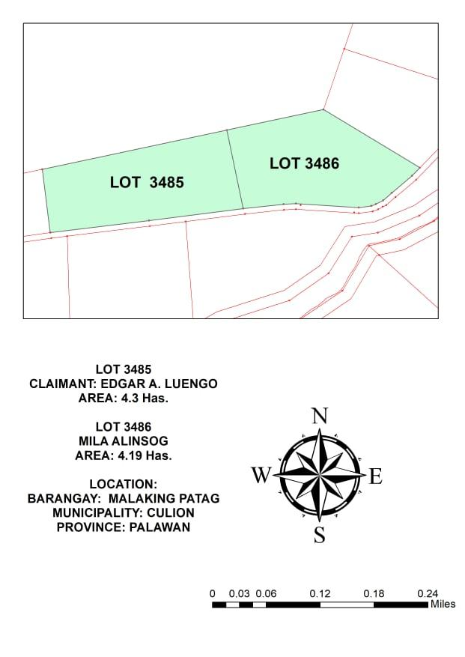
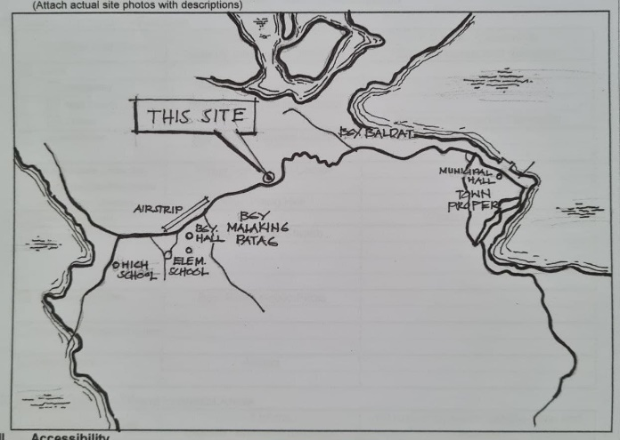
SITE INSPECTION AND EVALUATION
IN THE MUNICIPALITY OF CULION, PALAWAN

Slide 8
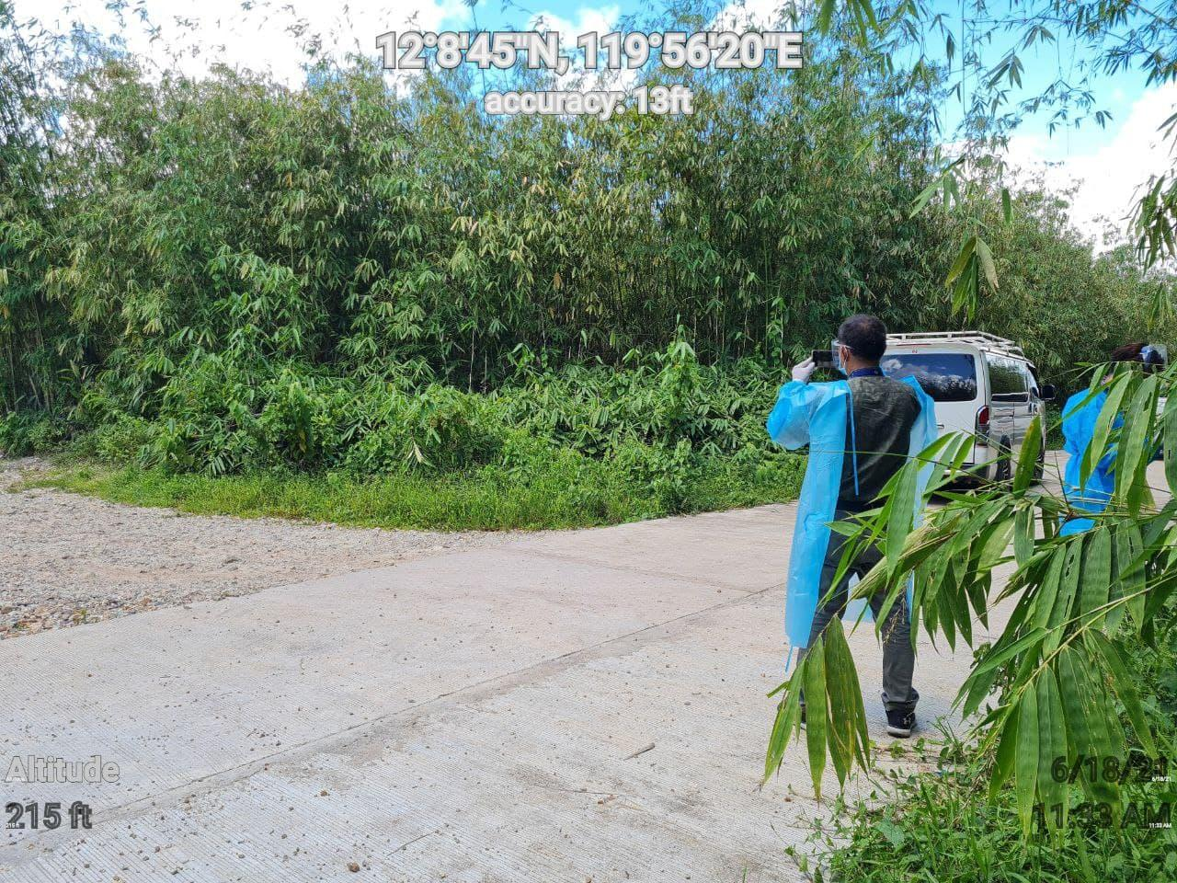
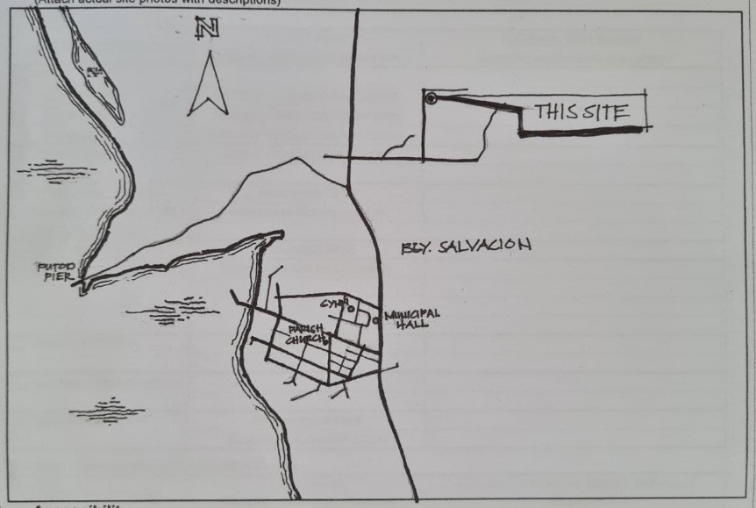
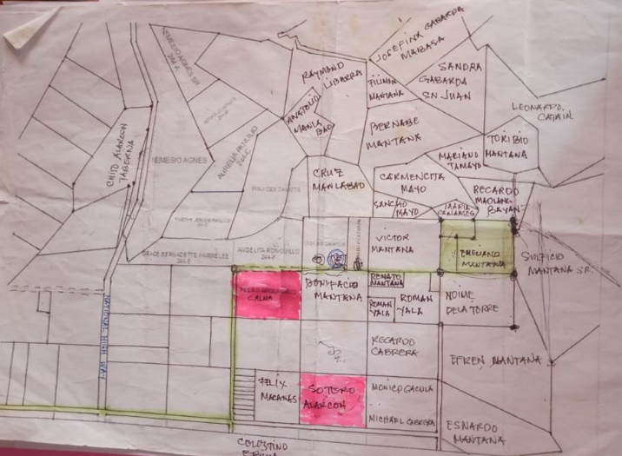
SITE INSPECTION AND EVALUATION IN THE MUNICIPALITY OF BUSUANGA, PALAWAN

Slide 9
End of Presentation…

