Slide 1

Update on the Status of NHA’s Yolanda Permanent Housing Program (YPHP)
in Palawan Province
(August 31, 2021)

Slide 2
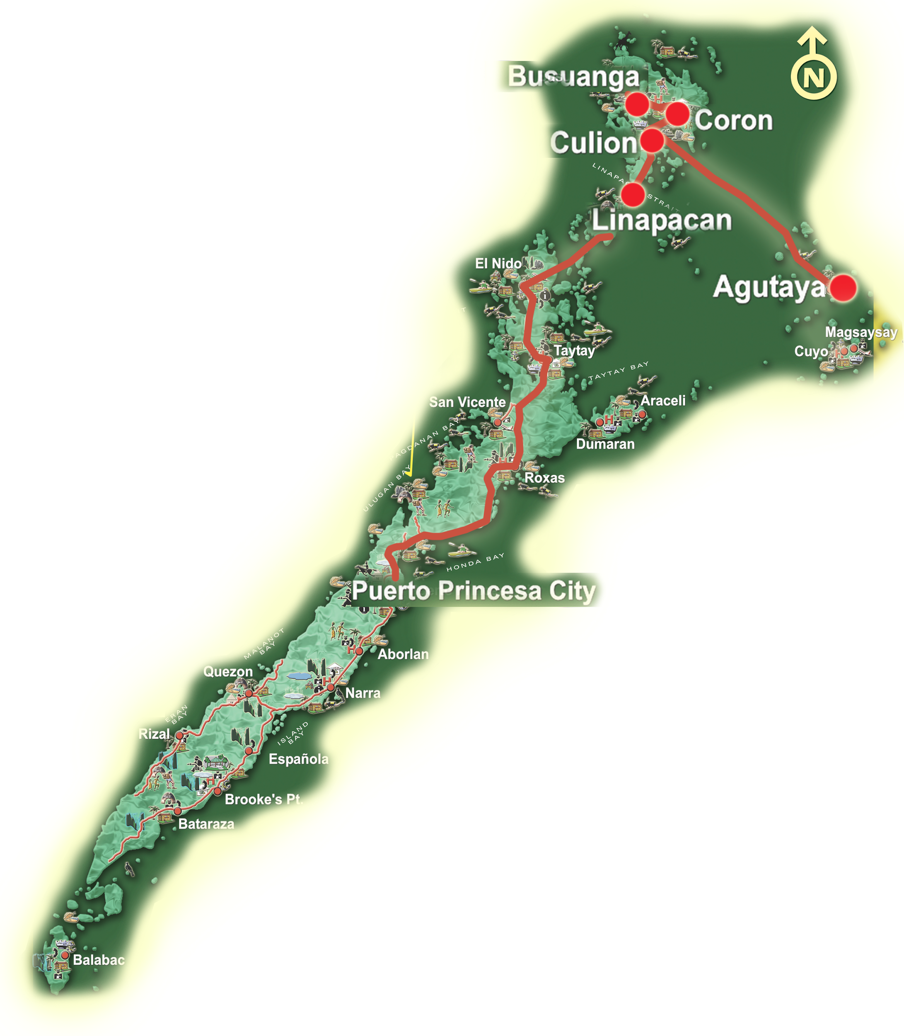
Magnitude No. of Families for provision of Permanent Resettlement Sites outside the “Unsafe Zones”
618 -
- 4,500
Location No. of Units
2,164 -
Busuanga – 618
Coron – 4,500
Culion – 2,164
Agutaya – 200
Linapacan – 1,278
TOTAL : 8,760
1,278 -
200 -

Slide 3
Update on the Status of the Remaining House & Lot Units within the Province of Palawan under the Yolanda Permanent Housing Program (YPHP)
(As of 30 June 2021)
No. | Location/Municipalities in the Province of Palawan | No. of Units for Completion | Remarks/Status
 |  |  | AO July 5, 2021 | AO August 31, 2021
1. | Coron | 2,670
 | 1. Coron Heights | 1,470 | 8.44 % On-going land development | 16.37 % On-going land development and housing construction.
 | 2. Coron Residences | 1,200 | 7.77 % On-going land development | 15.20 % On-going land development and housing construction.
2. | Culion | 708 | For completion by the Prov. Govt. of Palawan (PGP) by EO December, 2021. | With plans for termination of contract with the Provincial Government of Palawan. PGP to submit proposal.
3. | Cambian Ville Brgy. Cambian, Agutaya | 104 | The proposed project was confirmed by the NHA Board on June 29, 2021. For issuance of Notice of Award. | With Notice of Award. On-going compliances prior to issuance of Notice to Proceed
4. | Safari Ville Brgy. Salvacion, Busuanga | 328 | The proposed project was confirmed by the NHA Board on June 29, 2021. For issuance of Notice of Award. | With Notice of Award. On-going compliances prior to issuance of Notice to Proceed
5. | San Pablo Homes Brgy. Osmeña, Culion | 796 | The proposed project was confirmed by the NHA Board on June 29, 2021. For issuance of Notice of Award. | With Notice of Award. On-going compliances prior to issuance of Notice to Proceed
6. | Tarabidan Ville Linapacan | 684 | The proposed project was confirmed by the NHA Board on June 29, 2021. For issuance of Notice of Award. | With Notice of Award. On-going compliances prior to issuance of Notice to Proceed
TOTAL |  | 5,290

Slide 4
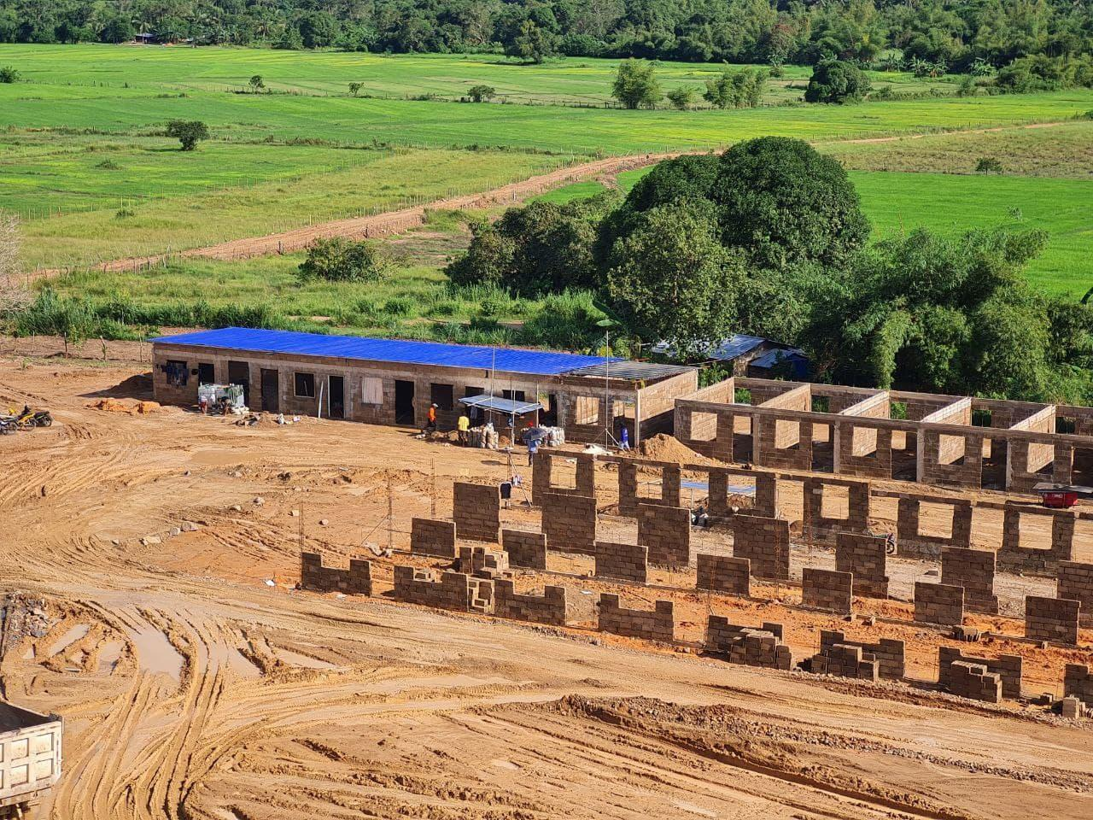
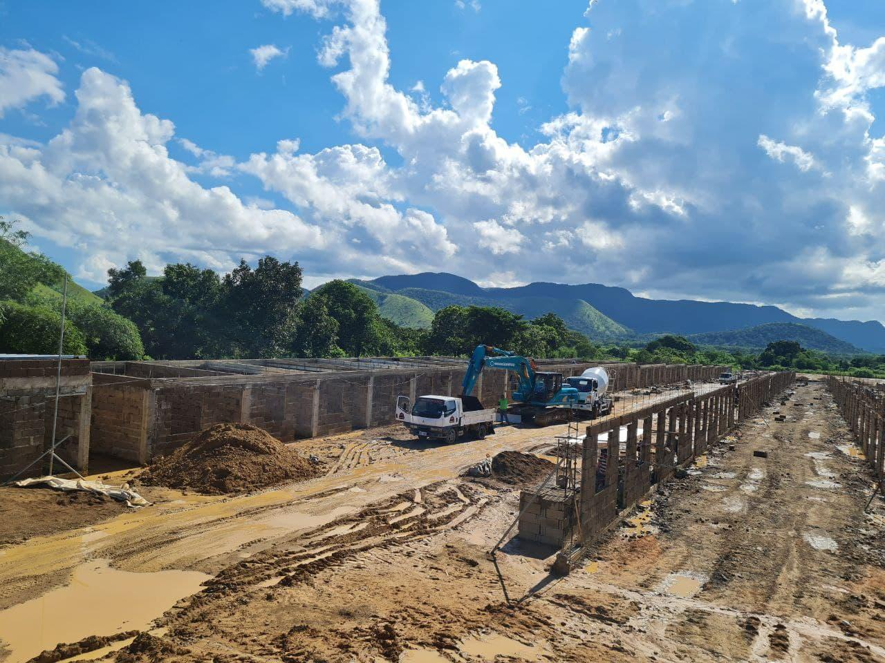
ON GOING LAND DEVELOPMENT AND HOUSING CONSTRUCTION IN THE MUNICIPALITY OF CORON, PALAWAN

Slide 5
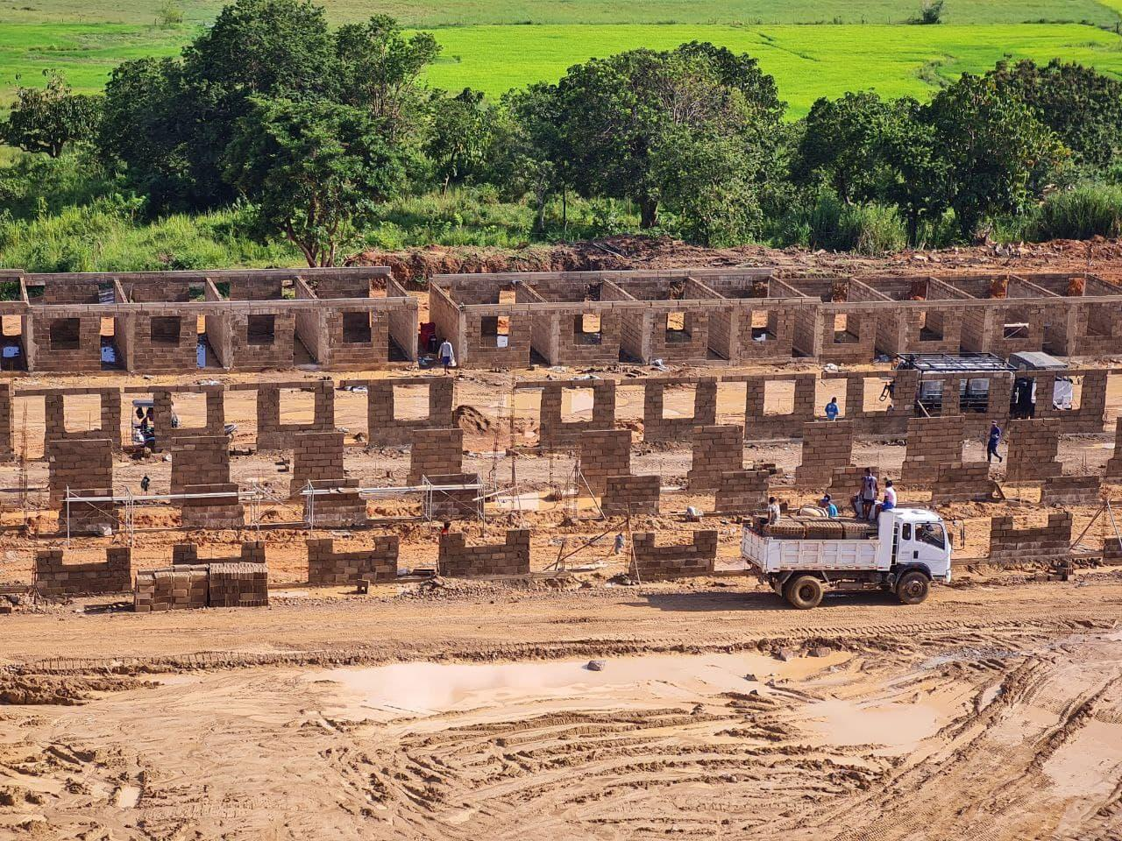
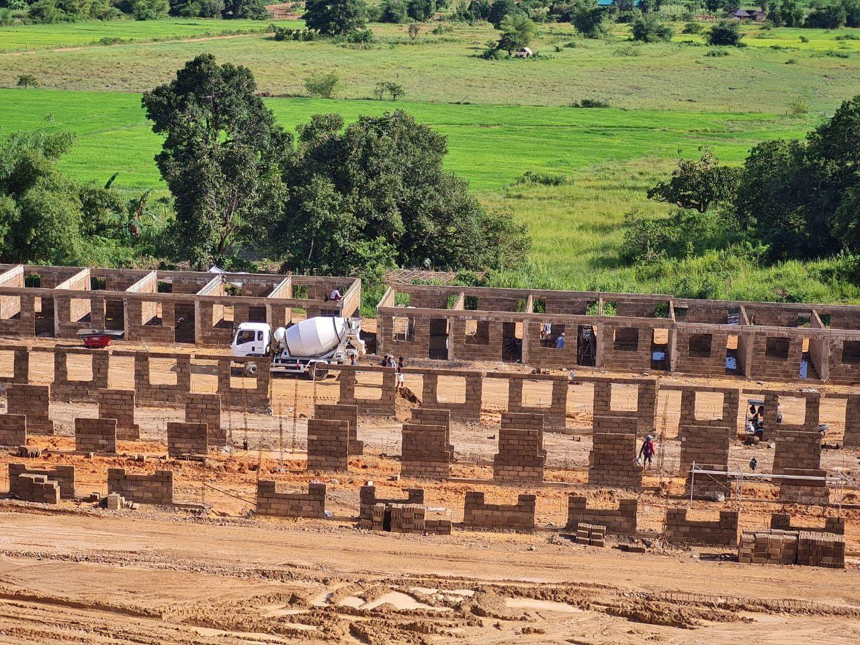

Slide 6
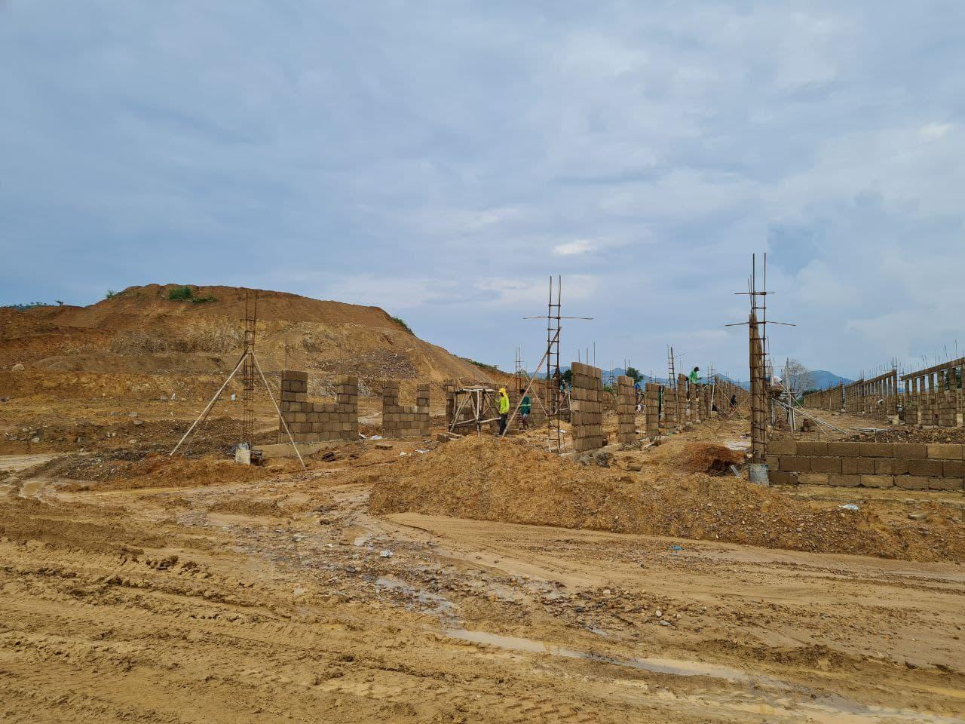
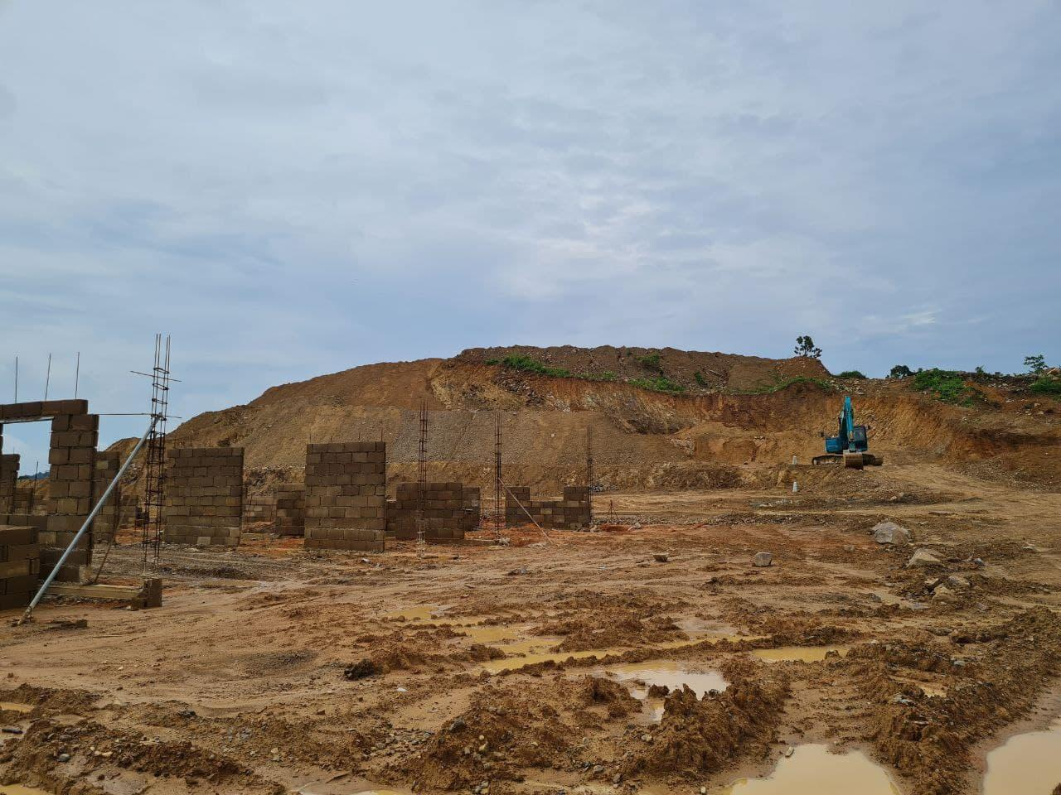

Slide 7
End of Presentation…
THANK YOU

