Slide 1

Update on the Status of NHA’s Yolanda Permanent Housing Program (YPHP)
in Palawan Province
(October 25, 2021)

Slide 2
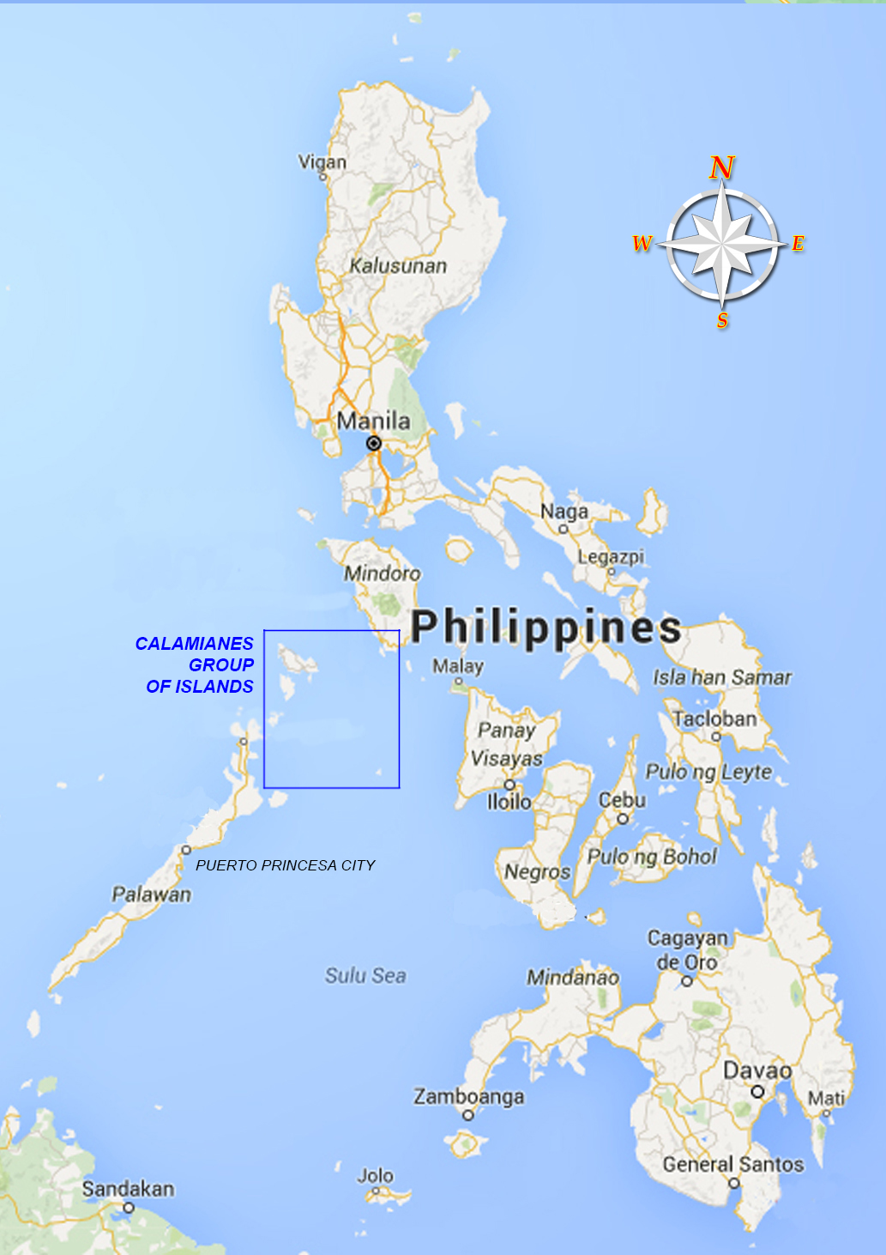
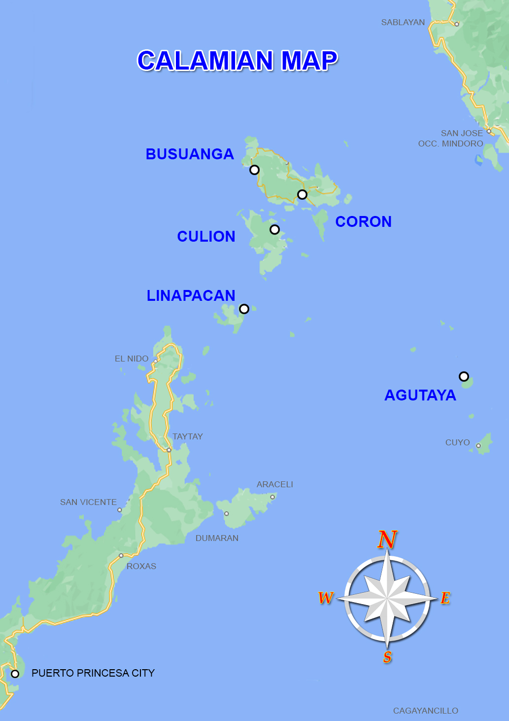
Map of the Philippines

Slide 3
Update on the Status of the Remaining House & Lot Units within the Province of Palawan under the Yolanda Permanent Housing Program (YPHP)
(As of 25 October 2021)
No. | Location/Municipalities in the Province of Palawan | No. of Units for Completion | Remarks/Status
 |  |  | AO August 25, 2021 | AO October 25, 2021
1. | Coron | 2,670
 | 1. Coron Heights | 1,470 | 16.37 % On-going land development and housing construction. | On-going Land Development and construction of 224 Housing Units. 26.75% accomplished. | Processing of Environmental Permits and Clearances is on-going. (SEP/PCSD, ECC). DENR, PCSD and other concerned agencies will facilitate in the land conversion from Forestland to Alienable and Disposable.
 | 2. Coron Residences | 1,200 | 15.20 % On-going land development and housing construction. | On-going Land Development and construction of 255 Housing Units. 26.54% accomplished.
2. | Culion (PGP implemented) | 708 | For completion by the Prov. Govt. of Palawan (PGP) by EO December, 2021. | For completion by the Prov. Govt. of Palawan (PGP) by EO December, 2021. 40% completed (as per report of Engr. Ranford Villegas of PGP) as of October 22, 2021.
3. | Villa Cambian Brgy. Cambian, Agutaya | 104 | With Notice of Award. On-going compliances prior to issuance of Notice to Proceed | - Land Classification of selected site is UPF. With Notice of Award. On-going compliances prior to issuance of Notice to Proceed. DENR, PCSD and other concerned agencies will facilitate in land classification of the selected site.
4. | Safari Ville Brgy. Salvacion, Busuanga | 328 | With Notice of Award. On-going compliances prior to issuance of Notice to Proceed | Selected site is Alienable and Disposable, but the access road is within timberland. With Notice of Award. On-going compliances prior to issuance of Notice to Proceed.
5. | San Pablo Homes Brgy. Osmeña, Culion | 796 | With Notice of Award. On-going compliances prior to issuance of Notice to Proceed | Land Classification of selected site is Alienable and Disposable. Land Development and Housing Plans reviewed and endorsed to Regional Office for approval.
6. | Tarabidan Ville Bgy. San Miguel, Linapacan | 684 | With Notice of Award. On-going compliances prior to issuance of Notice to Proceed | - Land Classification of selected site is UPF. With Notice of Award. On-going compliances prior to issuance of Notice to Proceed. DENR, PCSD and other concerned agencies will facilitate in land classification of the selected site.
Total |  | 5,290

Slide 4
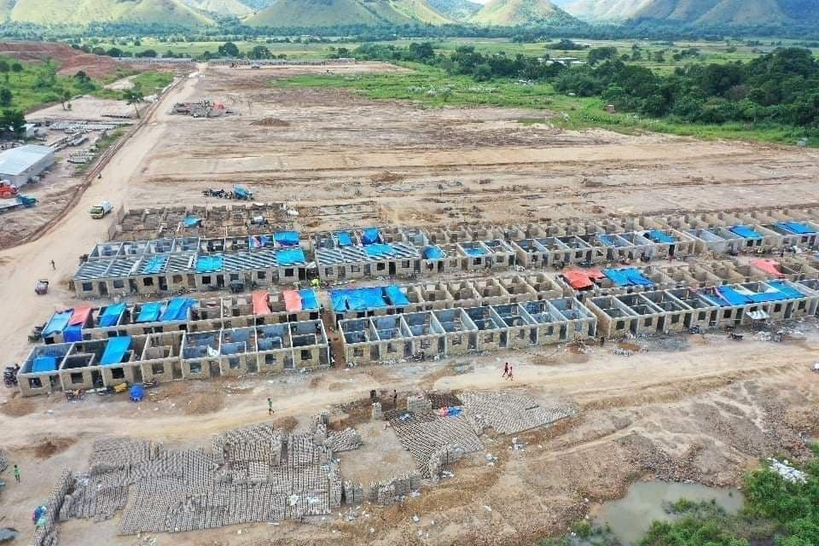
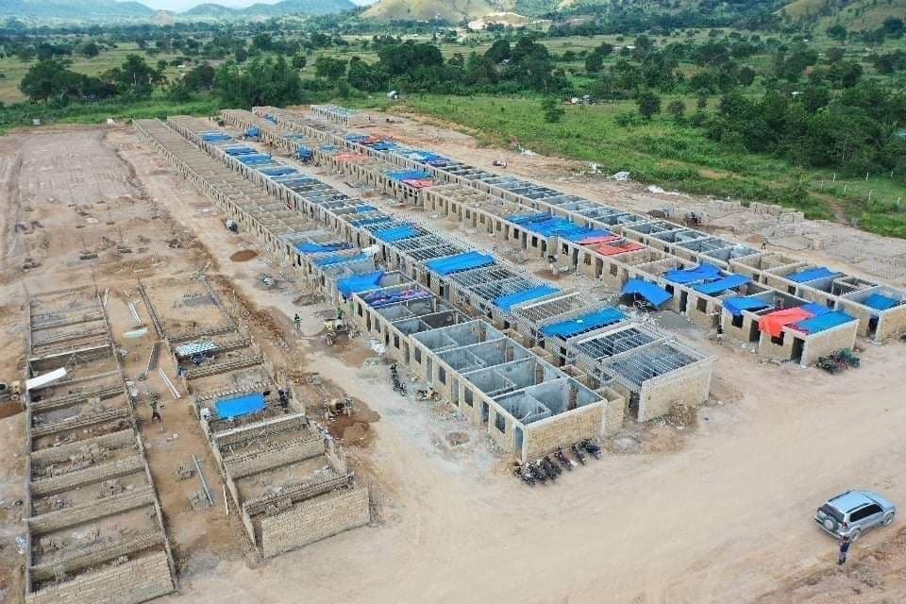
ON GOING LAND DEVELOPMENT AND HOUSING CONSTRUCTION IN CORON HEIGHTS, BGY. SAN NICOLAS, CORON, PALAWAN

Slide 5
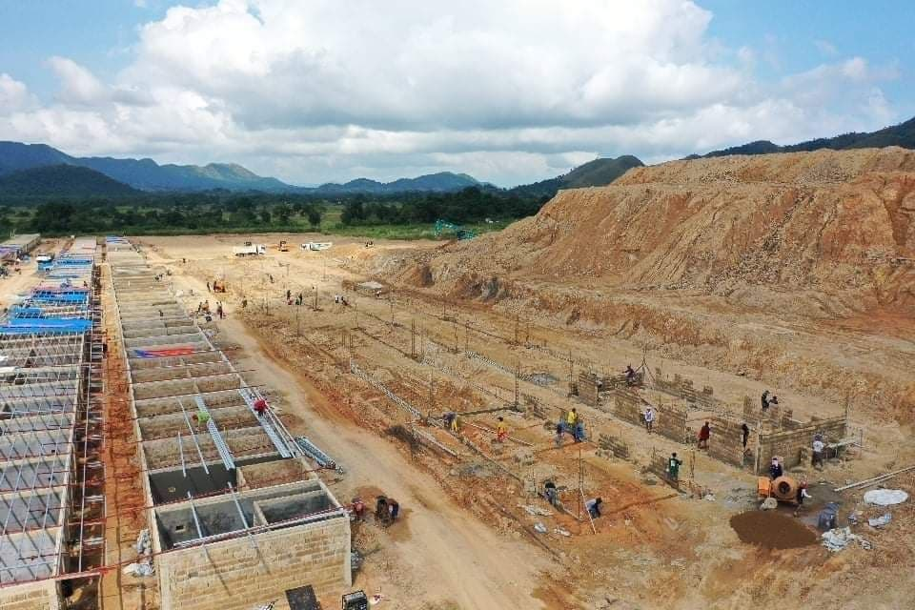
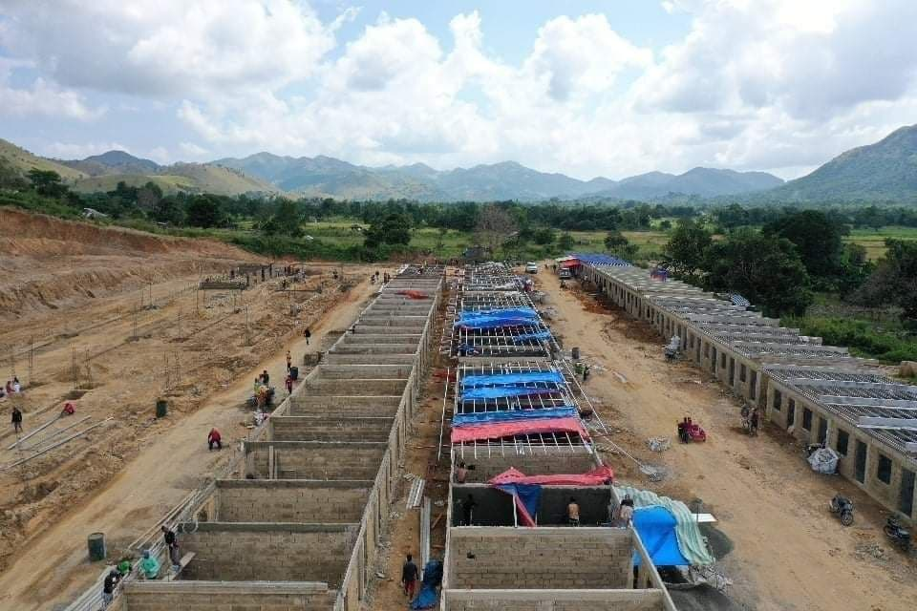
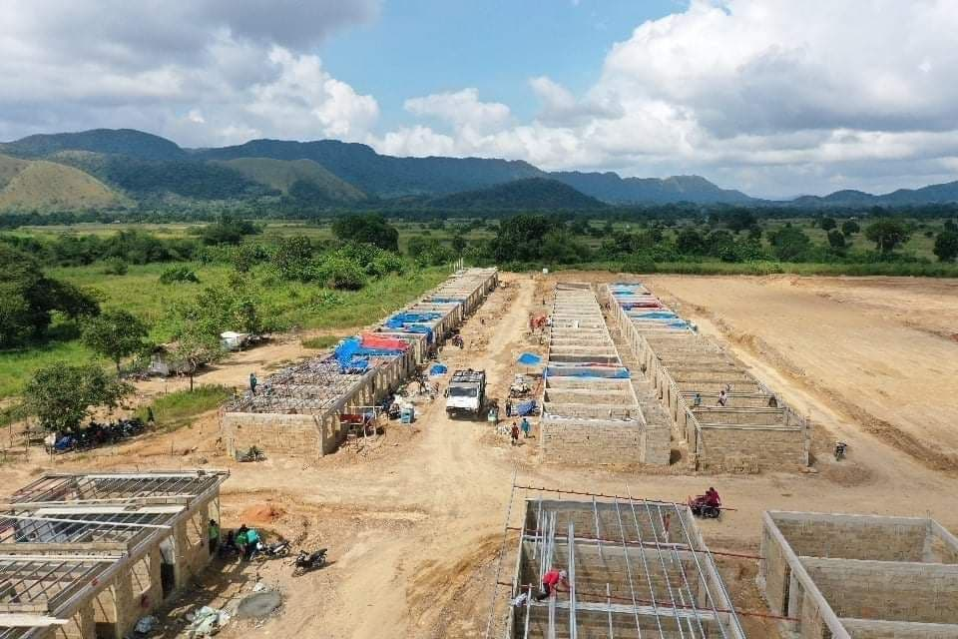
ON GOING LAND DEVELOPMENT AND HOUSING CONSTRUCTION IN CORON RESIDENCES, BGY. SAN NICOLAS, CORON, PALAWAN

Slide 6
End of Presentation…
THANK YOU

