Slide 1

Update on the Status of NHA’s Yolanda Permanent Housing Program (YPHP)
in Palawan Province
(December 14, 2021)

Slide 2
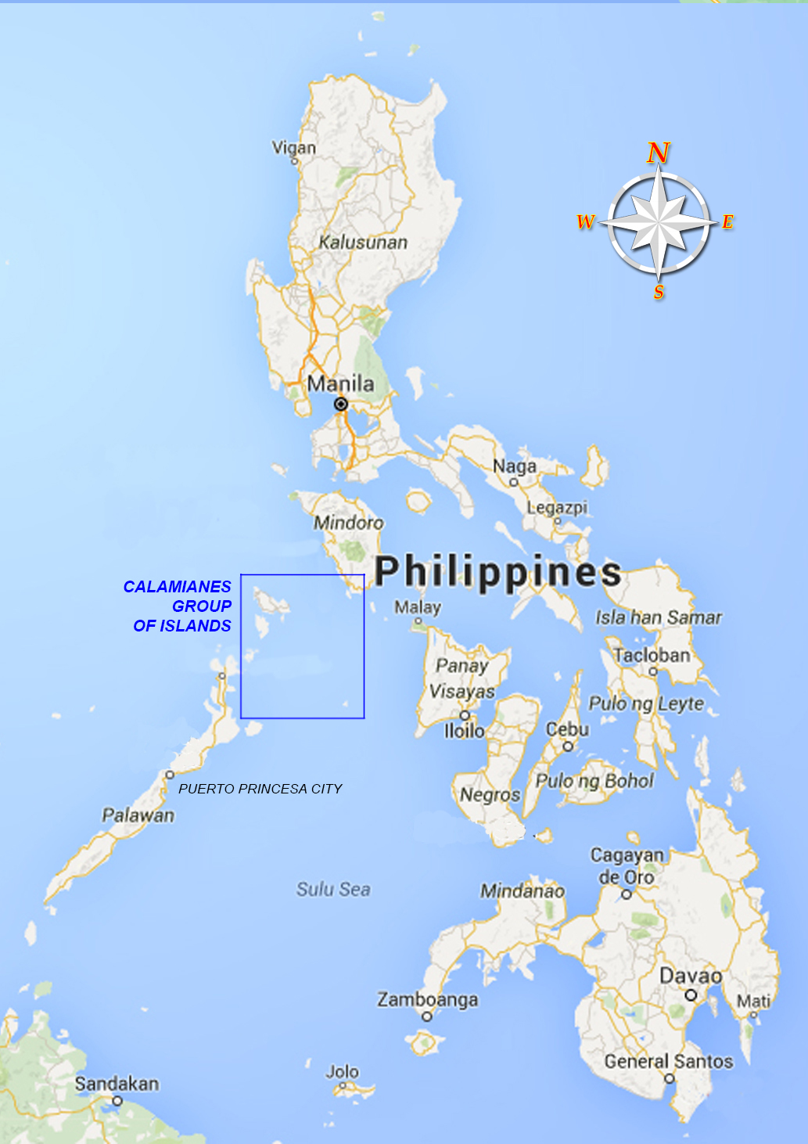
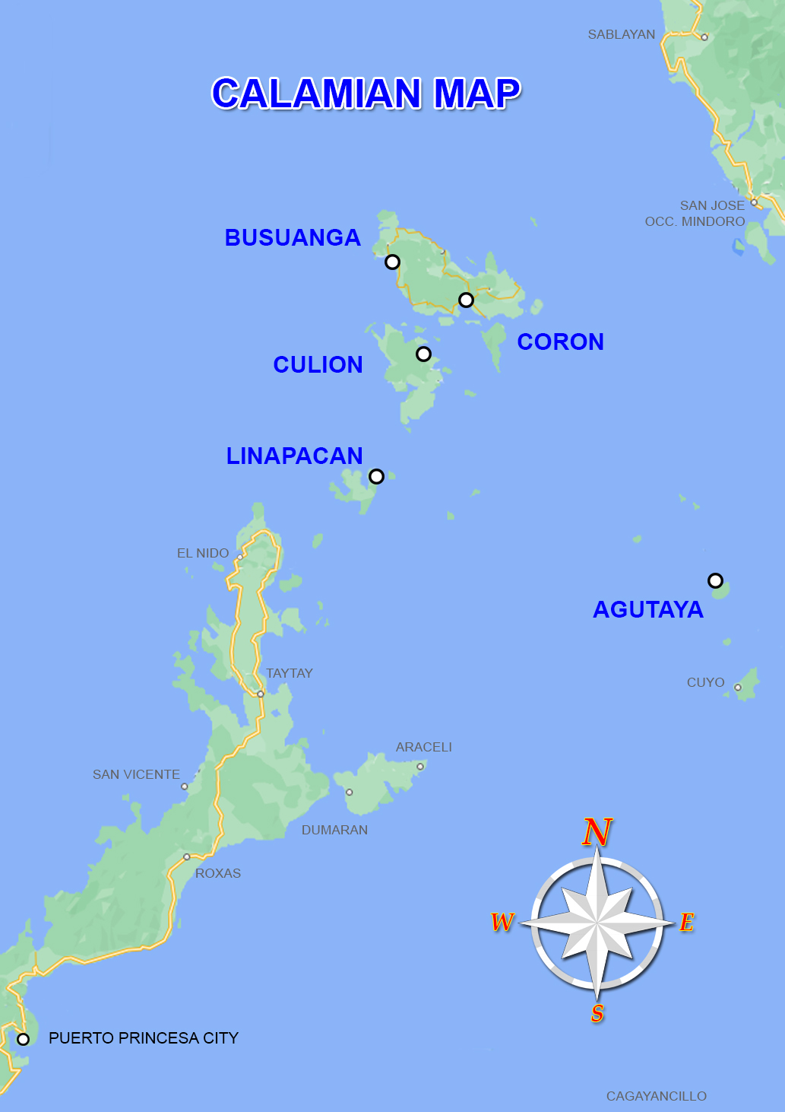
Map of the Philippines

Slide 3
Update on the Status of the Remaining House & Lot Units within the Province of Palawan under the Yolanda Permanent Housing Program (YPHP)
(As of 14 December 2021)
No. | Location/Municipalities in the Province of Palawan | No. of Units for Completion | Remarks/Status
 |  |  | AO October 25, 2021 | AO December 14, 2021
1. | Coron Heights Bgy. San Nicolas, Coron, Palawan | 1,470 | On-going Land Development and construction of 224 Housing Units. | On-going Land Development and construction of 500 Housing Units. 27.22% accomplished. | Processing of Environmental Permits and Clearances is on-going. (SEP/PCSD, ECC). DENR, PCSD and other concerned agencies will facilitate in the land conversion from Forestland to Alienable and Disposable.
2. | Coron Residences Bgy. San Nicolas, Coron, Palawan | 1,200 | On-going Land Development and construction of 255 Housing Units. | On-going Land Development and construction of 500 Housing Units. 27.55% accomplished.
3. | Villa Cambian Brgy. Cambian, Agutaya | 104 | With Notice of Award. On-going compliances prior to issuance of Notice to Proceed | - Land Classification of selected site is UPF. With Notice of Award. On-going compliances prior to issuance of Notice to Proceed. DENR, PCSD and other concerned agencies will facilitate in land classification of the selected site.
4. | Safari Ville Brgy. Salvacion, Busuanga | 328 | With Notice of Award. On-going compliances prior to issuance of Notice to Proceed | NTP Received by the contractor on December 6, 2021
5. | San Pablo Homes Brgy. Osmeña, Culion | 796 | With Notice of Award. On-going compliances prior to issuance of Notice to Proceed | NTP Received by the contractor on December 6, 2021
6. | Tarabidan Ville Bgy. San Miguel, Linapacan | 684 | With Notice of Award. On-going compliances prior to issuance of Notice to Proceed | - Land Classification of selected site is UPF. - With Notice of Award. On-going compliances prior to issuance of Notice to Proceed. - DENR, PCSD and other concerned agencies will facilitate in land classification of the selected site.
7. | Baldat (PGP implemented) Bgy. Baldat, Culion, Palawan | 28 | -
8. | Binudac (PGP implemented) Bgy. Binudac, Culion, Palawan | 274 | -
9. | Galoc (PGP implemented) Bgy. Galoc, Culion, Palawan | 406 | -
Total |  | 5,290

Slide 4
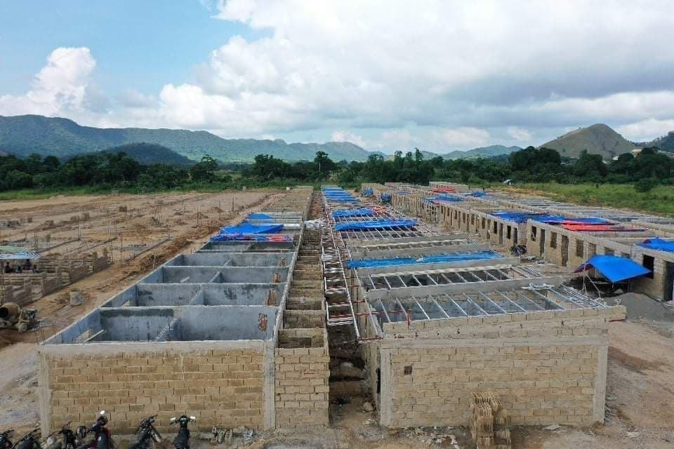
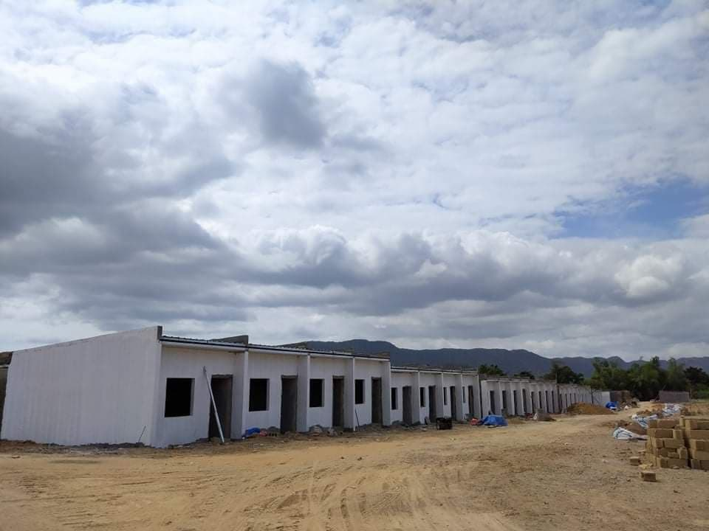
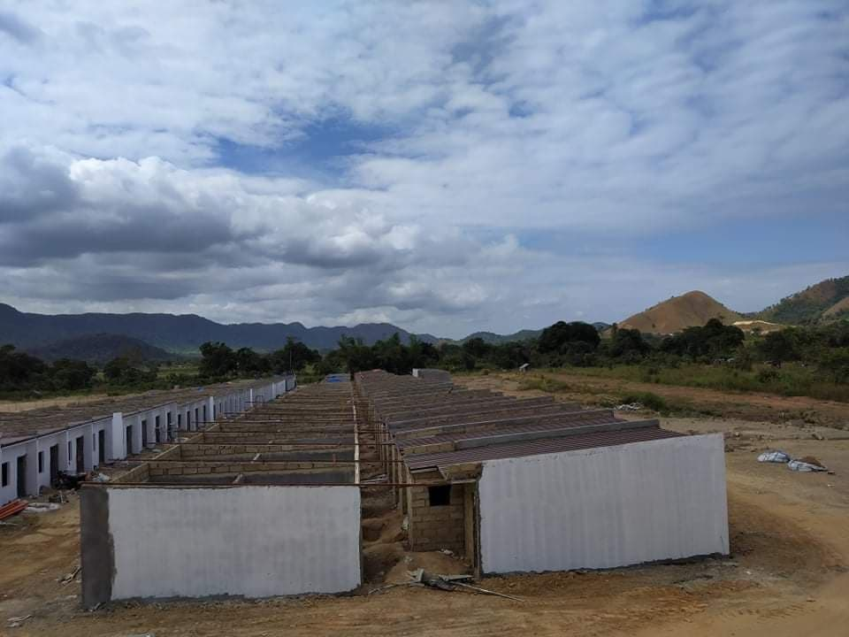
ON GOING LAND DEVELOPMENT AND HOUSING CONSTRUCTION IN CORON HEIGHTS, BGY. SAN NICOLAS, CORON, PALAWAN

Slide 5
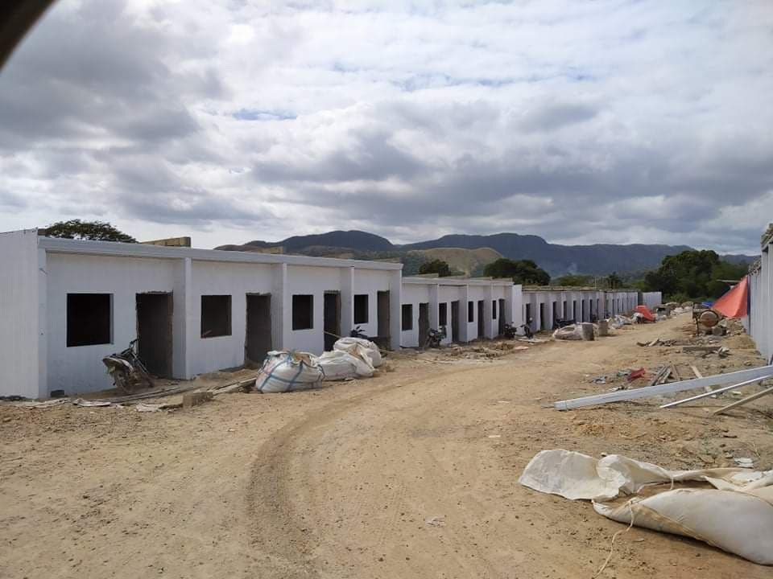
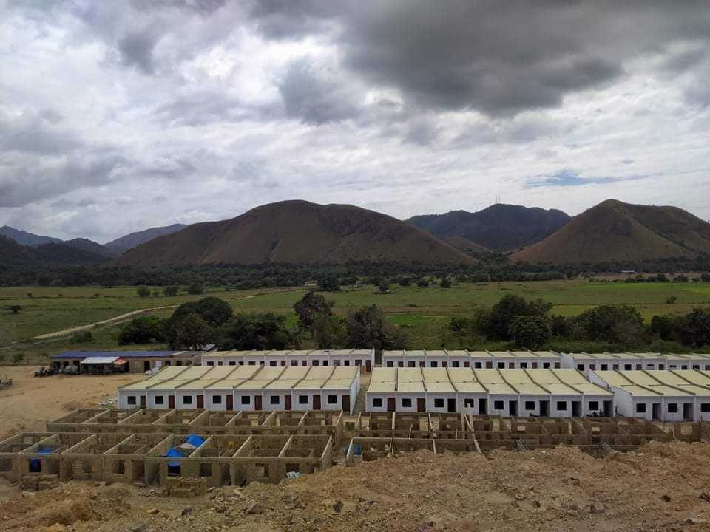
ON GOING LAND DEVELOPMENT AND HOUSING CONSTRUCTION IN CORON RESIDENCES, BGY. SAN NICOLAS, CORON, PALAWAN

Slide 6
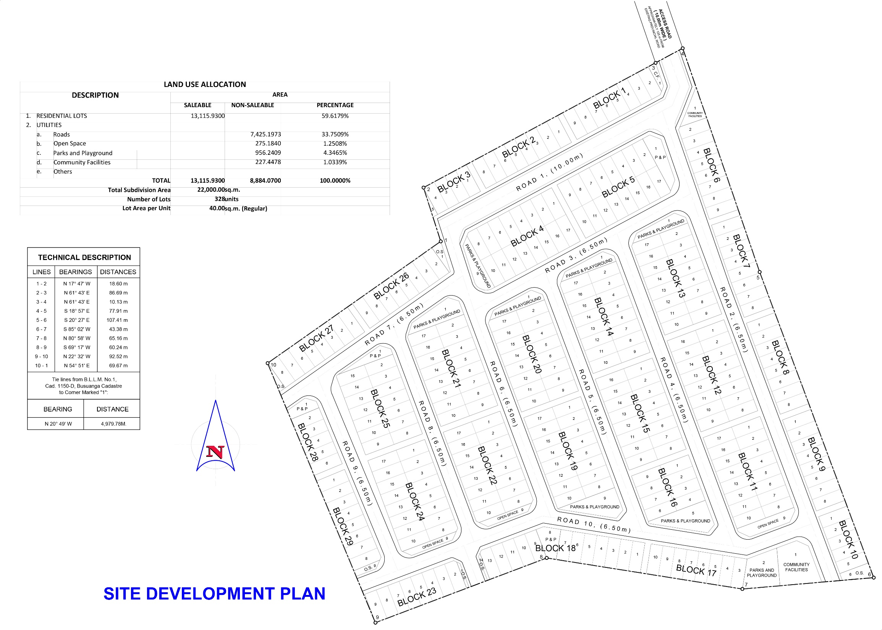
SAFARI VILLE
Bgy. Old Busuanga, Busuanga, Palawan

Slide 7
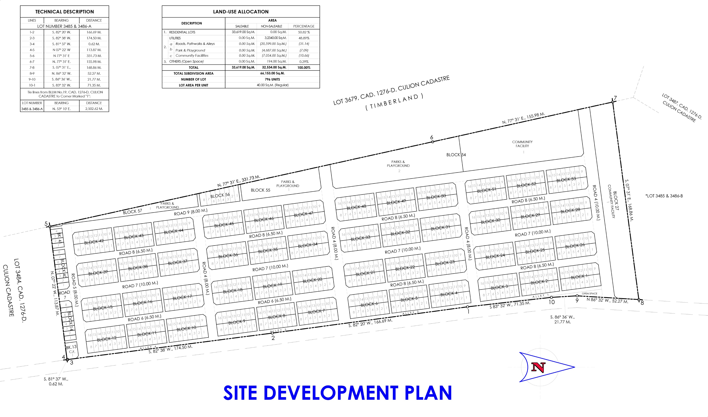
SAN PABLO HOMES
Bgy. Malaking Patag, Culion, Palawan

Slide 8
End of Presentation…
THANK YOU

