Slide 1

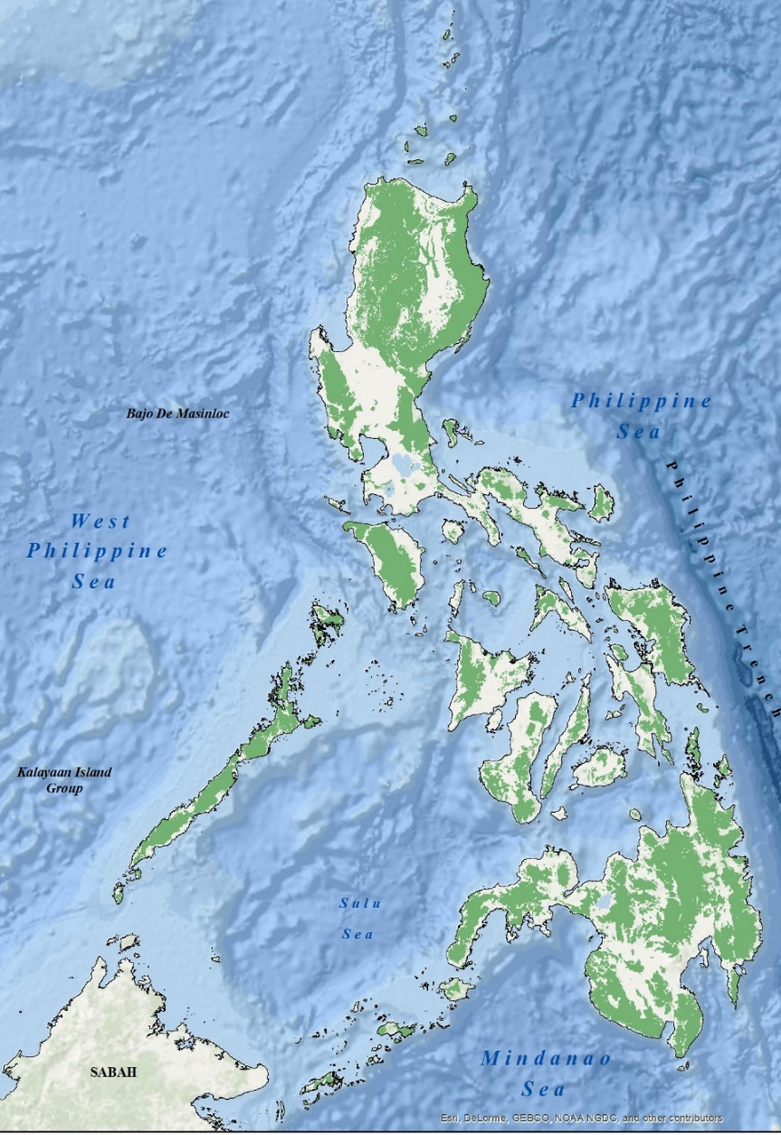


Process of Land Classification and Reclassification
BEATA D. BATADLAN
Chief, Land Classification Division
Resource Data Analysis Branch
National Mapping and Resource Information Authority
Review and Updating of the Results of the FLBD in Palawan
Notes:
Good Morning Everyone. My presentation is about the Process of Land Classification and Reclassification with some sort of brief history and legal basis. I am Beata Batadlan, the chief of the land classification division of NAMRIA

Slide 2

Land Classification – is a system of determining which portions of the unclassified lands of the public domain are needed for forest purposes, and which portions are to be declared as alienable or disposable (A&D)
Unclassified Public Forest (UPF) – Mass of lands of the public domain which has not been the subject of the present system of classification for the determination of which lands are needed for forest purposes and which are not (PD 705)
Land Classification Map – a map showing the classification of lands of the public domain (Forestland or A&D) based on the land classification system undertaken by the then Bureau of Forestry, the Ministry of Natural Resources, through the Bureau of Forest Development and the Department of Environment and Natural Resources (DAO 24-2008)
Definitions of Terms
Notes:
Let me start by defining some important terms….

Slide 3
Definitions of Terms
Timber or Forest Land – lands of the public domain which are needed for forest purposes and declared as permanent forest to form part of the forest reserves (DAO 24-2008)
Agricultural Land – refer to alienable & disposable lands (A&D) of the public domain which have been the subject of the land classification system and declared as not to be needed for forest purposes (DAO 24-2008)
(The administrative jurisdiction and management of which shall be transferred to the Bureau of Lands)
Note:
Lands of public domain are, by default, owned by the State. The only classification of land that may be subject to private ownership would be agricultural lands that are classified as alienable and disposable lands. Forest and mineral lands cannot be the subject of private ownership (Article XII of 1987 Constitution)
Notes:
There is a big difference between "forest" as defined in a dictionary and "forest or timber land" as a classification of lands of the public domain as appearing in our statutes. One is descriptive of what appears on the land while the other is a legal status, a classification for legal purposes or as a classification of lands of the public domain in the Constitution

Slide 4
Definitions of Terms
G.R. Case No. 167707 - October 8, 2008
There is a big difference between
FOREST – (as defined in a dictionary) is an area of land dominated by trees - descriptive of what appears on the land
FOREST LAND - classification of lands of the public domain - legal status, a classification for legal purposes
Boracay Case:
Even if its forest cover has been replaced by beach resorts, restaurants and other commercial establishments, it has not been automatically converted from public forest to alienable agricultural land.
Review and Updating of the Results of the FLBD in Palawan
Notes:
There is a big difference between "forest" as defined in a dictionary and "forest or timber land" as a classification of lands of the public domain as appearing in our statutes. One is descriptive of what appears on the land while the other is a legal status, a classification for legal purposes or as a classification of lands of the public domain in the Constitution

Slide 5
Brief History
1903
Act 926
1st Public Land Act
Bureau of Forestry provides certification to the Bureau of Public lands which lands are more valuable for agricultural than forestry purposes
Bureau of Forestry and Bureau of Public Lands, Dept. of Interior supervises
Land Classification System was introduced
The first LC map was approved June 20, 1920
Bureau of Forestry
Dept. of Agriculture and Natural Resources (DANR)
Governor-General (upon recommendation of DANR) shall from time to time classify the lands of the public domain into A&D, Timber and Mineral lands
1919
Act 2874
2nd Public Land Act
1936
Commonwealth Act 141
Public Land Act
Bureau of Forestry
Dept. of Agriculture and Commerce (DAC)
The President (upon recommendation of DAC) shall from time to time classify the lands of the public domain into A&D, Timber and Mineral lands (Section 6, Chapter II)
the present governing law of our public land
Review and Updating of the Results of the FLBD in Palawan
Notes:
Land Classification was already mention on the first Public Land Act in 1903: The Bureau of Forestry provides certification to BPL which lands are more valuable for agricultural than Forestry purposes. On the 2nd Public Land Act in 1919 the Land Classification System was introduced and the 1st Land Classification map was approved June 20, 1920 and the Bureau of Forestry was under the Dept of Agriculture and Natural Resources. Here comes the CA 141, which remains to be the governing law of our public land act as of this time. The difference between the 1919 and 1936 PLA is the authority of who shall from time to time classify the lands of the public domain into A&D, Timber and Mineral land. It’s the Governor-General in 1919 and the President in 1936 upon the recommendation of the Department Head: DANR and DAC. The 3 classification categories were the same. But during this time there was no proper guidelines or criteria in land classification system.

Slide 6
Brief History
1975
PD 705
Revised Forestry
Reform Code
Bureau of Forestry Bureau of Forest Development (BFD)
Department of Natural Resources (DNR)
The Department Head shall study, devise, determine and prescribe the criteria, guidelines and methods for the proper and accurate classification and survey of all lands of the public domain into agricultural, industrial, residential, resettlement, mineral, timber…
Chapter II Section 13
System of Land Classification
Criteria or Guidelines
Chapter II Section 15
Topography
No land of the public domain eighteen per cent (18%) in slope or over shall be classified as alienable and disposable, nor any forest land fifty per cent (50%) in slope or over, as grazing land.
Review and Updating of the Results of the FLBD in Palawan
Notes:
Pursuant to PD 705 or Revised Forestry Reform Code of the Philippines, Bureau of Forestry becomes BFD under DNR.
There is a provision in Chapter II Section 13 System of Land Classification, that the Dept Head shall devise criteria and guidelines for the proper classification and survey of all lands of the public domain into Agricultural, industrial, residential, resettlement, Mineral & Timber.

Slide 7
The following lands, even if they are below eighteen percent (18%) in slope, are needed for forest purposes, and may not, therefore, be classified as alienable and disposable land, to wit:
Areas less than 250 hectares which are far from, or are not contiguous with, any certified alienable and disposable land;
Isolated patches of forest of at least five (5) hectares with rocky terrain, or which protect a spring for communal use;
Areas which have already been reforested;
Areas within forest concessions which are timbered or have good residual stocking to support an existing, or approved to be established, wood processing plant;
Ridge tops and plateaus regardless of size found within, or surrounded wholly or partly by, forest lands where headwaters emanate;
Appropriately located road-rights-or-way;
Twenty-meter strips of land along the edge of the normal high waterline of rivers and streams with channels of at least five (5) meters wide;
Strips of mangrove or swamplands at least twenty (20) meters wide, along shorelines facing oceans, lakes, and other bodies of water, and strips of land at least twenty (20) meters wide facing lakes;
Areas needed for other purposes, such as national parks, national historical sites, game refuges and wildlife sanctuaries, forest station sites, and others of public interest; and
Areas previously proclaimed by the President as forest reserves, national parks, game refuge, bird sanctuaries, national shrines, national historic sites
1975
PD 705
Revised Forestry
Reform Code
Criteria or Guidelines
Chapter II Section 16
Areas needed for forest purposes
Notes:
The following lands, even if they are below eighteen percent (18%) in slope, may not, therefore, be classified as alienable and disposable land, to wit:
Areas less than 250 hectares which are not contiguous with any certified alienable and disposable land
Isolated patches of forest of at least five (5) hectares
Reforested area such as NGP sites;
Ridge tops and plateaus
road-rights-or-way;
Twenty-meter strips of land along the edge of the normal high waterline of rivers
Strips of mangrove or swamplands at least twenty (20) meters wide, along shorelines facing oceans, lakes, and other bodies of water,
Areas proclaimed by the President as forest reserves, national parks, game refuge, bird sanctuaries, national shrines, national historic sites

Slide 8
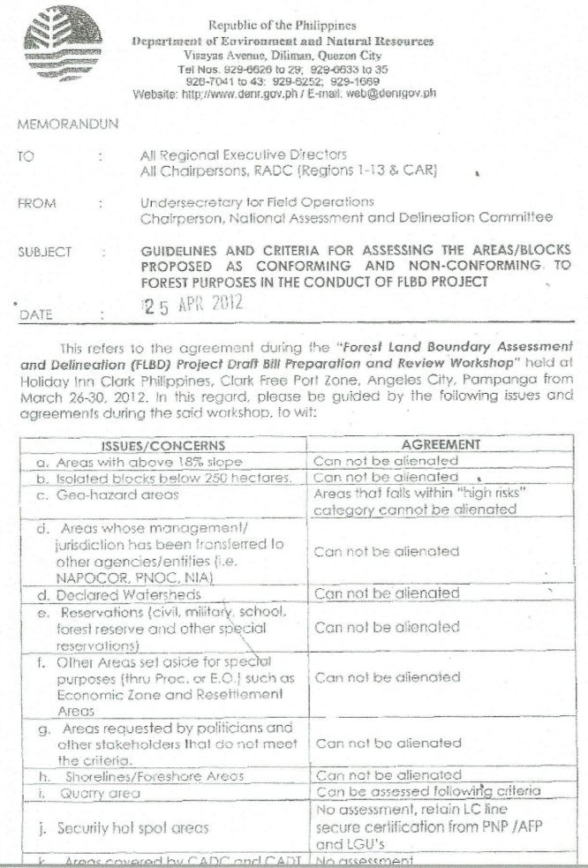
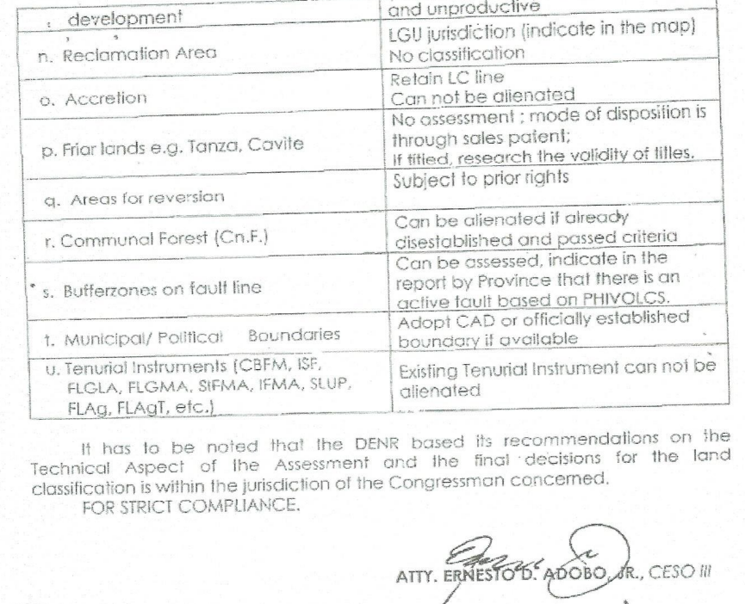
Additional Criteria or Guidelines
April 25, 2012, A MEMORANDUM was issued by USEC Ernesto Adobo with a subject: Guidelines and Criteria for assessment under FLBD project
Can not be alienated:
“high risk” in Geohazard map
Management has been transferred to other agencies
Shorelines/Foreshore area
CADC and CADT – Ancestral Domain
Notes:
In addition, based on the memorandum issued by USEC Ernesto Adobo dated April 25, 2012. The following areas can not be alienated:
“high risk” in Geohazard map
Management has been transferred to other agencies, such as NAPOCOR
Shorelines/Foreshore area
CADC and CADT

Slide 9
Brief History
1975
PD 705
Revised Forestry
Reform Code
Criteria or Guidelines
All boundaries between permanent forests and alienable and disposable lands shall be clearly marked and maintained on the ground, with infrastructure or roads, or concrete monuments at intervals of not more than five hundred (500) meters in accordance with established procedures and standards, or any other visible and practicable signs to insure protection of the forest
Chapter II Section 17 Establishment of boundaries of Forestland
Review and Updating of the Results of the FLBD in Palawan
Notes:
After classifying the UPF areas based on the criteria and guidelines, a ground survey shall be conducted and all boundaries between FL and A&D shall be clearly marked and maintained on the ground. In other words “lagyan ng mohon sa ground”

Slide 10
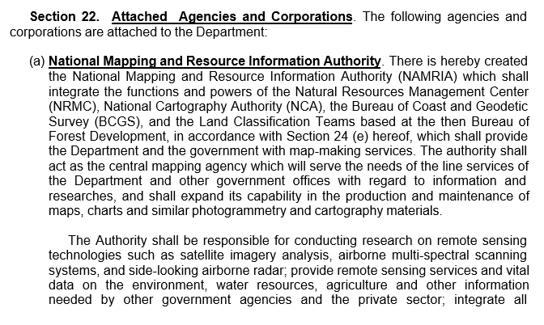
Brief History
Article XII
Section 3. Lands of the public domain are classified into agricultural, forest or timber, mineral lands and national parks.
1987 Constitution
February 1987
EO 192
Organized the DENR June 1987
Land Classification Teams
From BFD
NAMRIA
All the data such maps, document, records were transferred to NAMRIA
Notes:
Pursuant to Sec 3 Article 12 of the 1987 Constitution, Lands of the public domain are classified into agricultural, forest or timber, mineral lands and national park. This time from 3 to 4 categories by adding national park.
It is also in 1987 that executive order 192 was issued organizing the DENR and based on Section 22, NAMRIA hereby created which shall integrate the function and powers of NRMC, NCA, BCGS and the LC teams based at the Bureau of Forest Development. All the data such maps, document, records were transferred to NAMRIA.

Slide 11
Brief History
Section 2. Powers and Functions of NAMRIA.
2.5 To classify, reclassify, assess and re-assess lands in the public domain (including existing forest reservations, national parks, wilderness areas, civil and/or military reservations, resettlement areas) into agricultural, industrial, commercial, residential, resettlement, mineral, timber or forest and grazing lands and into such other classes as may be provided by law; and to establish all boundaries clearly marked on the ground between alienable or disposable lands and forest lands.
DAO 31
Implementing Guidelines of EO 192
NAMRIA will prepare the LC map, conduct the ground survey and establish boundaries clearly marked (monument) on the ground
But who will approved the LC Map?
UPF – approved by the NTEC and the corresponding DAO shall be issued and approved by DENR Secretary
Classified – Re-classification – through an act of Congress
Review and Updating of the Results of the FLBD in Palawan
Notes:
DAO 31 was issued, as the implementing guidelines of EO 192, classification of the public domain and the establishment of boundaries on the ground between FL and A&D is a already a function of NAMRIA. Therefore, NAMRIA will prepare the Land Classification Map and establish monument on the ground.

Slide 12
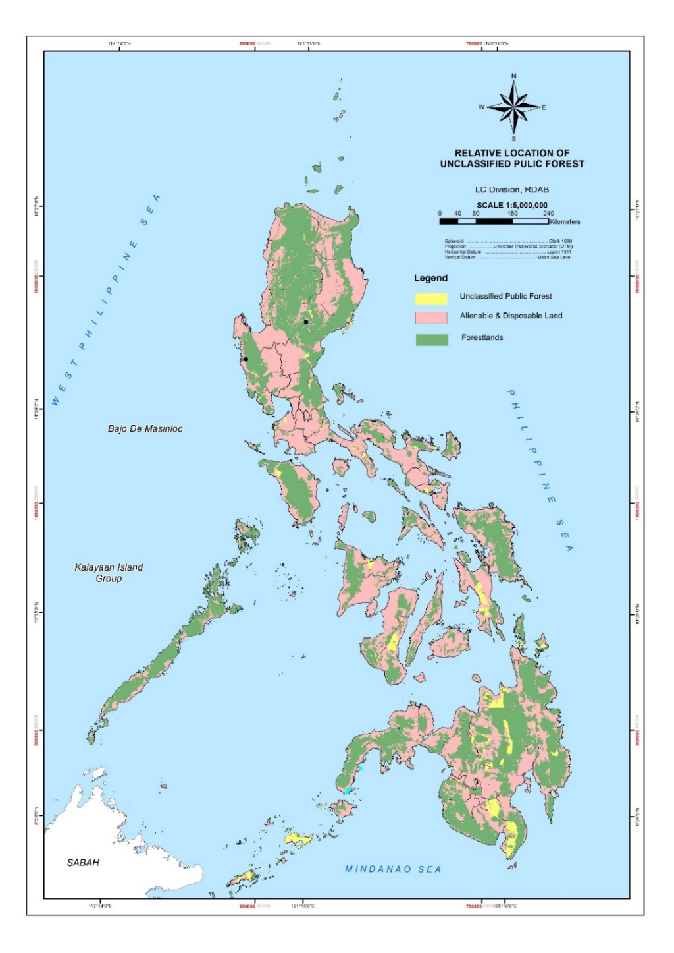
Land Classification Map
Based on the Land Classification Statistics published by DENR through this website https://forestry.denr.gov.ph/index.php/statistics/philippines-forestry-statistics
755,009 has
14,194,675 has
15, 806,325 has
No UPF in Palawan
Review and Updating of the Results of the FLBD in Palawan
Notes:
Based on the Land Classification Statistics published by DENR, the total forestland area is 15,806 (50% of the total land area of PH) and the UPF area 755 thousand hectares (excluding area within CADC, small islands and covered by presidential proclamations)

Slide 13
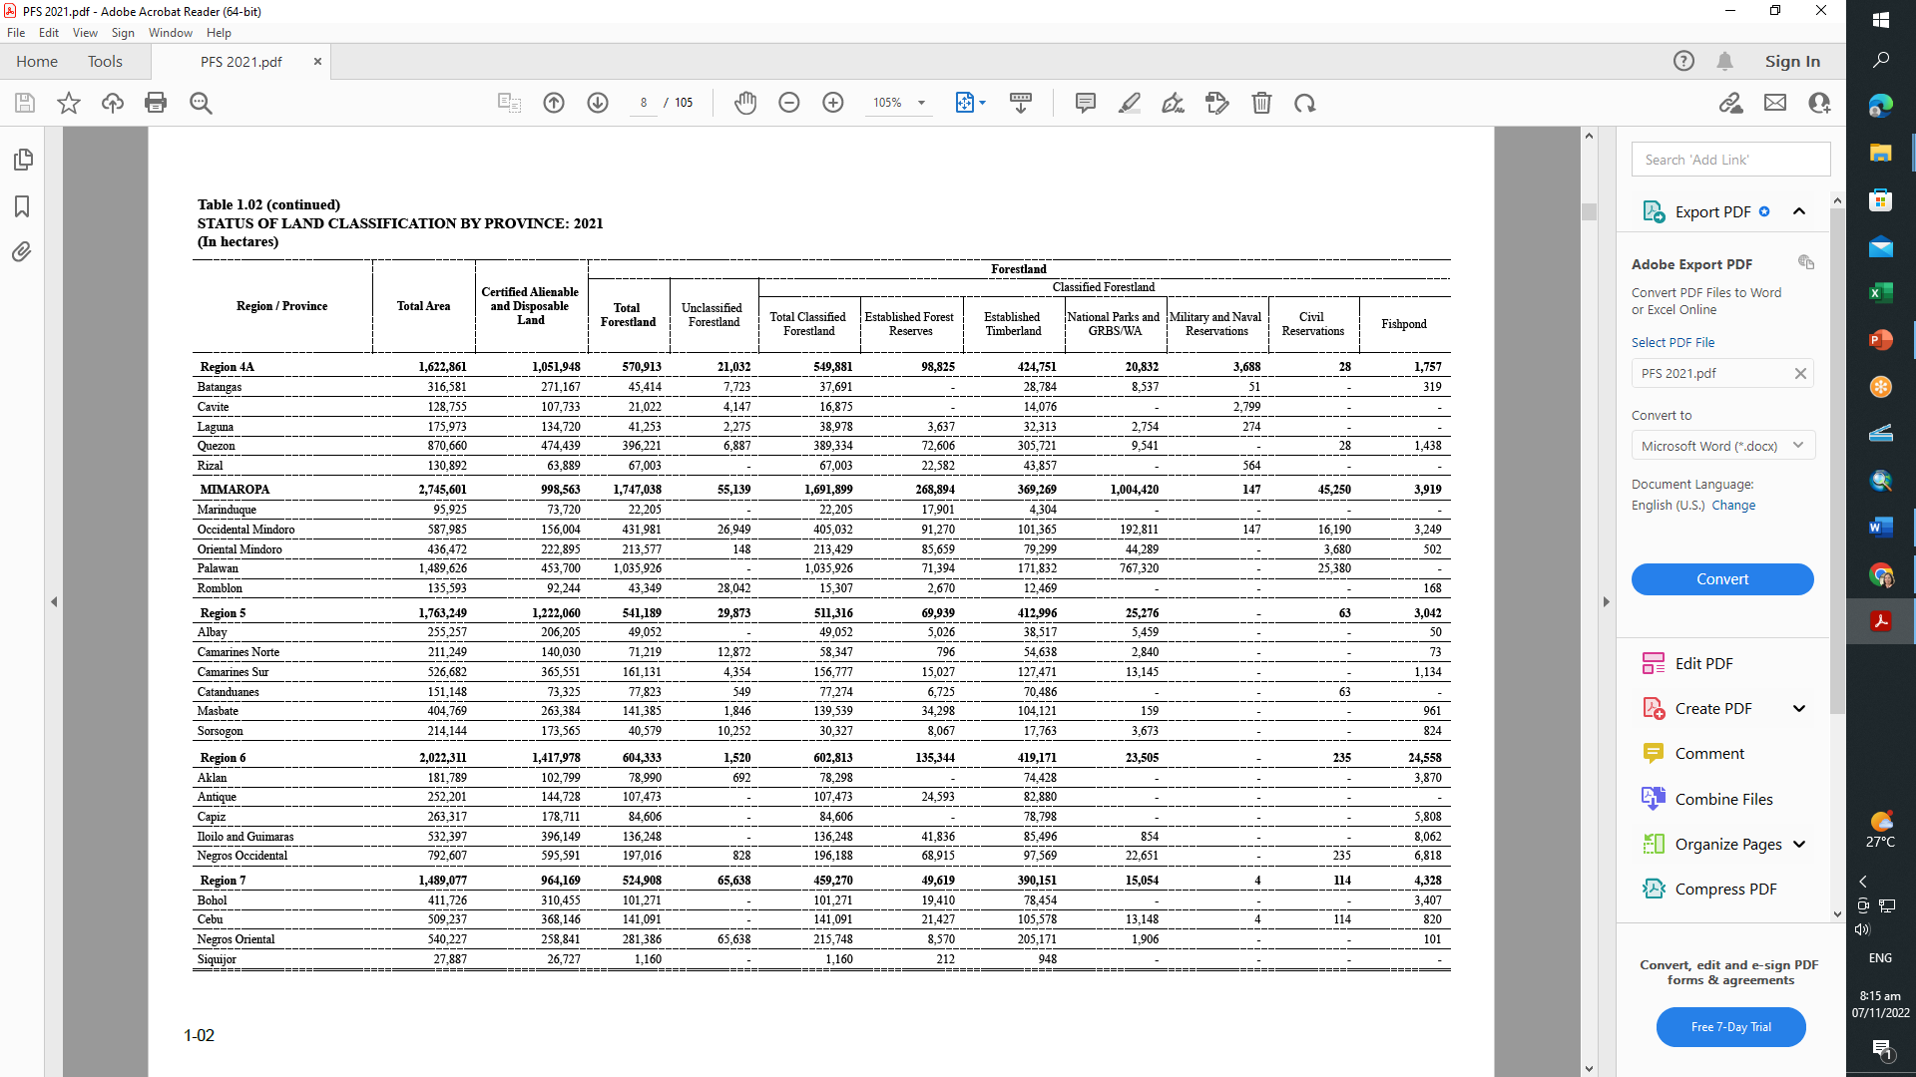
Remaining Unclassified Public Forest
Based on the Land Classification Statistics published by DENR through this website https://forestry.denr.gov.ph/index.php/statistics/philippines-forestry-statistics
755,009 has
14,194,675 has
15, 806,325 has
No UPF in Palawan
Review and Updating of the Results of the FLBD in Palawan
Notes:
Based on the Land Classification Statistics published by DENR, the remaining UPF area is 755,009 hectares but based on our inventory there are approximately 798,299 hectares still unclassified. Excluding area within CADC, small islands and covered by presidential proclamations

Slide 14
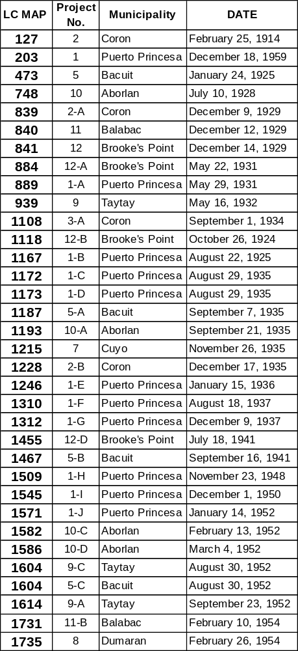
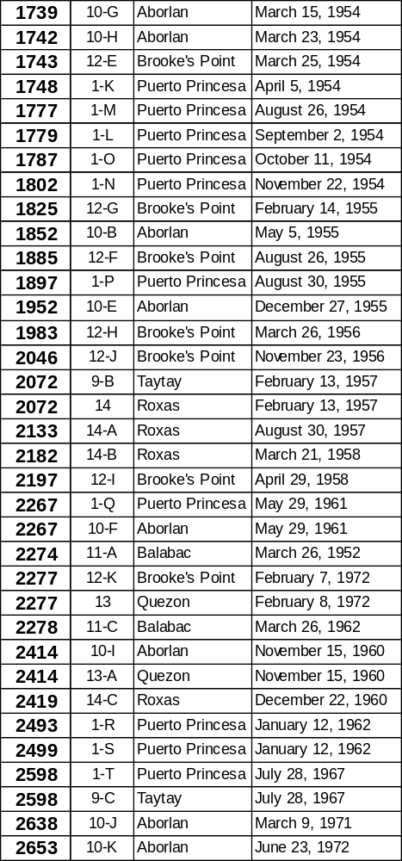
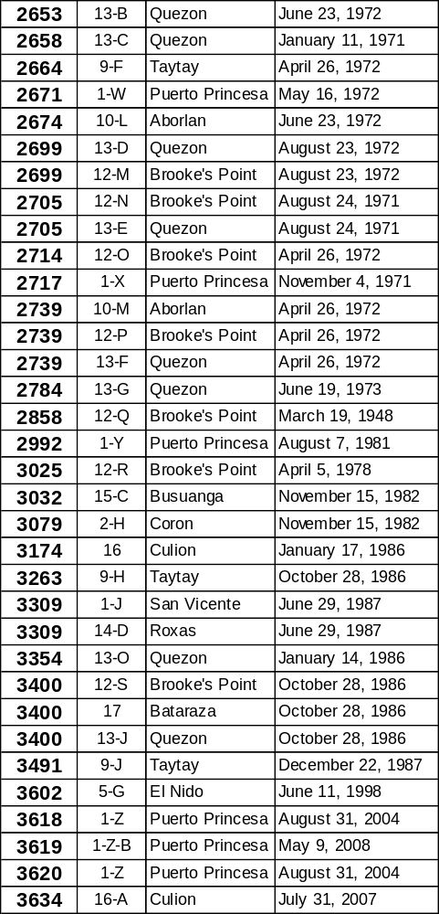
Approved Land Classification Maps of Palawan
Total of 103 Approved LC Map of Palawan
1st LC Map, February 1914 – Coron
Last LC Map, July 2007 – Culion
42 Approved LC After Proc. 219
July 2, 1967
DECLARING THE ENTIRE PROVINCE OF PALAWAN AS GAME REFUGE AND BIRD SANCTUARY, AND THE SMALL ISLAND OF PALAWAN AS NATIONAL RESERVES
16 Approved LC After Proc 2152
December 29, 1981
DECLARING THE ENTIRE PROVINCE OF PALAWAN AND CERTAIN PARCELS OF THE PUBLIC DOMAIN AND/OR PARTS OF THE COUNTRY AS MANGROVE SWAMP FOREST RESERVES
Review and Updating of the Results of the FLBD in Palawan

Slide 15
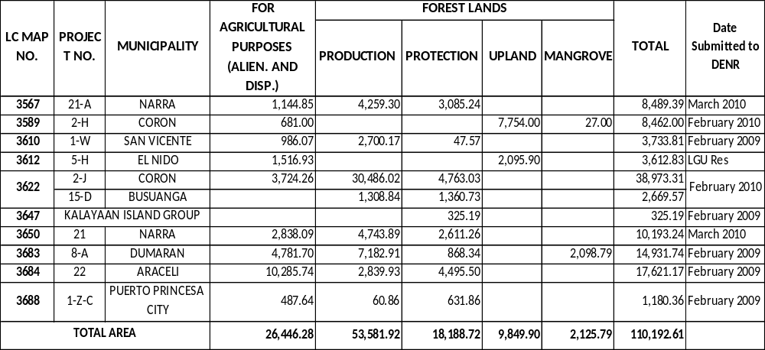
Proposed Land Classification Maps of Palawan
Review and Updating of the Results of the FLBD in Palawan
Notes:
Proposed Land Classification Map of Palawan

Slide 16
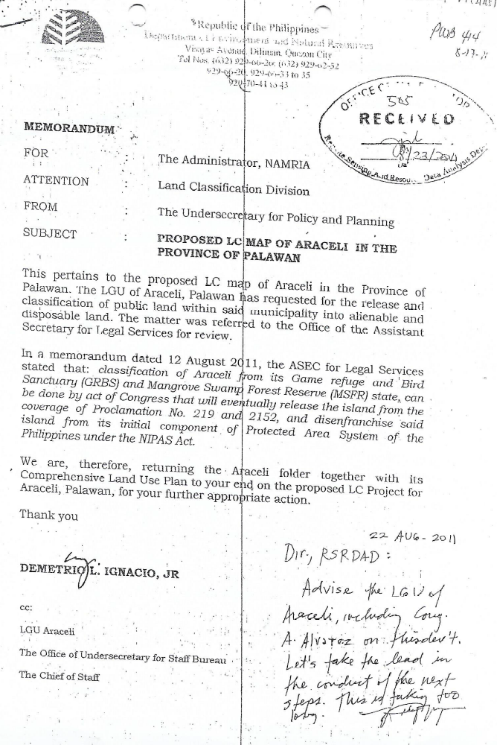
Review and Updating of the Results of the FLBD in Palawan

Slide 17
Recommendation of BMB formerly PAWB:
August 12, 2011
Re-classification of Palawan Island from its GRBS and MSFR state, can be done by act of Congress or
The intended re-classification is effected through an executive issuance expressly excluding proposed area from the operation of Proc 219 and 2152
Review and Updating of the Results of the FLBD in Palawan

Slide 18
THANK U
FOR LISTENING
Review and Updating of the Results of the FLBD in Palawan

