Slide 1

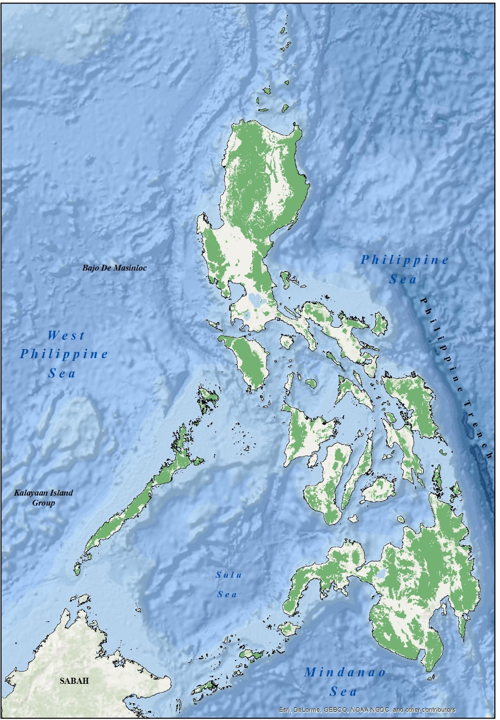
FORESTLAND BOUNDARY DELINEATION PROJECT OUTPUTS
AND
PROPOSED A&D BLOCKS FROM THE IDENTIFIED UPF AREAS IN THE PROVINCE OF PALAWAN
PALAWAN

Slide 2
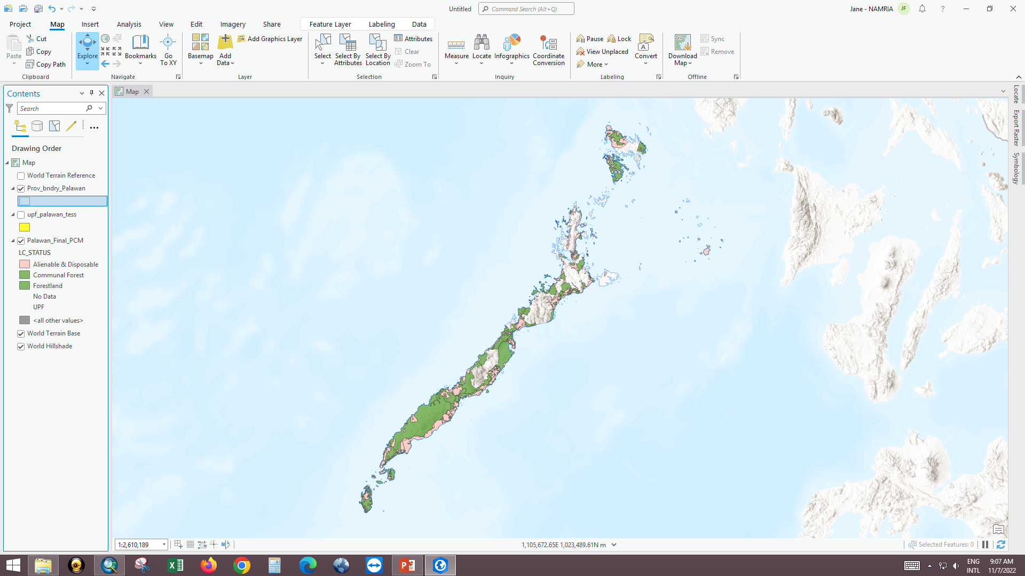
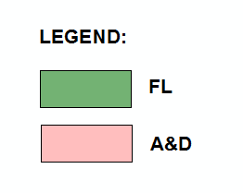
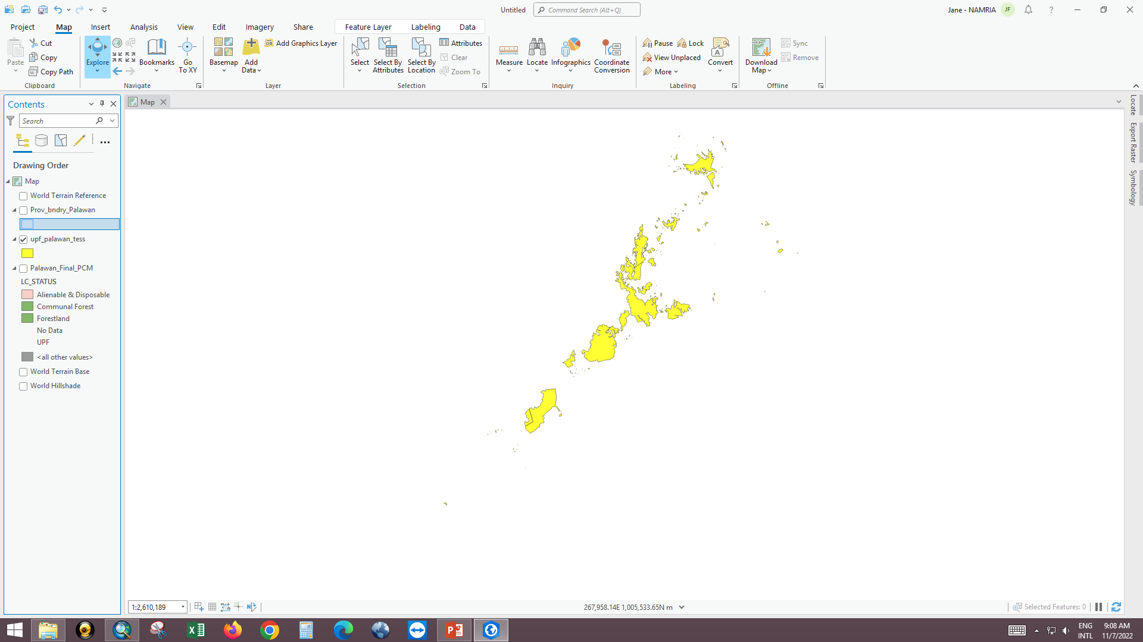
UNCLASSIFIED PUBLIC FOREST PROVINCE OF PALAWAN
No. of UPF Sites | Total Area (Ha)
354 | 504,634.04
Areas With No Approved
LC Maps
Total LC maps = 106 LC maps
Sulu Sea

Slide 3
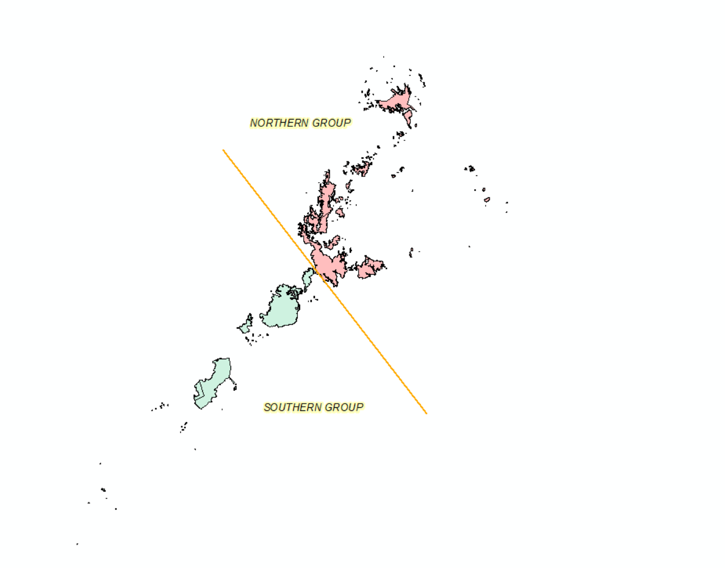
UPF- 354 Blocks
290 blocks
-35 blocks for assessment
-255 blocks retain fl
64 blocks
-8 blocks for assessment
-56 blocks retain fl

Slide 4
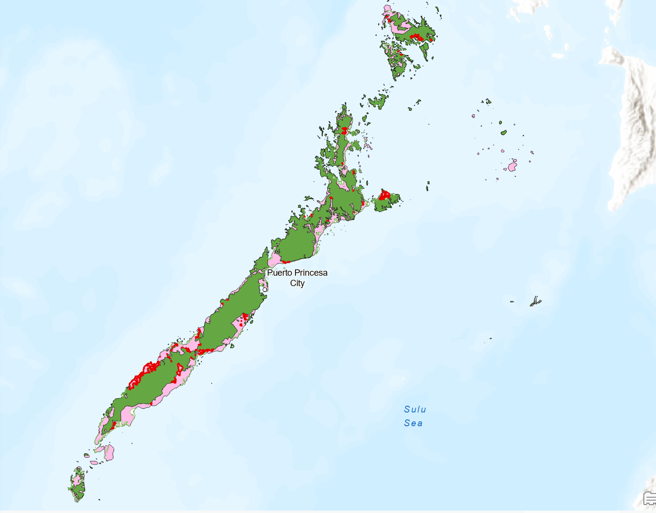
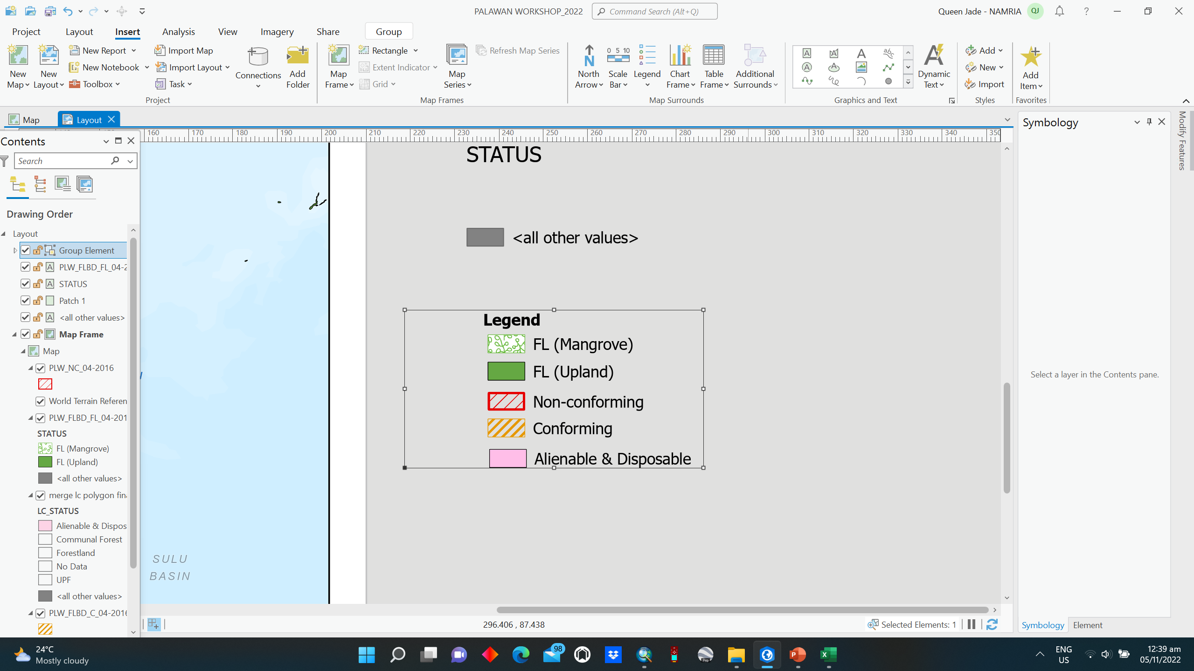
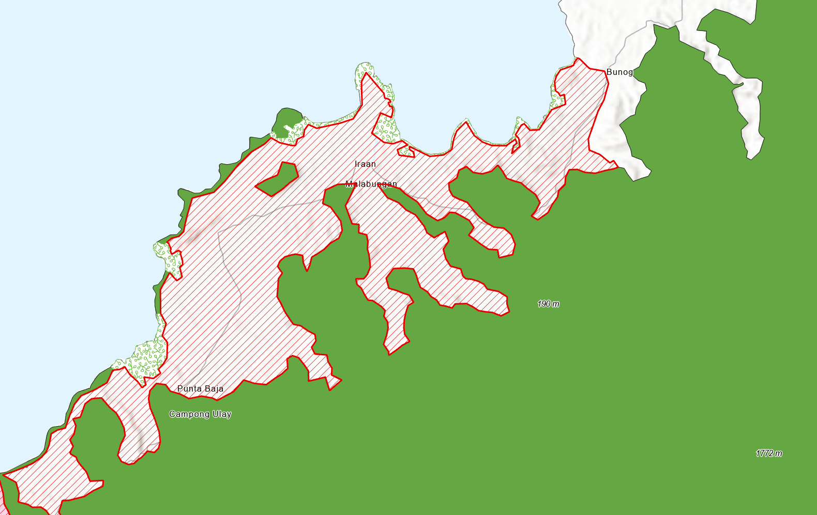
NON-CONFORMING BLOCKS
Forestland (FL)
Certified Alien. & Disp
MUNICIPALITIES | NO. OF BLOCKS | COVERED BARANGAYS | AREA (hectares)
1. Aborlan | 4 | Aporawan, Sagpangan, Isaub, Mabini, R. Magsaysay & Gogognan | 1,381.3343
2. Araceli | 3 | Balogo, Maur., Tal, Madoldolon, Sto Nino | 3,056.958
3. Bataraza | 3 | Sumbiling, Sapa | 569.7607
4. Brooke’s Pt | 2 | Nambalot, Maasin, Malis | 743.355
5. Busuanga | 2 | New Buasuanga, San Rafael | 233.8243
6. Coron | 2 | Poblacion, Marcilla | 1,853.767
7. Culion | 2 | Jardin, Osmena | 131.0236
Non-Conforming
Based on the municipal boundary provided by Region IV-B, during the implemenetation of FLBD
Source: FLBD Output as of April 2016, Widus Hotel Pampanga

Slide 5
Continuation…
NON-CONFORMING BLOCKS
MUNICIPALITY | NO. OF BLOCK | COVERED BRGY | AREA (ha)
8. Dumaran | 3 | Danleg, Sta. Teresita, Ilian | 130.1689
9. El Nido | 4 | New Ibajay | 888.1378
10. Narra | 7 | Aramaywan, Calategas, Tacras, Bato-bato, Burirao, Ipilan, | 2,416.8708
11. Puerto Princesa City | 5 | Babuyan, Napsan, San Rafael, Tanabag | 279.6017
12. Quezon | 21 | Alfonso XII, Alfonso XIII, Malatgao, Aramaywan, Sugod, Calumpang, Pinaglabanan, Quinlogan, Sowangan, Tabon, Tagusao | 1,393.86194
MUNICIPALITY | NO. OF BLOCK | COVERED BRGY | AREA (ha)
13. Rizal | 1 | - | 1,4281.2
14. Roxas | 1 | New Barbacan | 34.6069
15. San Vicente | 3 | Caruray, Port Barton, San Isidro | 207.7221
16. Sofronio Spanola | 6 | Abo-abo, Isumbo, Irary, Pulot center, Panitian | 3,493.0478
17. Taytay | 4 | Bantulan, Calawag, Pamantolon | 274.4326
TOTAL | 73 |  | 31,369.673
Source: FLBD Output as of April 2016, Widus Pampanga

Slide 6
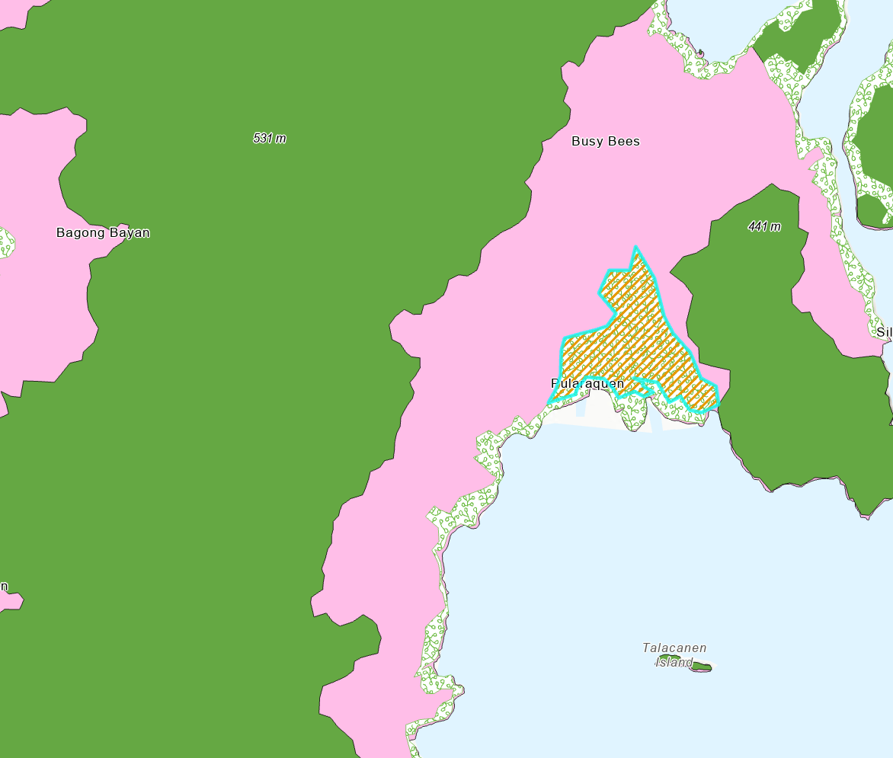
CONFORMING BLOCKS
MUNICIPALITY | NO. OF BLOCK | COVERED BRGY | AREA (ha)
1. Taytay | 1 | Busy Bees | 374.293
2. Roxas | 3 | Antonino, Bagong Bayan, Narra | 77.020
TOTAL | 4 |  | 451.315
Based on the municipal boundary provided by Region IV-B
Source: FLBD Output as of April 2016, Widus Pampanga

Slide 7
UNCLASSIFIED PUBLIC FOREST PROVINCE OF PALAWAN
No. of UPF Sites | Total Area (Ha)
354 | 504,634.04
Areas With No Approved
LC Maps
Total LC maps = 106 LC maps
Sulu Sea

Slide 8
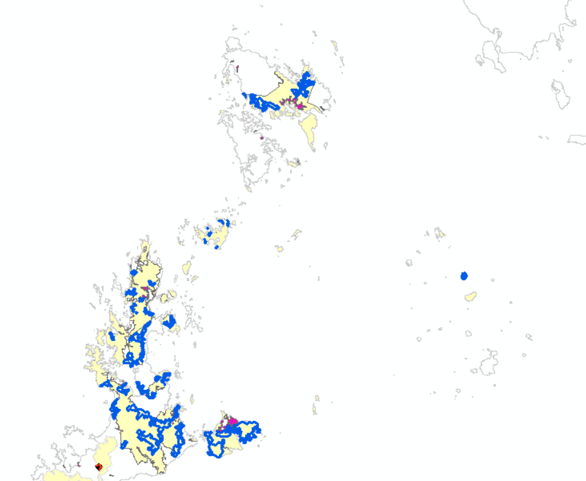
NORTHERN PALAWAN
Blocks assessed in North Palawan
Proposed A&D
FLBD Non-conforming

Slide 9
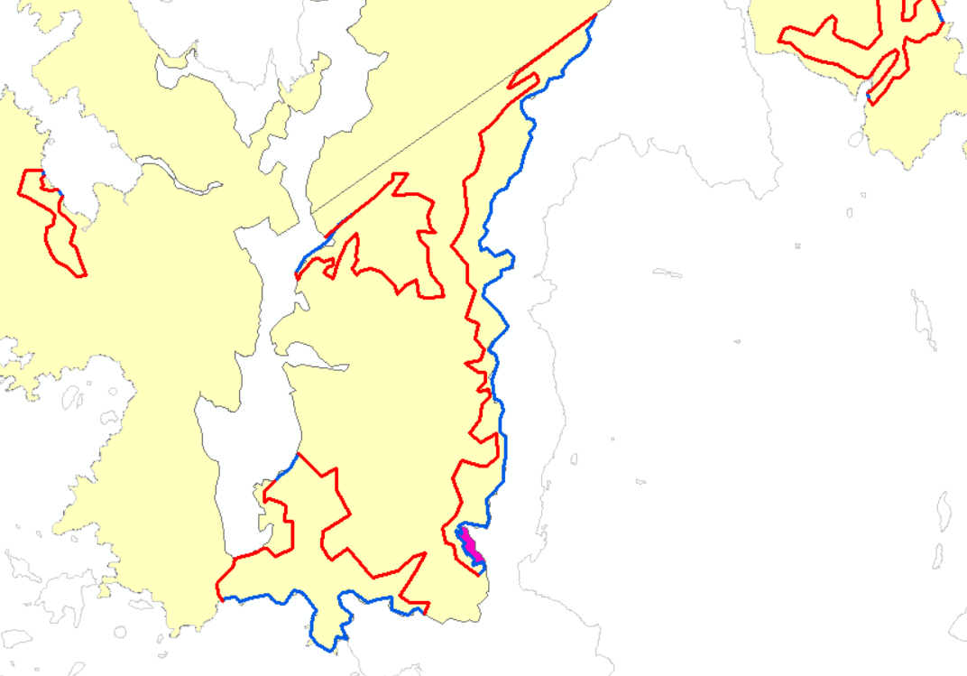
Blocks assessed in North Palawan
Proposed A&D
Cutline
TOTAL CUTLINE – 1, 093km

Slide 10
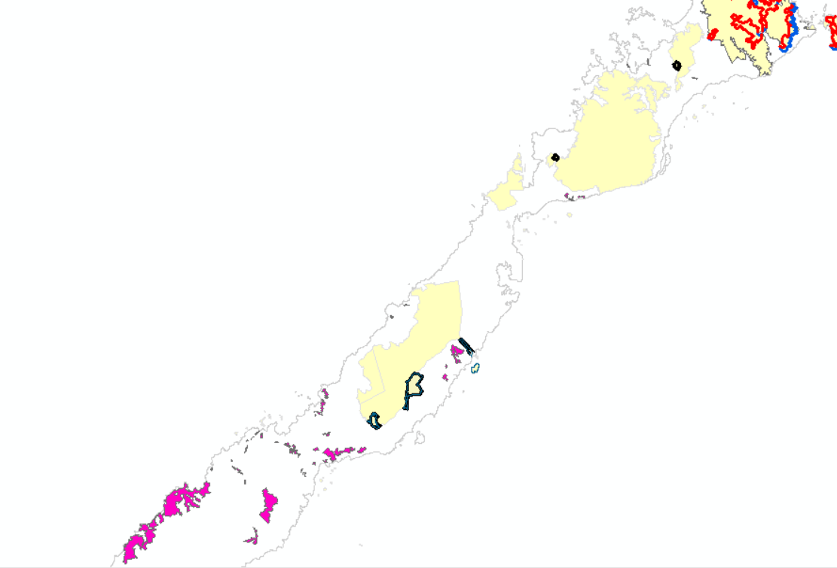
SOUTHERN PALAWAN
Blocks assessed in North Palawan
Proposed A&D
FLBD Non-conforming
TOTAL CUTLINE – 48km

Slide 11
SUMMARY
FLBD NON-COFORMING BLOCKS In Hectares |  | PROPOSED ALIENABLE AND DISPOSABLE FROM THE IDENTIFIED AREAS WITH NO APPROVED LC MAPS
Area in Hectares | NO. of Blocks | TOTAL Area in Hectares | Cutline in kilometers | NO. OF BLOCKS
31,369 | 73 | 42,673 (Northern Palawan) 5,645 (Southern Palawan) 48,318 | 1,093 ( Northern Palawan 48 ( Southern Palawan) 1,146 | 60

