Slide 1
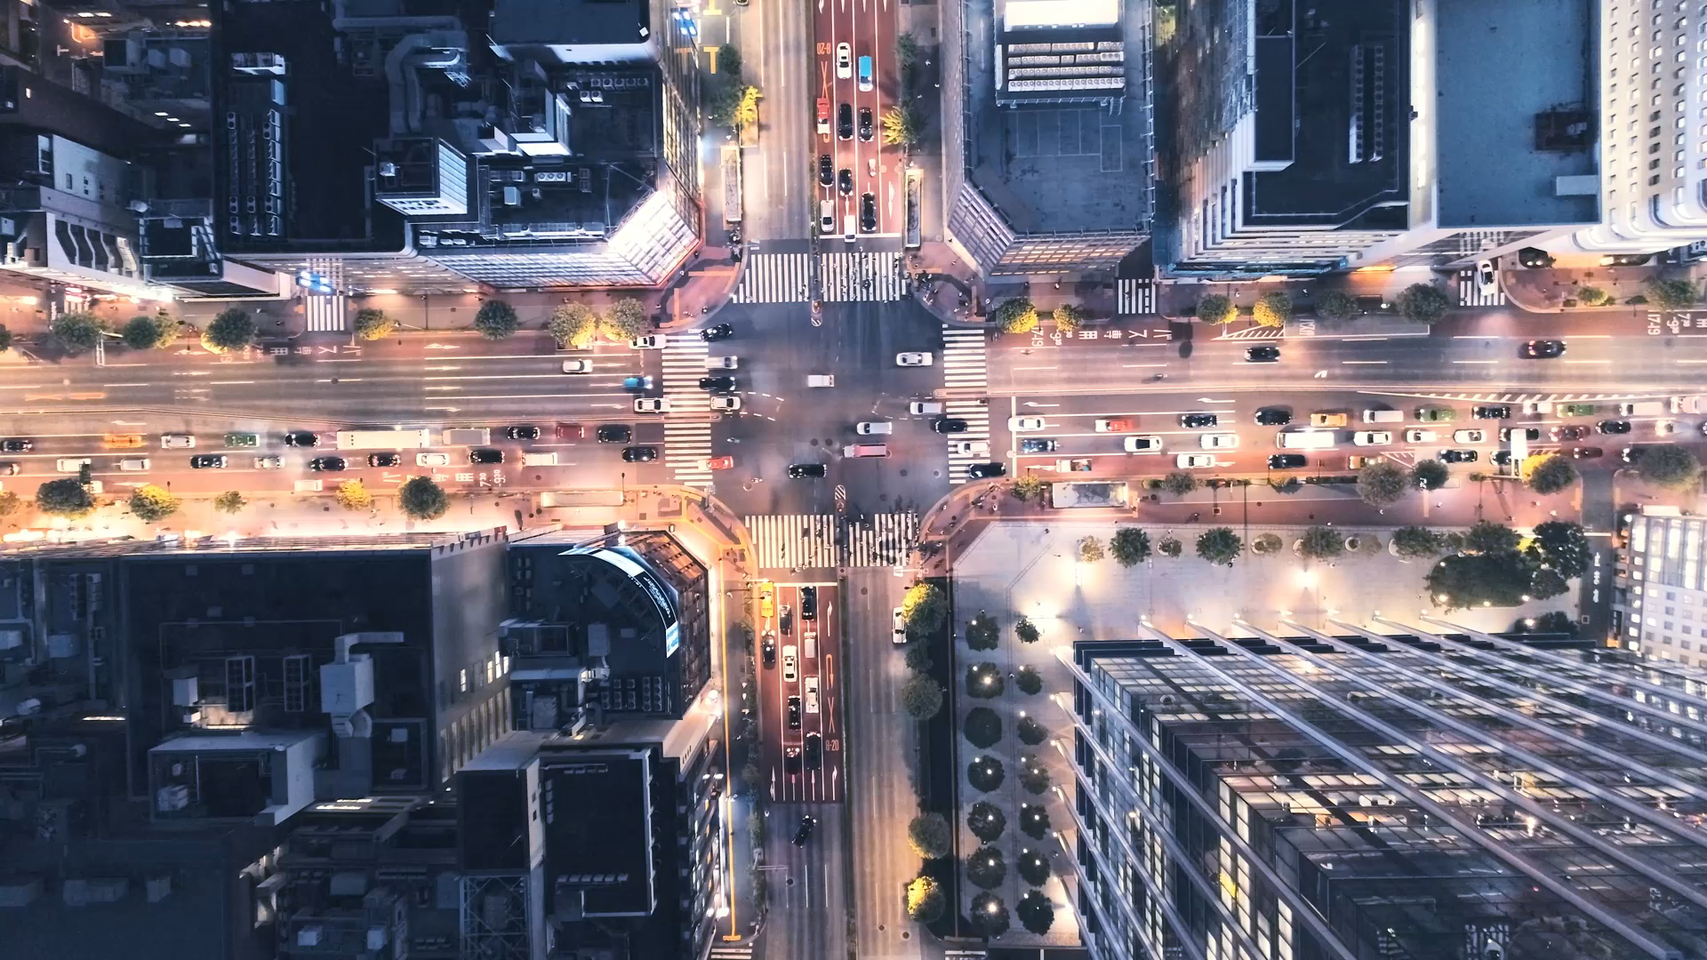
The Urban Ecosystem Dynamics
Presented by Leonora P. Gonzales, PhD, EnP, fPIEP
07 September 2022

Slide 2
Urbanization : PSA
1. In their entirety, all municipal jurisdictions which, whether designated chartered cities, provincial capital or not, have a population density of at least 1,000 persons per square kilometer: all barangays;
2. Poblaciones or central districts of municipalities and cities which have a population density of at least 500 persons square kilometer;
3. Poblaciones or central districts not included in (1) and (2) regardless of the population size which have the following:
street pattern or network of streets in either parallel or right angel orientation;
at least six establishments (commercial, manufacturing, recreational and/or personal services);
at least three of the following:
a town hall, church or chapel with religious service at least once a month;
a public plaza, park or cemetery;
a market place, or building, where trading activities are carried on at least once a week;
a public building, like a school, hospital, puericulture and health center or library.
4. Barangays having at least 1,000 inhabitants which meet the conditions set forth in (3) above and where the occupation of the inhabitants is predominantly non-farming or fishing.

Slide 3
Urbanization Defined
a historical process describing the evolution of towns from a rural setting to modern society, accompanied with changes in the physico-ecological, socio-economic and demographic attributes of a population, into a new settlement.
Movement of people from the rural areas, the countryside and the hinterlands towards the city for various reasons
Concentration of human population into discrete areas, leading to transformation of land for non- agricultural uses i.e.residential, commercial, industrial & transportation purposes; can include densely populated centers, as well adjacent peri urban or suburban fringes

Slide 4
Urban Ecosystem Defined
An urban ecosystem is simply the community of plants, animals, and humans that inhabit the urban environment.
It is an area physically dominated by built structures like buildings, roads, sewers, and power lines.
It also contains a rich patchwork of green spaces — parks, yards, street plantings, greenways, urban streams, commercial landscaping, and unbuilt lots — that provide the living heart of the urban ecosystem (Earth on Edge)

Slide 5
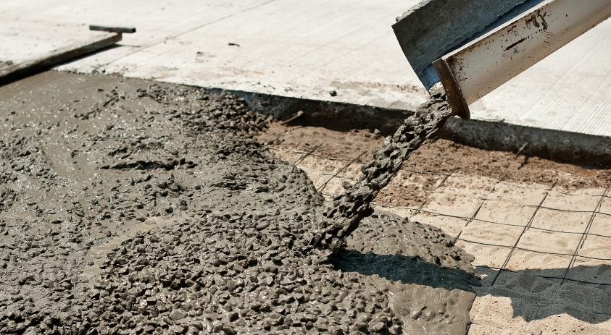
The Story of Concrete
Concrete ranks second to water in terms of its wide usage and application on earth (Watts, J., 2019).
If the cement industry were a country , it would be the third largest CO2 emitter with 2.8 bn tonnes next to China and the US.
It is the raw materials that fuel modern civilization and urban development putting roofs on our heads, fortifying our defense from disasters both man made and natural ones. (The Guardian, 2019)

Slide 6
Urban Planning and Design: Principles and Strategies
Promote compact urban designs encouraging multiple/mixed use
Establish a network of public open and green spaces not only in the urban core but along the peri-urban areas
Address water quality and minimize dependence on traditional sources, i.e. groundwater extraction

Slide 7
… urban planning design principles
Resolve urban flooding issues through green infrastructure
Establish active mobility model for urban transport system

Slide 8
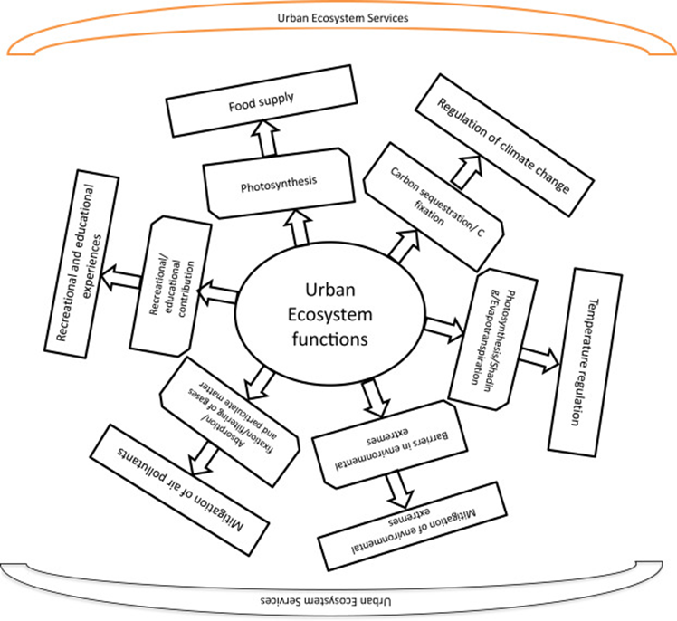
A Glimpse at the Urban Ecosystem
where people live in high densities or those where the built infrastructure covers a large proportion of the land
incorporate both planted vegetation such as urban forests, parks and gardens and water bodies like ponds, small lakes and wetlands (Pickett et al. (2001)
Where the health and well-being benefits are most significant
Source: Ecological Economics of Urban Settlements, Vaishali Kapoor, ... Rahul Bhadouria, in Urban Ecology, 2020

Slide 9
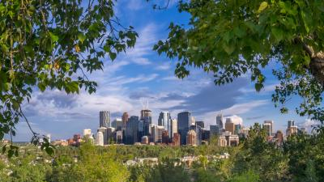
Urban Ecosystem as a “Source” and “Sink” Landscape
Urban landscape -
“gray or brown landscape” (i.e., buildings and roads)
“blue landscape” (i.e., rivers, lakes)
“green landscape” (i.e., gardens, turfs, vegetation belts) UHI effect and heavy traffic - imbalance between “source” and “sink” in an urban area
UHI effect and heavy traffic - imbalance between “source” and “sink” in an urban area
Source: (Wenwu Zhao, ... Yue Liu, 2019)

Slide 10
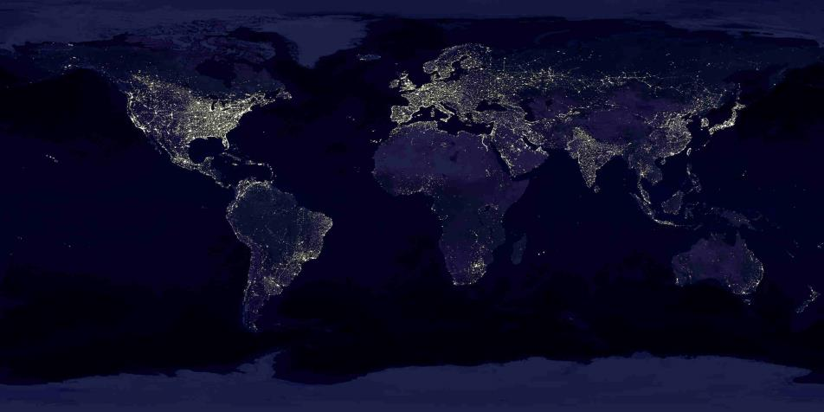
Cities = 2-3% of the Earth’s land surface
2100, more than 90% will live in the cities
(UNDESA 2007)

Slide 11

Urban populations account for 54% of the total global population
(United Nations, 2014)

Slide 12
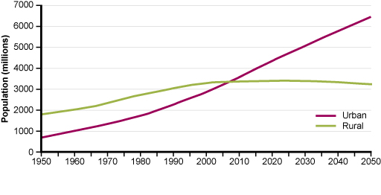
World population to reach 9.9 billion by 2050, an increase of more than 25% from the current 2020 population of 7.8 billion.

Slide 13
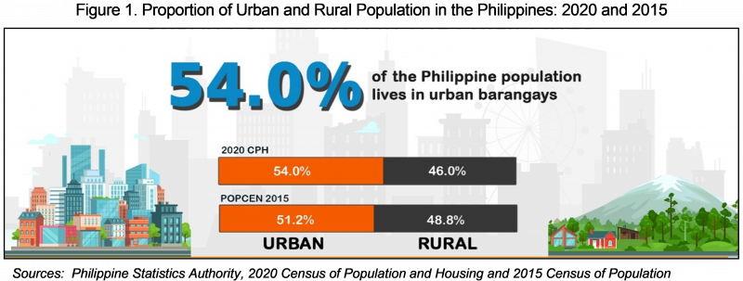

Slide 14
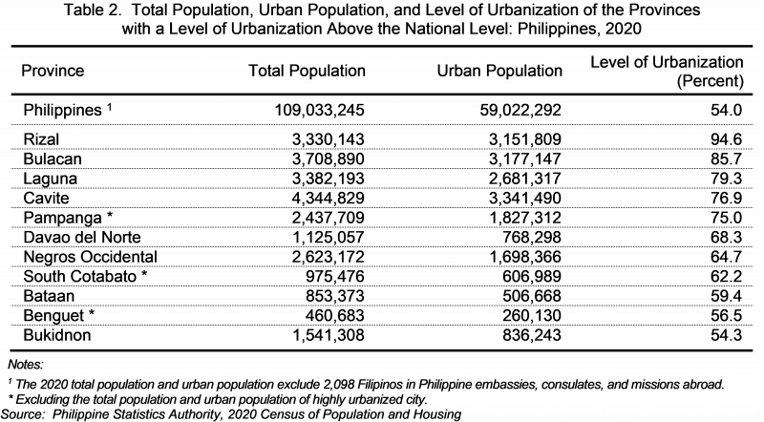

Slide 15
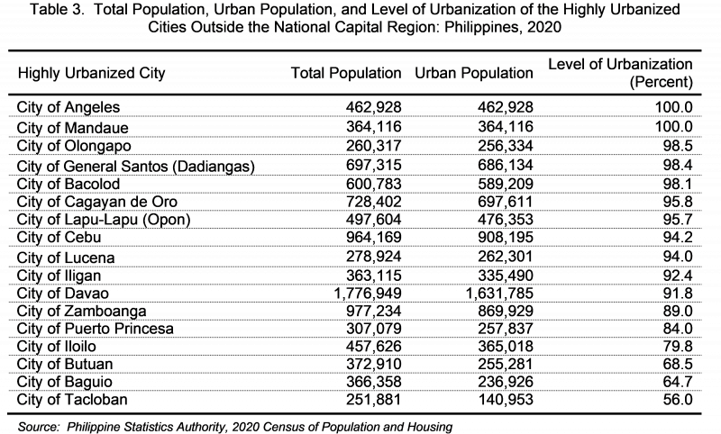

Slide 17


3 Major Trends in Urbanization
Cities and Biodiversity Outlook, 2012
Increase in total urban area is
faster than increase in urban population
4.9 B
urban population
2.84 B
2000
2010
2020
2030

Slide 18
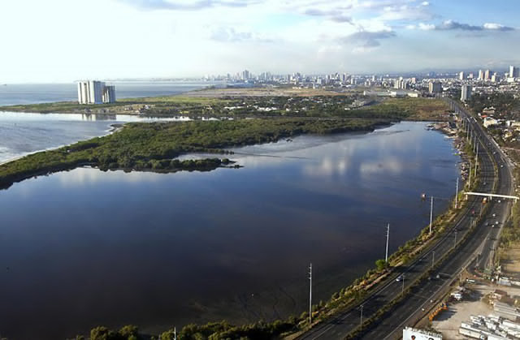
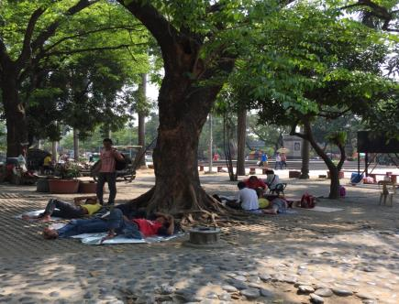
3 Major Trends in Urbanization
2. Urban expansion will heavily draw on resources putting at risk ecosystems goods and services; occurring in low economic and human capacity and in areas adjacent to biodiversity hotspots
3. Urbanization rates are highest in poorly capacitated urban governance arrangements

Slide 19
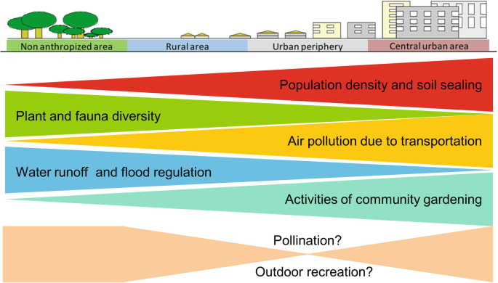
The Urban – Rural Gradient
The loss and fragmentation of natural habitat has reduced the richness of taxa in the urban core to less than half of that found in rural areas (McKinney, 2002).
Competition from exotic-invasive species further reduces native species diversity.

Slide 20
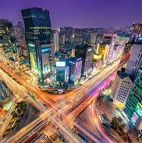
Cities at Risk
Intensive and rapid urban growth is the greatest Urban areas will add some 2 billion new residents worldwide by 2030, growing from the current urban population of 2.9 billion to 4.9 billion.
Growth of giant cities — megacities with more than 10 million people — will be a factor in future urban growth.
Urban growth will not occur in these megacities, but in smaller cities – which means for the landscape is that urban areas will be spread over a significantly larger area than today, changing natural areas into urban and suburban environments.
Within existing cities, more people will use parks and other green areas, and development will gradually fill in vacant parcels, increasing the stress on the remaining green areas.

Slide 21
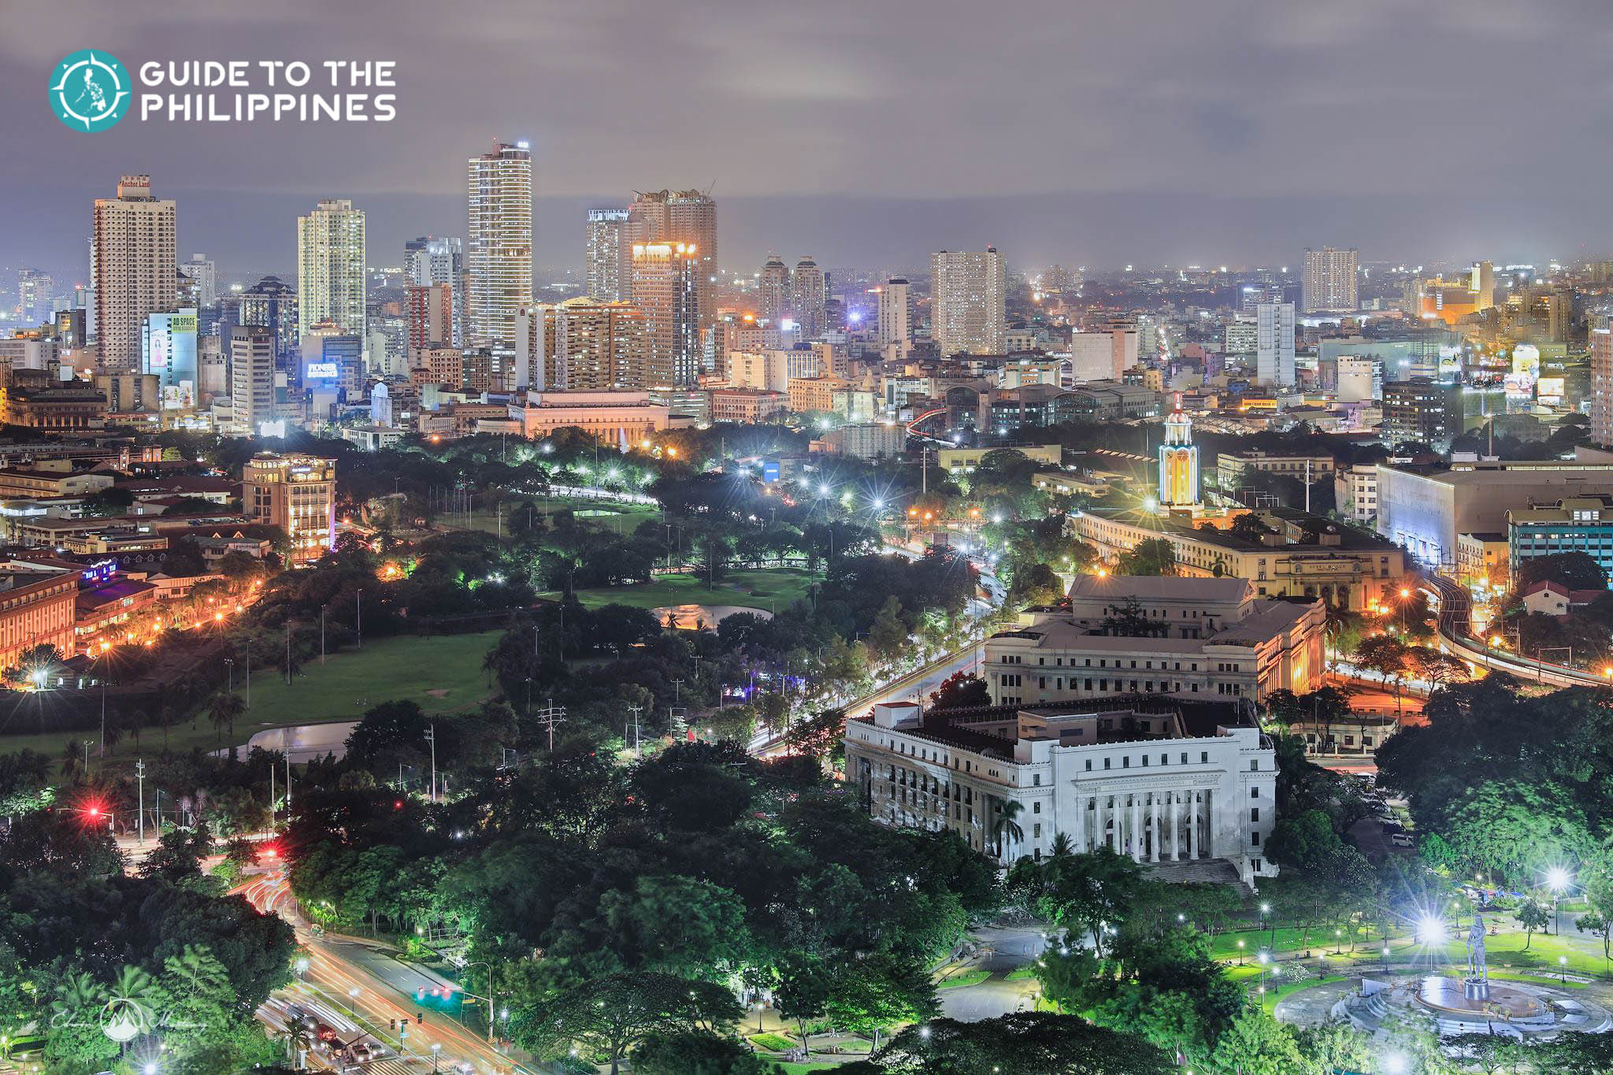
The Workings of Urban Ecosystems
biological components include plants, animals, and other forms of life
physical components i.e. soil, water, air, climate, and topography including energy use and the import, transformation, and export of materials

Slide 22
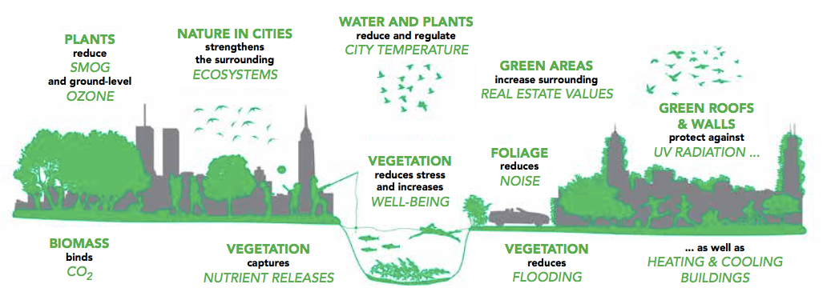
Urban Ecosystem Services

Slide 23
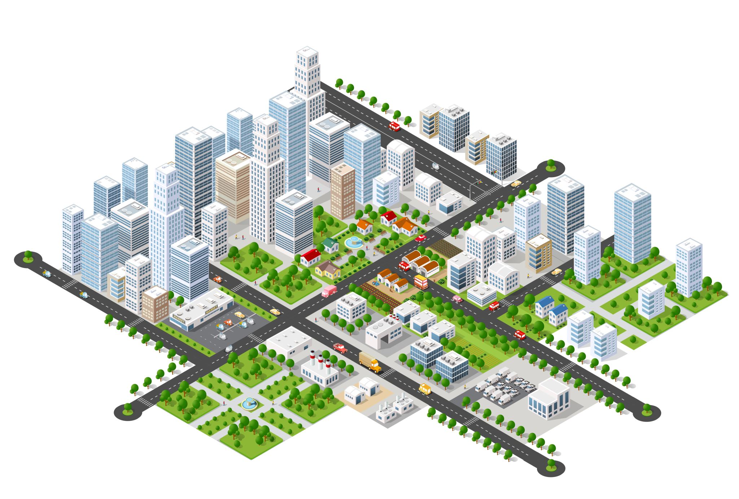
Urban Ecosystems Vs Other Ecosystems
Urban ecosystems are generally highly disturbed systems
Buildings, roads, parking lots, and other constructions form impenetrable covering of the soil.
Unlike natural ecosystems however, urban ecosystems are a hybrid of natural and man-made elements.

Slide 24
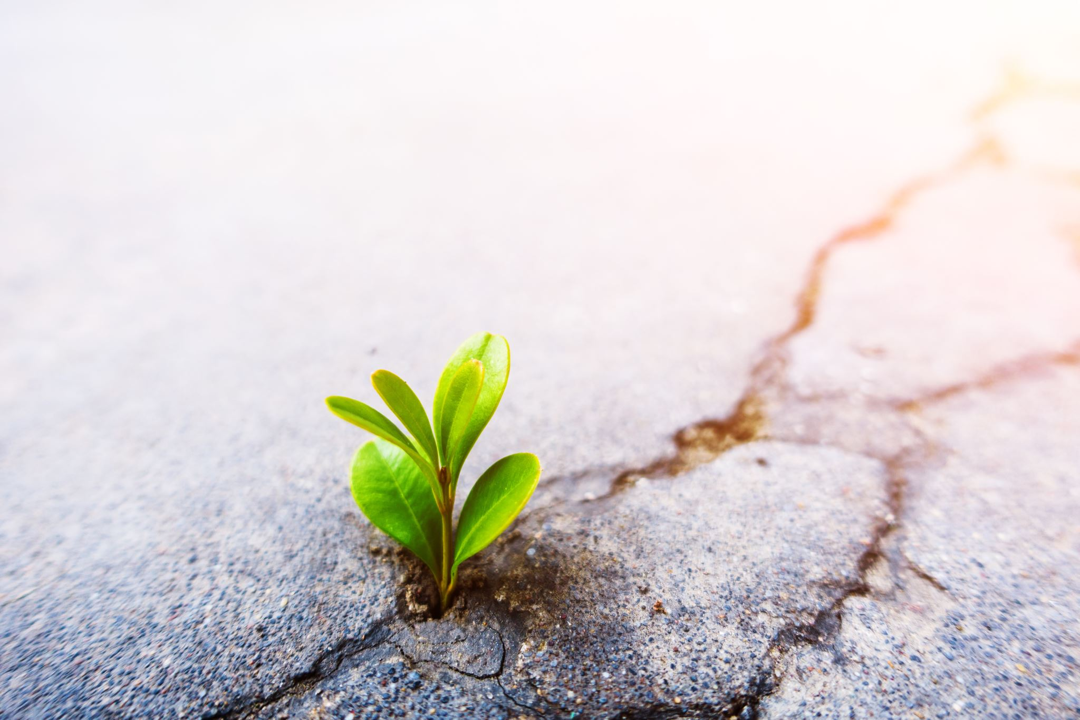
The Urban Landscape
The plant life is different characterized by many nonnative and invasive species.
Environmental stresses also modify the natural elements of urban ecosystems

Slide 25
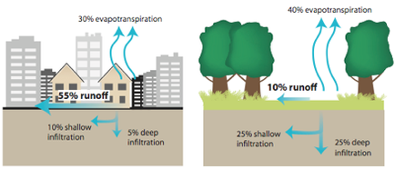
CITIES CREATE URBAN HEAT ISLAND EFFECT
Notes:
Build­ings mostly cover the city’s landscape resulting in less shade and moisture that otherwise keep urban areas cool.
Built-up areas also evaporate less water, which contributes to elevated surface and air temperatures.
Properties of building materials, in particular solar reflectance, thermal emissivity, and heat capacity, give rise to urban heat islands, as they determine how the sun’s energy is reflected, emitted, and absorbed
(US-EPA, 2017)
https://www.researchgate.net/publication/352508663_THE_INFLUENCE_OF_LANDSCAPE_AND_VEGETATION_STRUCTURES_ON_LAND_SURFACE_TEMPERATURE_THE_CASE_OF_URBAN_GREEN_SPACES_OF_CITY_OF_CALAMBA_LAGUNA_PHILIPPINESTHE INFLUENCE OF LANDSCAPE AND VEGETATION STRUCTURES ON LAND SURFACE TEMPERATURE: THE CASE OF URBAN GREEN SPACES OF CITY OF CALAMBA, LAGUNA, PHILIPPINES
May 2021
Journal of Management and Development Studies 9(1):1-17
Authors:
Mark Anthony F. Rabena
University of the Philippines Los Baños
Green spaces of the City of Calamba extracted from Landsat 8 Operational Land Imager (OLI) and Thermal Infrared Sensor (TIRS) satellite image data were used to determine the relationship of both landscape and vegetation structures on land surface temperature (LST). Based on regression analysis, results showed that LST of green spaces is linearly dependent on its area. Specifically, LST tends to decrease by 0.0058°C as the area is increased by one hectare. Shape metrics such as perimeter-area ratio and shape index showed nonlinear relationship with LST. Similarly, normalized difference vegetation index (NDVI) was not significant in affecting LST linearly. Therefore, large patches of green spaces must be maintained or increased to mitigate heat islands. Shape irregularity and vegetation abundance have no strong influence on LST of green spaces. Given the limitation of the research, further studies on LST of green spaces must be conducted to validate the results.

Slide 26
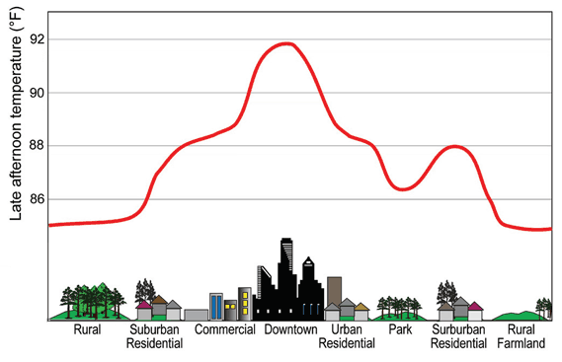
Heat Islands Impacts
Increased Energy Consumption
Elevated Emissions of Air Pollutants/Greenhouse Gases
Compromised Human Health and Comfort
Impaired Water Quality

Slide 27
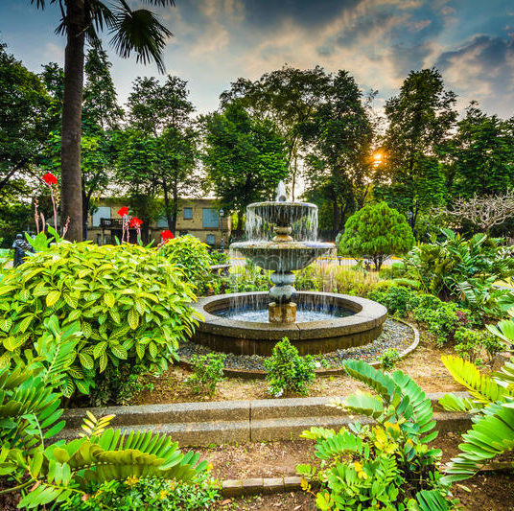
UHI and Vegetation
Urban landscapes with 50–90 % impervious ground cover can lose 40–83 % of rainfall to surface runoff, whereas forested landscapes lose only about 13 % of rainfall input from similar precipitation events

Slide 28
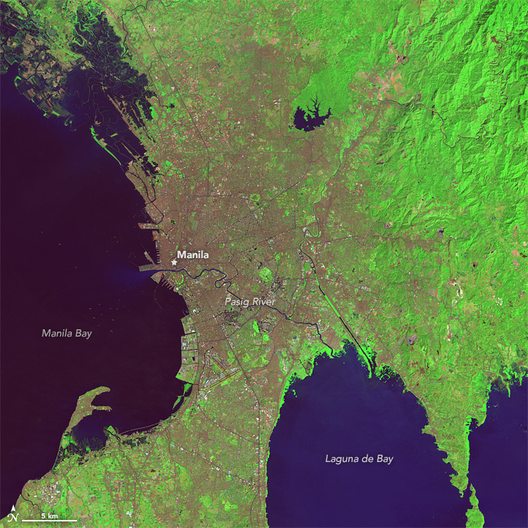
The Rapid Growth of Manila
https://earthobservatory.nasa.gov/images/86780/the-growth-of-manila

Slide 29
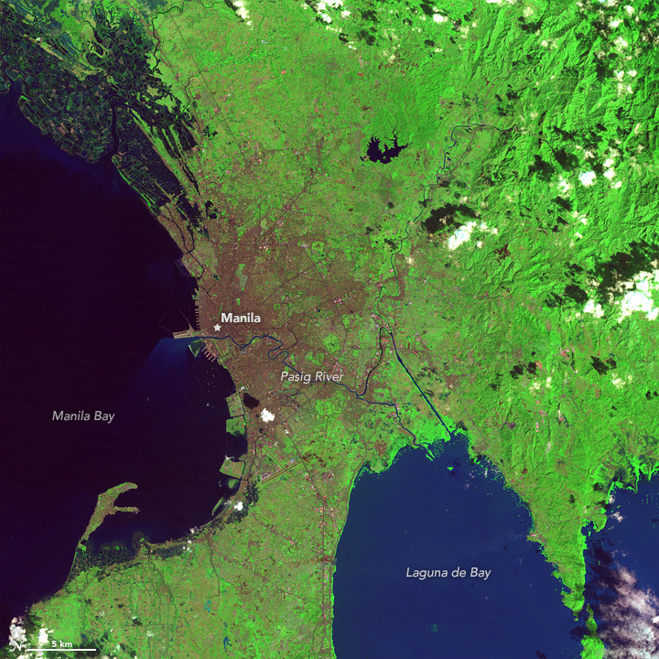
31 January 1988
07 February 2014

Slide 30
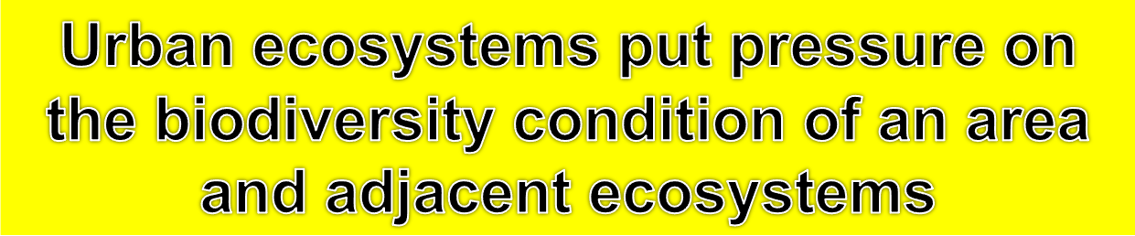
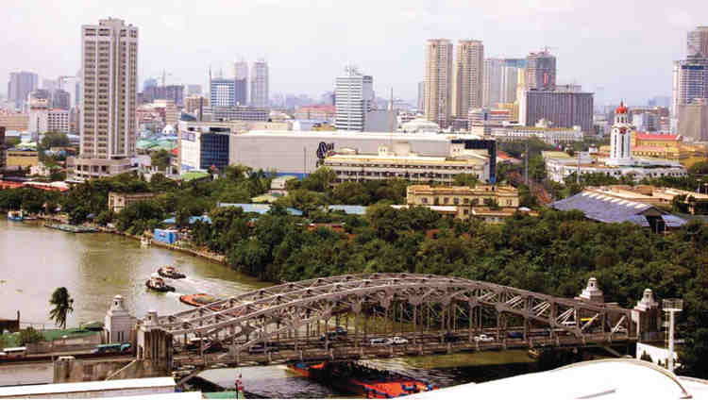
Urban biodiversity as the variety and richness of living organisms and habitat diversity found in and on the edge of human settlements. It ranges from the rural fringe to the urban core.(Muller et al, 2008)

Slide 31
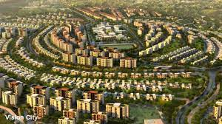
Vision of a City
To manage all the green spaces as a single living ecosystem that benefits both wildlife and people.
Advance the science of urban ecology — how its green elements interact with surrounding rural areas, as well as with the city's human inhabitants.
Find a new way to assess and manage urban green spaces

