Slide 1
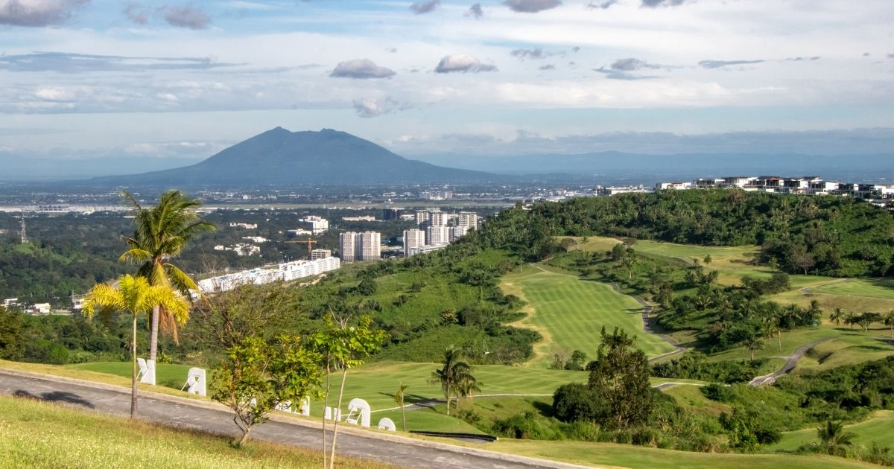
REGIONAL PRESENTATION TEMPLATE AND GUIDE
1st Field Operations Management Conference
April 16-18, 2023
Marriot Hotel, Clark, Pampanga

Slide 2
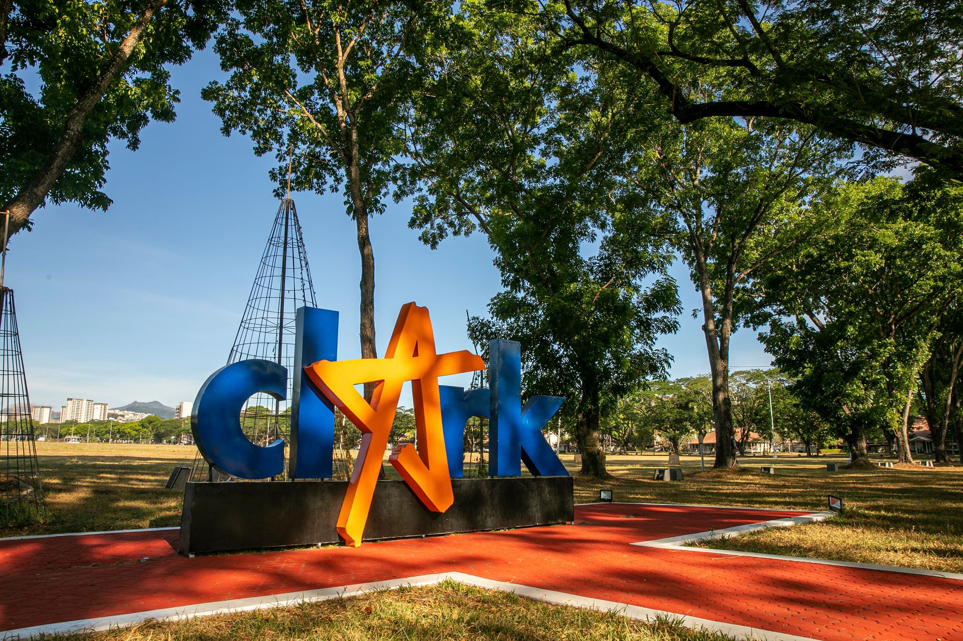

REGIONAL PRESENTATION TEMPLATE AND GUIDE
MECHANICS:
Each presenter is given a maximum of twenty (20) minutes to make a presentation in the following order:
  Two (2) best practices in their region
  One (1) major challenge/difficulty encountered and;
  Operational, Policy & Emerging Issues on the Priority Programs.
The best practices/milestones documented must demonstrate effective governance, strong partnership and collaboration with priority stakeholders, impacts in the community/ies, replicability and cost effectiveness. Meanwhile, presenters must also discuss the major challenge/difficulty encountered, as well as their strategy to overcome the same. All of these may be presented either thru AVP or PPT Slides.

Slide 3
REGIONAL PRESENTATION TEMPLATE AND GUIDE
The Operational, Policy and Emerging Issues must be presented using the template provided. Please limit your presentation to a maximum of six to seven (6-7) slides.

Slide 4
OPERATIONAL, POLICY & EMERGING ISSUES
Operational, Policy & Emerging Issue | Status/Action Taken at Regional-Level | Recommendation by the Region | Concerned Sector/Bureau (FMB, BMB, LMB, ERDB, MGB, EMB, Other Offices)
CLEAN AIR
CLEAN WATER
SOLID WASTE MANAGEMENT
GEOHAZARD, GROUNDWATER ASSESSMENT AND RESPONSIBLE MINING
NATIONAL GREENING PROGRAM

Slide 5
OPERATIONAL, POLICY & EMERGING ISSUES
Operational, Policy & Emerging Issue | Status/Action Taken at Regional-Level | Recommendation by the Region | Concerned Sector/Bureau (FMB, BMB, LMB, ERDB, MGB, EMB, Other Offices)
INTENSIFIED FOREST PROTECTION PROGRAM
PROTECTED AREAS, CAVES, WETLANDS MANAGEMENT AND WILDLIFE CONSERVATION
SCALING UP OF COASTAL AND MARINE ECOSYSTEMS
IMPROVED LAND ADMINISTRATION
MANILA BAY REHABILITATION

