Slide 1






Development of Underwater Sensor
Network for Tsunami Detection through Ground Station Terrestrial and Nanosatellite
Communication
Year 1
First Quarter Report
(April 2023 – June 2023)
Program Leader: Lorena C. Ilagan
Implementing Agency: University of Perpetual Help System DALTA – Las Piñas
Cooperating Agency: Philippine Navy
Funding Agency: PCIEERD-GIA
Year of TR Completion: 2025

Slide 2
Outline
Brief background
Needs/Problem(s), Solution(s), Differentiation, Benefits
Objectives
Methodology
Workplan / timeline of activities
Expected outputs
Expected outcomes
Proposed budget and list of equipment

Slide 3
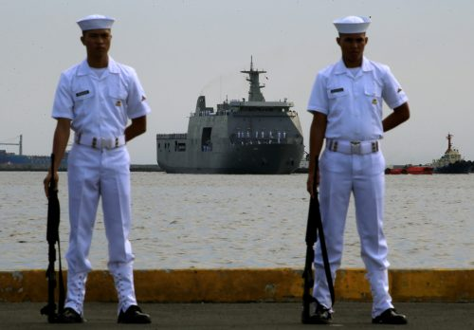
BRIEF BACKGROUND
In the East Asia Forum published on June 15, 2021, it was reported that the Philippines is keen to expand the Philippine Navy’s capabilities into the sub-surface domain
Persistent naval presence serves “deterrence and detection” and quickly raise alarms to any immediate threat and protect its Exclusive Economic Zone (EEZ)
Figure 1. The Philippine Navy

Slide 4
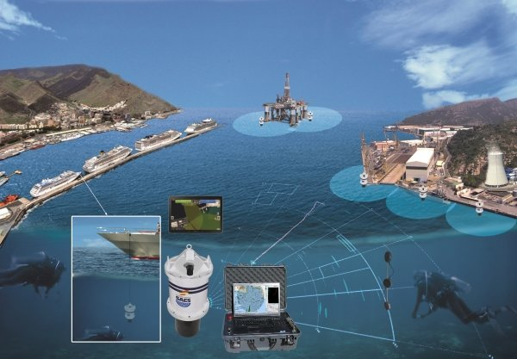
NEEDS
With the mentioned threats, the need to develop a Ground Sensor Terminal (GST) that could readily provide underwater data will address these issues.
Figure 2 Critical Infrastructures and Potential Underwater Threats
The inability to access underwater information on a global landscape reduces the ability to respond in the current and emerging threats to the Philippine waters brought about by natural disasters especially in identified areas such as Verde Island Passage.

Slide 5

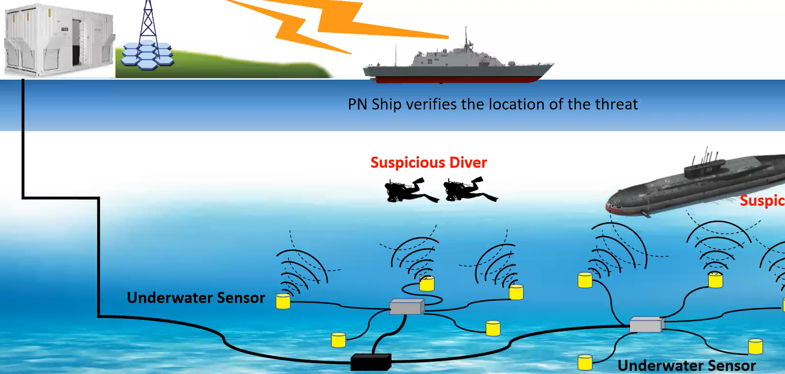
SOLUTION
The UnderWater Sensor Network(UWSN) is an emerging technology which when utilized accessed via nanosatellite or terrestrial communication may help mitigate Philippine Sea threats from natural disasters.
Figure 3 Underwater Sensor Network Pictorial Diagram
A network of independent sensor nodes is called UWSN which are dispersed geographically underwater to detect characteristics of water such as quality, temperature and pressure. The detected data may be used by several applications.

Slide 6

Location: Isla Verde Passage, Mindoro

Slide 7
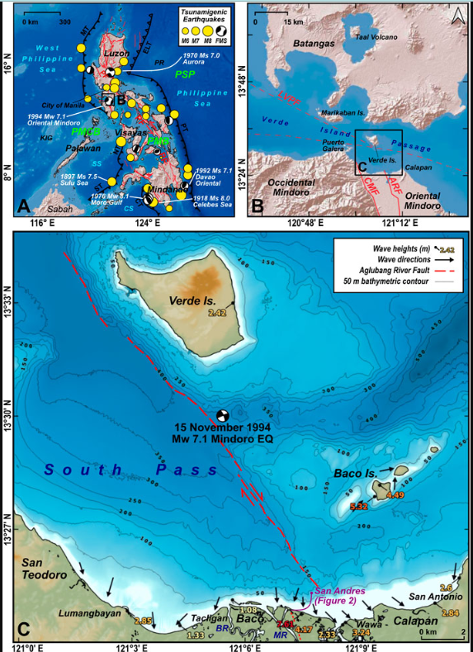
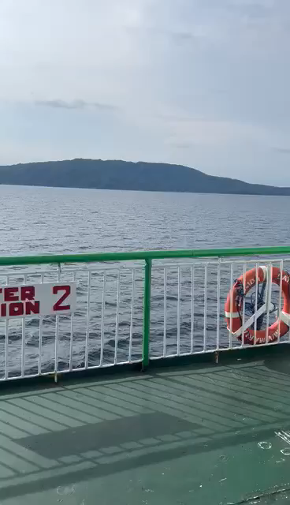
Ocular Inspection at Isla Verde

Slide 8
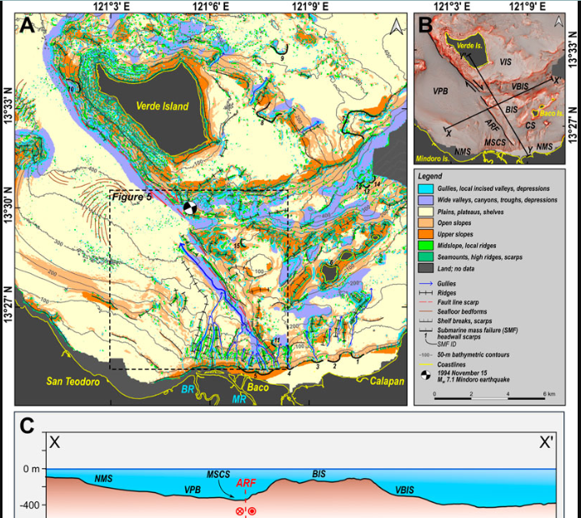
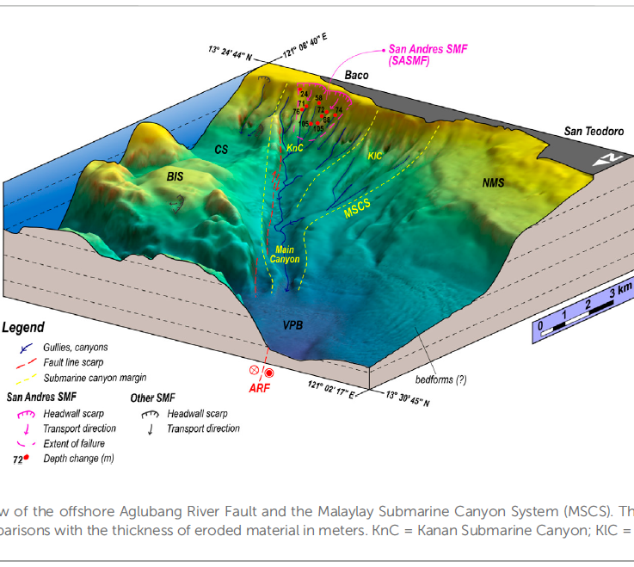
Bathrymetric Survey

Slide 9
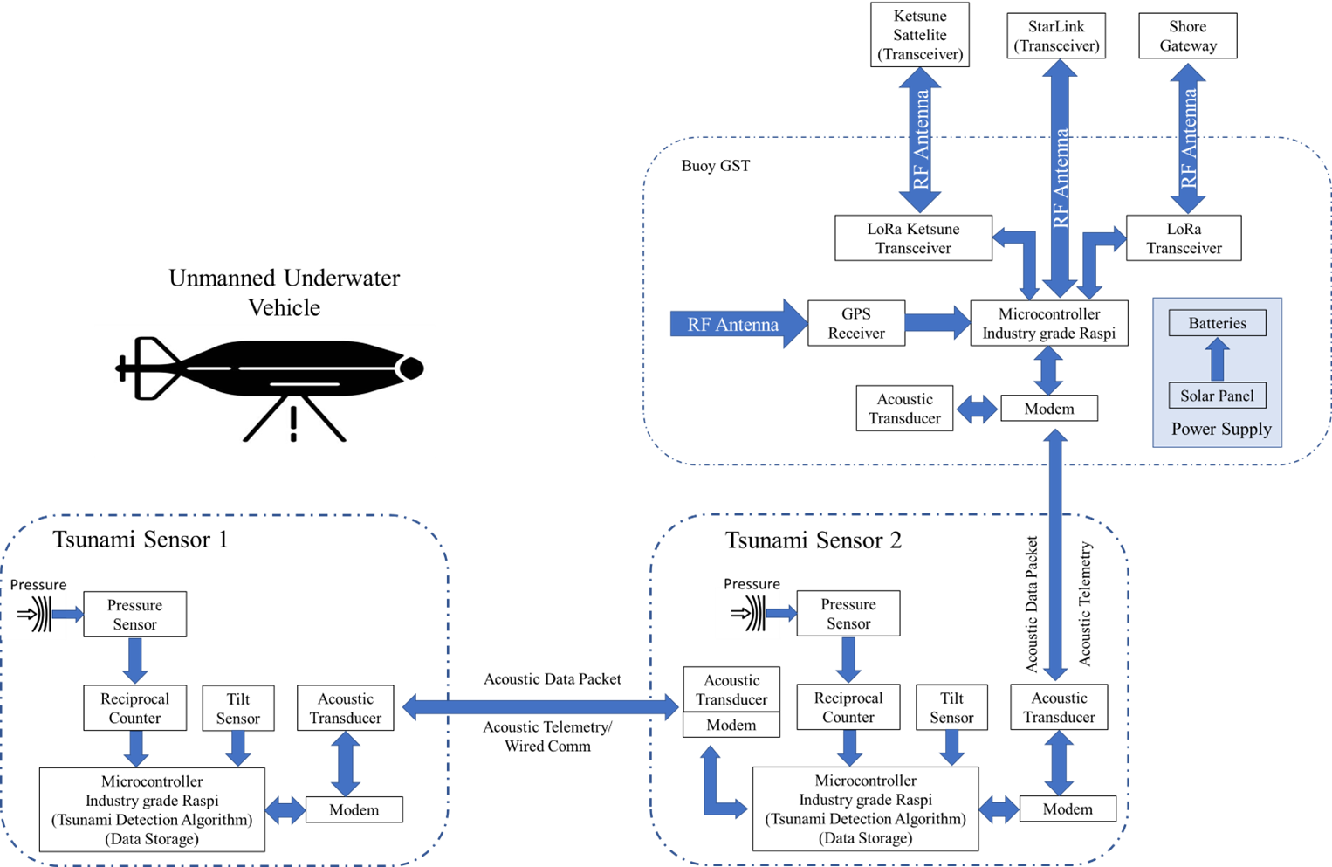
Figure 4 Underwater Sensor Network Conceptual Framework

Slide 10
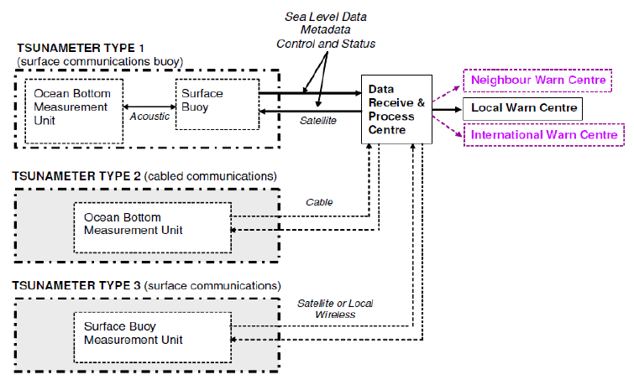

Slide 11
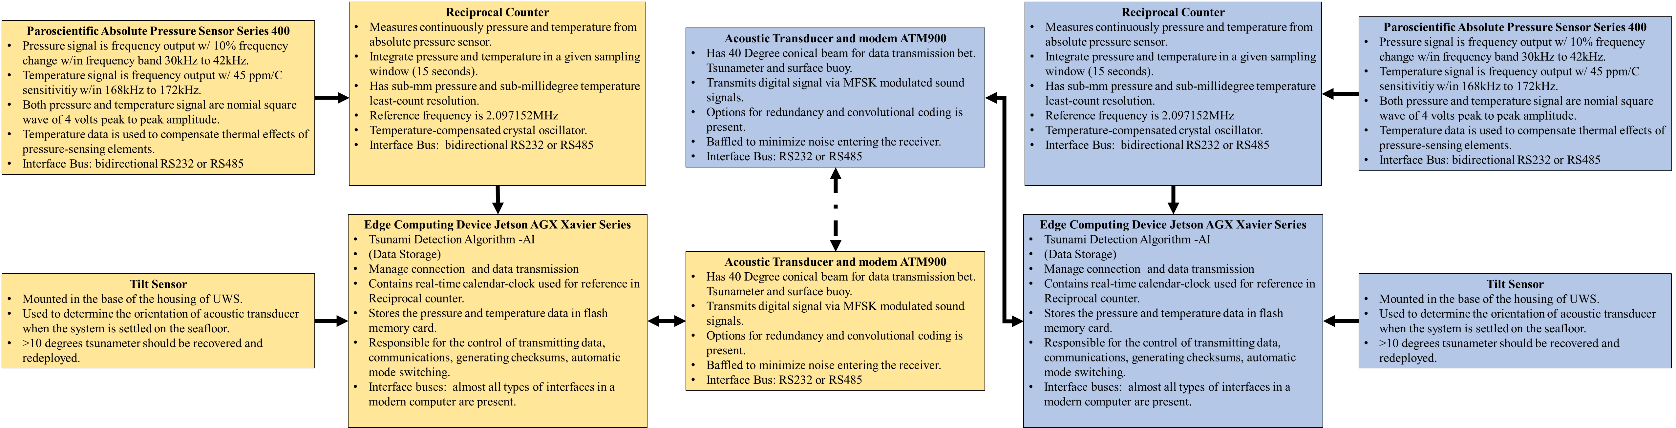
Figure 5 Underwater Sensor Network Functional Block Diagram

Slide 12
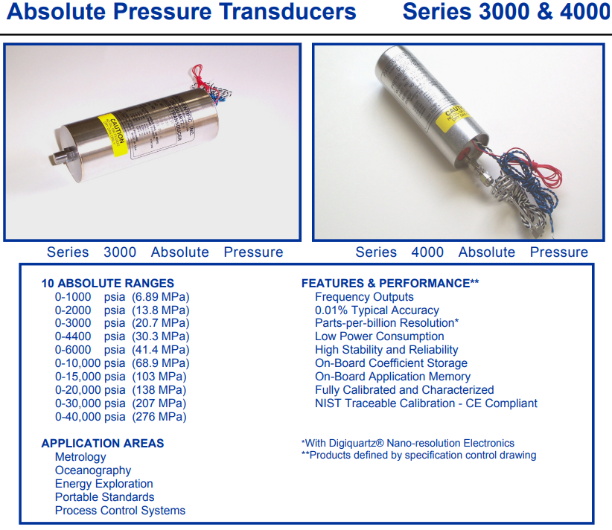
Initial Engineering Design Review
Initial Parts and Components considered during the Initial Design Revew

Slide 13
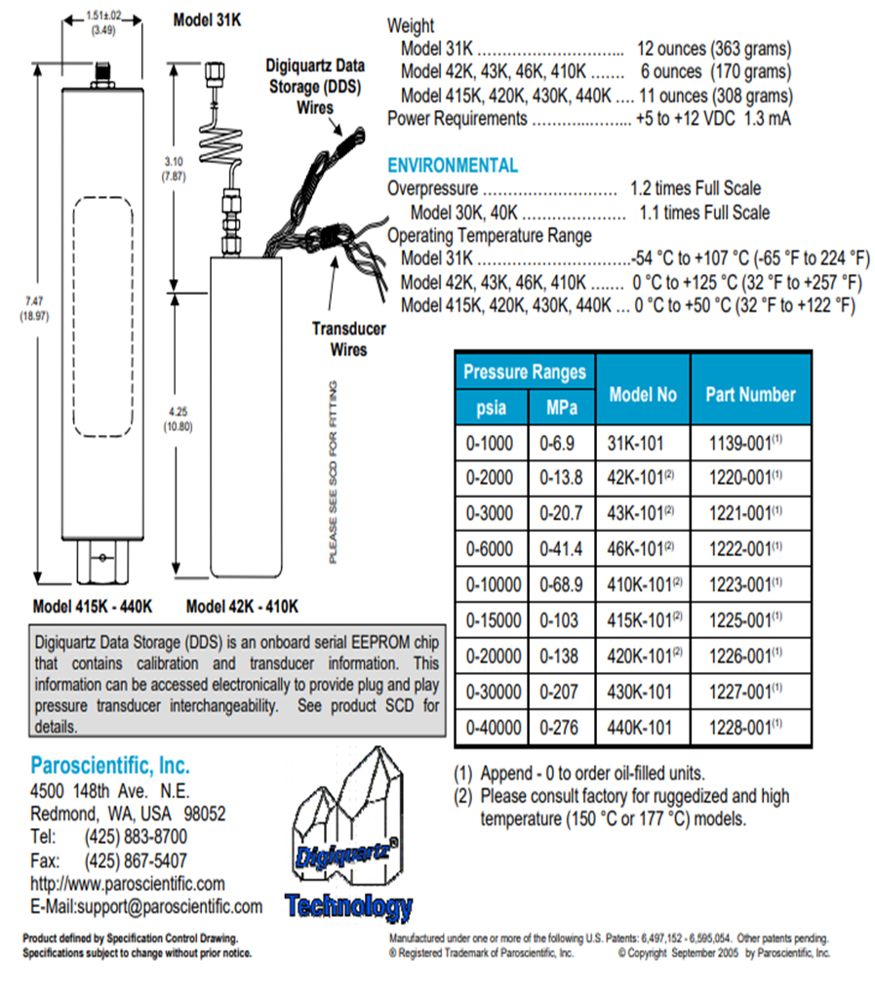
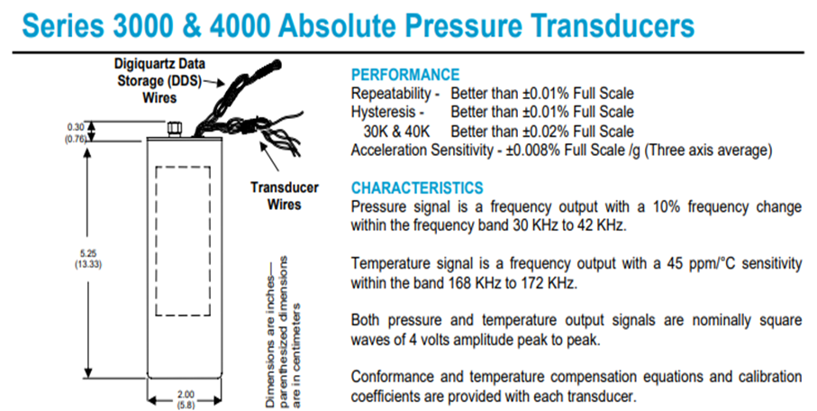

Slide 14

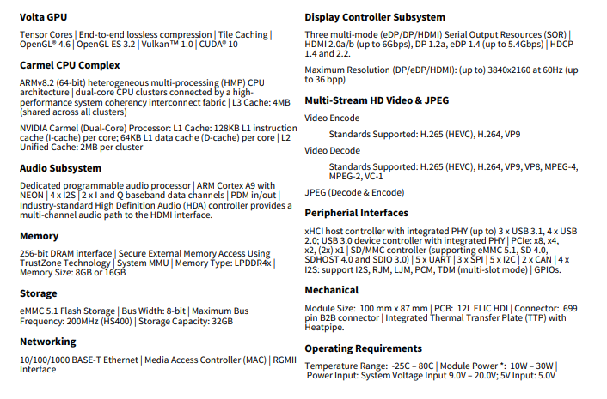

Slide 15
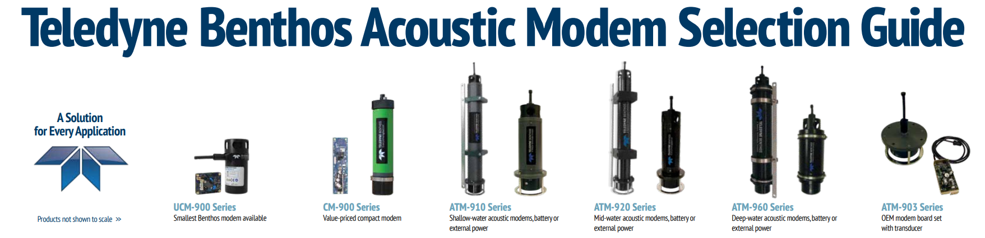
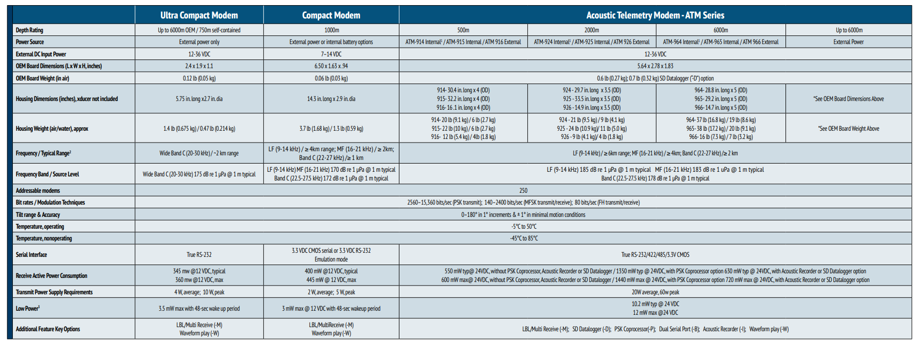

Slide 16
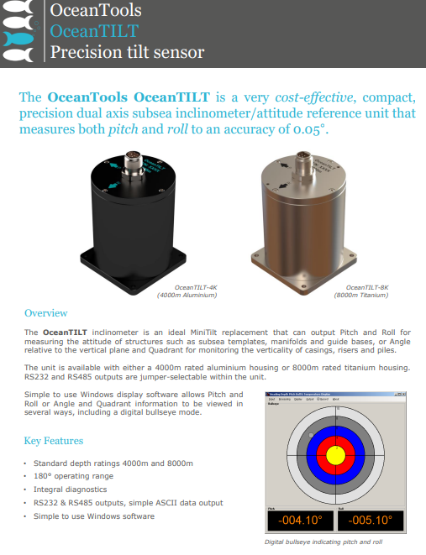
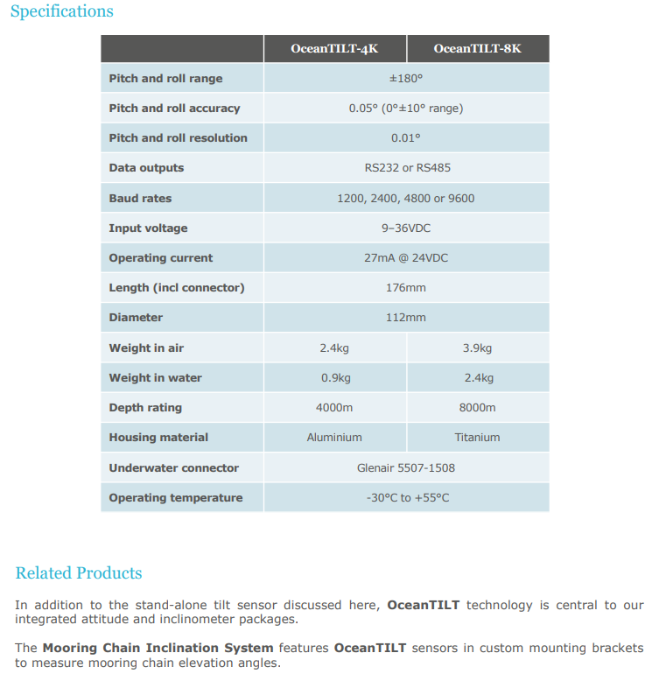

Slide 17
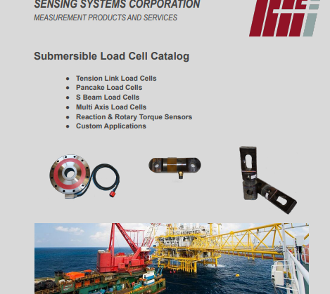
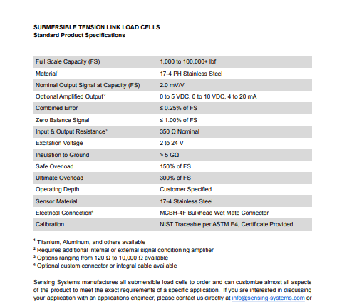
Submersible Load Cell

Slide 18
Battery and Power Consumption with Charging feature for 4 Years Lifetime.
Power Distribution
Battery and Power Consumption with Charging feature for 4 Years Lifetime.
In deep ocean applications where long-lasting batteries are required, lithium thionyl chloride (Li-SOCl2) batteries are commonly used. These batteries are known for their high energy density and excellent performance in extreme environments, including deep-sea conditions.
Lithium thionyl chloride batteries offer several advantages for deep ocean applications:
High energy density: Li-SOCl2 batteries have a high energy density, which means they can store a significant amount of energy in a compact size. This is beneficial for deep ocean applications where space is limited.
Wide temperature range: These batteries can operate over a wide temperature range, typically from -55°C to +85°C (-67°F to +185°F). Deep ocean environments can have extreme temperatures, and Li-SOCl2 batteries can withstand these conditions effectively.
Long shelf life: Li-SOCl2 batteries have an impressive shelf life, with some models capable of retaining their charge for up to 20 years. This makes them suitable for long-duration deployments in deep-sea applications.
Low self-discharge rate: These batteries have a very low self-discharge rate, meaning they can hold their charge for extended periods without significant power loss. This is important for deep ocean applications where regular battery replacements are challenging.
High reliability: Li-SOCl2 batteries are known for their reliability and long service life. They are designed to withstand harsh conditions, including high pressures and corrosive environments encountered in deep-sea settings.

Slide 19
Physical Bus Interfaces to Main Controller and Acoustic Physical Interface
Reciprocal Counter → Jetson AGX Xavier: RS232 or RS485 (need a connector)
Tilt Sensor → Jetson AGX Xavier: RS232 or RS485
Acoustic Modem and Transducer → Jetson AGX Xavier: RS232 or RS485
UWS1 ←→ UWS2: If seafloor is not flat, then Wired connection with RS232 or RS485 interface
UWS1 ←→ UWS2: If seafloor is flat: Then Wireless
UWS1 ←→ UWS2: If seafloor is not flat, then Wired connection with RS232 or RS485 interface
UWS1 ←→ UWS2: If seafloor is flat: Then Wireless
UWS2 ←→ Buoy: Wireless, modified x-modem protocol (water as medium

Slide 20
Tsunameter Mode of Operation
Standard/Idle Mode – Tsunameter is in low-power operation, transmission of data is once every 6 hours. Messages/packets
Sent contains the following information.
• Message ID, a sequential number
• Message status, C = corrupted, I = intact
• Date= month day year
• Time= hour minute second
• Main battery voltage,or error code
• Acoustic modem DSP battery voltage
• Acoustic modem battery voltage
• Four values for water column height in millimeters corresponding to 15-minute intervals
• Number of tries to deliver tsunameter data
• Checksum delimiter
• Checksum
F | F | FFF | FFFF | FFFF | FFFFFF | F | FF
Message ID | Status | Date (YMDHMS) | Voltage/Errorcode | Acoustic modem/transducer voltage | Four values for water column height in millimeters corresponding to 15-minute intervals | Tx Trials | checksum

Slide 21
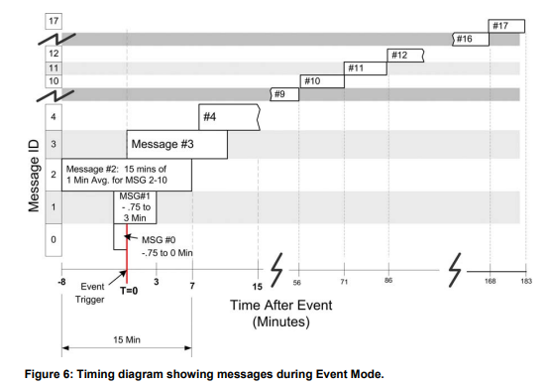
Tsunameter Mode of Operation
Event Mode – At the time the tsunami detection algorithm triggered. The system will enter in the event mode immediately and send message as message#0. Then, send alerts to the buoy. Then, the system in the buoy will activate the connected subsystems to transmit the signals both from LoRa, iridium satellite comms, or through starlink. Event mode message/packet contains the following:
• The exact time that the event was detected
• A message ID
• The average water column height that triggered the Event Mode, along with three
height deviations.
• Check sums and other data verification values that ensure the integrity of the data
transmission.

Slide 22
Planned Software to be Used
The operating system of the computer to be used is Linux-based. Tsunami detection algorithm can be written in C++ or Python. For the AI-based tsunami automatic detection system, it can be trained using tensorflow/keras platform and deployed in the computer using python.

Slide 23
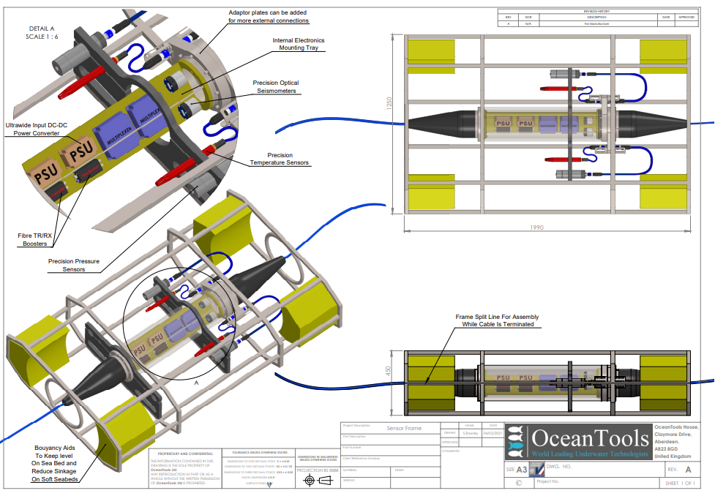
Structural Design

Slide 24
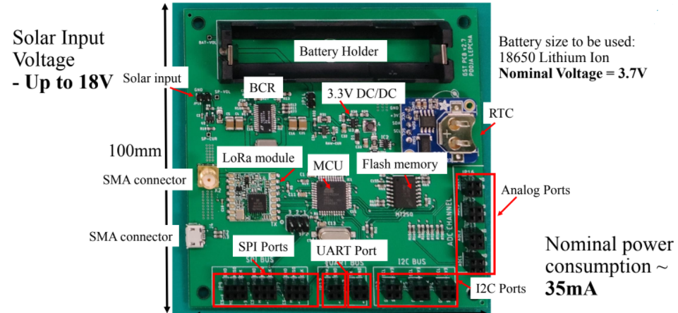
Methodology
The data collected from the sensors will be transmitted using LoRa technology wirelessly through radio frequency LoRa modulation then sends to satellite transceiver.
The satellite transceiver will downlink the data to the base station. In case of communication failures between the remote LoRa gateway and satellite transceiver. The connection will be rerouted from gateway through the internet then to the base station.

Slide 25
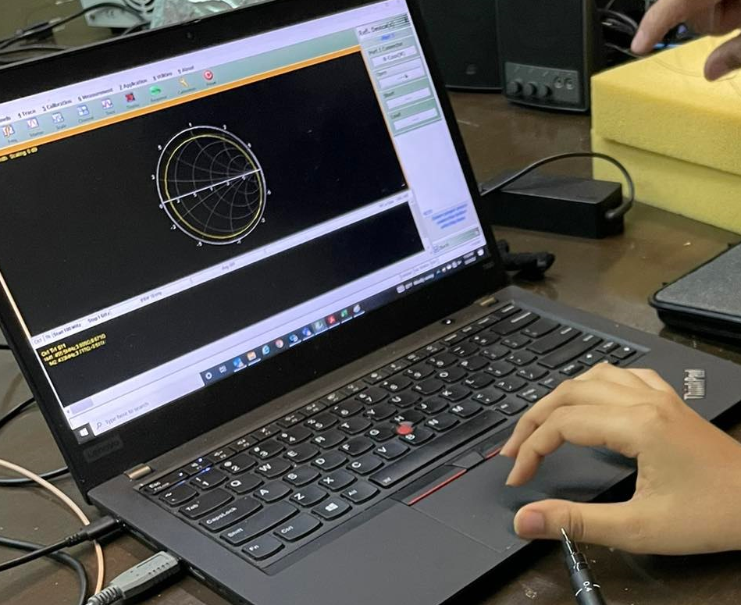
Quadrifillar Helical Antenna for GST

Slide 26
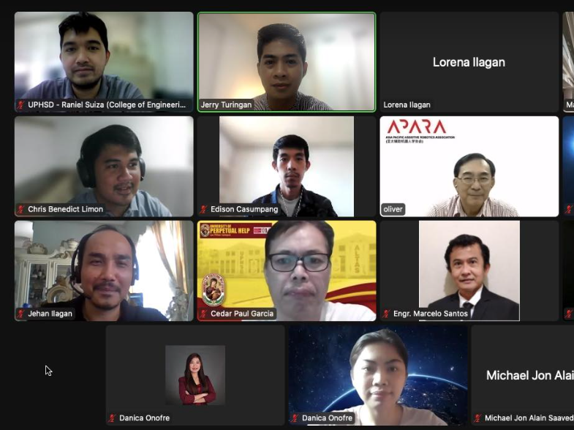

Slide 27
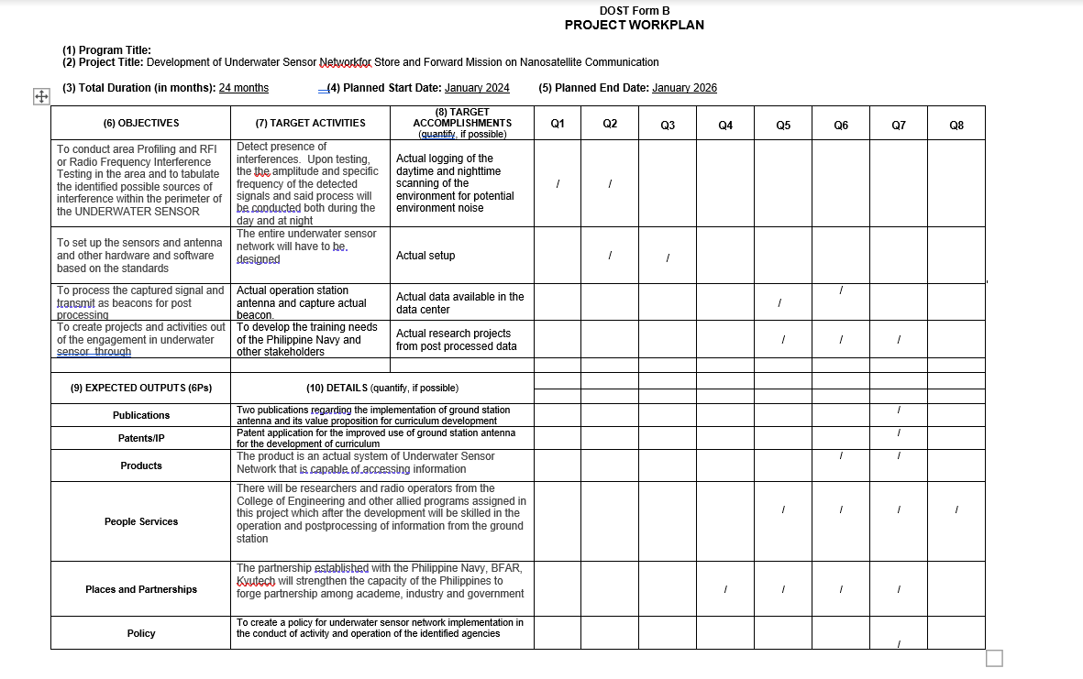

Slide 28
Expected Output
Rev 0 / 1-02-08
Publications | Two publications regarding the implementation of ground station antenna and its value proposition for curriculum development
Patents/IP | Patent application for the improved use of ground station antenna for the development of curriculum
Products | The product is an actual system of Underwater Sensor Network that is capable of accessing information
People Services | There will be researchers and radio operators from the College of Engineering and Philippine Navy and other allied Universities from UNISEC AND SEIPI assigned in this project which after the development will be skilled in the operation and postprocessing of information from the ground station
Places and Partnerships | The partnership established with the Philippine Navy, BFAR, Kyutech, SEIPI, UNSEC will strengthen the capacity of the Philippines to forge partnership among academe, industry and government
Policy | To create a policy for underwater sensor network implementation in the conduct of activity and operation of the identified agencies
Rev 0 / 1-02-08

Slide 29

Thank You

