Slide 1
MANGROVE INTERPRETATION
FOR ECOTOURISM
c.e.yao

Slide 2
WHAT IS MANGROVE INTERPRETATION
ARTICULATION/DEMONSTRATION ON
- IMPORTANCE OF MANGROVES
MANGROVE CHARACTERISTIC
- INTERELATIONSHIP AMONG ITS COMPONENTS (FLORA & FAUNA)
- SPECIES IDENTIFICATION
- HOW BAKAUAN REGENERATES
- HOW DID BAKAUAN LALAKI GOT ITS NAME

Slide 3
Developing Local Mangrove Specialist (LMS)
IDENTIFICATION OF VOLUNTEERS
MASTERY OF GIVEN TOPICS
ROLE PLAYING/ DRY RUN

Slide 4
WHAT IS ECOTOURISM
RESPONSIBLE TRAVEL
NATURE
CULTURE/PEOPLE
ENVIRONMENTAL CONSERVATION

Slide 5
A MUST FOR AN ECOTOURISM
1. CONSERVATION OF NATURE & CULTURE
2. EDUCATION OF TOURIST AND COMMUNITIES
3. ECONOMIC DEVELOPMENT OF THE AREA
4. EXPECRIENCE WHICH MOTIVATE PEOPLE TO CONSERVE
5. PARTICIPATE IN THE DEVELOPMENT

Slide 6
IS YOUR AREA APPROPRIATE FOR ECOTOURISM?
ANY ATTRACTION?
ARE YOU OFFERING SOMETHING UNIQUE
IS IT ACCESSIBLE, SAFE, RELIABLE?
HOW DEDICATED ARE TOURISM WORKERS
ANY SHARE OF THE COMMUNITY?
ARE DENR/LGU SUPPORTIVE
IS THER A FINANCING ACCESS TO START

Slide 7
Mangrove Ecotourism Inputs:
Presentation/Demonstration
Detrital Food Chain – major source of fish food
Demonstration on bakauan regeneration– a long journey, a slim chance
Fiddler crabs courtship -
Snapping shrimps – a mangrove delicacy
Mangrove lobster – the mystic land builder
Tabigi – the fruit puzzle

Slide 8
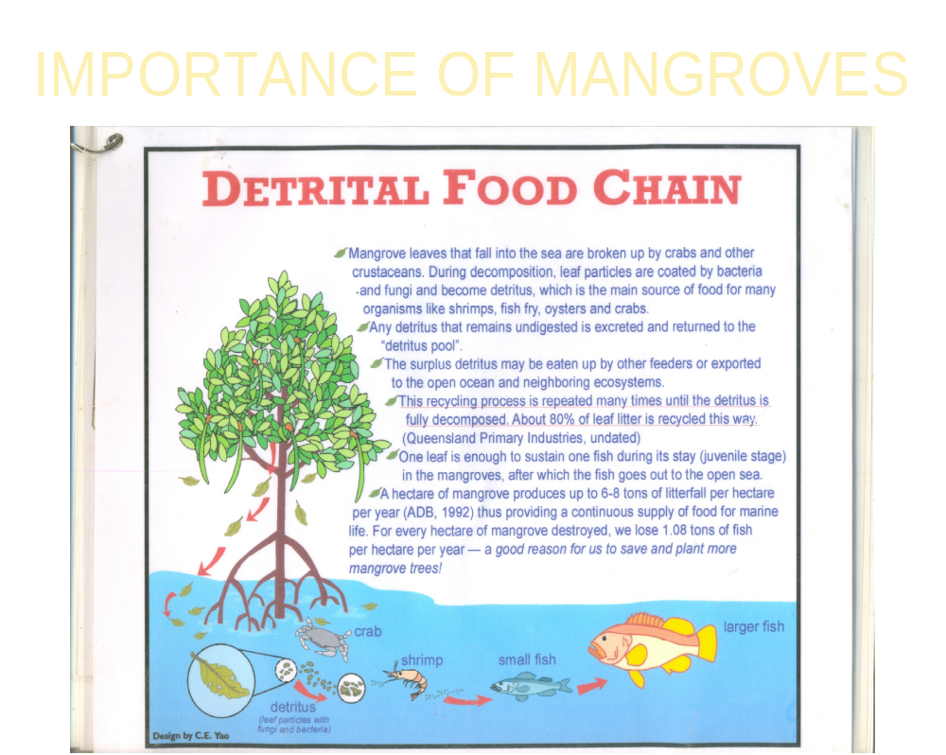

Slide 9
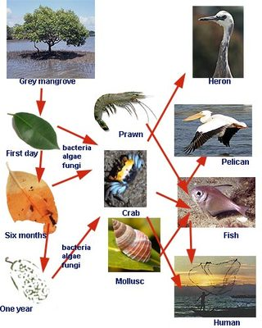
DFC

Slide 10
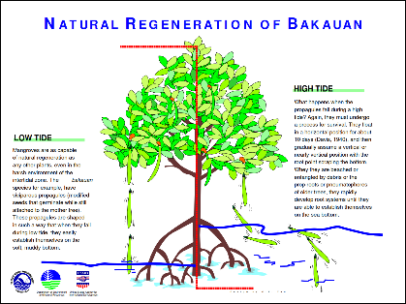
Bakauan regeneration

Slide 11
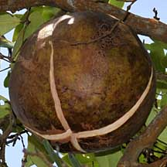
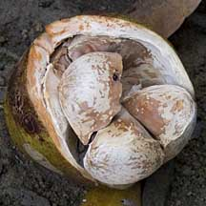
Tabigi, the puzzle fruit

Slide 12
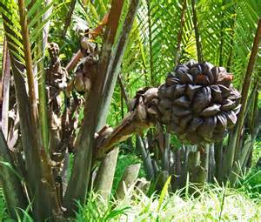
Nipa: a high value species
For nipa shingle
Nipa wine/vinigar
bioethanol

Slide 13
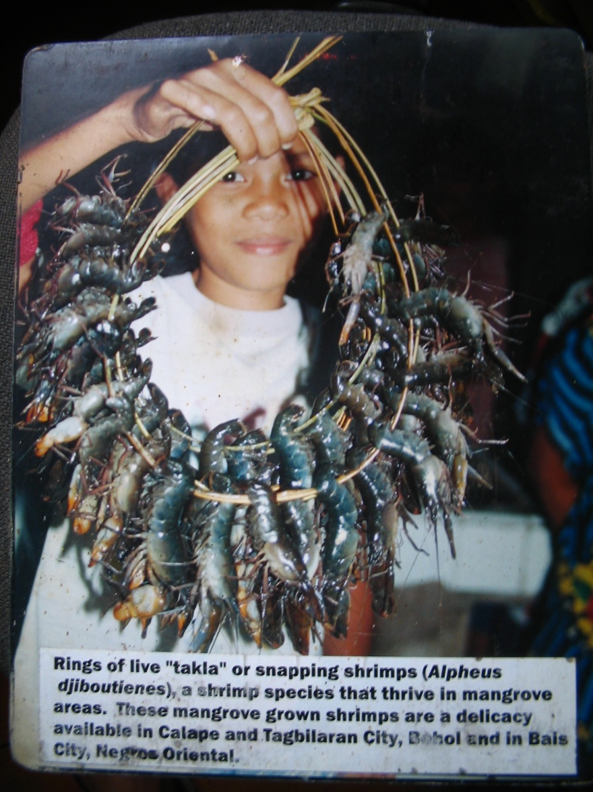
The Crunchy Crustacian

Slide 14
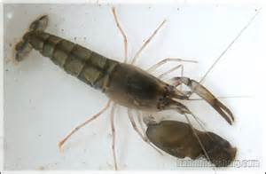
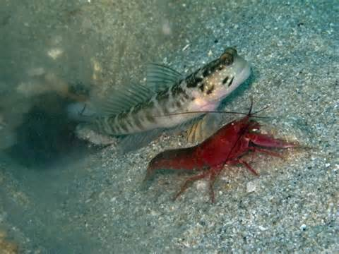
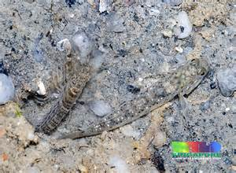
Snapping Shrimp & Gobi Fish Symbioses

Slide 15
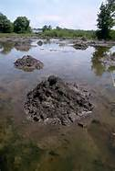
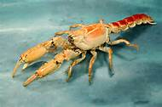
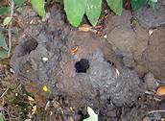
MUD LOBSTER the LAND BUILDER
Eating lobster, you get thirsty and after
dringking, a with sweet after-taste

Slide 16
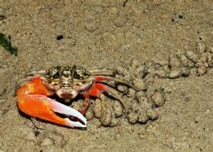
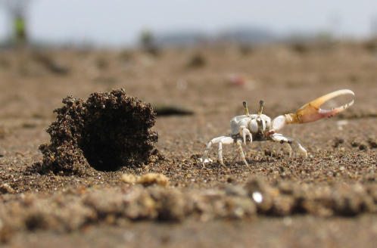
Fiddler crab courtship

Slide 17
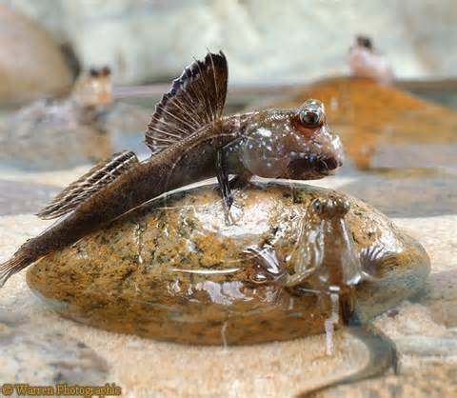
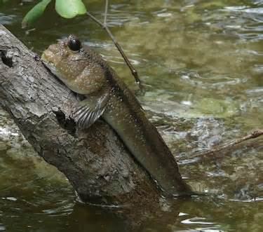
MudSkipper, the climbing fish

Slide 18
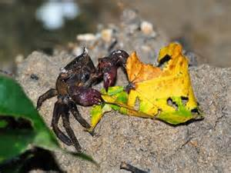
Sesarma: the leaf eating crab, the detritus link

Slide 19
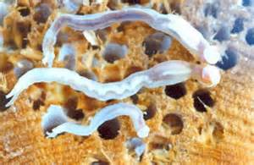
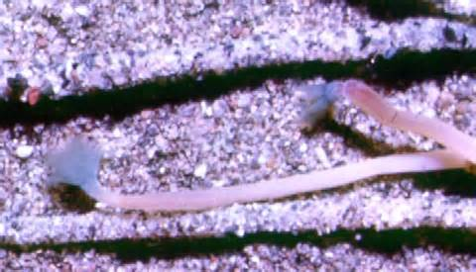
Tamilok: a mangrove delicacy
When they are ready to undergo metamorphosis, they search for suitable timber on which to settle. They seem to be able to detect rotting wood and are able to swim towards it when they are close enough. Each one then crawls around until it finds a suitable location where it attaches itself with a byssus thread. It may secrete an enzyme to soften the wood before starting to dig with its foot. When it has formed a hollow, it undergoes a rapid metamorphosis, shedding and consuming the velum and becoming a juvenile shipworm with small horny valves at the anterior end. It can then begin to dig more efficiently. It bores deeper into the wood and spends the rest of its life as a tunneller.^{[6]}

Slide 20
ADDITIONAL INFO
How deltas are formed, named
Why mangroves along rivers are more divers and luxuriant
name some livelihoods in the mangroves
How did bakauan lalaki got its name
What is the difference between major and minor groups of mangroves

Slide 21
Additional inputs
What is a Mangrovetum
What are the edible mangrove fruits
Mangrove bonsai materials
Towns/cities name after mangroves
Can mangrove survive sans sea water

Slide 22
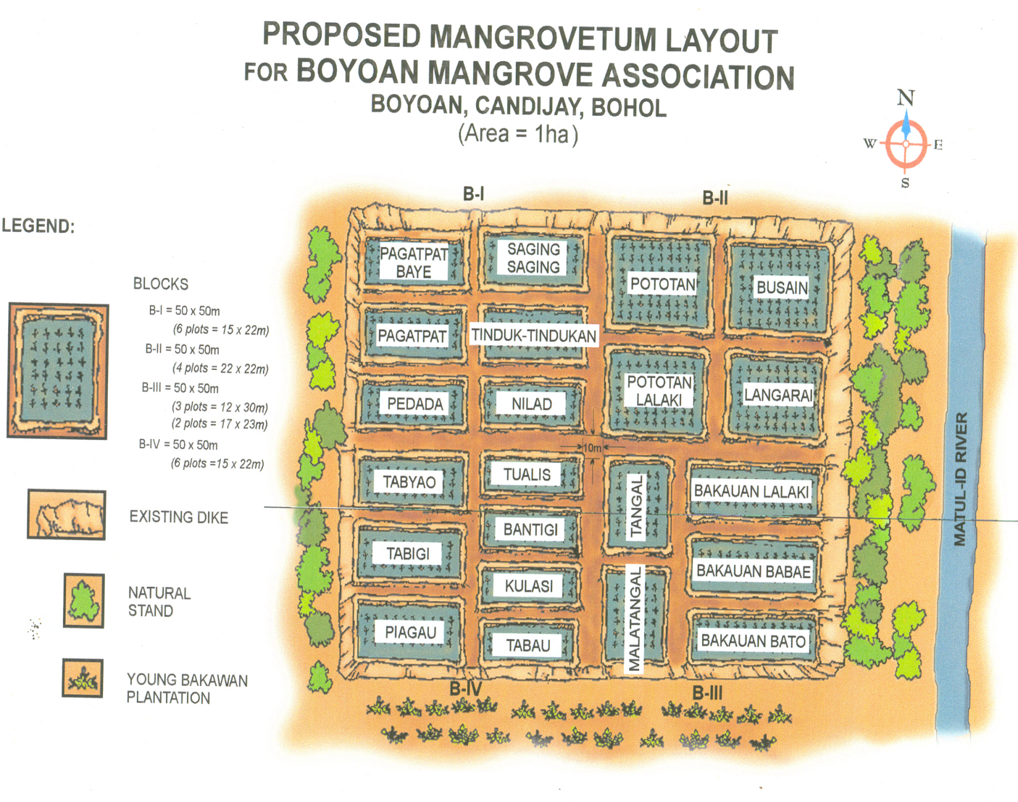
CANDIJAY, BOHOL/prese ppt
*
ESTABLISHED IN 1999 WITH ONLY TWO BAKAUAN SPECIES

Slide 23
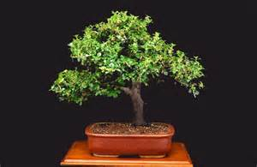
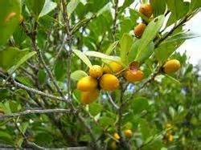
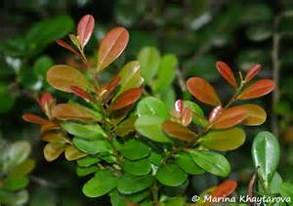
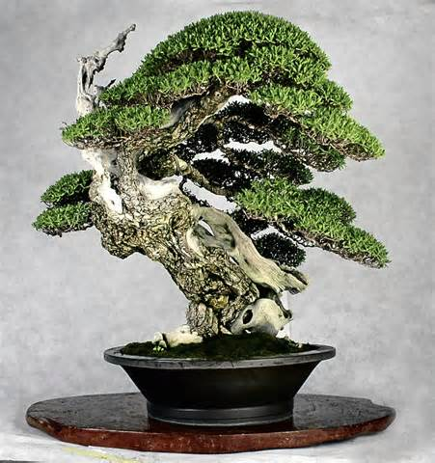
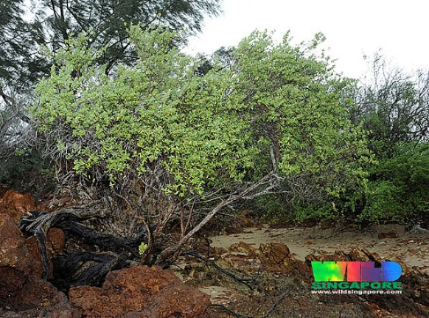
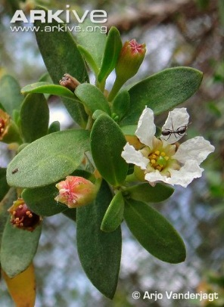
Prized mangrove bonsai
BANTULINAO
BANTIGUE

Slide 24
Places named after mangroves
SPECIES | L0CATION | SPECIES | LOCATION | REMARK
Bani Banago Banilad | Pangasinan Bacolod City Cebu City, Dmgt | Maribago Molave | Lapu-lapu City Zambo Sur
Bitaog Botong | Talingting, Siquijor Quezon | Tabontabon | Leyte
 |  | Talisay – | Cebu, Batangas, NegOcc, Camnor
ipil | Samboanga Sibugay
Kulasi Pandan Pitogo | Ilo-ilo antique Bohol, Zambo SUR
Piapi | Davao City
Pototan | Ilo-ilo, Laguna (Potatan)

Slide 25
SALAMAT

