Slide 1

PHILIPPINE
RECLAMATION
AUTHORITY (PRA)
16 October 2023
Venue

Slide 2

Outline
PRA Mandate
Approved Reclamation Projects
  Ongoing Projects in Manila Bay
Projected Economic/Financial Benefits to Government
  Reclamation Development Phase
  Horizontal Development Phase
  Vertical Development Phase
Environmental Enhancement
  5% earmarked for Green Spaces or Urban Forests
Notes:
This outlines the brief presentation of the PRA.

Slide 3

PRA Mandate
P.D. No. 3-A (1973)
P.D. No. 1084 (1977)
E.O. No. 525 (1979)
E.O. No. 654 (1981)
E.O. No. 153 (1999)
E.O. No. 74 (2019)
Limiting reclamation to the National Government or any entity authorized under proper contract
Created PRA, defining its powers and functions, providing funds and other purposes.
Designated PRA as the agency primarily responsible for integrating, directing and coordinating all reclamation projects
PRA classified among the Infrastructure /Utilities Group of Corporations under Letter of Implementation No. 97 and shall operate on a self-liquidating basis. Identified large reclamation projects which can provide vital infrastructures for the Government’s overall economic and social development programs.
Authorizing the Utilization of Offshore Areas as Sources of Dredge Fill Materials for Government Reclamation Projects and for Other Purposes
Delegating to the PRA Governing Board the Power of the President to Approve Reclamation Projects

Slide 4
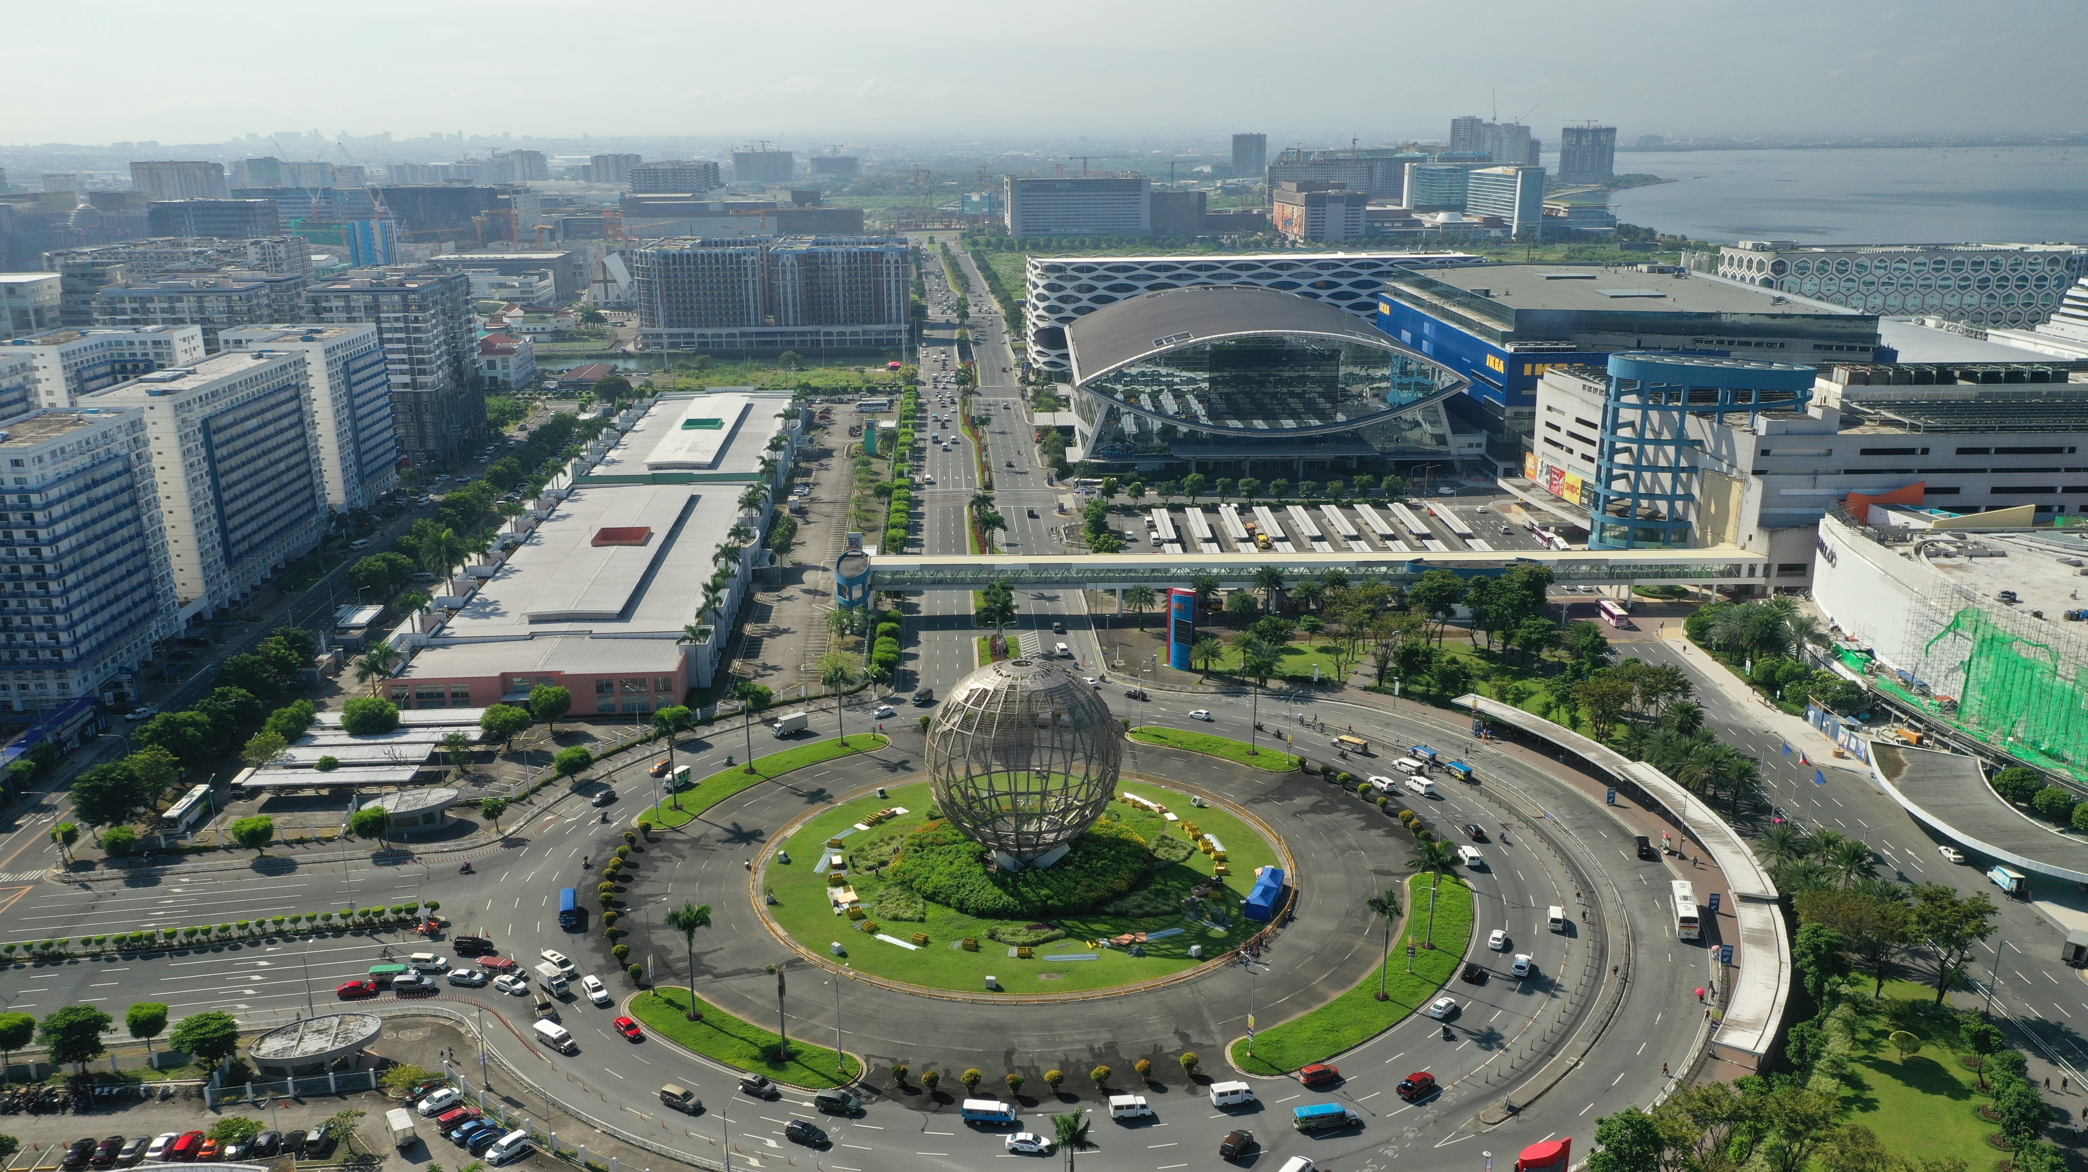
PRA Mission and Vision
Mission
Vision
“We are the lead government instrumentality mandated to regulate reclamation, create environmentally sustainable reclaimed land, promote coastal resilience, and develop government properties to advance the country's development goals.”
“In 2040, the Filipino people shall benefit from well-planned, environmentally sustainable and resilient reclaimed lands, and efficiently developed and managed public estates.”

Slide 5
Land Reclamation is an internationally proven safe, reliable and sustainable solution to urban development and renewal. Reclamation is a proven safe, sustainable and environment-friendly solution to the acute demand for more living space for urban development and renewal, as evidenced by numerous reclamation projects worldwide. It is no surprise that many reclamation projects in advanced countries worldwide were undertaken to address the problem of land scarcity and to promote urban renewal in countries such as Singapore, Japan, Hong Kong, South Korea, Netherlands and Spain.

Slide 6
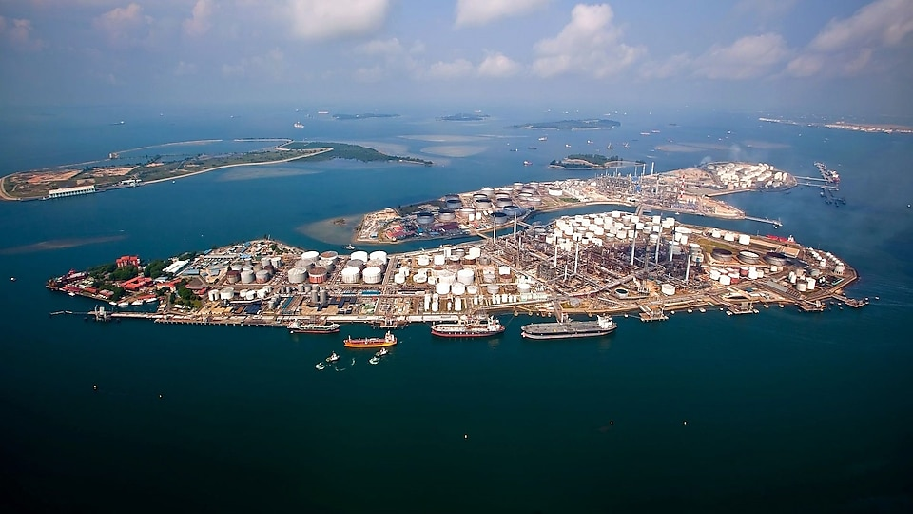
Reclamation as platform of economic growth in other countries
Jurong Island, Singapore
World-class infrastructure for refining, petrochemical, and specialty chemicals activities
50 billion SGD worth of investments
Employed 25,000 professionals
Sustainable and future ready
Enabled SG to be the 8th largest exporter of chemicals globally in 2019
Contributed 81 billion SGD to SG’s total output in 2015 (1/3 of SG’s total manufacturing output)
Houses 100 international chemical and energy companies such as Shell and Chevron
The reclamation amalgamated several islands comprising some 991 has. into a huge island of 3,000 has.
Image credit: Shell
Source: Singapore Economic Development Board (edb.gov.sg),
Singapore National Library Board (nlb.gov.sg)

Slide 7
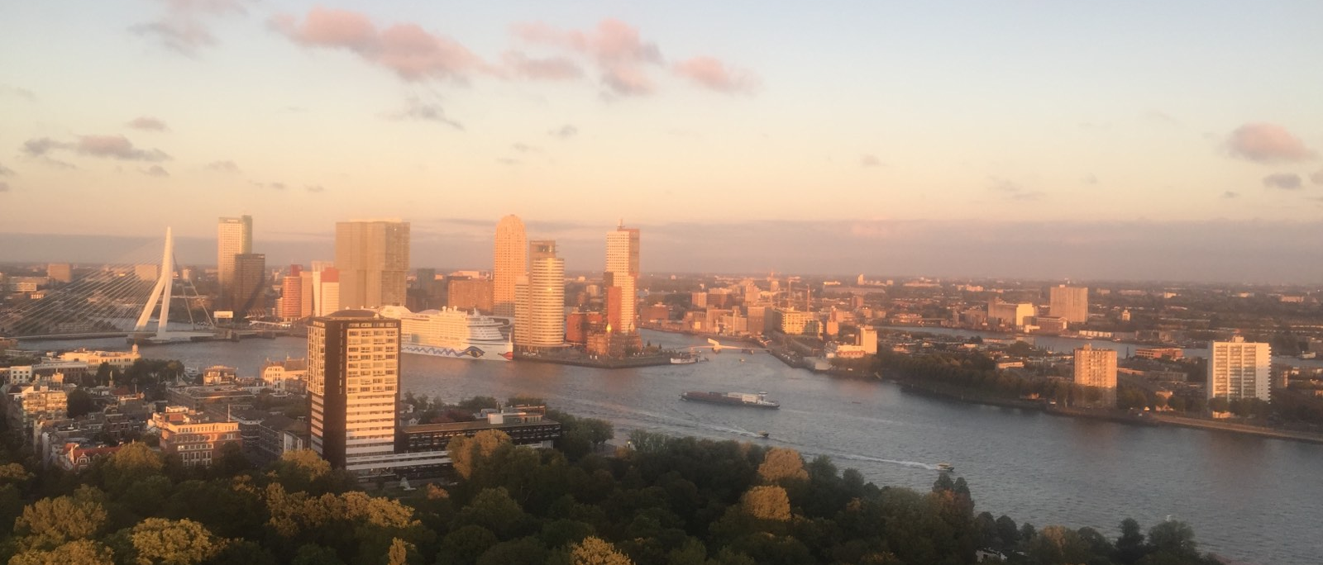
Reclamation as platform of economic growth in other countries
Rotterdam, the Netherlands
Rotterdam has been extending towards the sea numerous times to accommodate increasing demand of port development and other land uses
Port of Rotterdam – 12,600 has. (portofrotterdam.com)
In 2021, the Port of Rotterdam contributed 63 billion Euros to the NL economy, equivalent to 8.2% of Dutch GDP (cbre.com.au)

Slide 8
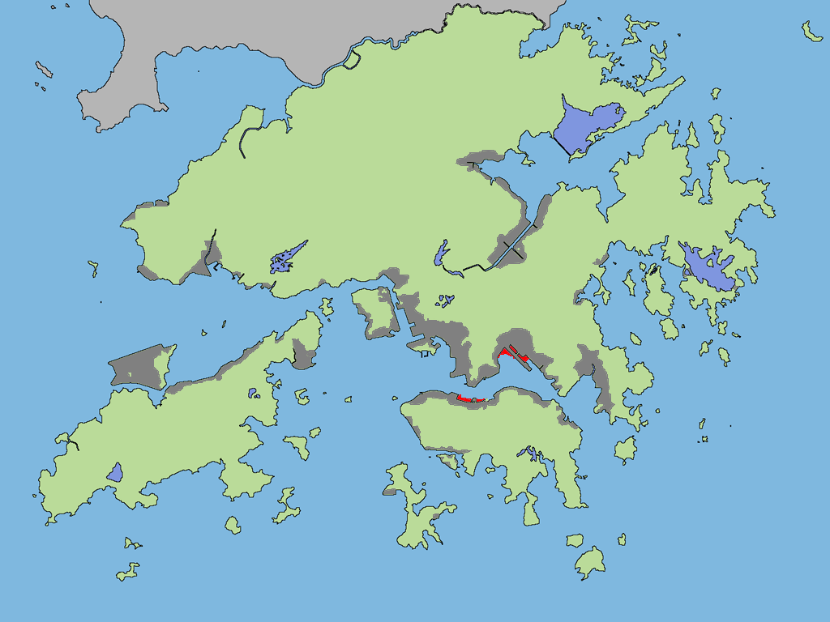
Reclamation as platform of economic growth in other countries
Hong Kong
Built-up areas - 24% of land of which 26% is reclaimed land
Reclaimed land accommodates 27% of total population
Decreased land reclamation from 2000-2013 resulted in land shortage, rent and price increases, and low space vacancies.
“More developable land is needed not only to support a still growing population, but also to sustain economic growth and a quality living environment.”
Plans to reclaim in waters with low ecological and environmental impact outside of Victoria Harbour (East Lantau Metropolis, approximately 1,000 has.)
Image credit: Shell
Dark gray = reclaimed
Source: Hong Kong 2030+ (Master Plan)

Slide 9
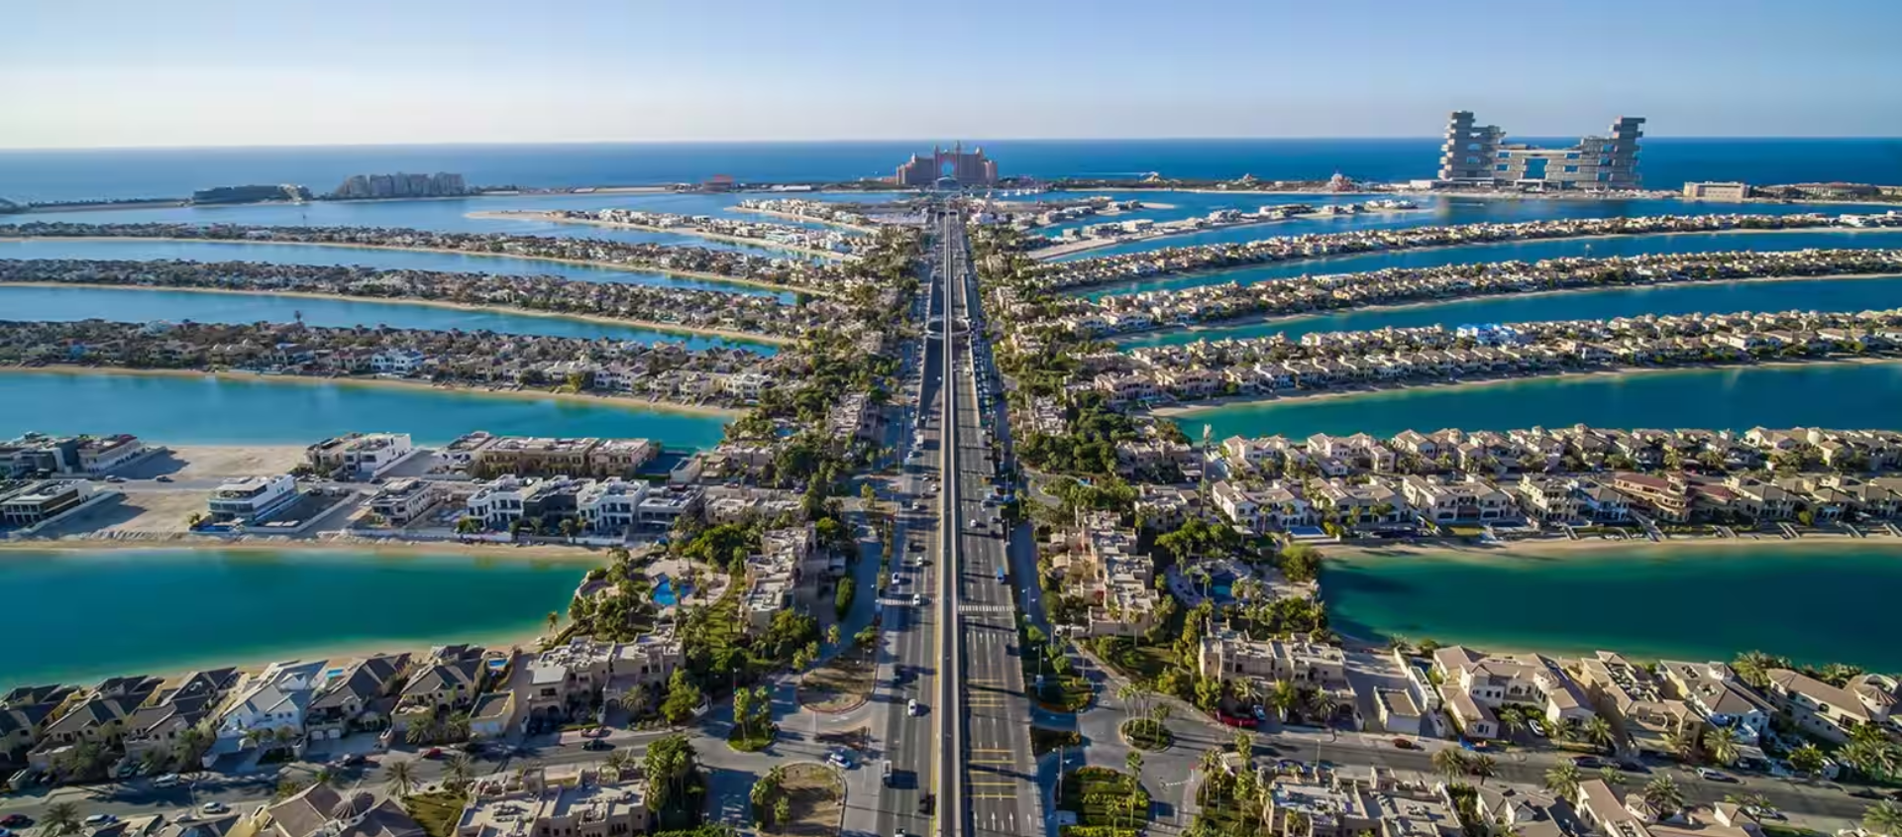
Reclamation as platform of economic growth in other countries
Palm Jumeirah, Dubai
560 hectares
Home to some of Dubai's top luxury resorts, including Atlantis, The Palm, FIVE Palm Jumeirah Hotel, Jumeirah Zabeel Saray, One&Only The Palm and many more.
Access is easy, with a network of roads, tunnels and public transport options such as the Palm Monorail.
Satellite guided technology was used to help build the frond-shaped island.
Palm Jumeirah welcomes 4 million visitors every year and is home to 80,000 residents from 70 nationalities.
Source: visitdubai.com, CNN
Image credit: Shell

Slide 10
Land reclamation effectively creates spaces for development pathways such as agglomeration economies.
It can provide sufficient and efficient spaces for a healthy business ecosystem.
It can provide a wider horizon of career growth and opportunities for Filipinos and even for foreign individuals.

Slide 11
If there is any credible and visible example that reclamation projects can be safe, reliable and sustainable, these should be the existing SM MOA Complex reclaimed in the 1990s and the CCP-FCA Complex reclaimed in the 1960s and 1970s.
Through the decades, these reclamation projects have survived battering typhoons and floods - proving the stability, safety and reliability of reclamation. Also, through the decades, no untoward incident related to reclamation construction has disrupted or marred the many important international and national events that have taken place in these reclaimed areas.

Slide 12
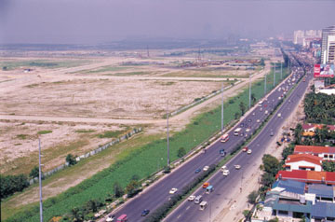
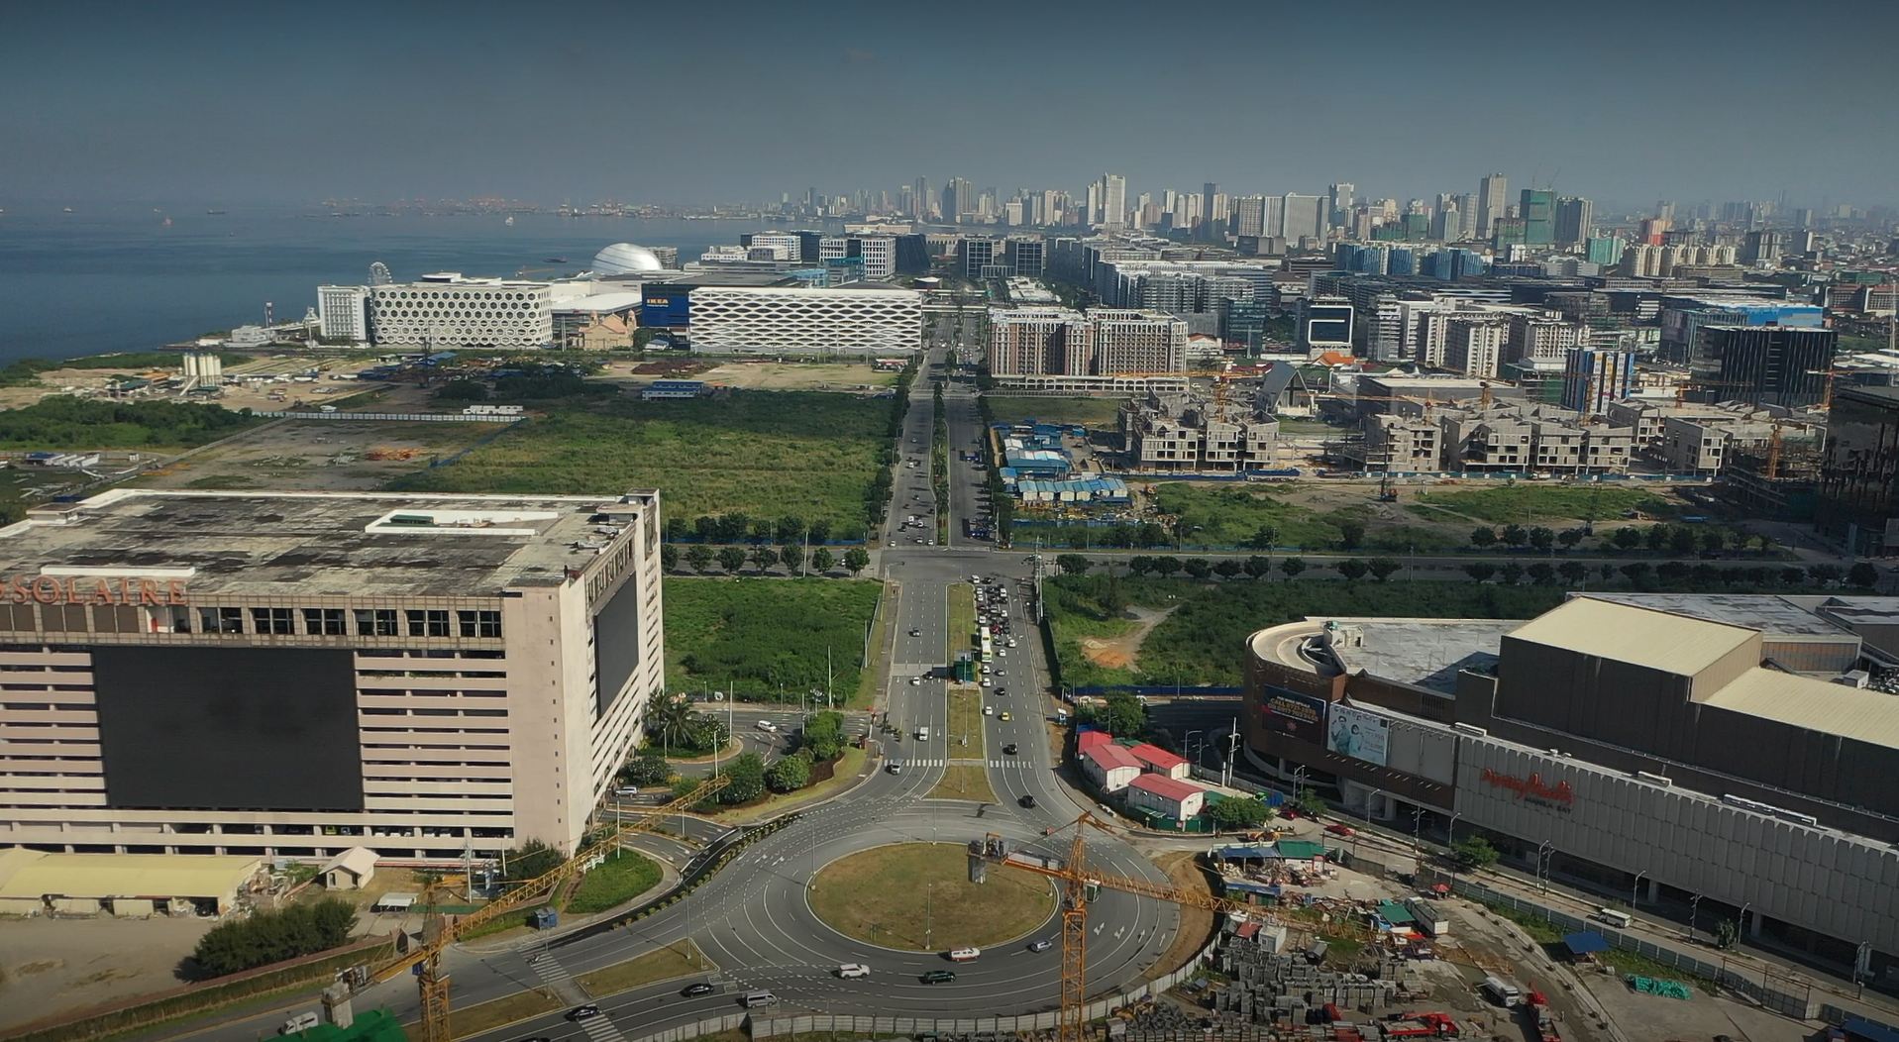
BAY CITY
CCP-FCA
CBP 1-A
CBP 1-B&C
Asiaworld
GSIS Building
Senate Complex
World Trade Center
CCP
PICC
Coconut Palace
Sofitel
Star City
SM MOA Complex
Metropolitan Park
IKEA
Esplanade Seaside Terminal
Entertainment City (Solaire, Okada, City of Dreams)
Ayala Malls Manila Bay
DFA ASEANA
PITX
Marina Asiaworld City
Imperial Plaza
Coastal Luxury Residences
Before land development
With land development and increasing number of locators
Approximately 900 hectares of existing island reclamation along Manila Bay.

Slide 13
PPP Modality of the Reclamation Projects
The reclamation projects are being implemented through joint venture partnerships with qualified private sector proponents.
In the pursuit of its proprietary functions, a proponent may also form joint ventures with the private sector in accordance with its own rules and procedures issued under a proper ordinance. In relation to this, a proponent adopts its own Public Private Partnership ("PPP") guidelines through an Ordinance

Slide 14
Reclamation Development Cycle
Based on experience from Pasay reclamation projects, a complete cycle of reclamation projects is 30 years.
4 years to develop a raw land thru reclamation;
3 years of horizontal development to create a service land; and
23 years to complete vertical developments

Slide 15

General Information on
Approved Projects in Manila Bay
Project General Information
No | Project Name | Area | Province | Region | Private Partner | Proponent | Size (has) | Remarks
Approved Projects Issued with PRA Permits
1 | Navotas City Coastal Bay Reclamation Project | Navotas | Metro Manila | NCR | Argonbay Construction Corporation, Inc. | City | 650 | CNTP
2 | Manila Horizon | Manila | Metro Manila | NCR | JBros Construction Corporation | City | 419 | NTM and NTCARW
3 | Manila Waterfront City | Manila | Metro Manila | NCR | Waterfront Manila Premier Development Inc. | City | 318 | Ongoing Implementation
4 | Manila Solar City | Manila | Metro Manila | NCR | Manila Goldcoast Development Corporation | City | 148 | NTM and NTCARW
5 | Pasay SM Reclamation Project | Pasay | Metro Manila | NCR | SM Prime Holdings, Inc. | City | 360 | Ongoing Implementation
6 | Pasay Harbor City Reclamation Project | Pasay | Metro Manila | NCR | Pasay Harbour City Corporation | City | 265 | Ongoing Implementation
7 | Parañaque Coastal Bay Reclamation Project | Parañaque | Metro Manila | NCR | Alltech Contractors, Inc. | City | 203.43 | CNTP
8 | Las Piñas Coastal Bay Reclamation Project | Las Piñas | Metro Manila | NCR | Alltech Contractors, Inc. | City | 431.71 | CNTP
9 | Bacoor City 90-Hectare Inner Islands Reclamation Project | Bacoor | Cavite | 4A | Frabelle Fishing Corporation | City | 90 | Ongoing Implementation
10 | Bacoor City 230-Hectare Outer Islands Reclamation Project | Bacoor | Cavite | 4A | Frabelle Fishing Corporation | City | 230 | Ongoing Implementation
11 | Diamond 100-Hectare Reclamation Project | Bacoor | Cavite | 4A | Diamond Export Corporation | City | 100 | Ongoing Implementation
Approved Projects
12 | City of Pearl / New Manila Bay Reclamation and Development Project | Manila | Metro Manila | NCR | UAA Kinming Group Development Corporation | City | 400.7 | For MOA Signing
13 | MCTE Reclamation Project | Bacoor | Cavite | 4A | Coastal Road Corporation / Cavitex Holdings Inc. | Province | 844 | For MOA Signing
14 | Cavite 4-Island Reclamation Project (Islands A, C, D, and E) | Cavite City | Cavite | 4A | Century Peak Corporation | Province | 472 | For MOA Signing
Total Area: 5,503.12 has.
Notes:
The list shows the fourteen (14) PRA approved reclamation projects in Manila Bay and their status prior to the suspension order.
The six (6) reclamation projects, namely 360-ha Pasay SM, 265-ha Pasay Harbor City, 318-ha Manila Waterfront City, 90-ha Bacoor City, 230-ha Bacoor City, and 100-ha Diamond, were implemented by the project proponents (LGUs) and their joint venture partners but were stopped following the suspension of reclamation activities/projects in Manila Bay. The remark "Ongoing Implementation" pertains to their status prior to the suspension order.
(Please refer to slide no. 8 for the project status before the suspension.)

Slide 16
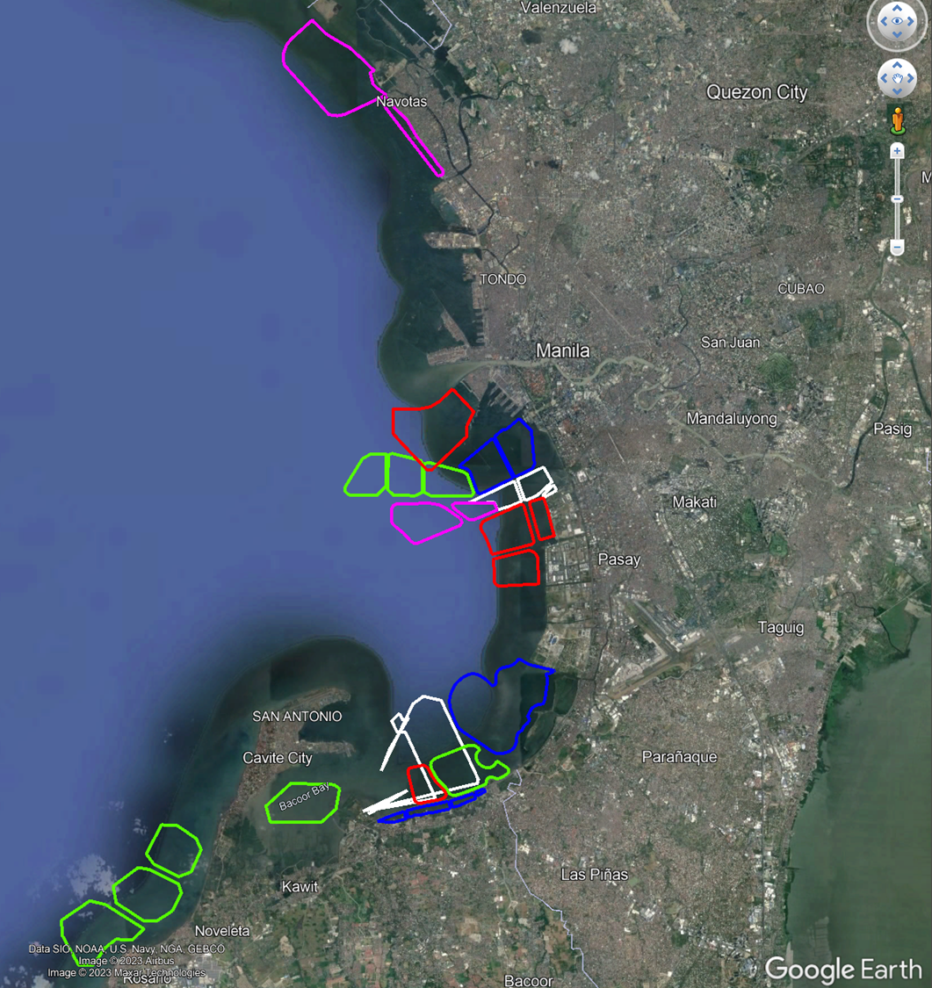
Approved Reclamation Projects in Manila Bay
Navotas
  650-ha. Navotas Coastal Bay Reclamation
Pasay City
  360-ha. Pasay City Reclamation and Development Project
  265-ha. Pasay Harbor City Reclamation Project
Manila City
  Manila Waterfront City Reclamation Project
  Horizon Manila Reclamation Project
  Manila Solar City Project
  City of Pearl / New Manila Bay
Bacoor
  90-ha. Bacoor
  100-ha. Bacoor
  230-ha. Bacoor
Las Pinas
  Las Pinas Coastal Bay Project
Paranaque
  Paranaque Coastal Bay Project
Cavite Province
  844 MCTE
  Cavite 4-Island Reclamation Project (Islands A, C, D and E)
Notes:
The slide shows the relative location of the reclamation projects. The approved reclamation projects of each LGU were identified and grouped accordingly per LGU.

Slide 17
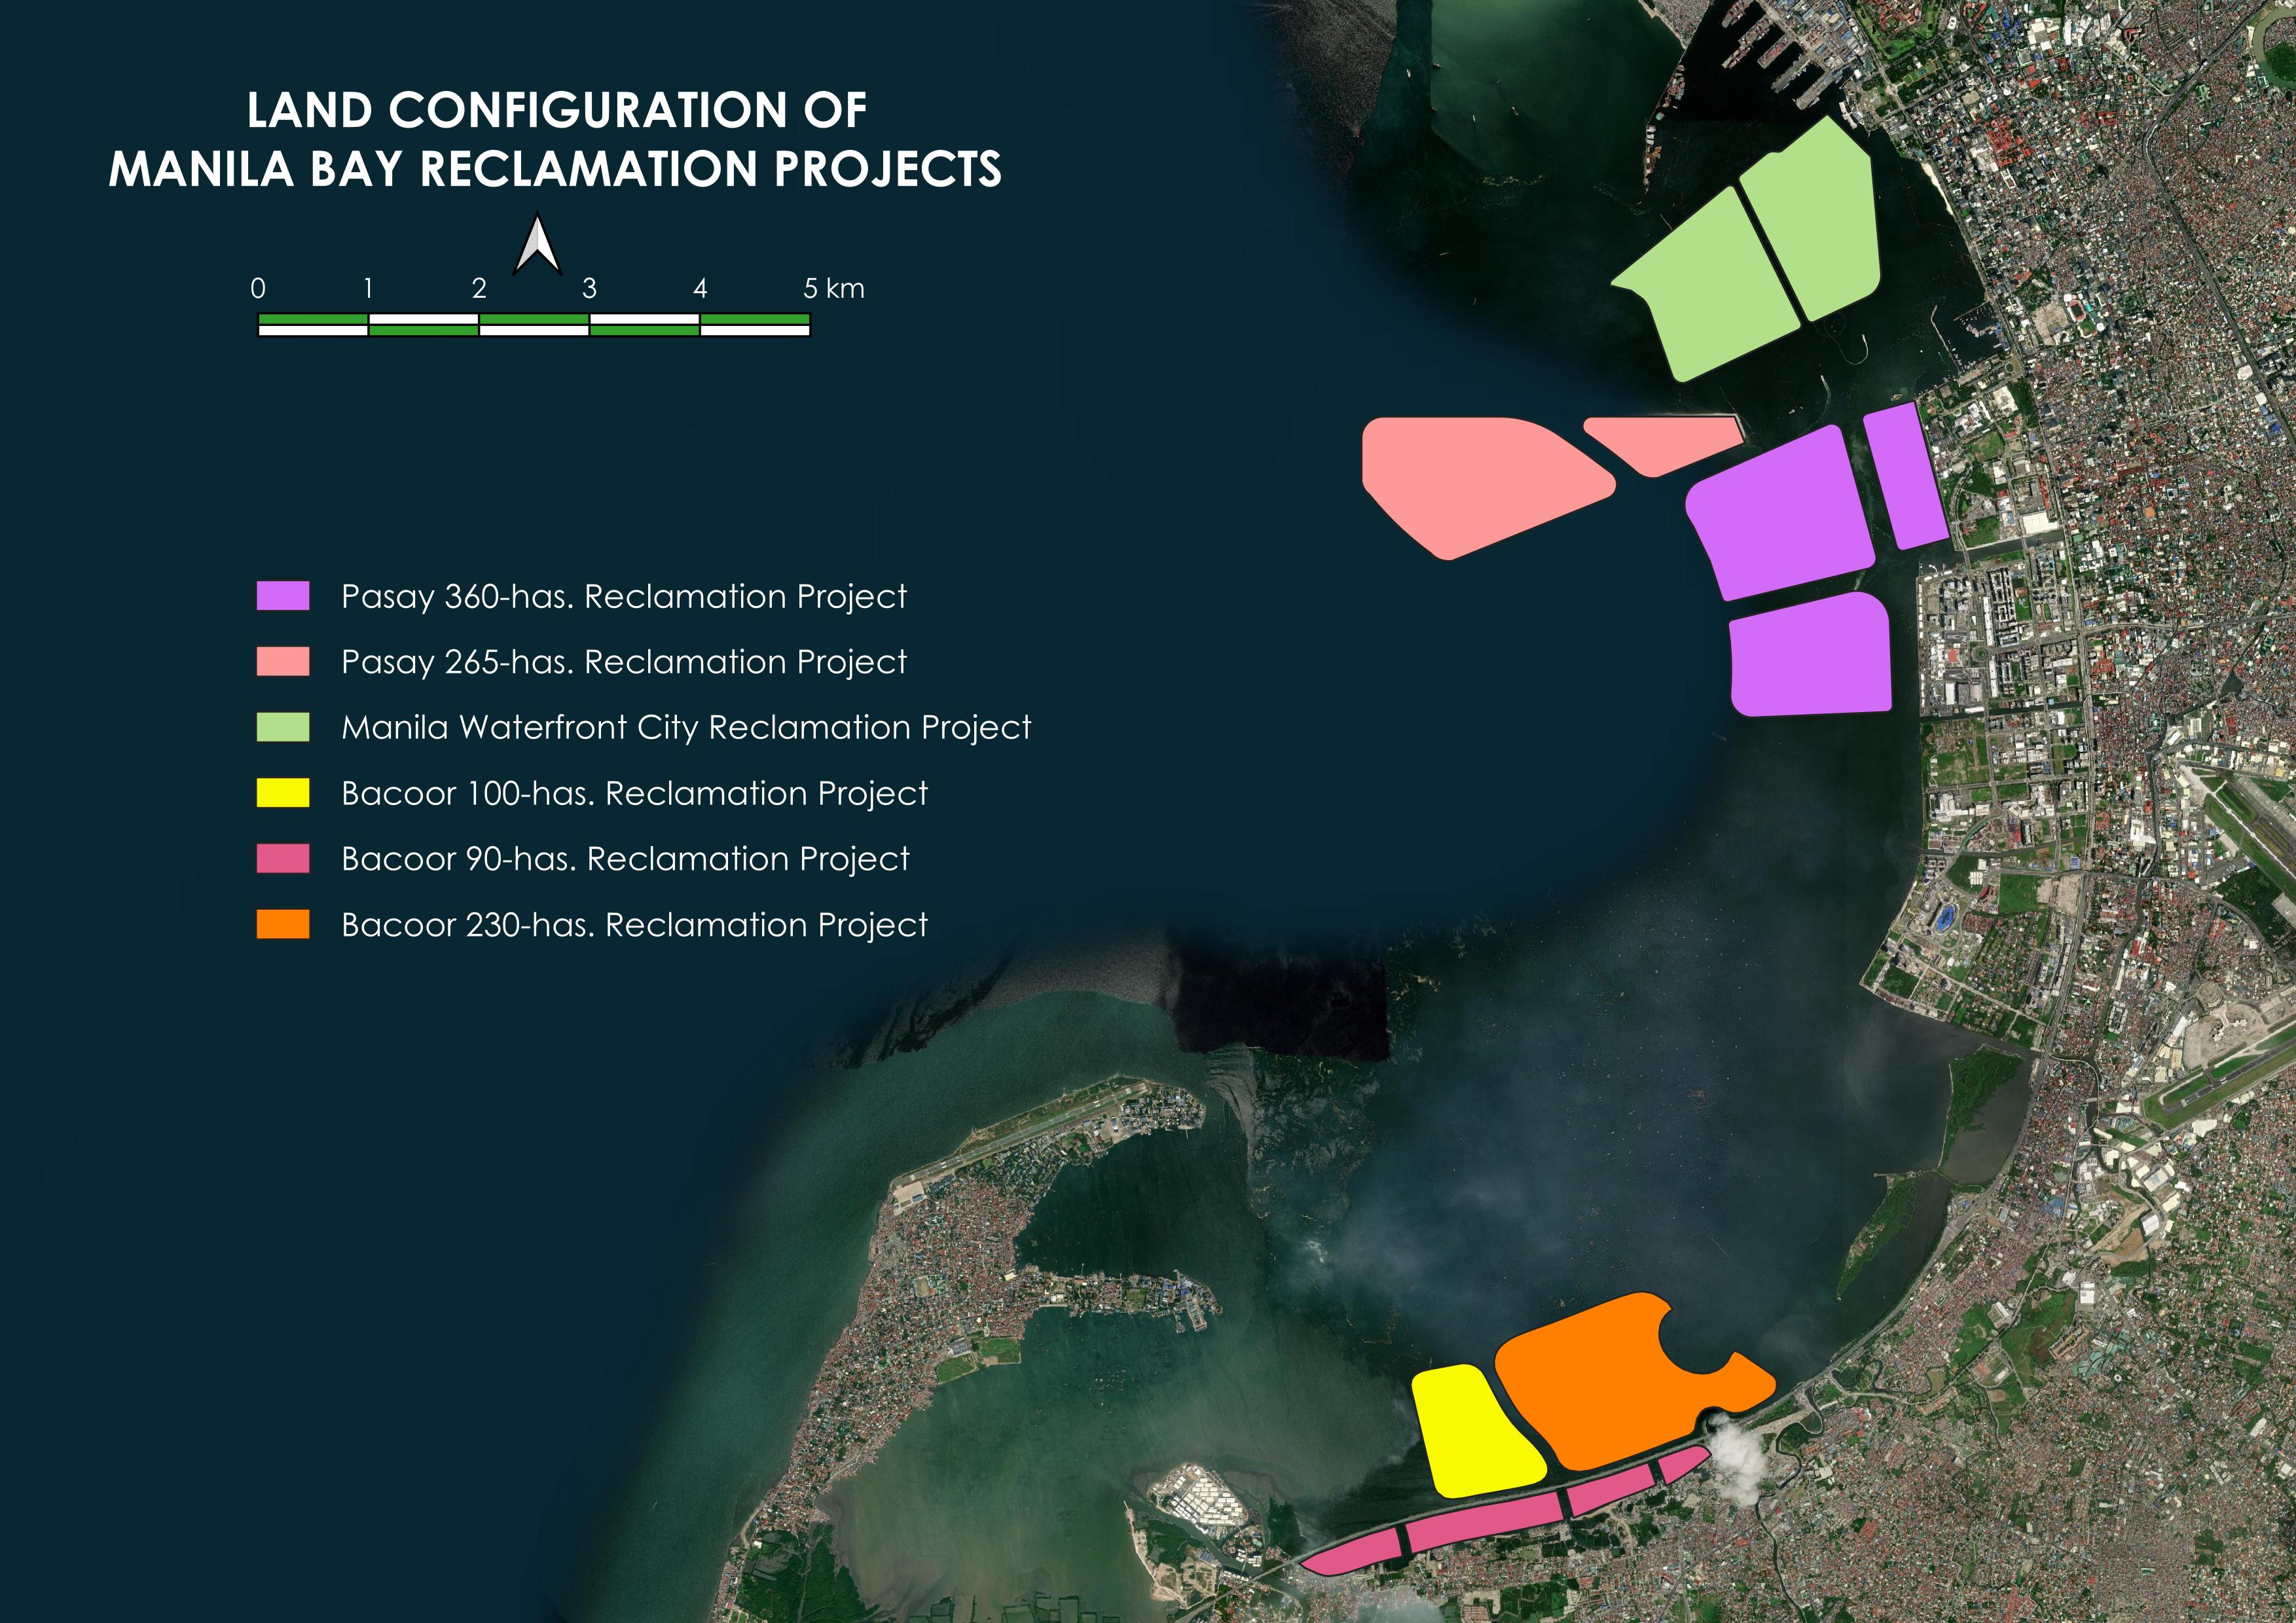
Ongoing Reclamation Projects
Pasay City
  360-ha. Pasay City Reclamation and Development Project
  265-ha. Pasay Harbor City Reclamation Project
318-ha Manila Waterfront
Bacoor
  90-ha. Bacoor
  100-ha. Bacoor
  230-ha Bacoor
Notes:
The three ongoing projects that conducted actual reclamation works before the suspension of the activities/projects in Manila Bay are as follows:
360-ha Pasay City Reclamation and Development Project (Pasay 360) – a project of LGU Pasay with its joint venture (JV) partner SM Smart City Infrastructure and Development Corporation;
265-ha Pasay Pasay Harbor City Reclamation Project (Pasay 265) – a project of LGU Pasay with its JV partner Pasay Harbor City Corporation; and
318-ha Manila Waterfront City Reclamation Project (Manila Waterfront) – a project of LGU Manila with its JV partner Waterfront Manila Premier Development Inc.
For Manila Waterfront, the sand key dredging, sand filling/placement of the sand key, and sandbagging were ongoing prior to the suspension of reclamation activities to contain Phase 1 of Island A. Reclamation/island sand filling has yet to be conducted.
The three Bacoor City Reclamation Projects, comprising the 90-ha inner island, 100-ha Diamond, and 230-ha outer island, have undertaken preparatory works to construct the laydown/staging area in preparation for the assembly of dredging pipes, storage facilities and materials, among others. The 100-ha Diamond and 230-ha outer island have already started the dredging/desilting to construct a sand key foundation, while the 90-ha inner island has filled with sand within a portion of Island B.

Slide 18
Summary of Benefits:
Reclamation Development Phase
Direct Investments (reclamation cost only) | 650 Billion | Php
PRA Fees | 25 Billion | Php
Extraction Fees* | 30 Billion | Php
4. Valuation of the Raw Land Assets** | 734.71 Billion | Php
* Based on estimated volume reserved of PRA GSQP as submitted to DENR-MGB
** Based on estimated reclamation cost only per location
Notes:
For land valuation, average estimated reclamation cost per LGU is used in the computation.

Slide 19
Summary of Benefits:
Horizontal Development Phase
Direct Investments (land development - estimates only) | 1.95 Trillion | Php
PRA Fees | 19 Billion | Php
Real Property Taxes (Land) | 4.8 Million | Per Hectare/Annum
Valuation of Saleable Land Assets* | 2,204 Billion | Php
5. Business Taxes and Permits | **can be sourced from the LGUs
6. Income Taxes | **can be sourced from BIR | Php
7. Contribution to the Gross National Production (GNP)
a. Employment Generated | *Unaccounted yet but existing developments can attest to the huge potential of these reclaimed lands to attract investors and businesses | Unaccounted yet but existing developments can attest to the huge potential of these reclaimed lands to attract investors and businesses
b. Forward and Backward Linkages | *Unaccounted yet but development activities attributed to the FDIs generated by these projects accounts for a very significant number of businesses consisting of the various factors of the economy contributing to gross national production | unaccounted yet but development activities attributed to the FDIs generated by these projects accounts for a very significant number of businesses consisting of the various factors of the economy contributing to gross national production
*based on estimated land development cost only
Notes:
Notes: Land Development Estimate is x3 of est. reclamation cost

Slide 20
Summary of Benefits:
Full Development Phase
Direct Investments (vertical development) | 23 Trillion | Php
PRA Fees
Real Property Taxes (Land and Buildings/ Improvements) | 140 Million | Per Hectare/Annum
Valuation of Saleable Land Assets* | 10,503 Billion | Php
5. Business Taxes and Permits | **can be sourced from the LGUs
6. Income Taxes | **can be sourced from BIR | Php
7. Contribution to the Gross National Production (GNP)
a. Employment Generated | *Unaccounted yet but existing developments can attest to the huge potential of these reclaimed lands to attract investors and businesses | Unaccounted yet but existing developments can attest to the huge potential of these reclaimed lands to attract investors and businesses
b. Forward and Backward Linkages | *Unaccounted yet but development activities attributed to the FDIs generated by these projects accounts for a very significant number of businesses consisting of the various factors of the economy contributing to gross national production | unaccounted yet but development activities attributed to the FDIs generated by these projects accounts for a very significant number of businesses consisting of the various factors of the economy contributing to gross national production
*Based on current zonal valuation or land per location

Slide 21
Project Benefits
In terms of financial outflows, on the part of the national and local government, reclamation projects shall be implemented at zero cost to the government.
Projects will be entirely financed by the private sector proponents under a PPP arrangement, pursuant to a PPP Code / Ordinance;
Private sector proponents will provide not only financing, but also the manpower, facilities, and technology necessary for the reclamation projects; and
The projects will not involve any commercial or construction risks to the government which will be assumed by the private proponents.

Slide 22
Financial Inflows to the Government
In terms of financial inflows to the National or local government, these projects will generate for the government billions of pesos in public revenues.
Billions of pesos by way of reclamation fees and charges, thru PRA;
After the construction of the projects and once developed, thousands more of new jobs and business opportunities will be created;
The local government will earn additional revenues in terms of property and business tax, while the National government will derive additional income taxes from new businesses; and
The National and local government stand to gain new land, at no financial cost, that can be devoted for public use or service or can be sold or developed to fund public service.

Slide 23
Financial Inflows to the Government
In terms of economic activity, the projects will have a multiplier effect on business, commercial activities in the cities and will create hundreds of thousands of jobs and spur economic activities.
During the horizontal and vertical construction period of road, buildings and other infrastructure facilities, the projects are expected to generate thousands of jobs and business opportunities; and
After the completion of the development and the commencement of business operations of locators, a total of millions of jobs are expected to be created.

Slide 24
Financial Inflows to the Government
In terms of social benefits, the proceeds from the projects will enable the National and local government to improve and expand its existing projects and services.
Local governments have committed to devote a substantial part of their gains from real property income from reclaimed area for social services, livelihood and pro-poor programs.

Slide 25
Environmental Enhancement
PRA Administrative Order No. 2019-05
Rules and Regulations to Govern the Mandatory Integration of Greenspaces in Reclamation Projects
Greenspaces shall be included in a reclamation project’s overall sustainable development plan and climate change adaptation program, to form part of the compliance with the reforestation and carbon sink program required for development projects to mitigate greenhouse gas (GHG) emission.

Slide 26
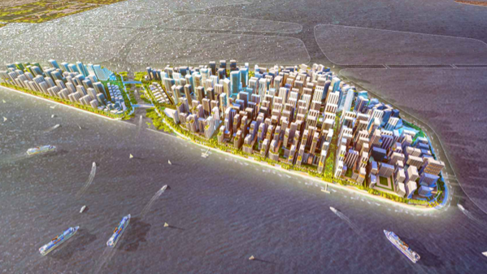

Slide 27
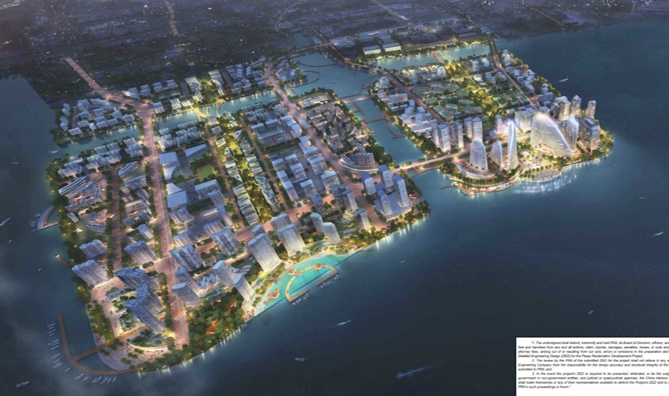

Slide 28
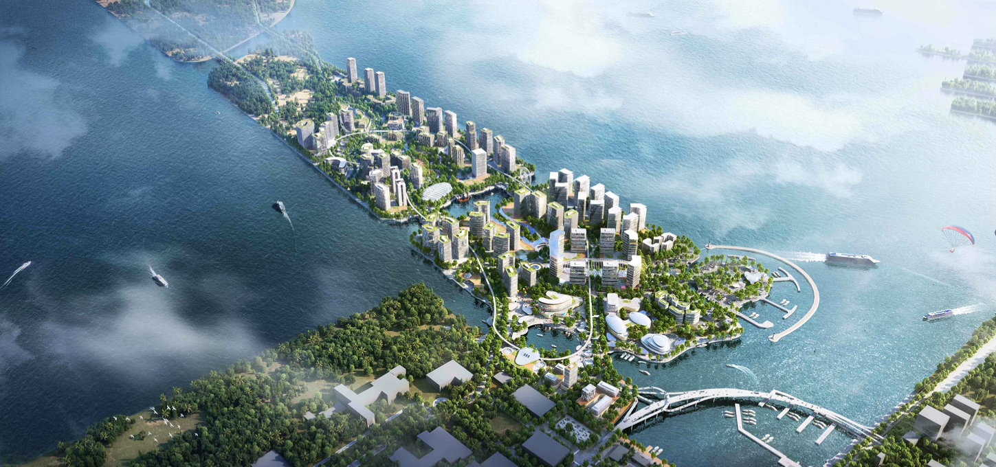

Slide 29
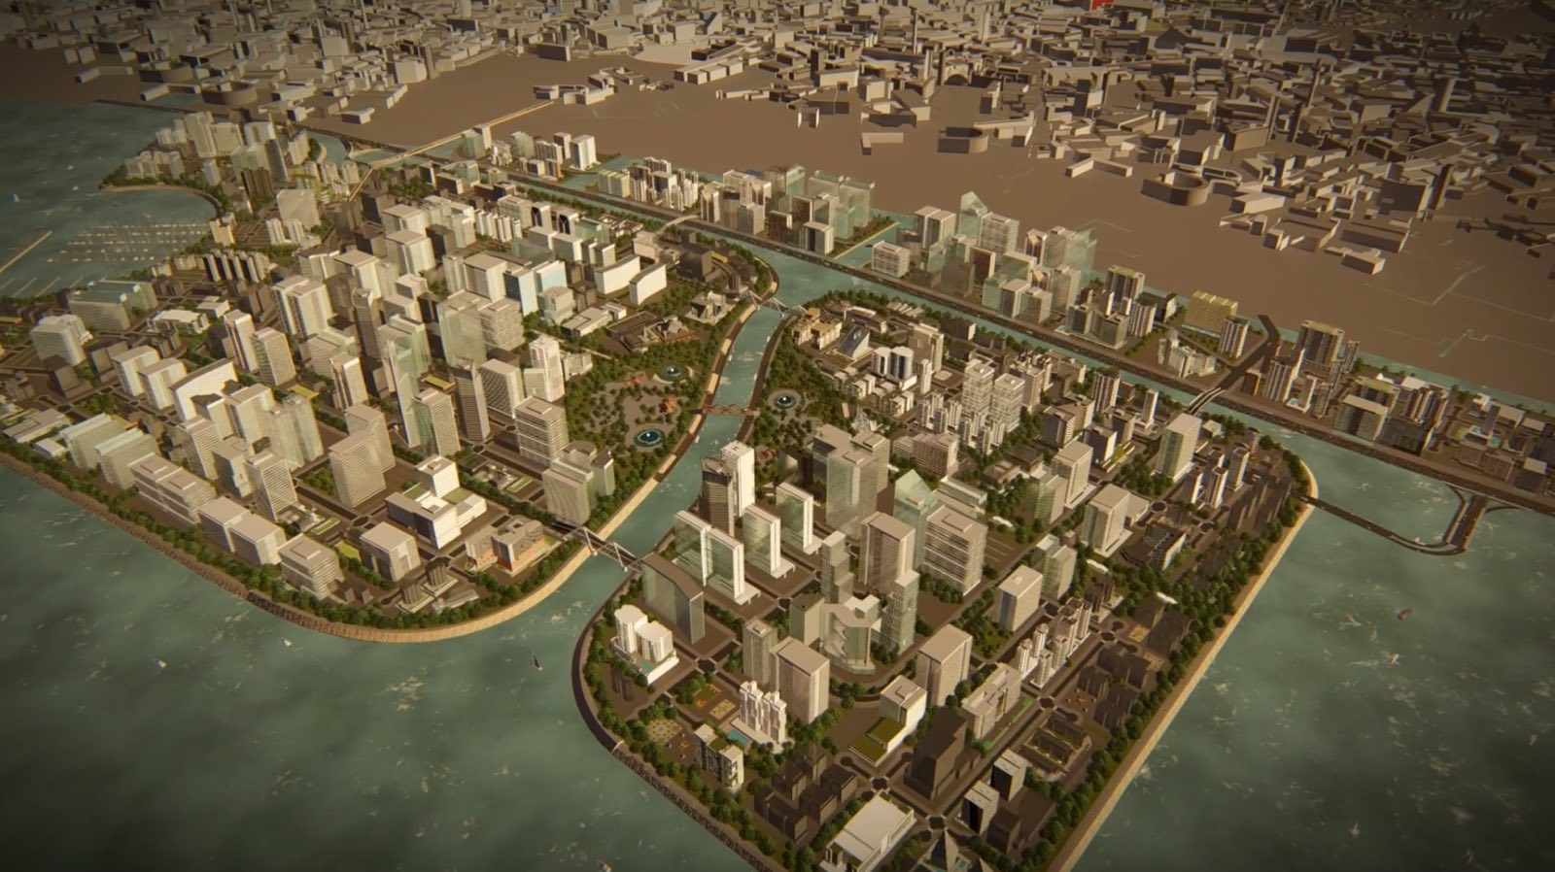

Slide 30
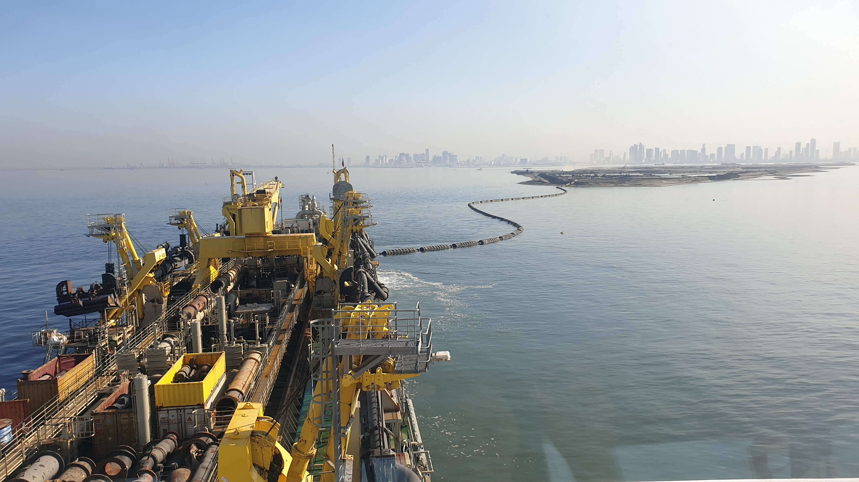
Thank you
Notes:
HJPA

