Slide 1
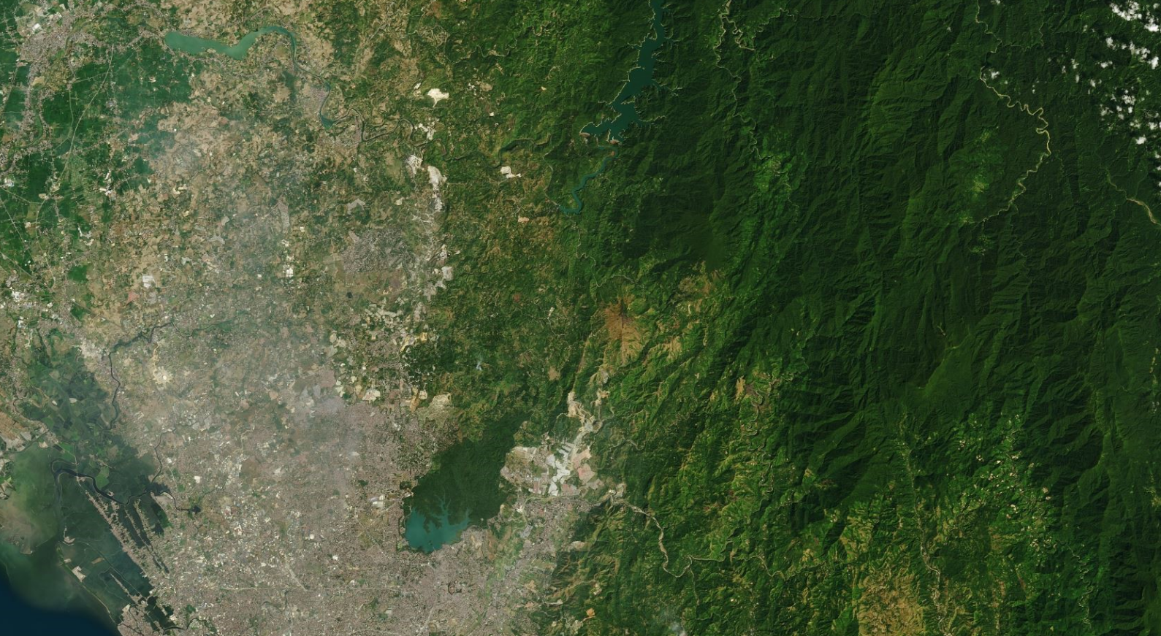


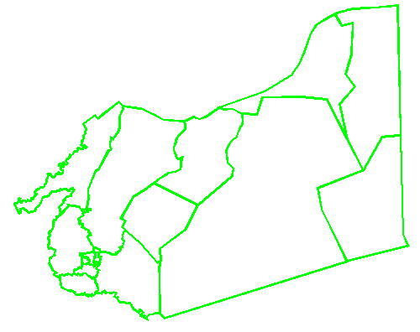










NORZAGARAY CAD 350 (SEPT 19,1990)
SJDM CAD 352 (DEC 29,2010)
CLUP RIZAL
R.A 8797
JULY 15, 2000
PROPOSED NAMRIA COMMON WORKING BDRY OF BOTH LGUS
LC 637 MARCH1,1927
LC-990 MARCH 24,1933
DISPUTED AREA 562 HAS.
LC-2670 JULY 27,1970
VS-04-000779 ( JUNE 24,2019)
CAD 674
MONTALBAN MACABUD CASE 9 (UNAPPROVED)
ADMINISTRATIVE CODE
VOL.1 BOOK 1
YEAR 1969
CAD 674 MONTALBAN
CADASTRE
SAN ISIDRO CASE 7
(UNAPPROVED)

